Slide 1
5th Annual Peer Summit
Baltimore North Sheraton – Towson, MD
MARYLAND DEPARTMENT OF HEALTH
Brendan Welsh, CPRS – Director, Consumer Affairs
May 16, 2019

Slide 2
Daily Agenda
09:00 am – 10:15 am: Greetings – Training and Board Updates (M/E)
10:15 am – 10:30 am: BREAK
10:30 am – 12:00 pm: Keynote – Yngvild Olsen, MD, MPH (M/E)
12:00 pm – 01:00 pm: LUNCH
01:00 pm – 02:15 pm: Workshops (Domain Identifiers in Folders)
02:15 pm – 02:30 pm: BREAK
02:30 pm – 03:45 pm: Plenary – Anastasia Edmonston, MS, CRC (M/E)

Slide 3
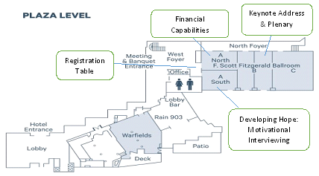
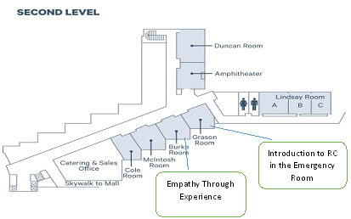
Workshop Breakouts
PLAZA LEVEL
Financial Capabilities (M/E)
  FS Fitzgerald Ballroom A NORTH
Developing Hope (R/W)
  FS Fitzgerald Ballroom A SOUTH
SECOND LEVEL
Empathy Through Experience (Eth)
  Burke Room
Intro to RC in the ED (Adv)
  Grason Room

Slide 4
Notes & Reminders
Checkout is at 12:00 pm – Check out during the 10:15 break!
Parking – Validation stamp available at the front desk
Venue Map – Located inside your conference folder
Room Monitors will redirect you to a different workshop when a room becomes full.
  Workshops are available on a first come first serve basis and seats will not be “saved” for friends or coworkers.
Awarding of CEU’s / Domain Identification
  Agendas are labeled with domains for all programing eligible for CEU’s
  Must sign in with room monitors for each workshop attended
  Must stay for the entire event.
  Must turn in conference evaluation at the registration table to receive CEU certificate at the conclusion of the second days programming.
  No certificates will be mailed or emailed after the event.
  Please refer to the FAQ’s sheet in your folder if you have questions about the CEU process related to the Peer Summit.
Notes:
· CEU certificates are only available at the end of the 2 day conference on Thursday.
· Total CEU’s for the 2019 Summit equal 10.5 total hours.
· CEU domain breakdown is determined by which workshop the participant attends.
· Domains for all conference programing are listed on the daily conference agendas.
· Please note each day has a separate agenda.
Daily CEU Breakdown (x 2 Days)
· Welcoming Remarks 1.25 CEU
· Keynote Address 1.5 CEU
· Workshops 1.25 CEU
· Plenary Sessions 1.25 CEU
· When submitting training information to the MABPCB for certification or recertification each domain must be identified separately.

Slide 5

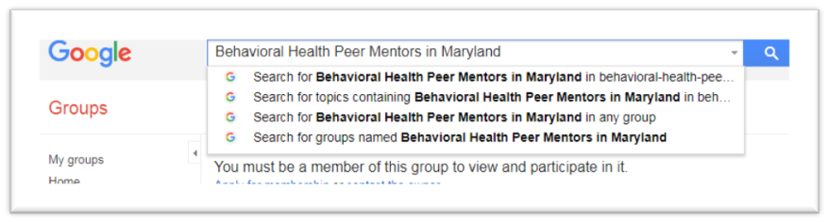
OCA ListServe
REMINDER - Resources for Peer Professionals
This Google Group hosts:
  Upcoming Peer Training
  Peer Employment Opportunities
  Recovery Advocacy Events

Slide 6

Facebook
REMINDER - Resources for Peer Professionals

Slide 7
BHA Training Update
Adelaide Weber – Coordinator of Special Programs – Office of Consumer Affairs
Fiscal Year 2018: July 1, 2017 – June 30, 2018
Total # of Training Program Subsidized by BHA | Total # of Training Participants (duplicated)
27 unique training programs | 968 Participants
Training Programs Include: CCAR—(RCA, Ethical Considerations for Recovery Coaches, Spirituality for Recovery Coaches) Multi-day Peer Conferences (Recovery Month Celebration, Peer Networking Conference, Annual Peer Summit) Domain and topic specific training related to Peer Recovery Specialist service delivery (Self-Care, TIC, IPS, Emotional CPR, and Mental Health First Aid)

Slide 8
BHA Training Update
Adelaide Weber – Coordinator of Special Programs – Office of Consumer Affairs
Fiscal Year 2019: Since July 1, 2018
Total # of Training Program Subsidized by BHA | Total # of Training Participants (duplicated)
30 unique training programs | 980 Participants
Training Programs Include: CCAR—(RCA, Ethical Considerations for Recovery Coaches, Spirituality for Recovery Coaches, Emergency Dept. for Recovery Coaches) Multi-day Peer Conferences (Recovery Month Celebration, Peer Networking Conference, Annual Peer Summit) Domain and topic specific training related to Peer Recovery Specialist service delivery (MI, TIC, and Mental Health First Aid, Recovery Messaging)

Slide 9



BHA Training Update
Adelaide Weber – Coordinator of Special Programs – Office of Consumer Affairs

Slide 10

Calling All Trainers
Adelaide Weber – Coordinator of Special Programs – Office of Consumer Affairs

Slide 11
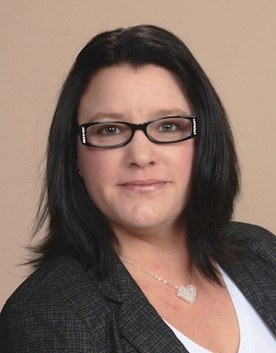
MABPCB Updates
Brandee Izquierdo, MPA, CPRS, RPS
President
Maryland Addiction & Behavioral-health
Professionals Certification Board (MABPCB)
IC&RC – Peer Chair

Slide 12

Break
Be back in 15 mins...

Slide 13
Questions
Maryland’s Certified Peer Recovery Specialist Credential
Brendan Welsh, CPRS
Director—Office of Consumer Affairs
Behavioral Health Administration
Maryland Department of Health
brendan.welsh@maryland.gov
Cell: 443-274-8218

Slide 14
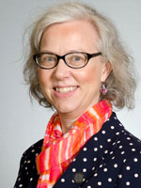
Keynote Address
The Treatment and Recovery Continuum in the Age of Opioids
Yngvild Olsen, MD, MPH
Behavioral Health Administration - Catonsville, MD
Notes:
Arthur H. Woodard Jr. graduated with his MSW, from the University Of Connecticut School Of Social work in 1984. A self-identified SOULcial Worker who’s practice has evolved through personal, educational, clinical, and practical experience.
Arthur identifies as a human Be-ing in long term recovery since 1978 from addiction and stress.
A Master Recovery Coach and Trainer, Arthur is engaged in learning, practicing and teaching Recovery and Care to those who seek it.
In this role Arthur has facilitated over 40 CCAR Recovery Coach Academies and over 30 Training Of Trainers since his own CCAR training experience in January 2009.
His trainings have taken him across the country having trained recovery coaches in Connecticut, Massachusetts, Maryland, Iowa, Illinois and New York.
Arthur notes that he facilitates Recovery Coach Academy’s and TOTs in the role of Recovery Coach. He remains a Learner and Doer even when training others to provide recovery support.
In his role as a Recovery Coaching Consultant with CCAR, Arthur has developed and delivered Recovery Coach Performance Support Services to CCAR volunteers and RCA graduates. He provides this support to CCAR’s 3 Recovery Community Centers monthly by facilitating an hour and a half collaborative learning opportunity to enhance and strengthen recovery coaching science and skills. In addition Arthur delivers a monthly hour-long CCAR CART Webinar to subscribed CCAR members. These webinars are intended to enhance and strengthen recovery coaches’ in the developing their Art of Coaching Recovery.
Arthur encourages Recovery Coaches and those in training to practice learning, living and leading Recovery as a means for supporting their performance in helping a peer’s recovery and their self-care.
He models active listening skills, asks good questions, and manages his stuff while treating Recovery Coaches and those in training as Resources.
Arthur reminds himself that he teaches best what he most needs to learn and when he teaches he has the opportunity to learn twice.
Ladies and Gentlemen it is my pleasure to introduce Arthur Woodward

