Slide 1
Maryland Situation Update on Coronavirus Disease (COVID-19) for BHA
Maryland Department of Health
Infectious Disease Epidemiology and Outbreak Response Bureau
October 2, 2020

Slide 2
Call Agenda
Picture Courtesy of NIAID-RML
Review current situation of COVID-19
Age distribution of COVID-19 cases
Access to Support for Patients with Disabilities in Healthcare Settings

Slide 3
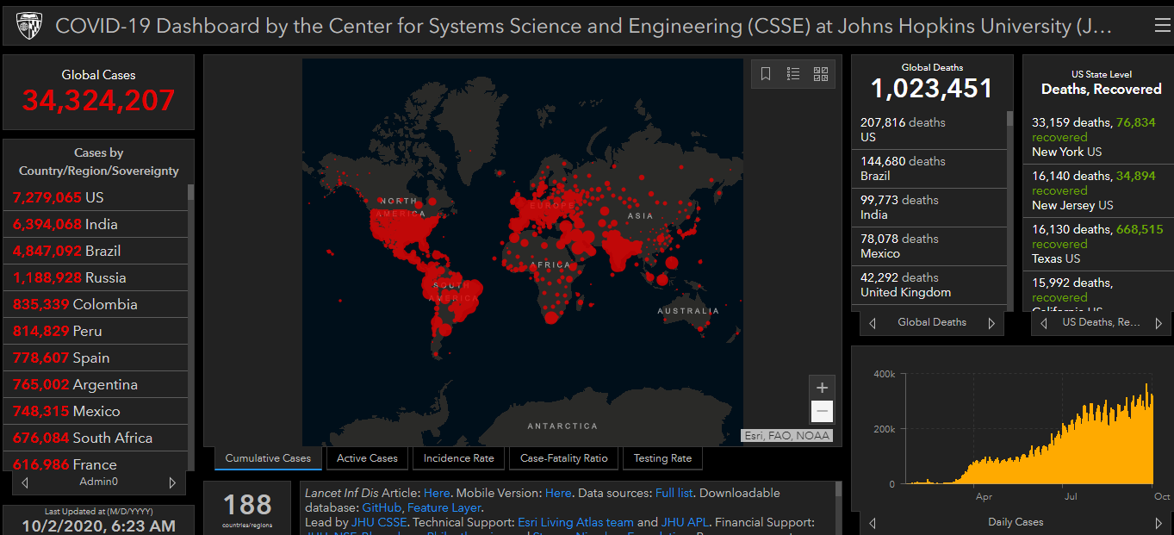
COVID-19 Global Situation Summary

Slide 4
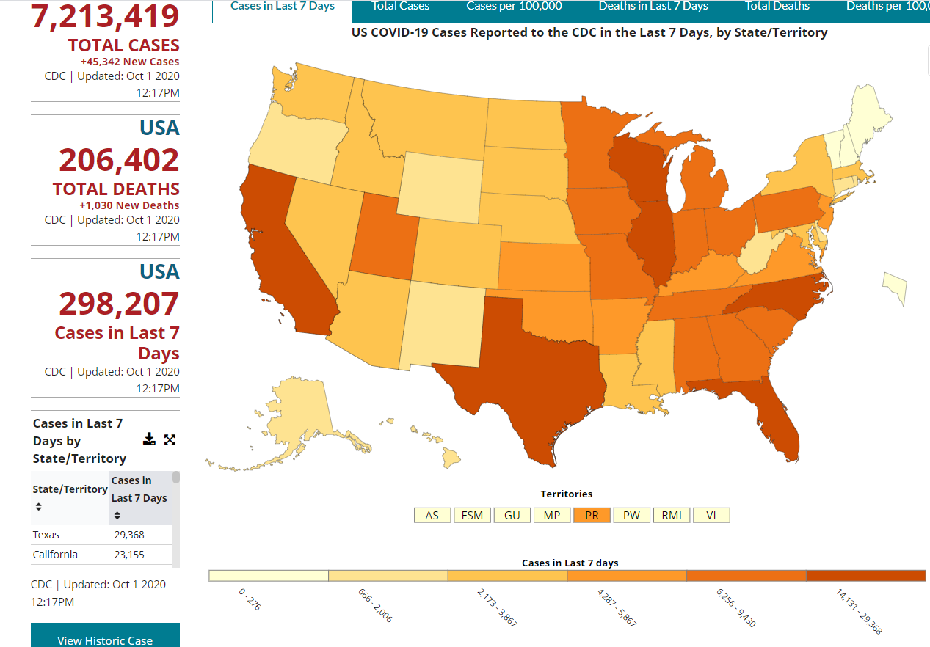
U.S.: COVID-19 Cases
https://www.cdc.gov/coronavirus/2019-ncov/cases-updates/cases-in-us.html Accessed 10/2/2020

Slide 5
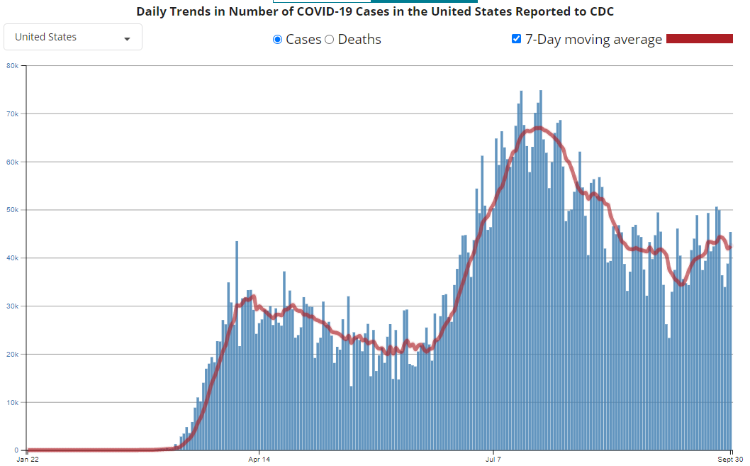
Number of Cases Reported in the USA, by Day

Slide 6
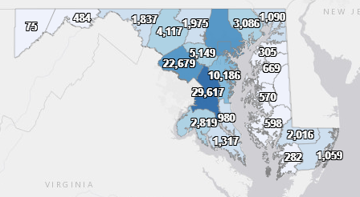
Maryland: COVID-19 Cases
http://health.maryland.gov/coronavirus
Data current as of 10/2/2020
Cases: 126,222
712 new
Deaths: 3,806
1 new
Hospitalizations: 15,574
Current: 323
Total tests 2,660,800

Slide 7
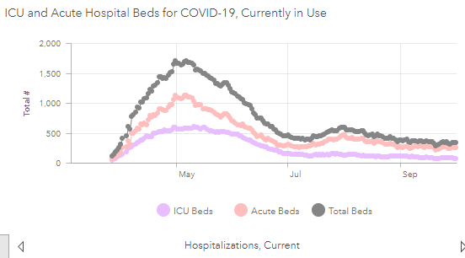

Slide 8
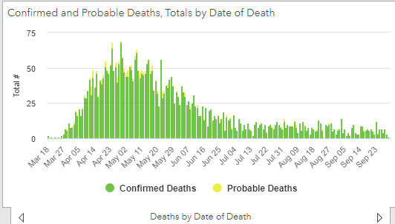

Slide 9
Testing Volume and % Positivity

Slide 10
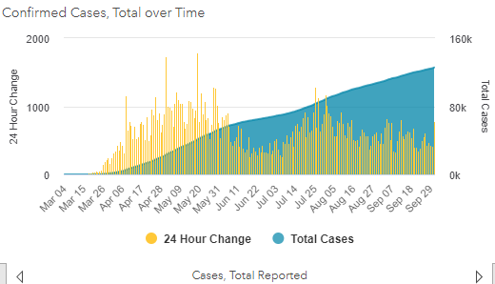

Slide 11
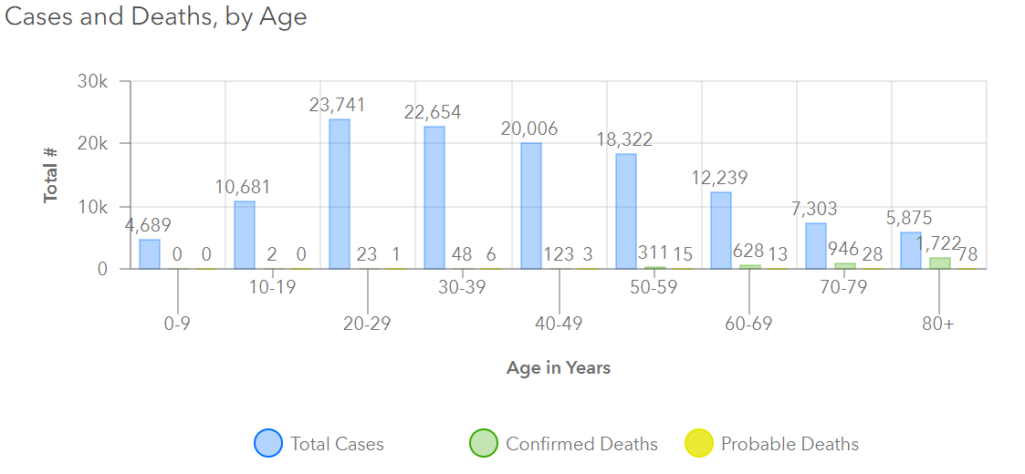
Maryland: COVID-19
Source: https://coronavirus.maryland.gov/, accessed October 1, 2020

Slide 12
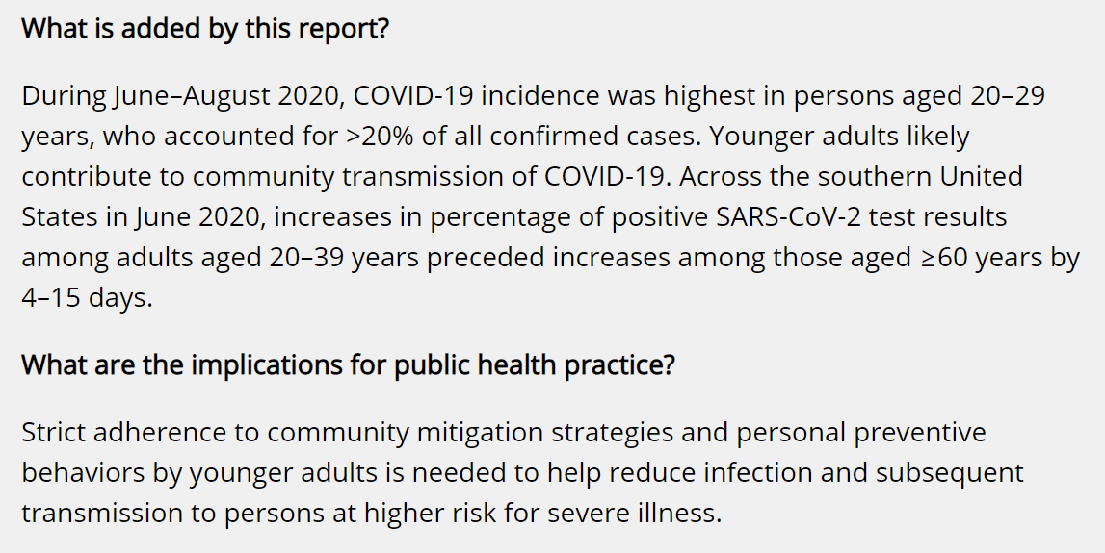
Source: https://www.cdc.gov/mmwr/volumes/69/wr/mm6939e1.htm?s_cid=mm6939e1_w#F1_up

Slide 13
Source: https://www.cdc.gov/mmwr/volumes/69/wr/mm6939e1.htm?s_cid=mm6939e1_w#F1_down, Accessed 9/29/2020

Slide 14
Access to Support for Patients with Disabilities in Healthcare Settings

Slide 15
Support Persons for People with Disabilities
Healthcare providers must allow authorized support person to accompany individuals with disabilities
The term “disability” means, with respect to an individual a physical or mental impairment that substantially limits one or more major life activities of such individual
A support person may be a family member, personal care assistant, similar disability service provider, or other individual knowledgeable about the management or care of the patient who is authorized to assist the patient in making decisions
https://coronavirus.maryland.gov/pages/cdc-resources

Slide 16
Support Persons and COVID-19
Patients with disabilities, regardless of diagnosis or symptoms of COVID-19, are permitted to have access to support persons
Individuals with COVID-19 symptoms shall not be permitted to serve as a support person
All support persons shall be subject to screening for COVID-19 symptoms upon arrival at the health care provider and periodically during their stay, if appropriate
Support persons shall be provided appropriate PPE, including instruction on how to utilize and conserve PPE

Slide 17
Facility Policy Must Include:
Provisions authorizing support persons to accompany, visit, and stay with individuals with disabilities during their visits to health care providers
Provisions for the designation of support persons who may accompany, visit, and stay with individuals with disabilities during their visits to health care providers
Provisions defining a support person as a family member, personal care assistant, similar disability service provider, or other individual knowledgeable about the management or care of the patient who is authorized to assist the patient in making decisions
Provisions establishing a process for individuals with disabilities to propose other reasonable accommodations that also comply with the health care’s infection control policy

Slide 18
Questions?
Email : mdh.ipcovid@Maryland.gov

