Slide 1
Maryland Situation Update on
Coronavirus Disease (COVID-19) for BHA: Vaccine Hesitancy Edition
Maryland Department of Health
Infectious Disease Epidemiology and Outbreak Response Bureau
February 26, 2021

Slide 2
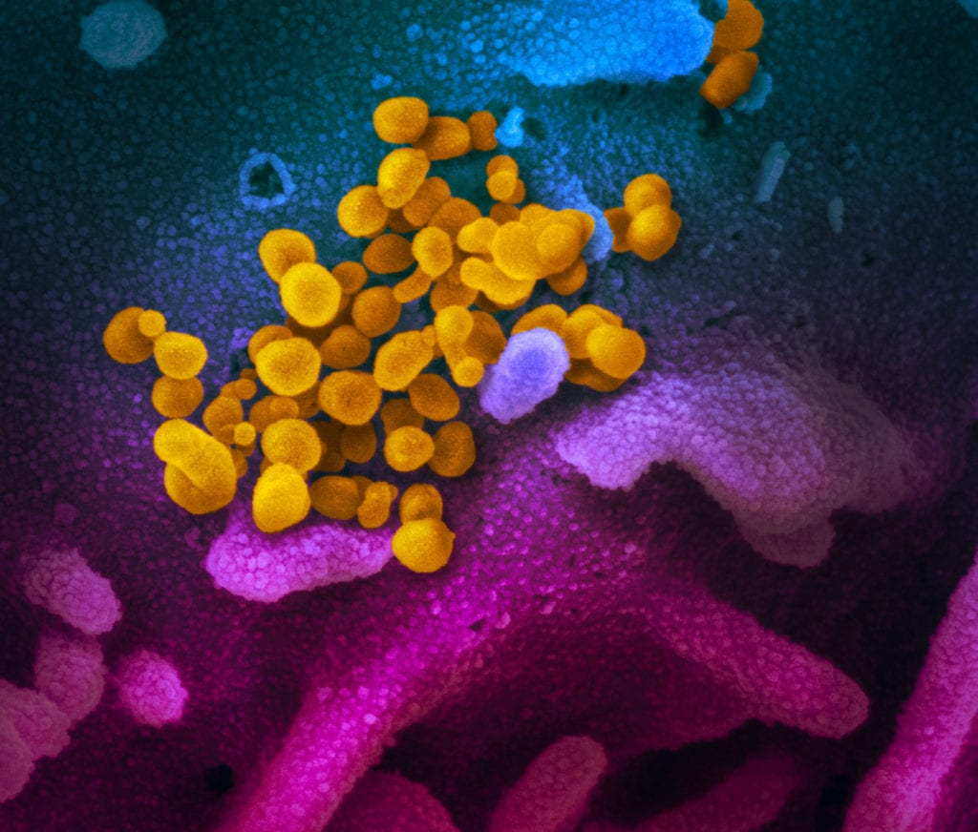
Call Agenda
Picture Courtesy of NIAID-RML
Review current situation of COVID-19
Vaccine Hesitancy Concerns
Q and A

Slide 3
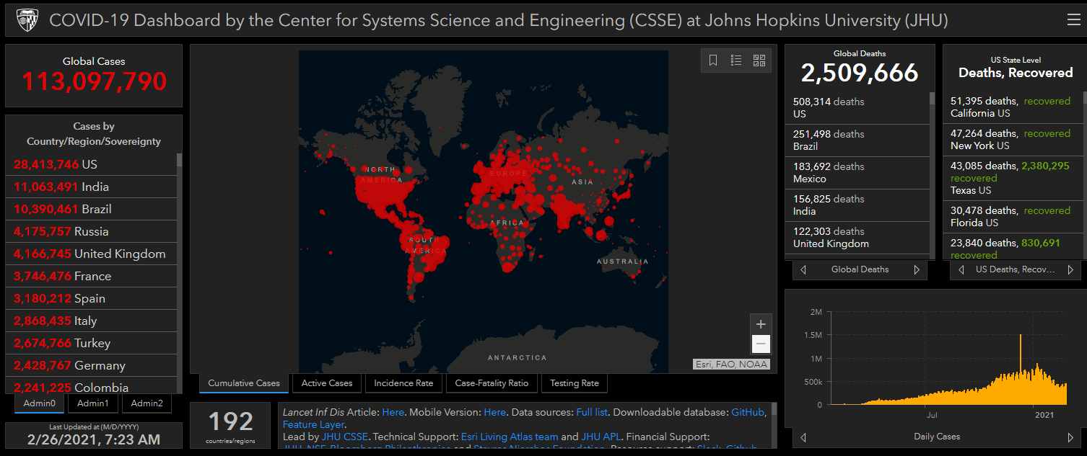
COVID-19 Global Situation Summary
https://gisanddata.maps.arcgis.com/apps/opsdashboard/index.html#/bda7594740fd40299423467b48e9ecf6

Slide 4
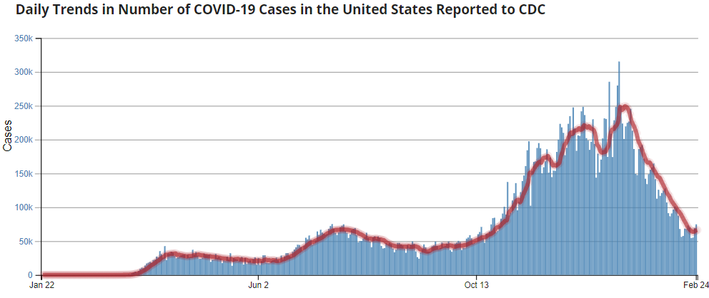
Number of Cases Reported in the USA, by Day
https://covid.cdc.gov/covid-data-tracker/#trends_dailytrendscases
Updated 2/26/2021

Slide 5
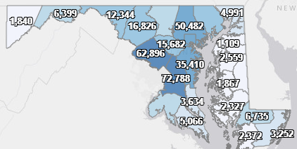
Maryland: COVID-19 Cases
http://health.maryland.gov/coronavirus
Data current as of 2/26/2021
Cases: 380,436
  970 new
Deaths: 7,656
  33 new
Hospitalizations: 34,848
  Current: 943 ( Down 9)
Total tests performed: 7,804,095
Case rate: 13 per 100,000

Slide 6
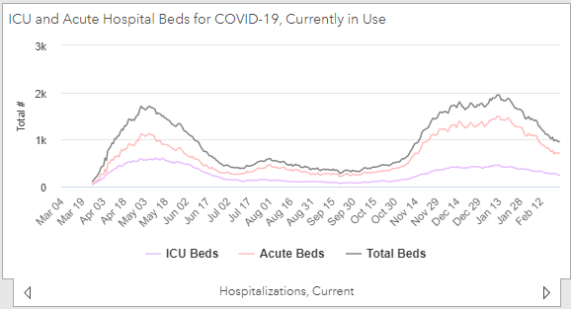
https://coronavirus.maryland.gov/ 2/26/2021

Slide 7
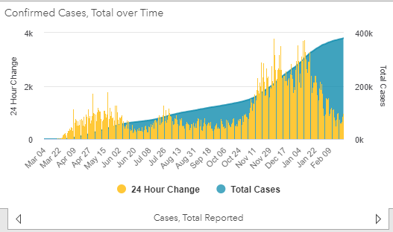
https://coronavirus.maryland.gov/ 2/26/2021

Slide 8
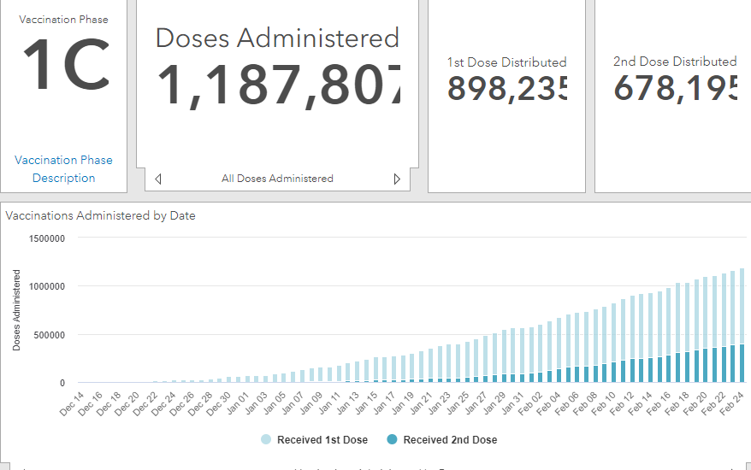
Maryland Vaccine Dashboard
https://coronavirus.maryland.gov/#Vaccine accessed February 26, 2021

Slide 9
COVID-19 Vaccines

Slide 10
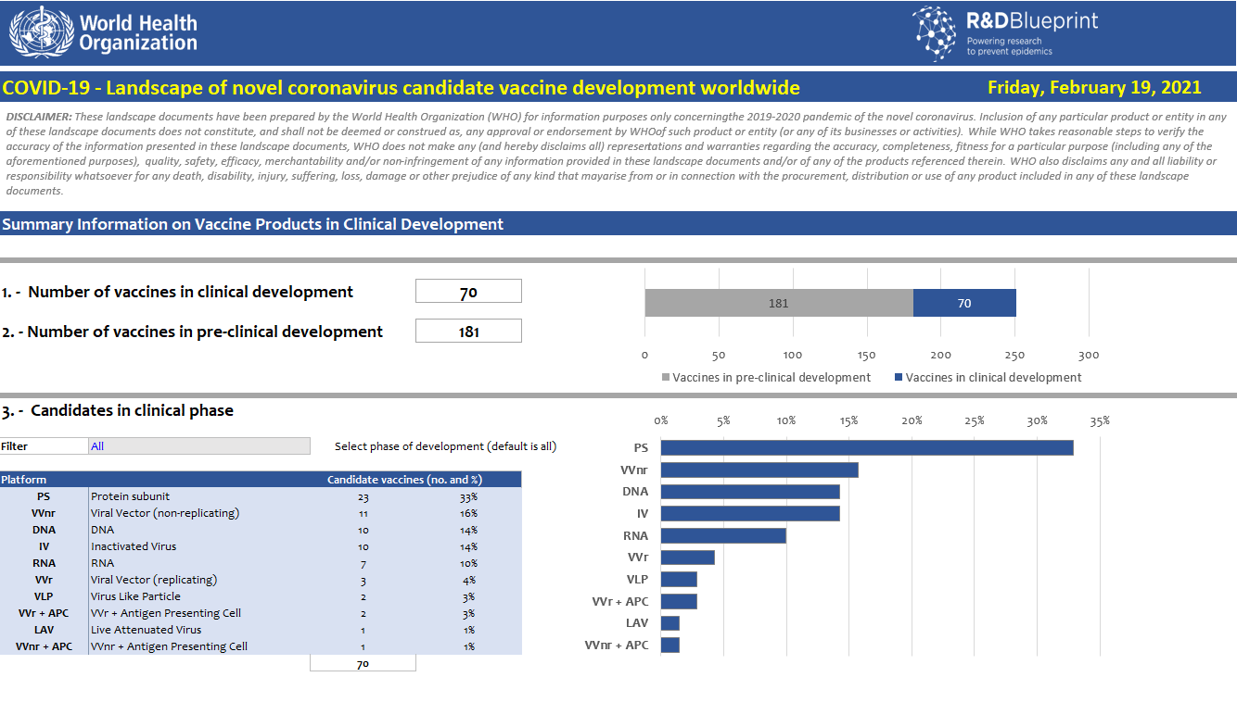
COVID-19 Vaccine Candidates

Slide 11
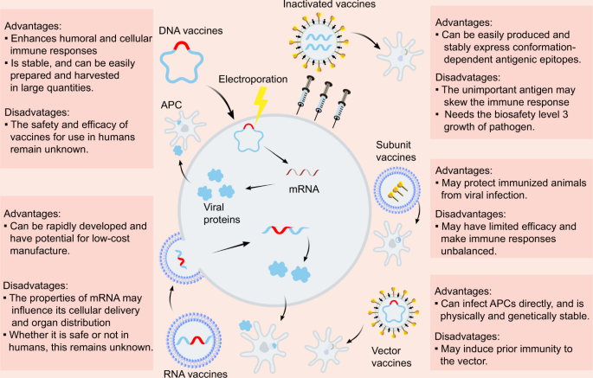
Dong, Y., Dai, T., Wei, Y. et al. A systematic review of SARS-CoV-2 vaccine candidates.
Sig Transduct Target Ther 5, 237 (2020). https://doi.org/10.1038/s41392-020-00352-y

Slide 12
COVID-19 Vaccines that have received FDA Emergency Use Authorization in the USA
Two vaccines have received EUA
  Pfizer: 2 doses given 21 days apart
  Moderna: 2 doses given 28 days apart
Both are mRNA vaccines
  Does not contain live virus
  mRNA rapidly degrades in the body
  Sends a message to build part of the spike protein to promote antibody formation
  Does not integrate into host RNA
Sources: https://www.pfizer.com/news/press-release/press-release-detail/pfizer-and-biontech-conclude-phase-3-study-covid-19-vaccine
https://investors.modernatx.com/news-releases/news-release-details/modernas-covid-19-vaccine-candidate-meets-its-primary-efficacy
https://www.cdc.gov/coronavirus/2019-ncov/vaccines/different-vaccines/mrna.html

Slide 13
Pfizer mRNA vaccine trial
Multinational placebo control trial
  2 doses given 21 days apart
  Enrolled >43,000 people
Endpoints
  Vaccine efficacy against lab confirmed COVID -19 7+ days after 2nd dose
    95% effective preventing symptomatic lab confirmed COVID-19
  Safety data
    Most common adverse reactions were:
      Injection site pain (84%)
      Fatigue (63%)
      Headache (55%)
    Serious adverse events
      2 deaths in vaccine group, 4 deaths in placebo group
      Non fatal SAEs: 0.6% in vaccine group, 0.4% in placebo group
https://www.cdc.gov/coronavirus/2019-ncov/vaccines/different-vaccines/Pfizer-BioNTech.html
https://www.cdc.gov/mmwr/volumes/69/wr/mm6950e2.htm?s_cid=mm6950e2_w

Slide 14
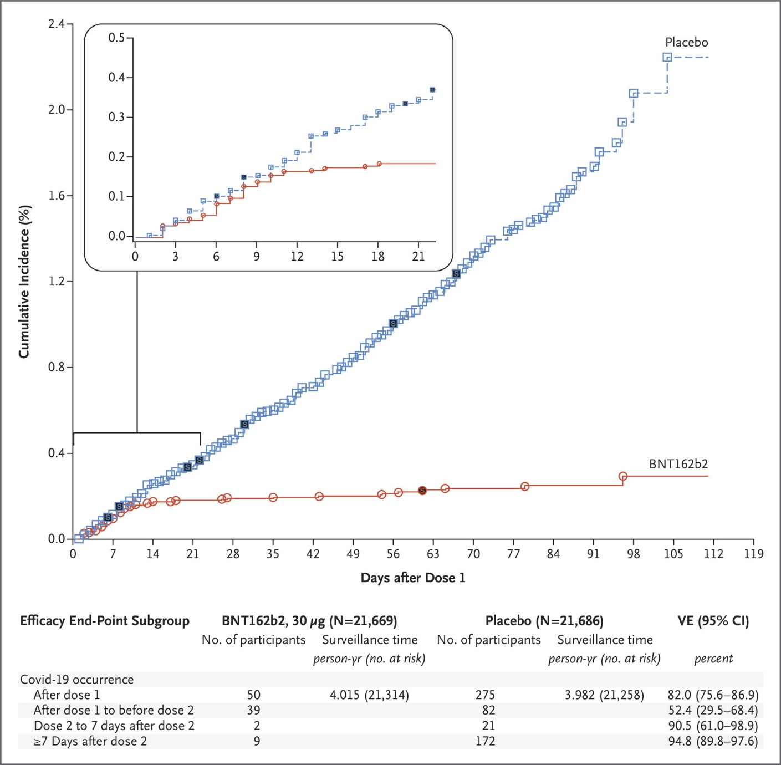
https://www.nejm.org/doi/full/10.1056/NEJMoa2034577#:~:text=The%20first%20primary%20end%20point,point%20was%20efficacy%20in%20participants

Slide 15
Moderna mRNA vaccine trial
Multinational placebo control trial
  2 doses given 28 days apart
  Enrolled >33,000 people
Endpoints
  Vaccine efficacy against lab confirmed COVID -19 14+ days after 2nd dose
    94.5% effective preventing symptomatic lab confirmed COVID-19
  Safety data
    Most common adverse reactions were:
      Injection site pain (92%)
      Fatigue (69%)
      Headache (63%)
    Serious adverse events
      1 death in vaccine group, 2 deaths in placebo group
      Non fatal SAEs: 1.0% in vaccine group, 1.0% in placebo group
https://www.cdc.gov/coronavirus/2019-ncov/vaccines/different-vaccines/Moderna.html
https://www.fda.gov/media/144434/download

Slide 16
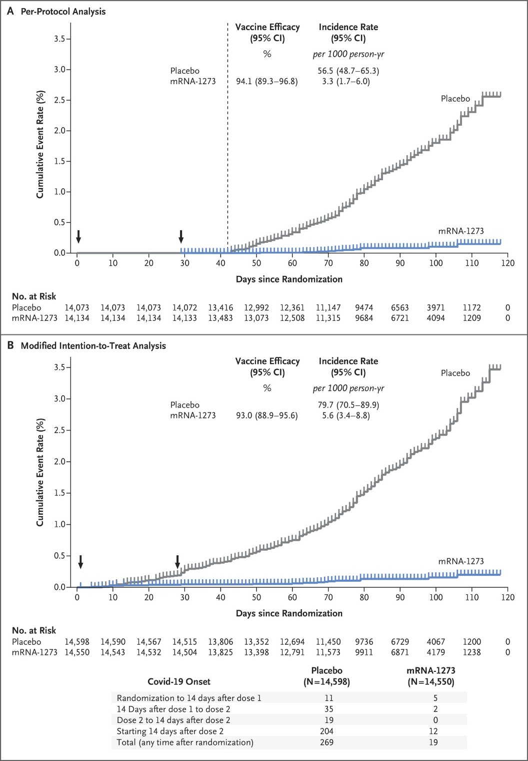
https://www.nejm.org/doi/full/10.1056/NEJMoa2035389

Slide 17
For Comparison: Influenza vaccine
Influenza vaccine side effects may include
  Injection site pain 36%
  Muscle aches 16%
  Headache 16%
  Fatigue 16%
https://www.cdc.gov/flu/professionals/vaccination/vaccine_safety.htm

Slide 18
Janssen Ad26.COVs2.s Vaccine
Data from ongoing multinational placebo control studies presented to FDA for EUA
Single dose vaccine
Vaccine efficacy against lab confirmed, moderate to severe COVID-19 is 66.9%
No specific safety concerns
  Most common side effects:
    Injection site pain 48.6%
    Headache 38.9%
    Fatigue 38.2%
https://www.fda.gov/media/146217/download

Slide 19
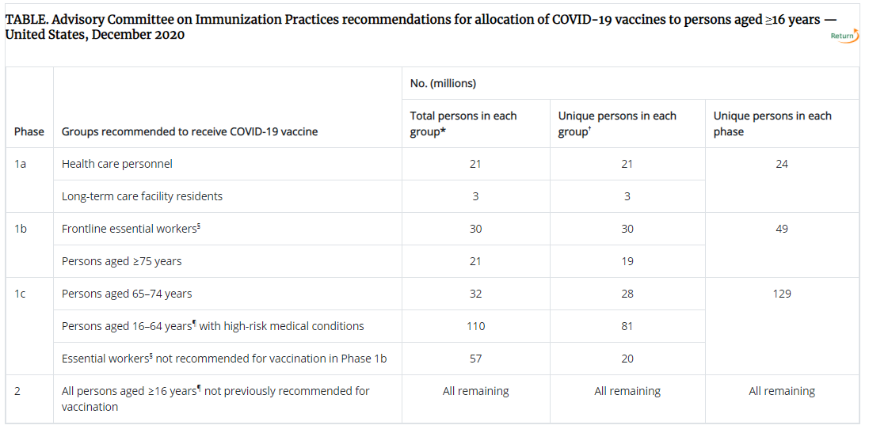
ACIP Advisory
https://www.cdc.gov/vaccines/hcp/acip-recs/vacc-specific/covid-19.html

Slide 20
Vaccine Safety Monitoring Systems
Vaccine Adverse Events Reporting System
  The national system that collects reports from healthcare professionals, vaccine manufacturers, and the public of adverse events that happen after vaccination; reports of adverse events that are unexpected, appear to happen more often than expected, or have unusual patterns are followed up with specific studies
v-safe
  A new smartphone-based, after-vaccination health checker for people who receive COVID-19 vaccines. V-safe uses text messaging and web surveys from CDC to check in with vaccine recipients following COVID-19 vaccination. V-safe also provides second vaccine dose reminders if needed, and telephone follow up to anyone who reports medically significant (important) adverse events.

Slide 21
Covid-19 Vaccine for Pregnant and Lactating Women
Pregnant women have not specifically been included in the initial Phase 2 and 3 studies, though pregnancy trials are being initiated.
  18 people did become pregnant after receiving the mRNA vaccine with no early concerning signals (12 Pfizer and 6 Moderna)
Developmental and Reproductive Toxicity (DART) studies in animal models
  Waiting on final data but so far no safety signals based on preliminary reports for the Pfizer-BioNtech and Moderna Covid-19 vaccines.
    Mice, rats, macaques
Not thought to cross the placenta or into breastmilk

Slide 22
Covid-19 Vaccine for Pregnant and Lactating Women
ACOG, SMFM, ACIP, CDC and ASRM recommend that COVID-19 vaccines should not be withheld from pregnant individuals who meet criteria for vaccination based on ACIP-recommended priority groups.
COVID-19 vaccines should be offered to lactating individuals similar to non-lactating individuals when they meet criteria for receipt of the vaccine based on prioritization groups outlined by the ACIP.
COVID-19 vaccination can cause fever in some patients (up to 16% of those vaccinated and mostly after the second dose) . VERY LOW absolute risk of birth defects

Slide 23
World Health Organization
Should pregnant women be vaccinated?
While pregnancy puts women at higher risk of severe
COVID-19, very little data are available to assess vaccine safety
in pregnancy.
Nevertheless, based on what we know about this kind of
vaccine, we don’t have any specific reason to believe there will
be specific risks that would outweigh the benefits of vaccination
for pregnant women. For this reason, those pregnant women
at high risk of exposure to SARS-CoV-2 (e.g. health workers)
or who have comorbidities which add to their risk of severe
disease, may be vaccinated in consultation with their health
care provider.
https://www.who.int/news-room/feature-stories/detail/the-moderna-covid-19-mrna-1273-vaccine-what-you-need-to-know

Slide 24
Myths and Facts
Can a COVID-19 vaccine make me sick with COVID-19?
  No. None of the authorized and recommended COVID-19 vaccines or COVID-19 vaccines currently in development in the United States contain the live virus that causes COVID-19. This means that a COVID-19 vaccine cannot make you sick with COVID-19.
After getting a COVID-19 vaccine, will I test positive for COVID-19 on a viral test?
  No. Neither the recently authorized and recommended vaccines nor the other COVID-19 vaccines currently in clinical trials in the United States can cause you to test positive on viral tests, which are used to see if you have a current infection.​
Is it safe for me to get a COVID-19 vaccine if I would like to have a baby one day?
  Yes. Based on current knowledge, experts believe that COVID-19 vaccines are unlikely to pose a risk to a person trying to become pregnant in the short or long term. Scientists study every vaccine carefully for side effects immediately and for years afterward. The COVID-19 vaccines are being studied carefully now and will continue to be studied for many years, similar to other vaccines.
https://www.cdc.gov/coronavirus/2019-ncov/vaccines/facts.html

Slide 25
Myths and Facts
Will a COVID-19 Vaccine alter my DNA?
  No. COVID-19 mRNA vaccines do not change or interact with your DNA in any way. The mRNA from a COVID-19 vaccine never enters the nucleus of the cell, which is where our DNA is kept. This means the mRNA cannot affect or interact with our DNA in any way.
If I have already had COVID-19 and recovered, do I still need to get vaccinated with a COVID-19 vaccine?
  Yes, you should be vaccinated regardless of whether you already had COVID-19. That’s because experts do not yet know how long you are protected from getting sick again after recovering from COVID-19.

Slide 26
Myths and Facts
Is it better to get immunity through a natural infection rather than a vaccine?
COVID-19 vaccination is a safer way to help build protection
  COVID-19 can have serious, life-threatening complications, and there is no way to know how COVID-19 will affect you. And if you get sick, you could spread the disease to friends, family, and others around you.
Getting COVID-19 may offer some natural protection, known as immunity. Current evidence suggests that reinfection with the virus that causes COVID-19 is uncommon in the 90 days after initial infection. However, experts don’t know for sure how long this protection lasts, and the risk of severe illness and death from COVID-19 far outweighs any benefits of natural immunity. COVID-19 vaccination will help protect you by creating an antibody (immune system) response without having to experience sickness.
https://www.cdc.gov/coronavirus/2019-ncov/vaccines/vaccine-benefits.html

Slide 27
Myths and Facts
Do vaccines have tracking devices?
  No. A video shared thousands of times on Facebook makes false claims about the products of syringe maker Apiject Systems of America. The company has an optional version of its product that contains a microchip within the syringe label that helps providers confirm a vaccine dose’s origin.
Do vaccines cause infertility?
  Misinformation on social media suggests the vaccine trains the body to attack syncytin-1, a protein in the placenta, which could lead to infertility in women. The truth is, there’s an amino acid sequence shared between the spike protein and a placental protein; however, experts say it’s too short to trigger an immune response and therefore doesn’t affect fertility.
https://www.muhealth.org/our-stories/covid-19-vaccine-myths-vs-facts

Slide 28
Finding Credible Vaccine Information Online
CDC’s NCIRD is a memberexternal icon of the World Health Organization’s (WHO) Vaccine Safety Netexternal icon and follows web content and credibility criteria defined by the Global Advisory Committee on Vaccine Safetyexternal icon (GACVS).
  CDC’s vaccines safety site is one of WHO’s 20 English language certified web sitesexternal icon.
As you surf for vaccine information, consider guidance from these sources:
  The Immunization Action Coalition suggests questions you should askexternal icon.
  The National Network for Immunization Information (NNii)external icon suggests questions to ask when evaluating information.
  The University of California San Francisco’s Evaluating Health Informationexternal icon page lists “Red Flags” every consumer needs to know.
  The Medical Library Associationexternal icon translates medical jargon (Medspeak)external icon into language everyone can understand.
While it’s a useful tool for researching health-related issues, the Internet does not replace a discussion with a healthcare professional.
https://www.cdc.gov/vaccines/vac-gen/evalwebs.htm

Slide 29
Why prioritize vaccine for BH patients?
Many Behavioral Health conditions may increase a patient’s risk for severe outcomes
  Schizophrenia may increase mortality in COVID-19 patients
  https://jamanetwork.com/journals/jamapsychiatry/fullarticle/2775179
Behavioral health conditions may increase a patient’s odds of COVID-19 infection
  Conditions may include ADHD, bipolar disorder, depression, schizophrenia
  https://onlinelibrary.wiley.com/doi/10.1002/wps.20806

Slide 30
Questions?
Email : mdh.ipcovid@Maryland.gov

