Slide 1
Maryland Situation Update on Coronavirus disease (COVID-19) for BHA
Maryland Department of Health
Infectious Disease Epidemiology and Outbreak Response Bureau
April 3, 2020

Slide 2
Call Agenda
Picture Courtesy of NIAID-RML
Review current situation of COVID-19
Updated Guidance from CDC
Questions and Answers

Slide 3
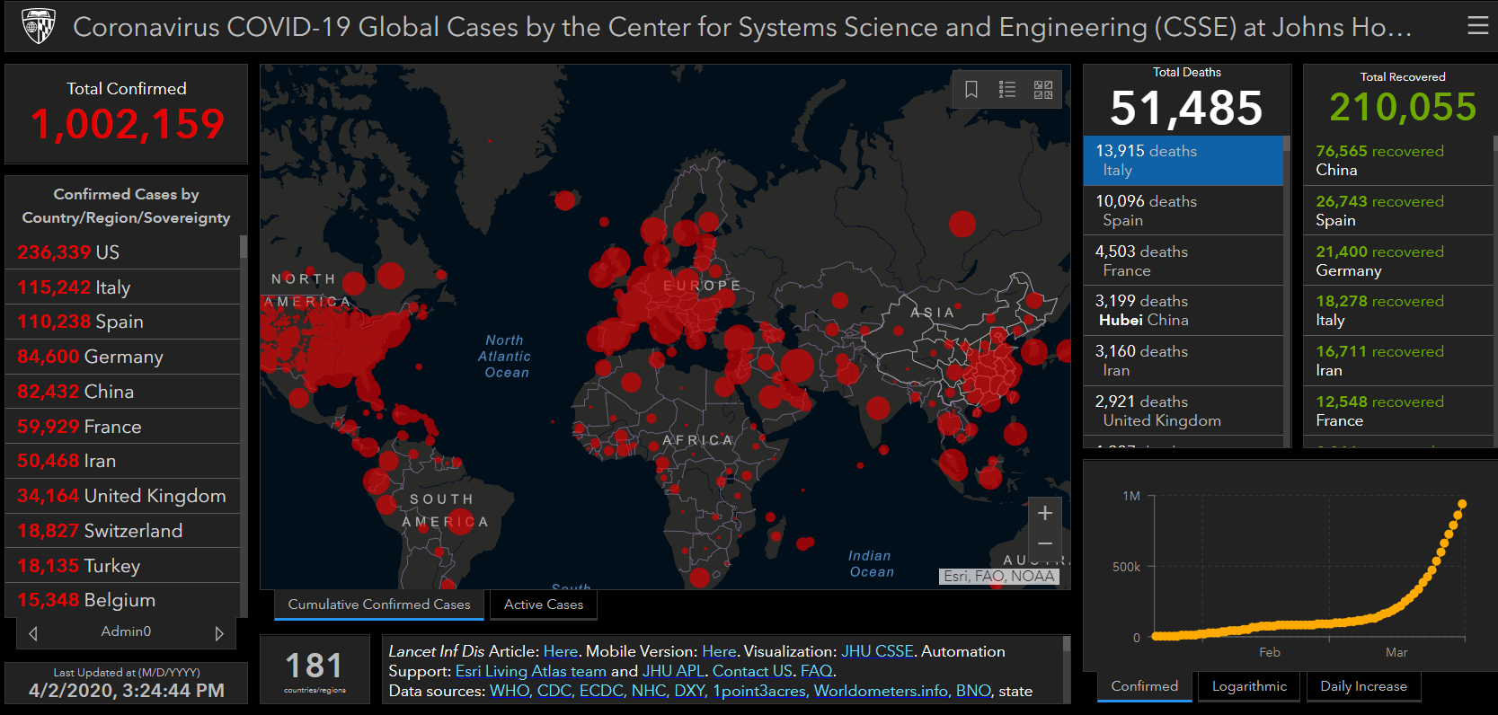
COVID-19 Global Situation Summary
Data current as of April 2, 5:45PM 2020
Notes:
As of last night, the united states is now reporting the highest number of CoVID-19 cases in the workd

Slide 4
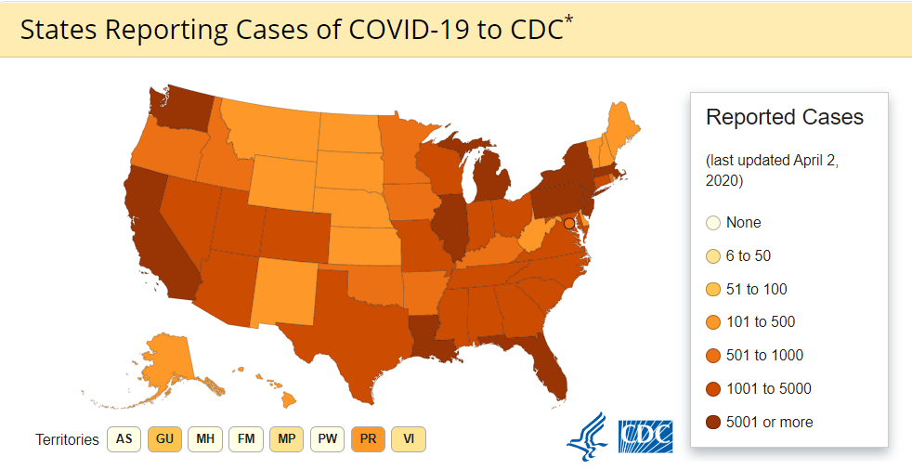
U.S.: COVID-19 Cases
213,144 Confirmed Cases
1,144 Travel-related cases
3,245 Close Contact
209,705 “Under Investigation”
4,513 total deaths
55 states and territories reporting
Source: www.cdc.gov, accessed April 2nd
Notes:
Cases in the United States soared over the past week. As of March 24th, 44, 183 cases of COVID-19 have been confirmed in the United States. 279 have been travel-related cases, 569 have been from close contact, and 43,135 cases are currently under investigation with no epidemiological links.

Slide 5
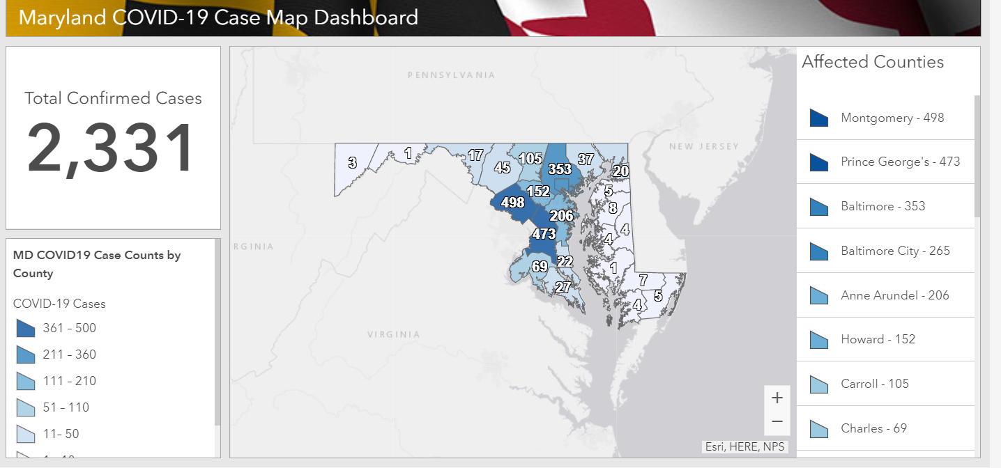
Maryland: COVID-19 Cases
http://health.maryland.gov/coronavirus
Data current as of April 2, 2020
Notes:
As of March 25th, 423 patients have tested positive for COVID-19. Maryland now has a heat map on their website to identify counties by the number of cases. This is identified by county of residence and not county by which cases are identified. In quick review:
I’m not going to read off every county this week but Montgomery, Prince George’s and Baltimore City currently have the greatest number of cases. The Maryland Emergency Management Agency will update this dashboard daily at 10 a.m based on the most available data across the state. This data and additional information will continue to be provided on our website at health.maryland.gov/coronavirus.
3

Slide 6
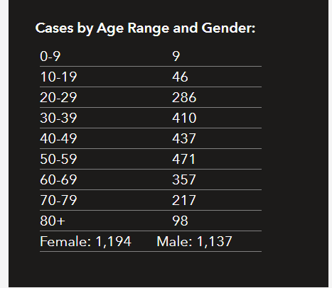
Maryland Epi Breakdown
Hospitalization: 582
Deaths: 36
Notes:
an increase of 194 since yesterday

Slide 7
Clinical Presentation
Incubation period is 2-14 days
*Fever
*Cough
*Shortness of Breath
May include:
Sore throat
Congestion
Fatigue
Headache
May be mild to severe

Slide 8
COVID-19 Testing
Priorities for testing:
1:Hospitalized patients and symptomatic healthcare workers
2: Patients in long term care, over 65, or with underlying conditions
3: Other symptomatic patients
1 Nasopharyngeal swab (NP) swab for COVID-19 testing
Provider clinical judgement for testing orders
Patients who are mildly ill and can safely manage at home for the duration of illness do not need to be tested
TESTING ASYMPTOMATIC PEOPLE IS NOT RECCOMENDED

Slide 9
Screening Staff
Screen staff and patients on entry for fever and symptoms
Sick staff should be sent home
Non-punitive staff leave policy
Staff with high or medium risk exposures should be excluded for 14 days after the last exposure date. Alternately, staff may work if they wear a mask and self monitor for symptoms with temperature check at least twice daily
Staff with a positive COVID-19 test may return to work 7 days after symptom onset AND 3 days after fever resolution with improving symptoms
Wear a mask until symptoms are completely resolved or 14 days after onset- whichever is longer
Not care for immunocompromised patients until symptom free

Slide 10
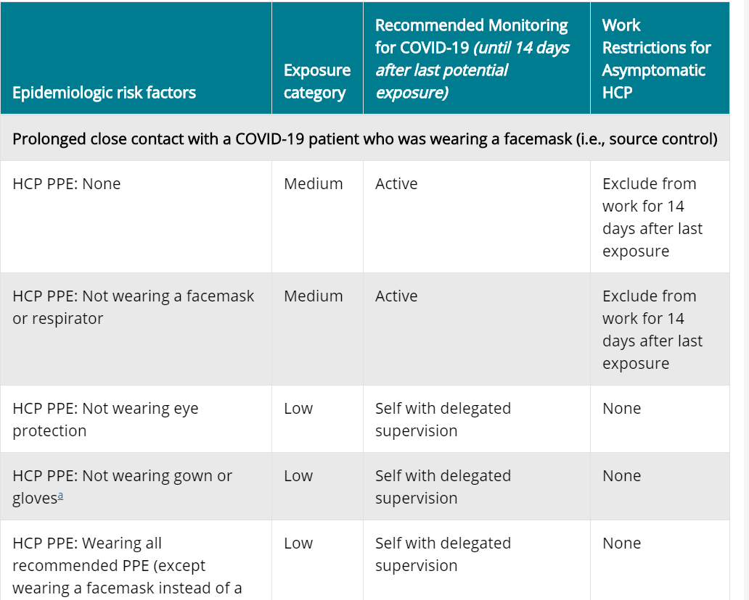
Screening Staff: Exposures
Staff with high or medium risk exposures should be excluded from work until 14 days after the exposure
Facilities could consider allowing asymptomatic HCP who have had an exposure to a COVID-19 patient to continue to work after options to improve staffing have been exhausted
Wear a mask while at work
Check for fever and symptoms at least twice a day
Notes:
Source control- putting a mask on the patient lowers the risk to the HCW

Slide 11
Screening Patients and Visitors
Sick patients should be:
Separated in the waiting room
Separate waiting room for patients with respiratory illness
Take patients with respiratory illness back to treatment quickly
Require 6 feet of space between ill and well patients in the waiting room
Patients with respiratory symptoms should wear a mask if tolerated
Guests and visitors should be screened with the same tools
If COVID-19 is prevalent in the community, or in the facility, consider that visitors be restricted

Slide 12
General Infection Control: PPE
Use droplet and contact precautions
Healthcare workers in contact with COVID-19 patients should wear:
Gloves
Disposable isolation gown
To be worn over/ in place of coat or apron
Facemask
Surgical or procedure masks are fine
Eye protection
Goggles or face shield
PPE shortages
Conserving PPE

Slide 13
General Infection Control
Post signage encouraging respiratory etiquette and hand hygiene
Provide alcohol based hand rub through out the facility.
Ensure sinks are stocked with soap and paper towels for staff hand hygiene
Avoid any aerosol generating procedures
Supplies for hand hygiene and respiratory etiquette (tissues, waste receptacles, ABHR) should be available at each station for patient use

Slide 14
Steps to Responding to a COVID-19 Case
Consult your local health department
Ensure symptomatic patients are on appropriate transmission based precautions when in the facility
Ensure sick staff are excluded
Contact investigation to determine exposed healthcare workers or patients- the local health department can help you
Exclusions as appropriate for healthcare workers with medium - high risk exposures

Slide 15
Resources
MDH Novel Coronavirus: http://health.maryland.gov/coronavirus
MDH Laboratory Coronavirus: https://health.maryland.gov/laboratories/Pages/Novel-Coronavirus.aspx
COVID-19 People at risk https://www.cdc.gov/coronavirus/2019-ncov/specific-groups/high-risk-complications.html
CDC Guidance for Infection Control https://www.cdc.gov/coronavirus/2019-nCoV/infection-control.html
EPA List N Disinfectants with COVID-19 claim https://www.epa.gov/pesticide-registration/list-n-disinfectants-use-against-sars-cov-2
Conserving PPE https://www.cdc.gov/coronavirus/2019-ncov/hcp/ppe-strategy/index.html

Slide 16
Questions?
Email : mdh.ipcovid@Maryland.gov

