Slide 1
Maryland Situation Update on Coronavirus Disease (COVID-19) for BHA
Maryland Department of Health
Infectious Disease Epidemiology and Outbreak Response Bureau
June 19, 2020

Slide 2
Call Agenda
Picture Courtesy of NIAID-RML
Review current situation of COVID-19
Re-opening guidance
Questions and Answers

Slide 3
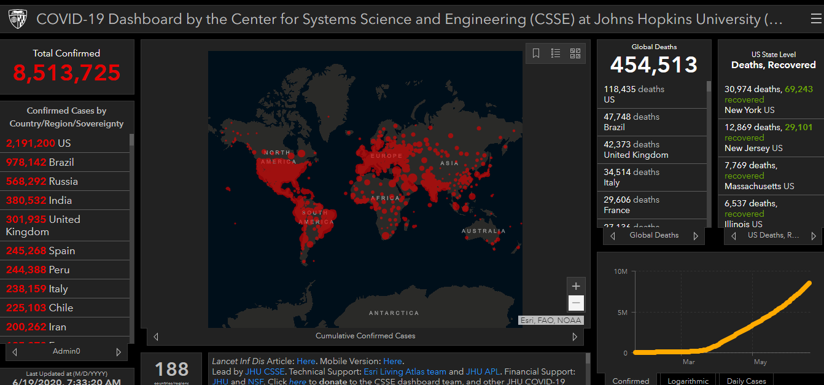
COVID-19 Global Situation Summary

Slide 4
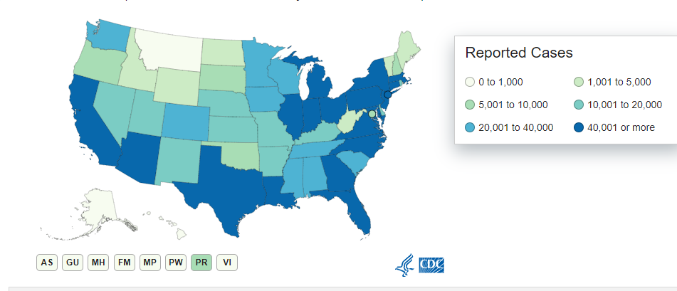
U.S.: COVID-19 Cases
2,155,572 Confirmed Cases
22,834 new
117,632 total deaths
754 new
55 states and territories reporting
Source: www.cdc.gov, accessed June 18, 2020

Slide 5
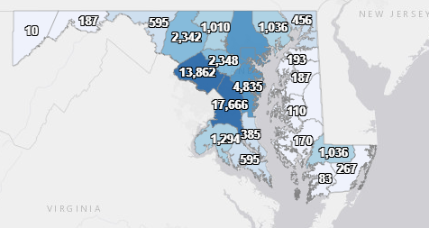
Maryland: COVID-19 Cases
http://health.maryland.gov/coronavirus
Data current as of 6/19/2020
Cases: 63,548
319 new
Deaths: 2,901
15 new
Hospitalizations: 10,447
90 new
Total tests 544,072

Slide 6
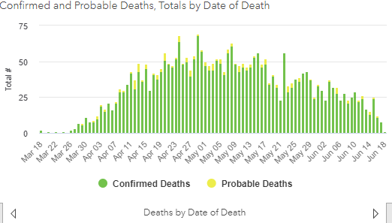

Slide 7
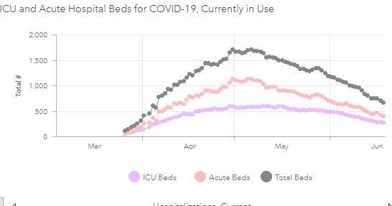

Slide 8
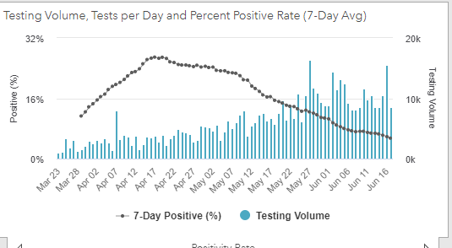
Testing Volume and % Positivity

Slide 9
Guidance for Outdoor Visits at Assisted Living Facilities in Maryland
Can apply to residential treatment settings too
Outdoor visits allowed if:
1. Visitors and Residents wear a face covering at all times
2. Visitors and residents maintain proper social distancing (6 feet) at all times
3. There is NOT an ongoing outbreak at the facility
Recommend no more than 2 visitors per resident at a time
Visitors are still not allowed in Long Term Care/Skilled Nursing settings

Slide 10
Guidance for positive staff
Staff who have a positive COVID-19 test must be excluded from work
If symptomatic, exclude:
for 10 days after symptom onset; AND
3 days after fever resolution; AND
other symptoms are resolving
If asymptomatic, exclude:
For 10 days after positive test
Monitor for symptoms

Slide 11
Contact notification
Positive staff should notify their employer
Will get a work excuse note from the contact tracing program
Notify other staff who may have close contact
Close contact is 15 minutes or more within 6 feet
Staff who have had close contact should preferably exclude from work for 14 days
If that staff person is necessary for the facility’s functioning, they may continue to work with a mask and careful monitoring of symptoms

Slide 12
Contact notification: Patients
Notify patients who have been in close contact
Close contact is 15 minutes or more within 6 feet
Create a form letter now for patient notification
Inform patients they may have been exposed,
recommend that patients self monitor for symptoms,
If patients develop symptoms, they should inform their HCP that they have been in contact with a confirmed COVID case

Slide 13
Guidance for reopening offices
Monitor local guidance and epidemiology to know when it is safer and allowed for businesses to re-open
Avoid large in person meetings, crowding, close contacts
Stagger work arrival times, break times, to reduce close contacts
Allow for telework to continue if possible, and stagger telework days
Review cleaning processes, increase cleaning of high touch surfaces
Clean at least once per shift
Encourage hand hygiene for staff and clients
Hang signs, place hand sanitizer

Slide 14
Guidance for reopening offices
Staff should not share work spaces or equipment
Masks and cloth face coverings should be worn in the office
Consider creating one way traffic in the office space so people are less likely to have close contact
Screen staff for signs and symptoms
Do not work while sick! Encourage non-punitive leave policies for ill staff
Cross train staff to ensure back up staffing is available if someone is out sick
https://www.cdc.gov/coronavirus/2019-ncov/community/resuming-business-toolkit.html

Slide 15
Break room rules for a COVID world
Limit the number of people in the room at one time
50% of capacity, per fire code, is recommended
Wear masks or face covering in the break room
Do not eat in the breakroom especially if others are present
Provide alternative eating locations where staff can physically distance
Stagger break times, and room use
Increase common cleaning and disinfection of common areas
Provide hand sanitizer or soap and sinks

Slide 16
Guidance for food service: In the kitchen
Protect high risk employees
Provide non-punitive sick leave policies for all staff
Allow for flexible work schedules to prevent crowding
Promote healthy hygiene for staff and patrons
Hand washing, face covering, respiratory etiquette
Increase cleaning and disinfection of food surfaces and high touch surfaces
Monitor staff for signs and symptoms; exclude ill workers
https://www.cdc.gov/coronavirus/2019-ncov/community/organizations/restaurants-and-bars-decision-tool.html
https://www.cdc.gov/coronavirus/2019-ncov/community/organizations/business-employers/bars-restaurants.html

Slide 17
Guidance for food service: For serving
No buffets or self service
Encourage pick-up or delivery options
Allow for outdoor eating if possible
Space eating areas so patrons may remain 6 feet apart while eating
Limit number of patrons in the dining area at any given time
Provide hand sanitizer and/or sinks with soap for patrons

Slide 18
Resources
MDH Novel Coronavirus: http://health.maryland.gov/coronavirus
MDH Laboratory Coronavirus: https://health.maryland.gov/laboratories/Pages/Novel-Coronavirus.aspx
COVID-19 People at risk https://www.cdc.gov/coronavirus/2019-ncov/specific-groups/high-risk-complications.html
CDC Guidance for Infection Control https://www.cdc.gov/coronavirus/2019-nCoV/infection-control.html
Behavioral Health https://www.cdc.gov/coronavirus/2019-ncov/hcp/infection-control-faq.html?CDC_AA_refVal=https%3A%2F%2Fwww.cdc.gov%2Fcoronavirus%2F2019-ncov%2Finfection-control%2Finfection-prevention-control-faq.html
Memory Care https://www.cdc.gov/coronavirus/2019-ncov/hcp/memory-care.html

Slide 19
Questions?
Email : mdh.ipcovid@Maryland.gov
https://www.cdc.gov/coronavirus/2019-ncov/hcp/guidance-risk-assesment-hcp.html

