Slide 1
Maryland Situation Update on
Coronavirus Disease (COVID-19) for BHA
Maryland Department of Health
Infectious Disease Epidemiology and Outbreak Response Bureau
August 7th, 2020

Slide 2
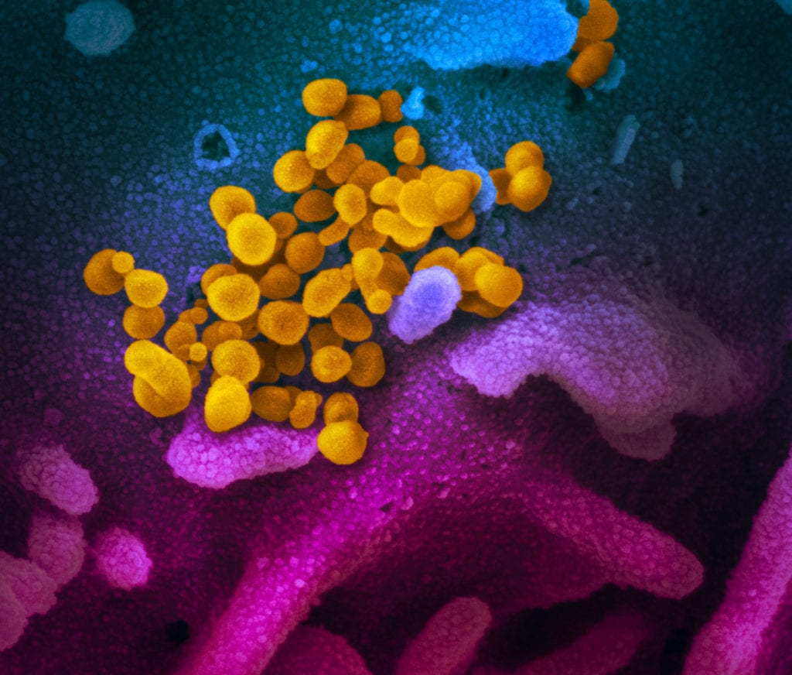
Call Agenda
Picture Courtesy of NIAID-RML
Review current situation of COVID-19
COVIDlink
CDC State Data
Questions and Answers

Slide 3
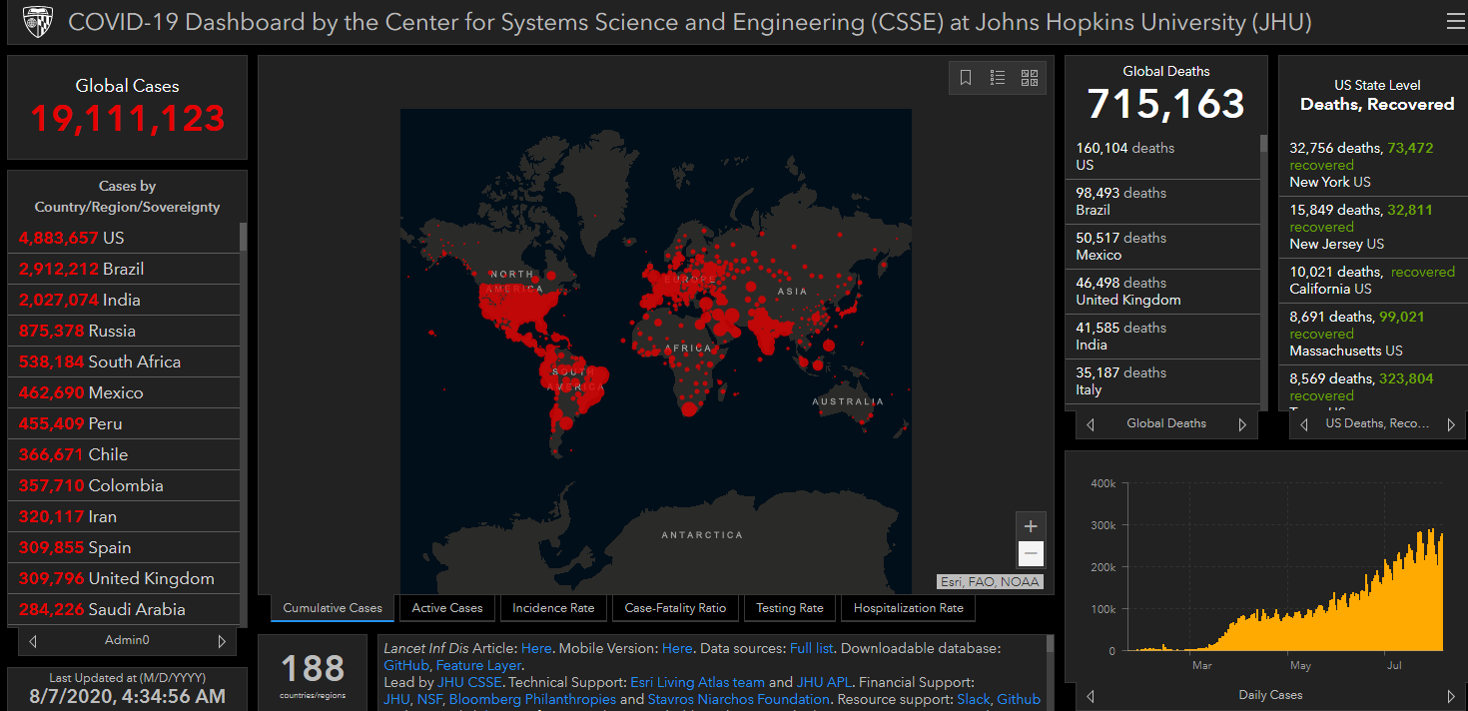
COVID-19 Global Situation Summary

Slide 4
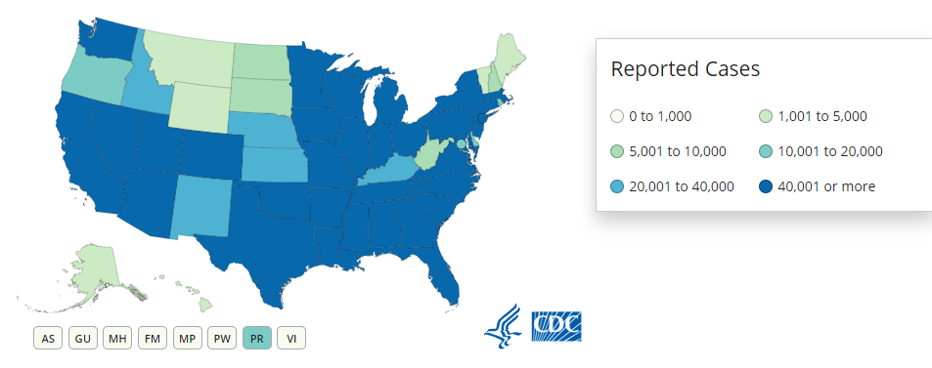
U.S.: COVID-19 Cases
4,802,491 Confirmed Cases
  53,685 new
157,631 total deaths
  1,320 new
https://www.cdc.gov/coronavirus/2019-ncov/cases-updates/us-cases-deaths.html
Accessed 8/7/2020

Slide 5
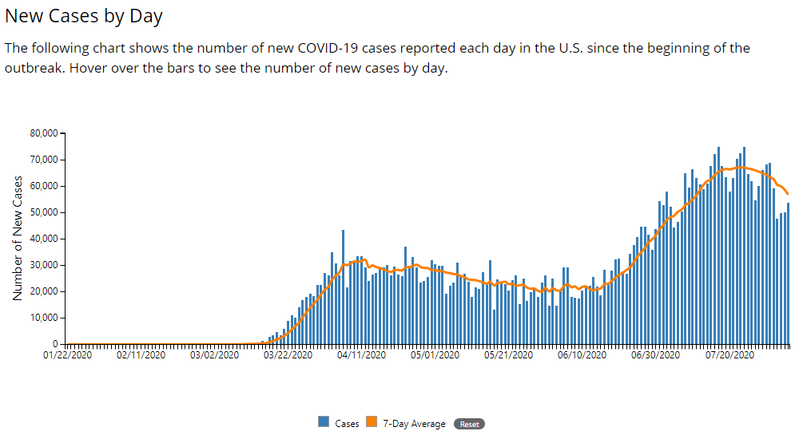

Slide 6
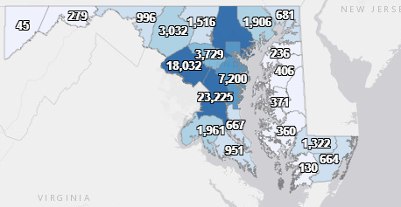
Maryland: COVID-19 Cases
http://health.maryland.gov/coronavirus
Data current as of 8/7/2020
Cases: 93,806
  801 new
Deaths: 3,429
  14 new
Hospitalizations: 13,047
  Current: 528
  69 new
Total tests 1,377,459
Total people tested: 1,006,824

Slide 7
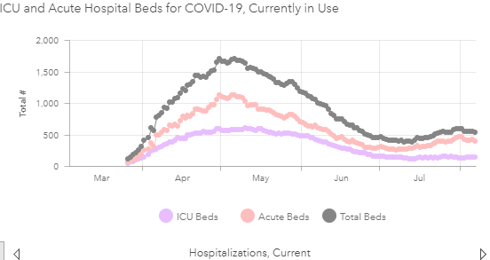

Slide 8
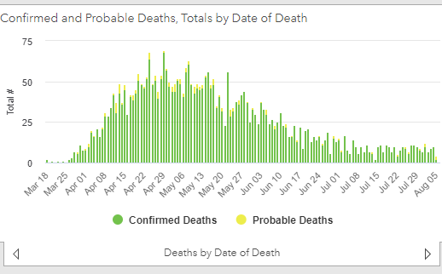

Slide 9
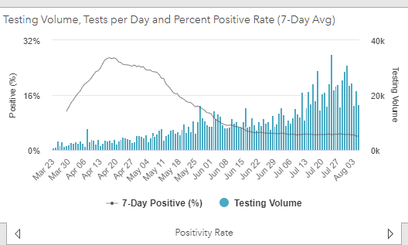
Testing Volume and % Positivity

Slide 10
COVIDLink

Slide 11
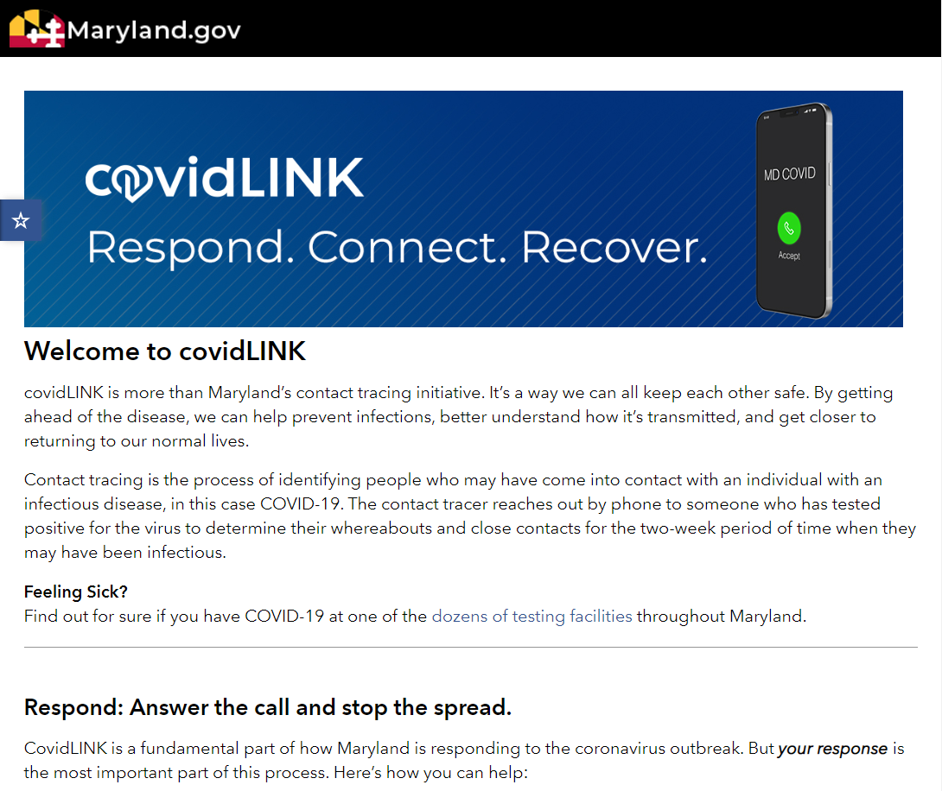

Slide 12
Automated
COVID-19
Contact
Tracing Communications

Slide 13
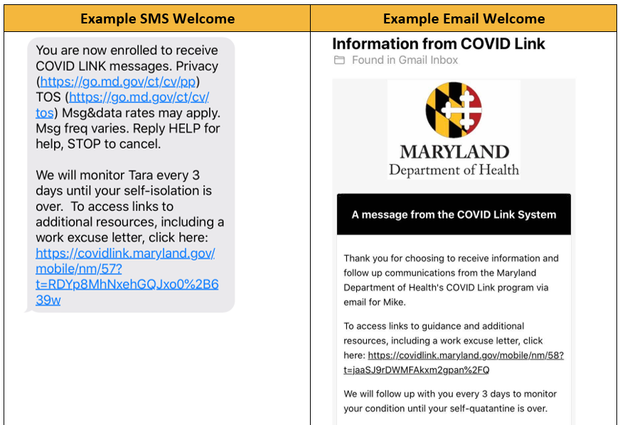

Slide 15
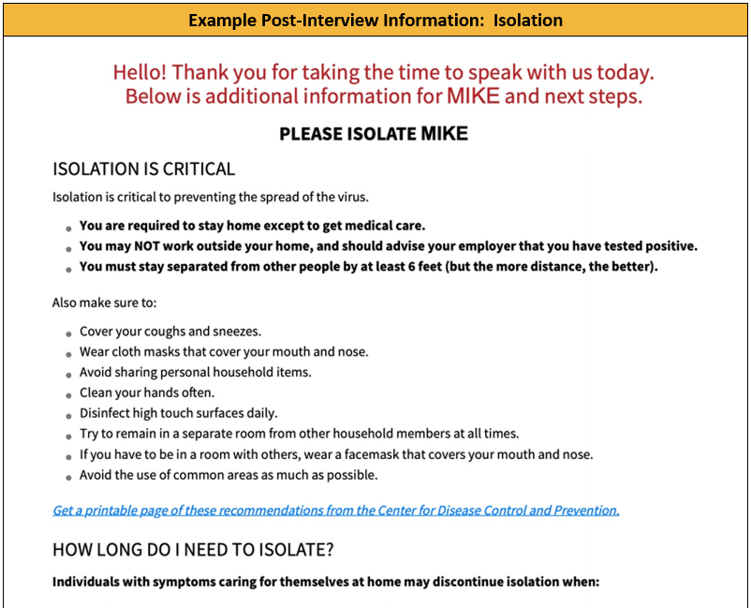

Slide 16
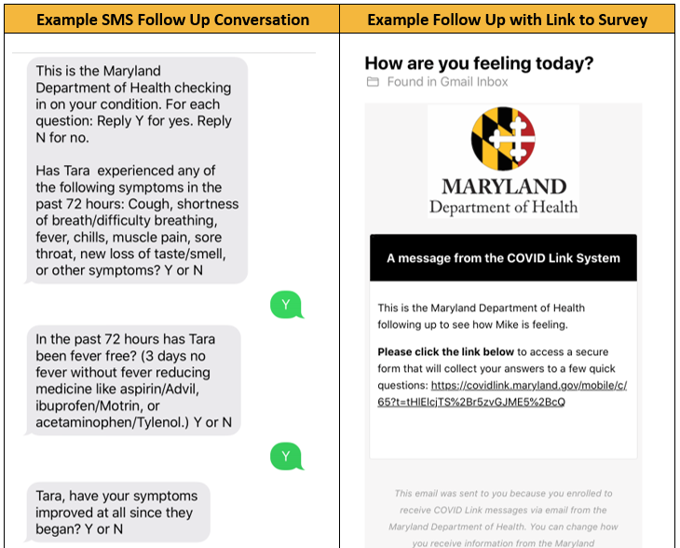

Slide 17
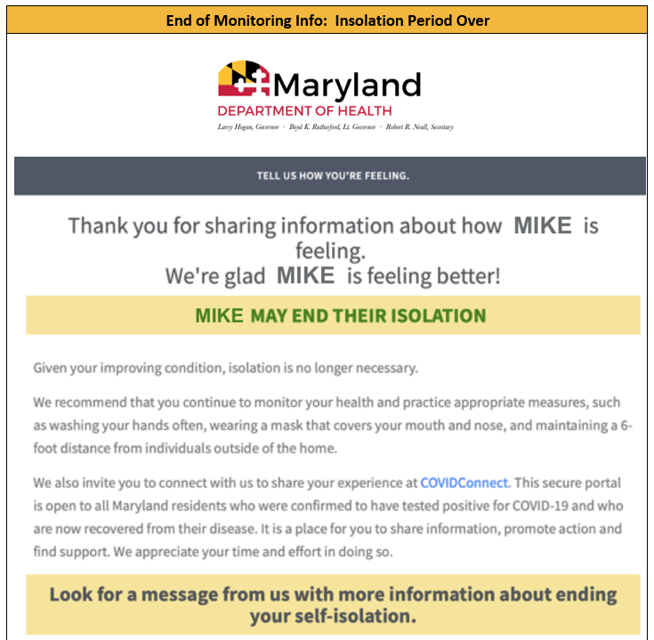

Slide 18
What COVIdLink Does and Doesn’t Do
Does:
Provide a convenient place to enter daily symptom check
Allows the patient to check in with public health department
Gives information about the steps in the contact tracing process
Provides a work excuse letter
Does not:
Interact with any other apps on your phone, including social media
Look through your phone for known contacts
Send notifications to any other people

Slide 19
CDC State Indicator Reports

Slide 20
Data Sources
State-level case counts and mortality data: State-verified case report counts in NNDSS and DCIPHER
County-level case counts and mortality data: USAFacts
COVID-like Illness (CLI) Emergency Department Data: BioSense- Facility Location
Total testing volume and results: HHS Protect Laboratory Data
Population denominator for incidence calculations: 2018 US Census estimates
There might be slight discrepancies between the numbers CDC is displaying and what MDH has on the website. The MDH data are generally a little more complete than the CDC data

Slide 21
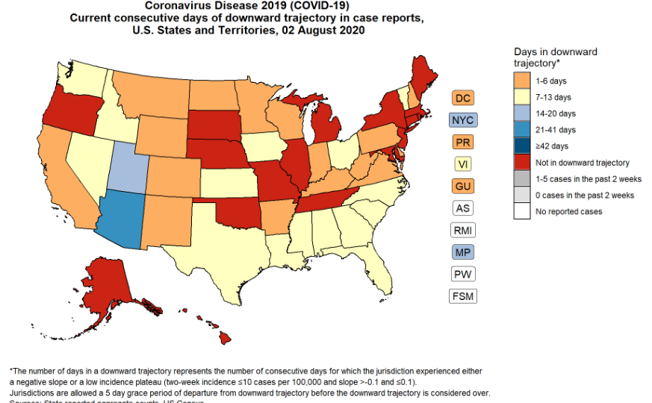

Slide 22
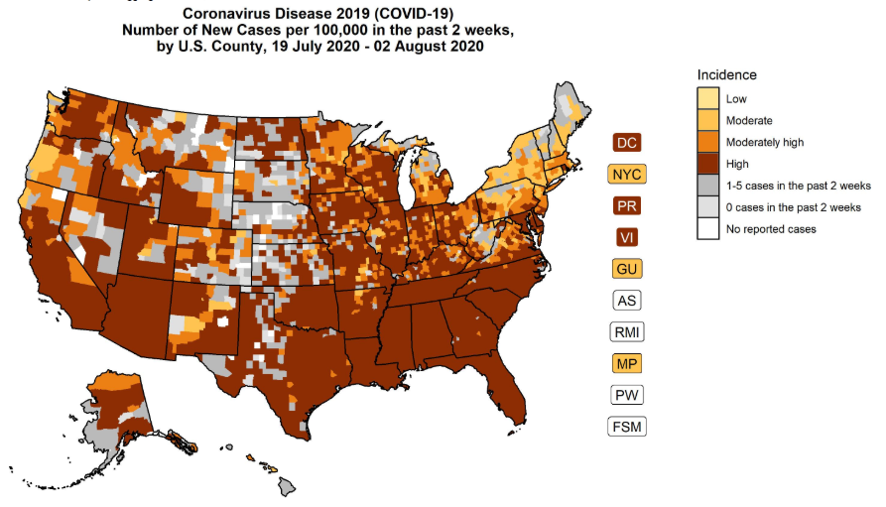

Slide 23
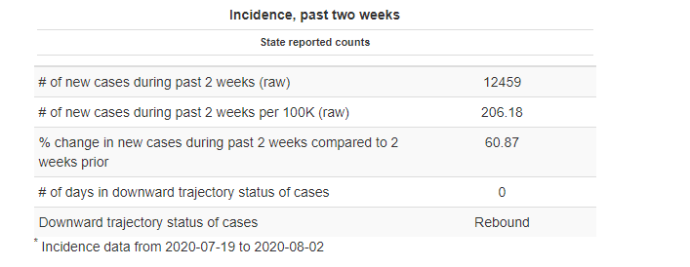
Maryland Specific Data

Slide 24
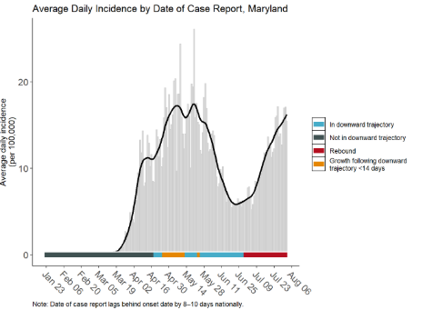

Slide 25
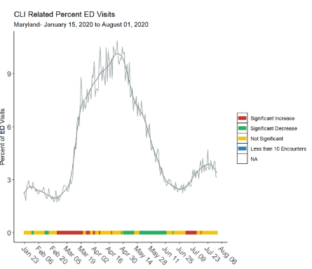

Slide 26
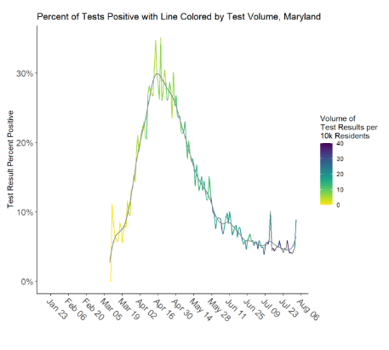

Slide 27
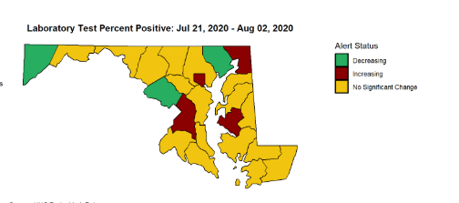

Slide 28
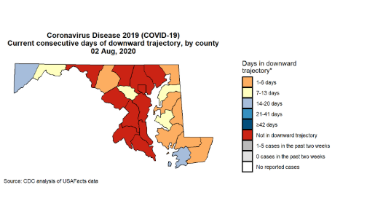

Slide 29
Resources
MDH Novel Coronavirus: http://health.maryland.gov/coronavirus
MDH Laboratory Coronavirus: https://health.maryland.gov/laboratories/Pages/Novel-Coronavirus.aspx
COVID-19 People at risk https://www.cdc.gov/coronavirus/2019-ncov/specific-groups/high-risk-complications.html
CDC Guidance for Infection Control https://www.cdc.gov/coronavirus/2019-nCoV/infection-control.html
Behavioral Health https://www.cdc.gov/coronavirus/2019-ncov/hcp/infection-control-faq.html?CDC_AA_refVal=https%3A%2F%2Fwww.cdc.gov%2Fcoronavirus%2F2019-ncov%2Finfection-control%2Finfection-prevention-control-faq.html
Memory Care https://www.cdc.gov/coronavirus/2019-ncov/hcp/memory-care.html

Slide 30
Questions?
Email : mdh.ipcovid@Maryland.gov

