Slide 1
Maryland Situation Update on Coronavirus Disease (COVID-19) for BHA
Maryland Department of Health
Infectious Disease Epidemiology and Outbreak Response Bureau
September 25, 2020

Slide 2
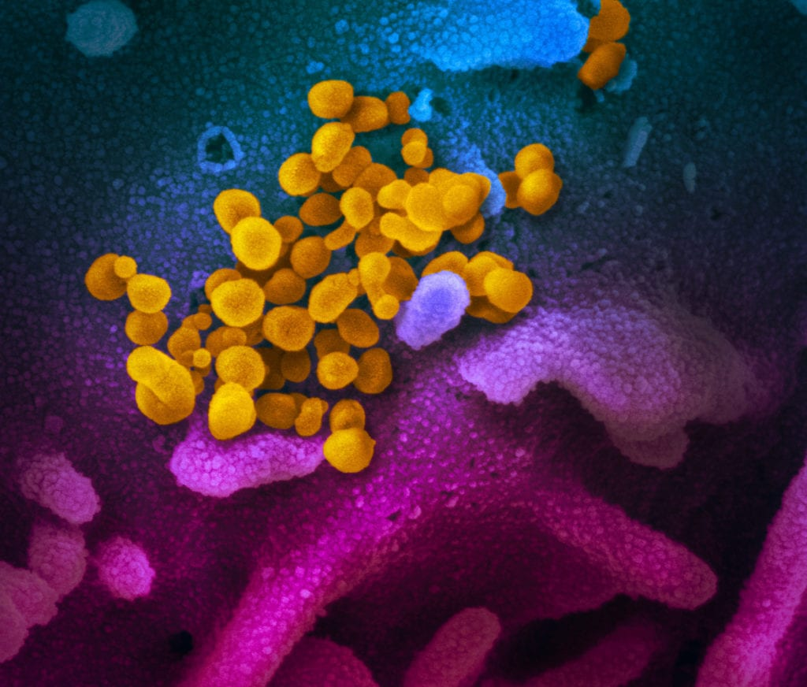
Call Agenda
Picture Courtesy of NIAID-RML
Review current situation of COVID-19
Long Haulers
Questions and Answers

Slide 3
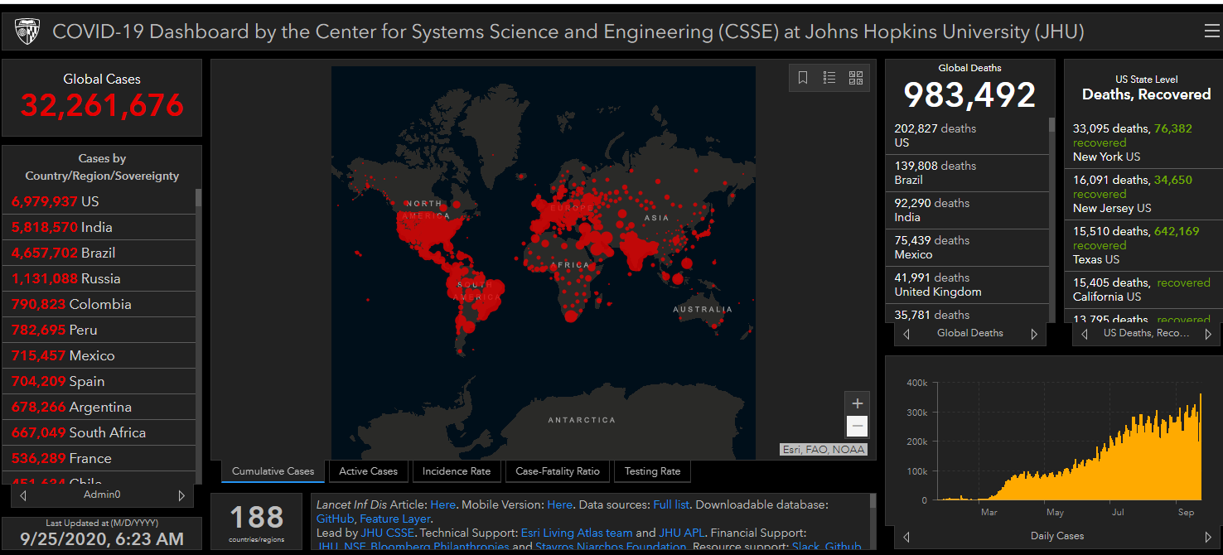
COVID-19 Global Situation Summary

Slide 4
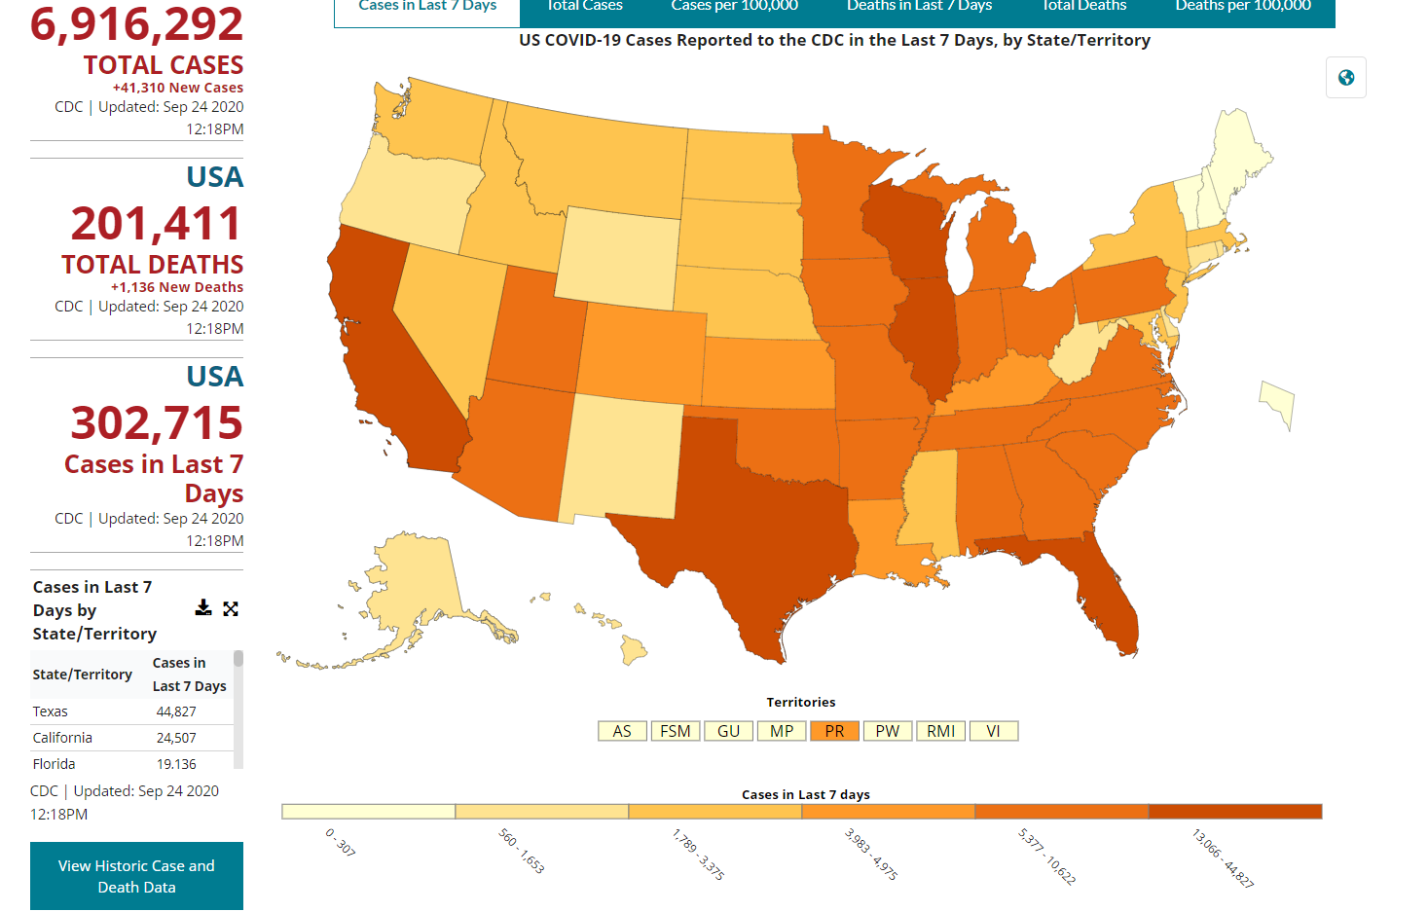
U.S.: COVID-19 Cases
https://www.cdc.gov/coronavirus/2019-ncov/cases-updates/cases-in-us.html Accessed 9/25/2020

Slide 5
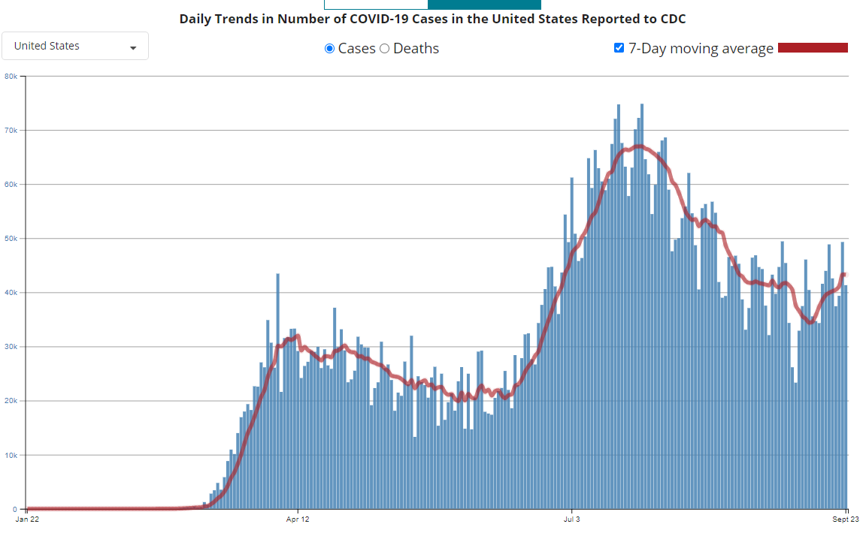
Number of Cases Reported in the USA, by Day

Slide 6
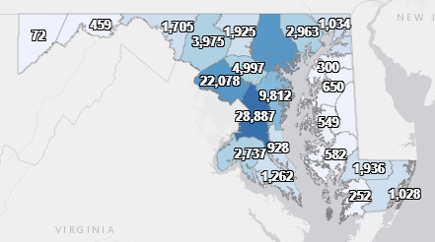
Maryland: COVID-19 Cases
http://health.maryland.gov/coronavirus
Data current as of 9/25/2020
Cases: 122,359
559 new
Deaths: 3,772
7 new
Hospitalizations: 15,139
Current: 344
Total tests 2,324,252

Slide 7
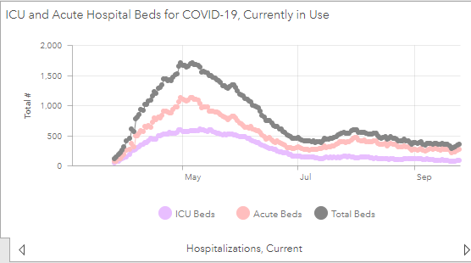

Slide 8
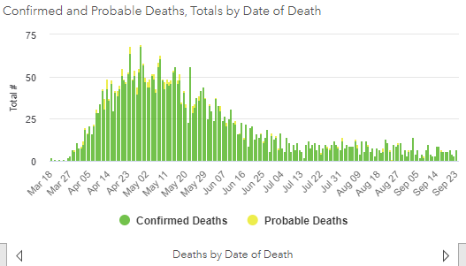

Slide 9
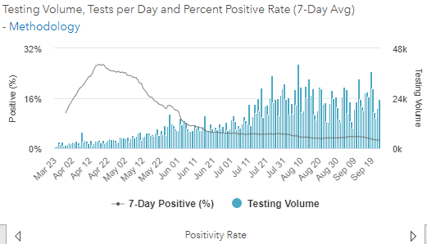
Testing Volume and % Positivity

Slide 10
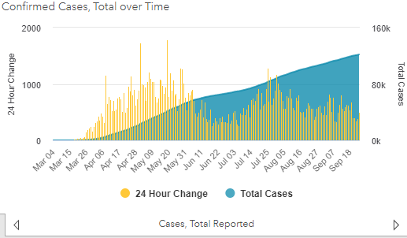

Slide 11
CMS Updates

Slide 12
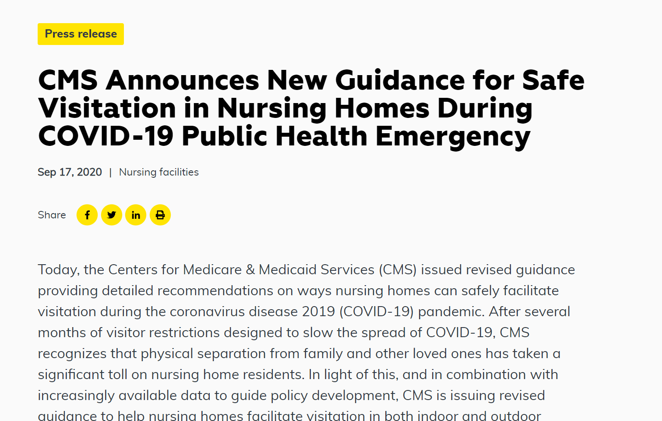
New CMS Memo Reversing Nursing Home Restrictions
https://www.cms.gov/files/document/qso-20-39-nh.pdf

Slide 13
General Visitation Allowed and Required
Outdoor visitation is preferred over indoor visitation; it is safer and can be conducted in a manner that reduces the risk of transmission
Facilities may allow indoor visits, while adhering to the following guidance to mitigate risks
Facilities may not restrict visitation without a reasonable clinical or safety cause
Health care workers and volunteers who are not employees of the facility but provide direct care to the facility’s residents must be permitted to come into the facility

Slide 14
CMS Core Principles of COVID-19 Infection Prevention
Screening of all who enter the facility for signs and symptoms of COVID-19 (e.g., temperature checks, questions or observations about signs or symptoms), and denial of entry of those with signs or symptoms
Hand hygiene (use of alcohol-based hand rub is preferred)
Face covering or mask (covering mouth and nose)
Social distancing at least six feet between persons
Instructional signage throughout the facility and proper visitor education on COVID19 signs and symptoms, infection control precautions, other applicable facility practices
Cleaning and disinfecting high frequency touched surfaces in the facility often, and designated visitation areas after each visit
Appropriate staff use of Personal Protective Equipment (PPE)
Effective cohorting of residents (e.g., separate areas dedicated COVID-19 care)
Resident and staff testing conducted as required at 42 CFR 483.80(h) (see QSO-20- 38-NH)

Slide 15
When Can Indoor Visitation Occur?
Indoor visitation may only occur when there has been no new onset cases of COVID-19 in the last 14 days in staff or residents and the facility is not currently conducting outbreak-related testing of residents
Community percent positivity must be under 10%
Outdoor visitation is preferred, but indoor visitation may occur when weather and other factors preclude outdoor visitation

Slide 16
What is Required for Indoor Visits
Visitors should be able to adhere to the core principles and staff should provide monitoring for those who may have difficulty adhering to core principles, such as children
Facilities should limit the number of visitors per resident at one time and limit the total number of visitors in the facility at one time (based on the size of the building and physical space). Facilities should consider scheduling visits for a specified length of time to help ensure all residents are able to receive visitors
Facilities should limit movement in the facility. For example, visitors should not walk around different halls of the facility. Rather, they should go directly to the resident’s room or designated visitation area. Visits for residents who share a room should not be conducted in the resident’s room.

Slide 17
Compassionate Care Visitation
Compassionate Care visits may occur even when community percent positivity is over 10%, and/or when there is an outbreak in the facility
Does not exclusively refer to end-of-life situations
Visits should be conducted using social distancing
Residents who are on transmission-based precautions for COVID-19 should only receive visits that are virtual, through windows, or in-person for compassionate care situations, with adherence to transmission-based precautions

Slide 18
Communal Dining and Group Activities
Residents may eat in the same room with social distancing (e.g., limited number of people at each table and with at least six feet between each person)
Facilities should consider additional limitations based on status of COVID-19 infections in the facility
Group activities may also be facilitated (for residents who have fully recovered from COVID-19, and for those not in isolation for observation, or with suspected or confirmed COVID-19 status) with social distancing among residents, appropriate hand hygiene, and use of a face covering
Facilities may be able to offer a variety of activities while also taking necessary precautions

Slide 19
CDC Updates

Slide 20
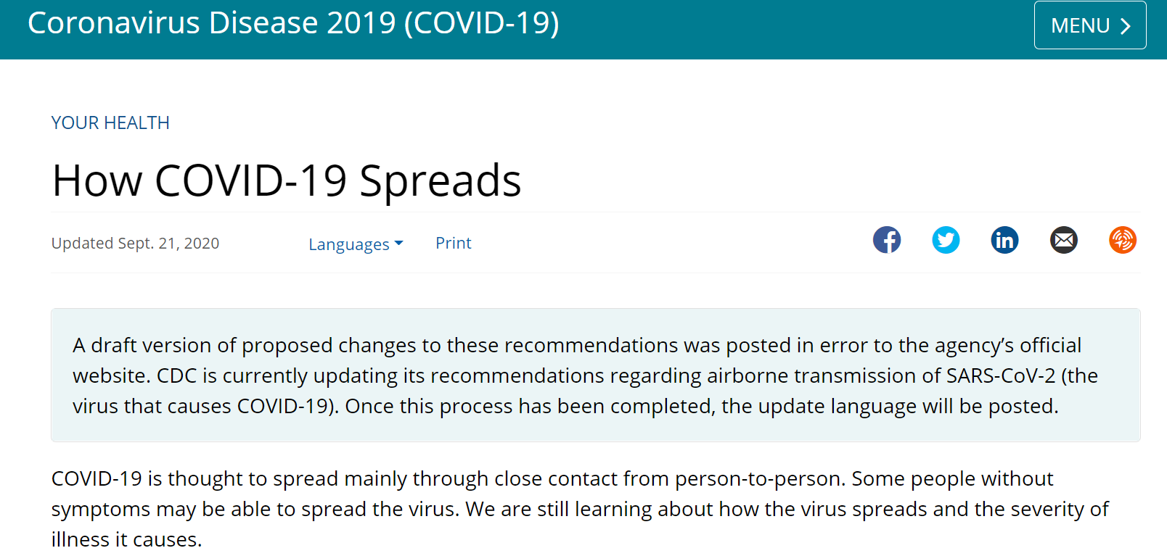
Source: https://www.cdc.gov/coronavirus/2019-ncov/prevent-getting-sick/how-covid-spreads.html, Accessed 9/22/20

Slide 21
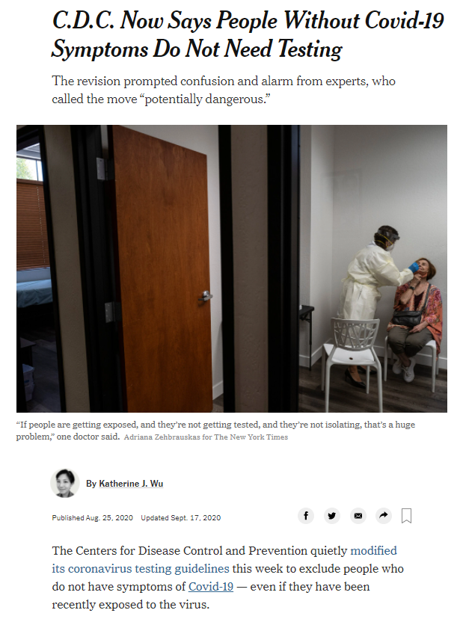
https://www.cdc.gov/coronavirus/2019-ncov/hcp/testing-overview.html
Notes:
https://www.nytimes.com/2020/08/25/health/covid-19-testing-cdc.html

Slide 22
Updated (i.e., Restored) CDC Testing Guidance (September 18, 2020)
https://www.cdc.gov/coronavirus/2019-ncov/hcp/testing-overview.html

Slide 23
Testing Asymptomatic Close Contacts is Critical to Stopping the Spread
Cases (infectious) and contacts (exposed, therefore at higher risk of developing disease) are advised to isolate/quarantine
As many as 40%-45%* of SARS-CoV-2 infections are asymptomatic
Asymptomatic individuals can transmit disease and are considered one of the driving forces of the pandemic
Identifying infectious close contacts is critical in breaking transmission chains
Critical to test asymptomatic close contacts of new cases
Identification of infectious asymptomatic contacts allows for another generation of contact tracing in order to identify contacts of the infectious close contacts
*Annals of Internal Medicine doi: 10.7326/M20-3012 (June 3, 2020)

Slide 24
Negative Tests Do Not Shorten Quarantine for Close Contacts
NOTE: A negative test of a close contact does not shorten the recommended 14-day quarantine period, because the close contact could develop disease up until the end of the incubation period

Slide 25
Questions?
Email : mdh.ipcovid@Maryland.gov

