Slide 1
Trauma-Informed Approaches and the Power of Peer Support?
Peer Network Conference
October 6, 2016
Columbia, Maryland
Cheryl S. Sharp, MSW, ALWF
Exclusive Consultant for Trauma Informed Services

Slide 2
Sharp holds the unique perspective of a person who has recovered from significant mental health challenges, a trauma survivor, a family member of a loved one who died as a result of mental health challenges, and a provider of substance abuse and mental health services. Sharp has worked with adult trauma survivors for over 30 years and trains and speaks internationally on trauma-informed care and suicide prevention. Sharp is also an ordained minister. She received a Substance Abuse and Mental Health Services (SAMHSA) Voice Award in 2015 for her work and personal stories educating the public about behavioral health and the Lou Ann Townsend Courage Award for her contributions to persons with psychiatric disabilities. As an exclusive consultant to the National Council’s Trauma-Informed Care Learning Communities, Sharp has led over 700 organizations in the implementation of trauma-informed care.
Cheryl S. Sharp, MSW, ALWF
Exclusive Consultant
Trauma Informed Services
and Suicide Prevention

Slide 3
Overview
Long and Winding Road
The Twisty Turny Journey
What is Trauma and Trauma Informed Care
Building Resilience
Power of Peer Support

Slide 4
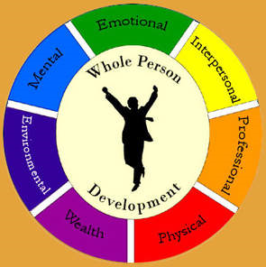
What is Our Work Together?
Health is a state of complete physical, mental and social well-being, and not merely the absence of disease or infirmity.
~ World Health Organization, 1948
We continue to be disconnected.
TIC brings us all together.

Slide 5
Why Understanding Trauma is Imperative?
Trauma is pervasive
Trauma’s impact is broad and diverse
Trauma’s impact is deep and life-shaping
Trauma, especially interpersonal violence and trans-generational transmission, is self-perpetuating
Trauma is insidious and differentially affects the more vulnerable
Trauma affects how people approach services
Service systems have often been re-traumatizing
5
Notes:
The service system has often been re-traumatizing -
HOW?

Slide 6
Why Address Trauma?
Current challenges may result from traumatic experiences
Triggers in settings can cause a person to relive the trauma and impede wellness, progress or access to care

Slide 7
Trauma results from the experience of an event, series of events, or circumstances that are physically and/or emotionally harmful or threatening and have lasting adverse effects on a person’s functioning and mental, physical, social, emotional, and/or spiritual well-being.
(SAMHSA Technical Experts)

Slide 8
Prevalence in the General Population
2012 numbers show that 59% of the general population has experienced at least one adverse childhood event ACEs (www.ACEstoohigh.net)
(www.ACEsconnection.org)

Slide 9
What is the Adverse Childhood Experiences (ACEs Study)
Center for Disease Control and Kaiser Permanente (an HMO) Collaboration
Over a ten year study involving 17,000 people
Looked at effects of adverse childhood experience over the lifespan
Largest study ever done on this subject

Slide 10
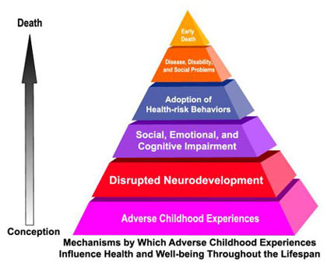
The ACEs Study
www.ACEstoohigh.net
Notes:
10

Slide 11
Impact Across the Lifespan
Includes:
Changes in brain neurobiology;
Social, emotional & cognitive impairment;
Adoption of health risk behaviors as coping mechanisms (eating disorders, smoking, substance abuse, self harm, sexual promiscuity, violence); and
Severe and persistent behavioral health, health and social problems, early death.
(Felitti et al, 1998)

Slide 12
Findings
80% of people in psychiatric hospitals have experienced physical or sexual abuse
66% of people in substance abuse treatment report childhood abuse or neglect
90% of women with alcoholism were sexually abused or suffered severe violence from parents

Slide 13
ACE Score Increases Suicide Attempt
1 of 100 people with 0 ACEs attempt suicide
10 of 100 people with 3 ACEs attempt suicide
20 of 100 people with 7 ACEs attempt suicide
Notes:
Even with the huge change in risk that I just showed you, smoking is only moderately attributable to ACEs. Many mental health conditions, including depression, have a much stronger relationship to ACEs.
This is what the ACE Study found with respect to attempted suicide.
Attempted suicide is extremely rare among people with no ACEs. In fact, among 100 people who have ZERO ACEs, only one will have ever attempted suicide.
CLICK FOR NEXT BAR
However, in a group of 100 people who have 3 ACEs, 10 will have attempted suicide.
CLICK FOR NEXT BAR
And when people have 7 ACEs, the risk doubles again: 20 out of 100 people with 7 ACEs have attempted suicide.
Attempted suicide is an important red flag, not just because it makes us uncomfortable, but because attempted suicide is highly associated with many costly mental illnesses and disorders including: bipolar, schizophrenia, depression, PTSD and borderline personality disorder.

Slide 14
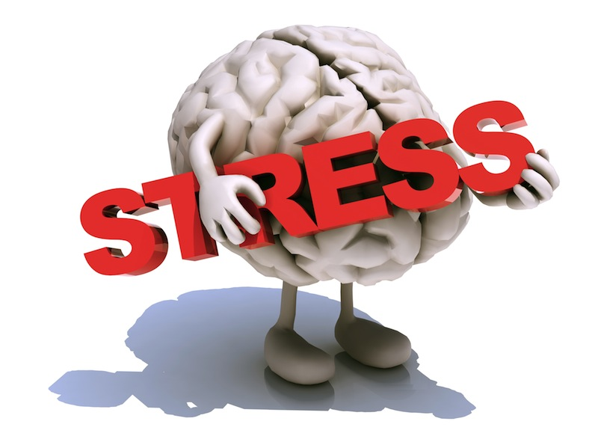
Survival Mode Response
Inability to
Respond
Learn
Process
Notes:
Allow time to calm & return to higher brain functioning
“We get stupid” says Dr. Perry “when we are afraid or in fear because we shut down to our primal brainstem to guarantee survival, and that brings with it fight, flight or freeze. We default to hyper-arousal and disassociation- two powerful tools to protect the body.
Under stress, as we said before, a brain goes to “Fight, flight or freeze” mode- our basic survival response where everything shuts down except that primal response mechanism. One of the most important take home messages we hope you leave with is, DON’T ATTEMPT TO SOLVE ISSES WHEN YOU OR THE PERSON YOU ARE SERVING IS IN A STRESS RESPONSE PATTERN. Walk away, calm down, anything to allow all those chemicals to drain, so you and your child can then talk, when neither of you are in the red zone!
Many of the interventions used by service provides are contingency‐based and rely on reward and punishment. They are based on the assumption that behaviors are INTENTIONAL when actually, behaviors are ELICITED. We need to change our paradigm and realize that what we see as “symptoms” are instead “adaptations.” We “tell, direct, advise” people to regulate (i.e. pay attention, problem solve, etc) which is our attempt to directly change the upstairs of the brain (reasoning capabilities in the cortex). If the downstairs of the brain is dysregulated, the information is getting distorted on the way to the cortex. We teach cortex‐specific interventions such as problem‐solving again and again. When these fail to work, we blame the consumer, and view him/her as “non‐compliant.”
Individuals can self regulate themselves in three ways:
The first is through bottom-up somatosensory regulatory routes – children rock themselves, suck their thumbs, walk around, hum
All sensory input from the outside world and from the inside world has its first stop low in the brain, either in the brainstem or the diencephalon. Patterned repetitive rhythmic activity over these sensory routes has the effect of regulating and to some degree calming an organizing a set of important neural networks that originate in these lower parts of the brain and are essential to the stress response.
Dissociate – we use this daily – many of you are using it now, or you have used it often during this presentation
Top-down cortically medicated modulation of the stress response, arousal, attention, impulsivity and so forth
During development the cortex becomes more mature and stronger. This is causes by exposure to patterned repetitive cognitive processes such as relationally-mediated conversation, the acquisition of language, learning how to read, complex social interactions, hearing and making music and a range of repetitive motor activities that are part of health developmental experiences. As the cortex matures and we develop executive function capabilities, we are more able to modulate the lower and more reactive part of our brain
It is through this top-down mechanism that cognitive behavioral therapy works
All functions of the brain is state dependent
14

Slide 15
Paradigm Shift
We begin to ask,
“What happened to you?”
rather than
“What is wrong with you?”
We have to ask,
“What’s strong?”
rather than
“What’s wrong?”

Slide 16
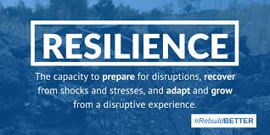
Resilience
The ability to recover from a traumatic event.

Slide 18
Principles of a Trauma-Informed Approach
Safety
Trustworthiness and transparency
Collaboration and mutuality
Empowerment
Voice and choice
Cultural awareness
(Fallot 2008, SAMHSA, 2012)
18
Notes:
Safety: throughout the organization, staff and the people they serve feel physically and psychologically safe; the physical setting is safe and interpersonal interactions promote a sense of safety.
Trustworthiness and transparency: organizational operations and decisions are conducted with transparency and the goal of building and maintaining trust among clients, family members, staff, and others involved with the organization. Trauma-informed peer support and mutual self-help are key vehicles for establishing safety, building trust, enhancing collaboration, and maximizing empowerment.
Collaboration and mutuality: there is true partnering and leveling of power differences between staff and clients and among organizational staff from direct care staff to administrators; there is recognition that healing happens in relationships and in the meaningful sharing of power and decision-making. The organization recognizes that everyone has a role to play in a trauma-informed approach; one does not have to be a therapist to be therapeutic.
Empowerment: throughout the organization and among the clients served, individuals’ strengths are recognized, built on, and validated and new skills developed as necessary. The organization fosters a belief in resilience and in the ability of individuals, organizations, and communities to heal and promote recovery from trauma; builds on what clients, staff and communities have to offer rather than responding to their perceived deficits.
Voice and choice: the organization aims to strengthen the clients’, family members’, and staff’s experience of choice and recognize that every person’s experience is unique and requires an individualized approach. The organization addresses cultural, historical, and gender issues; the organization actively moves past cultural stereotypes and biases, offers gender responsive services, Promotes the value of cultural connections, and recognizes

Slide 19
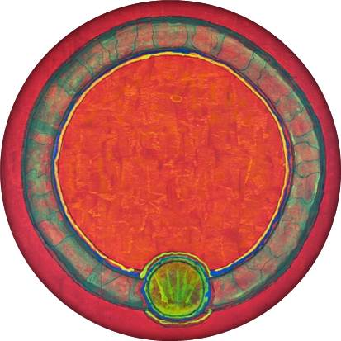
But What Exactly Does Safety Mean?
“We always recognized the importance of physical safety. Our refusal to tolerate violence of any sort constituted our best defense against any breach in physical safety. But a physically safe environment, although necessary, was not sufficient. So there had to be other kinds of safety, which I have termed psychological safety, social safety, and moral safety.”
(Sandra L. Bloom, Creating Sanctuary, 2013)

Slide 20
Psychological Safety
“Refers to the ability to be safe within oneself, to rely on one’s ability to self-protect and keep oneself out of harm’s way.”
(Bloom, 2013)
If you have never felt safe or remembered safety, how will you know it when it is present?

Slide 21
Social Safety
“The sense of feeling safe with other people…There are so many traumatized people that there will never be enough individual therapists to treat them. We must begin to create naturally occurring, healing environments that provide some of the corrective experiences that are vital for recovery.”
(Bloom, 2013)

Slide 22
Moral Safety
The never-ending quest for understanding how organizations function in the healing process.
An attempt to reduce the hypocrisy that is present, both explicitly and implicitly
A morally safe environment struggles with the issues of honesty and integrity
(Bloom, 2013)

Slide 23
A Trauma Informed Organization…
Realizes the prevalence of trauma
Recognizes the impact of trauma on patients and staff
Responds by putting this knowledge into practice
Resists re-traumatization
SAMHSA Technical Experts (2012)

Slide 24
A Trauma Informed Organization Offers…
Understanding of trauma and its impact
Safe environment
Services, support, recovery
Cultural competence, inquiry and humility
Service recipient choice and voice
Healing in relationships

Slide 25
Triggers
Sights
Sounds
Smells
Things that can re-stimulate a
trauma response.

Slide 26
It is the cycle of rupture and repair that is
ultimately restorative.
-Judith Lewis Herman

Slide 27
Stages of Healing (Cloitre et al., 2012; Herman, 1997; Najavits, 2002)
SAFETY: This is the phase you are in now. The goals are to free yourself from coping behaviors that interfere with your healing, stay alive, build healthy relationships, gain control over your feelings, learn to cope with day-to-day problems, protect yourself from destructive people and situations, not hurt yourself or others, increase your functioning, and attain stability.
REMEMBERANCE & MOURNING: Once you are more safe, you may need to grieve about the past, about how the trauma you experienced impacts you. You may need to cry deeply to get over the losses and pain you experienced: loss of innocence, loss of trust, loss of time.
RECONNECTION: After letting yourself experience mourning, you will find yourself more willing and able to reconnect with the world in joyful ways: Thriving, enjoying life, able to work and relate well to others. You will get to this stage if you can establish safety now!
Notes:
What do you think? Agree? Disagree? Other models?
Postponing trauma work? How decide? What if client wants to proceed?
Saving reconnection for last?
When to transition? How determined? (Stability, Skills, Attachment, State Change; F. Shapiro p. 93, 434)
Chronic vs. Acute Trauma? (intensity of sx, duration of tx, dimensions of life affected)
Therapist Neutrality: pp. 135, 151, 179
interpersonal/institutional response received
Unpredictable Danger to Reliable Safety
Dissociated Trauma to Acknowledges/Integrated Memory
Stigmatized Isolation to Restored Social Connection
TWO Primary Tasks of Stage I (Marich, 2012):
Coping skills & A/R strategies
“Recovery Capital” – capacity for positive affect, experience, resourcing

Slide 28
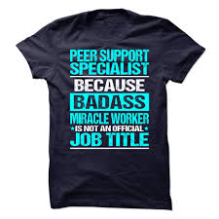
Trauma-Informed Intentional Peer Support (IPS)
The Three Principles of IPS
Learning vs. Helping
Relationships vs. the Individual
Hope and Possibility vs. Fear
The Four Task of IPS
Connection
Worldview
Mutuality
Moving Towards

Slide 29
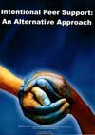
4 Tasks of IPS
Connection
Worldview
Mutuality
Moving Towards

Slide 30
Connection
We are hardwired to want it
Secured the survival of our species
It feels good
Why are we sometimes afraid of it?
Connection
Disconnection
Reconnection

Slide 31
Worldview
How do we come to
know what we know?

Slide 32
Mutuality
What is it we both want?

Slide 33
Moving Towards
Vision and Action

Slide 34
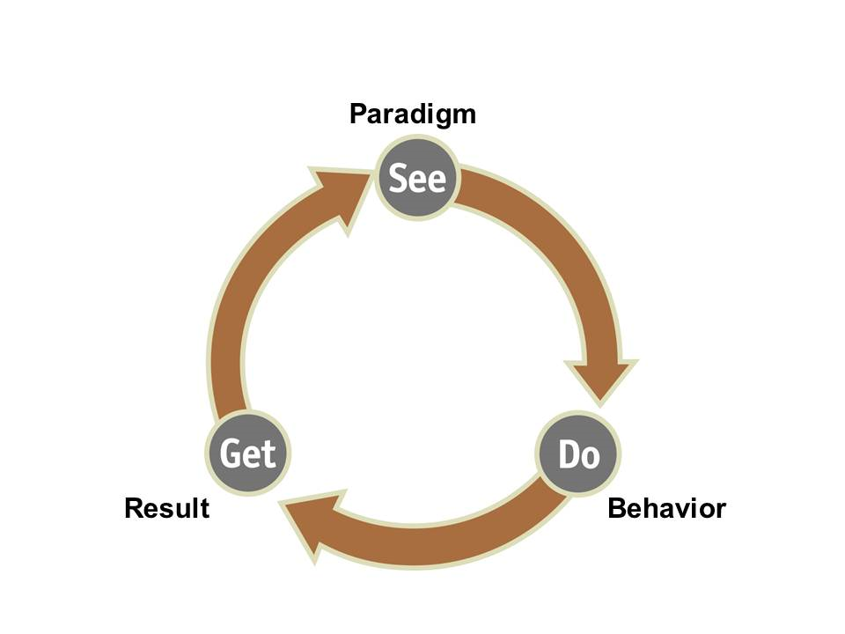
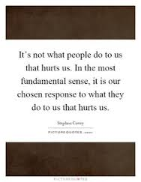
See Do Get – Steven Covey

Slide 35
Self Care
“That which is to give light must endure burning.”
Viktor Frankl

Slide 36
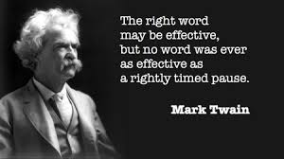
The Pause

Slide 37
W.A.I.T and Listen
Why Am I Talking? Listen for the Back Story

Slide 38
Imagine

Slide 39
Contact Information
Cheryl S. Sharp, MSW, ALWF
252/670-0178
cheryls@thenationalcouncil.org

