Slide 1
Balancing Work and Parenting During COVID 19
Kelly Coble, LCSW-C
Program Director, Telemental Health Program
University of Maryland School of Medicine
Department of Psychiatry
kcoble@som.umaryland.edu

Slide 2
Disclosures
No commercial or financial interests to disclose

Slide 3
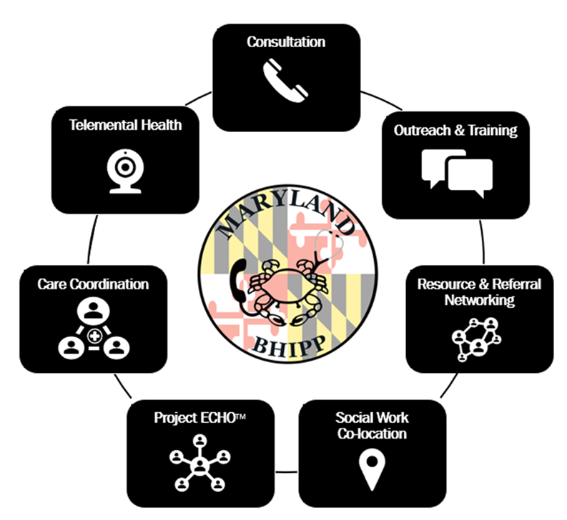
Maryland BHIPP
Offering support to pediatric primary care providers through free:
  Telephone consultation (855-MD-BHIPP)
  Resource & referral support
  Training & education
  Regionally specific social work co-location (Salisbury University and Morgan State University)
  Project ECHO®
  Direct Telespsychiatry & Telecounseling Services
  Care coordination
Supported by Maryland Department of Health,
Behavioral Health Administration & HRSA
www.mdbhipp.org
Notes:
Maryland Behavioral Health Integration in Pediatric Primary Care or BHIPP is a CPAP that supports the capacity of primary care providers in Maryland to manage pediatric mental health concerns. We do this, currently, in a number of ways: 1. We offer a free behavioral health telephone consultation service, including resource and referral support, 2. education and training, 3. Through our partnership with Salisbury and Morgan State University, we offer co-location of social work interns at select primary care sites, 4. Direct telepsychiatry and telecounseling services (coming soon) , 5. Care Coordination, and 6. Web-based longitudinal learning through Project ECHO like today.

Slide 4
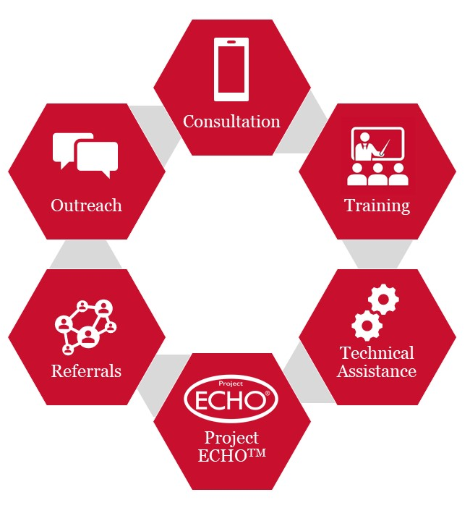



MACS Services
Services:
Providing free phone consultation for clinical questions, resources, or referral information
Offering education and training opportunities related to substance use disorders and chronic pain management
Technical Assistance Services
Project ECHO
Assisting in the identification of addiction and behavioral health resources that meet the needs of the patients in your community
  All services are available free of charge and regardless of your patient’s insurance status.
  1-855-337-MACS (6227) • www.marylandMACS.org

Slide 5
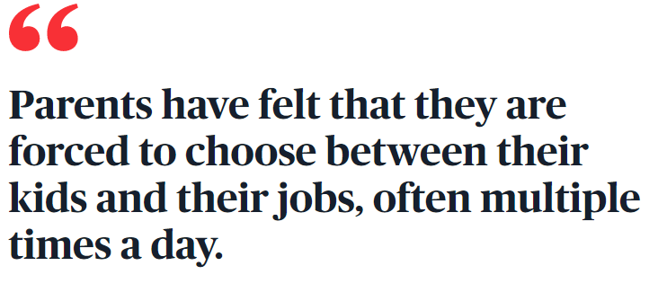
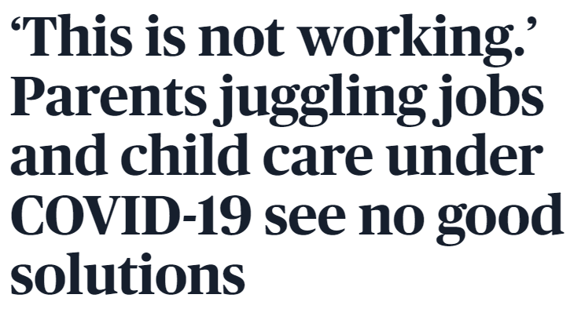
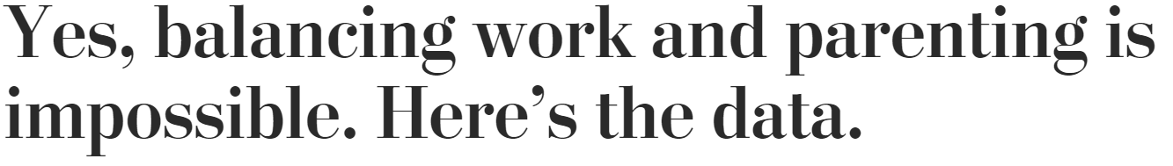
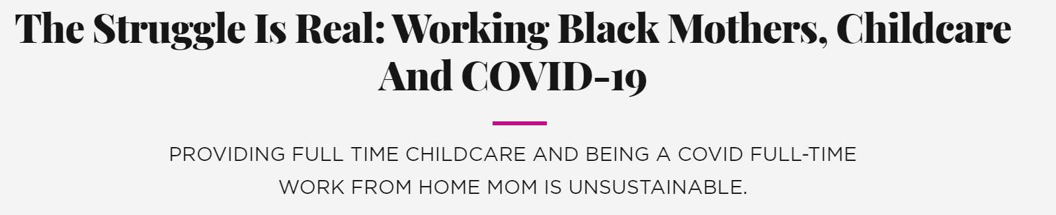
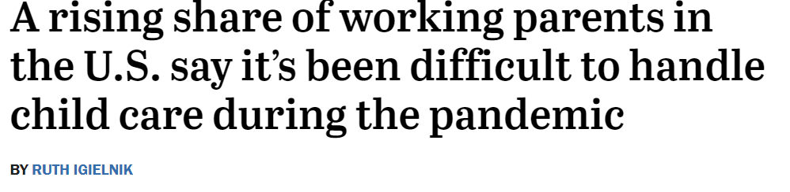

Slide 6
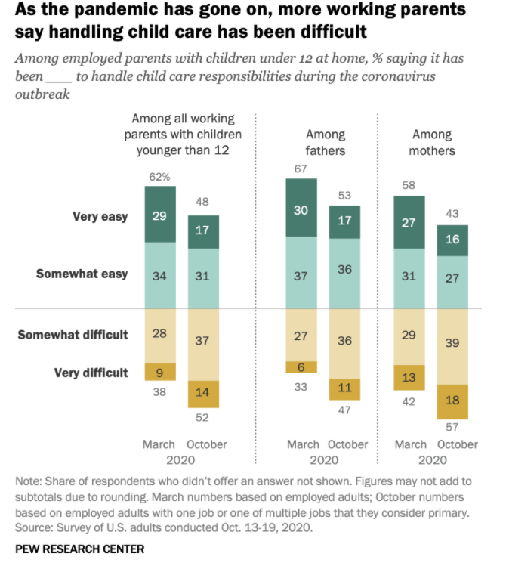

Slide 7
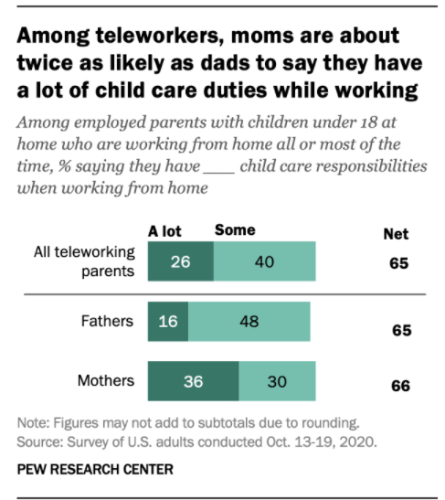

Slide 8
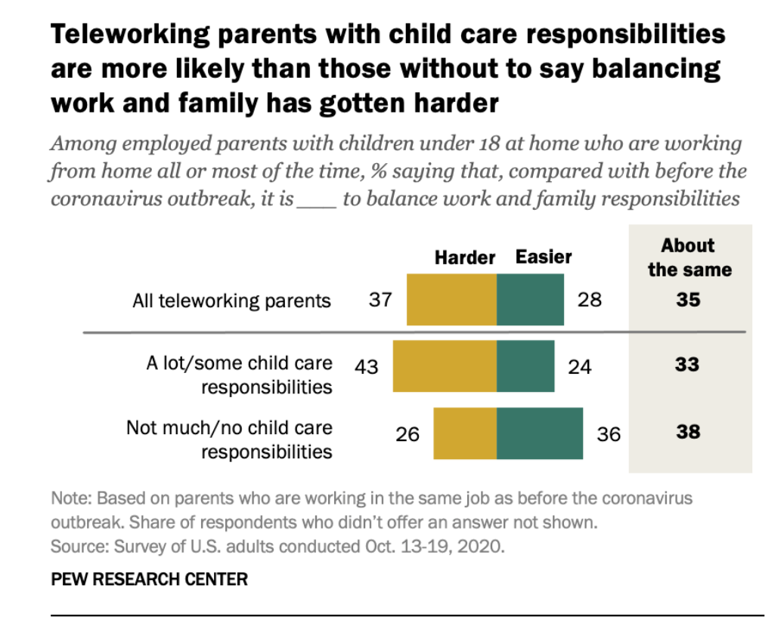

Slide 9
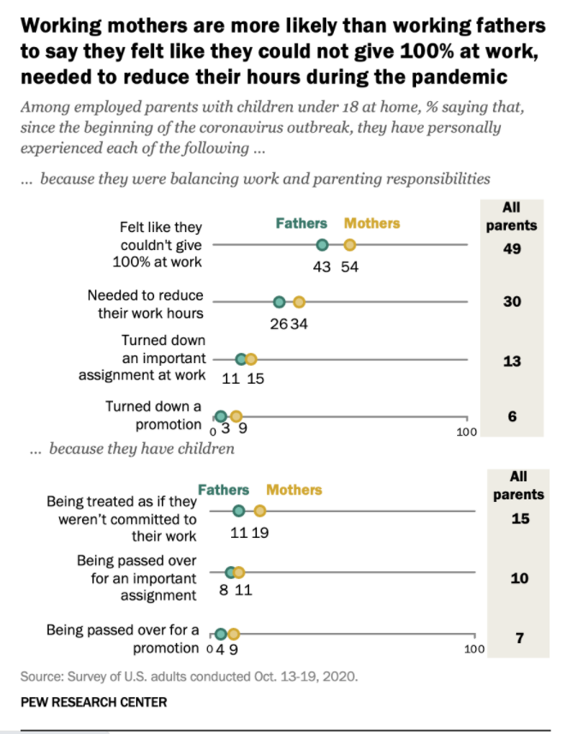

Slide 10
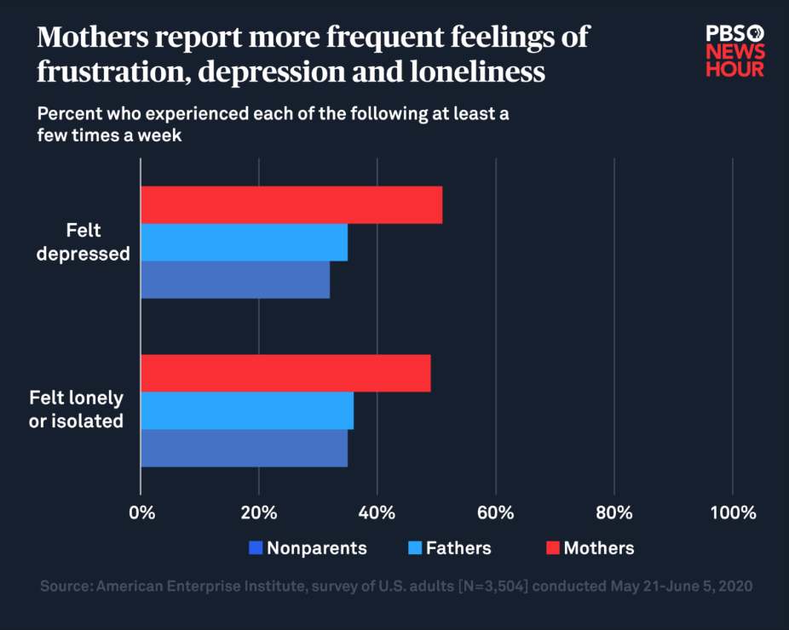

Slide 11
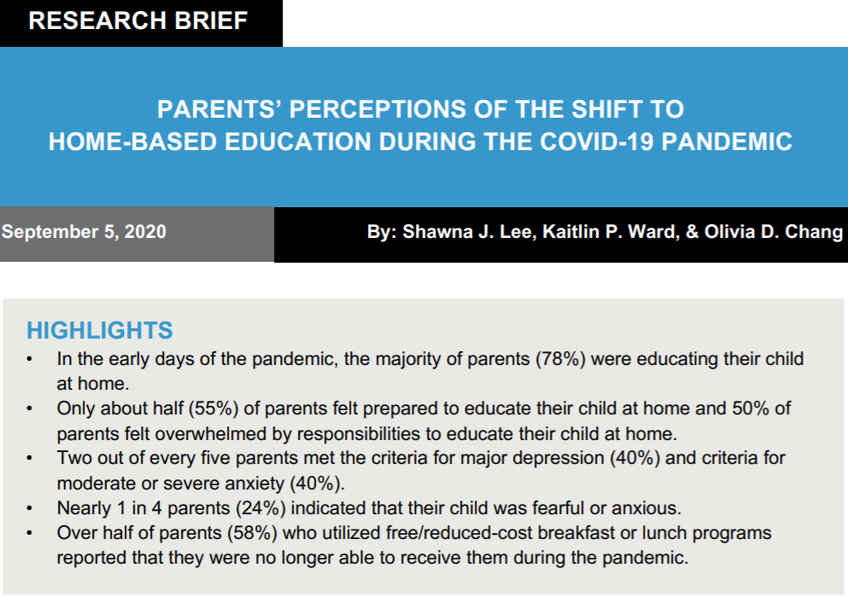
Lee, S.J., Ward, K.P., & Chang, O.D. (2020, September). Research brief: Parents' perceptions of the shift to home-based education during the Covid-19 pandemic. Ann Arbor, MI: University of Michigan Parenting in Context Research Lab. Retrieved from: https://bit.ly/2Ra5Q2R

Slide 12
Burnout Defined
Reduced Personal Accomplishment
Depersonalization
Emotional
Exhaustion
“Burnout is a syndrome of emotional exhaustion, depersonalization, and reduced personal accomplishment that occur among individuals who do ‘people work’ of some kind”
(Christina Maslach and Wilmar Schaufeli 1993)
Three-dimensional model used in nearly 80% of research on burnout (using Maslach Burnout Inventory)

Slide 13
Burnout on the rise
Rates of physician burnout of 7000 surveyed
Marked drop in % that say “work leaves enough time for personal and family life”
Shanafelt, T. D., Hasan, O., Dyrbye, L. N., Sinsky, C., Satele, D., Sloan, J., & West, C. P. (2015, December). Changes in burnout and satisfaction with work-life balance in physicians and the general US working population between 2011 and 2014. In Mayo Clinic Proceedings (Vol. 90, No. 12, pp. 1600-1613). Elsevier.

Slide 14
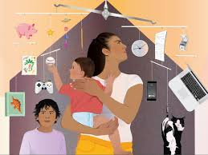
How COVID-19 makes it harder
Disruptions in our own daily life
  New financial concerns (drop in patient volumes and income)
  Loss of childcare and added responsibilities
Personal and professional social disconnection
  Loss of typical interpersonal supports
Change fatigue
  Policies are either “over-responsive” or “under-responsive”
Anticipatory anxiety
  Worry about how long we can sustain this pace
  2nd wave?

Slide 15
What can we do?

Slide 16
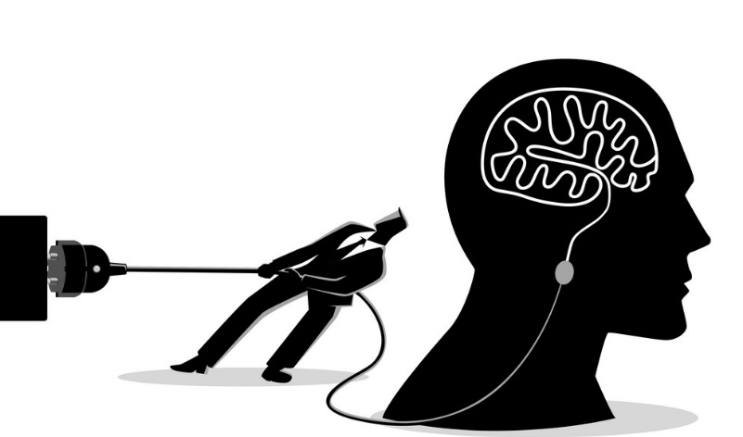
Recovery from Work Stressors
Psychological detachment from work
  Refraining from doing and thinking about job-related activities
  Not the same as having a generally detached attitude towards work
Benefits of detachment (Sonnetag 2012)
  Higher levels of psychological well-being
  Less emotional exhaustion
  Better sleep
  Improved job performance
  Reduce emotional exhaustion
  Decrease the need for “recovery time”
Psychological Detachment from Work:
A state of mind during non-work time characterized by the absence of job-related activities and thoughts (Sonnetag & Bayer 2005)

Slide 17

Recovery from Work Stressors
Supporting detachment from work
Shore up spatial and technological home/work boundaries (Sonnetag et al 2010)
  Establish “no-email” time
  Try to work in a physical space separated from where you spend time with family and engage in leisure activities
Spending time in “restorative environments”
  Natural settings
  Comfortable or familiar settings
Commit to doing other things
  Find “meaningful off-job activities”
    Volunteer work
    Mastery-building activities
    Faith activities

Slide 18
Navigating Stress at Work
Battle Buddies – How it works
Pair clinicians with similar levels of practice, responsibility, and experience
Buddies are not each others’ therapists; emphasis is on listening, validating, and providing feedback
Have clear parameters and boundaries for check-ins
  Connect 2-3x per week
  Can be a short call or Zoom meeting
  See how your buddy is taking care of himself/herself

Slide 19

Connecting to a Broader Professional Community
Project ECHO
Building a virtual learning community of PCPs caring for children and adolescents, centered around education in child mental health
Interactive case discussions are a major learning component, rather than only one-way lectures and didactics from experts

Slide 20
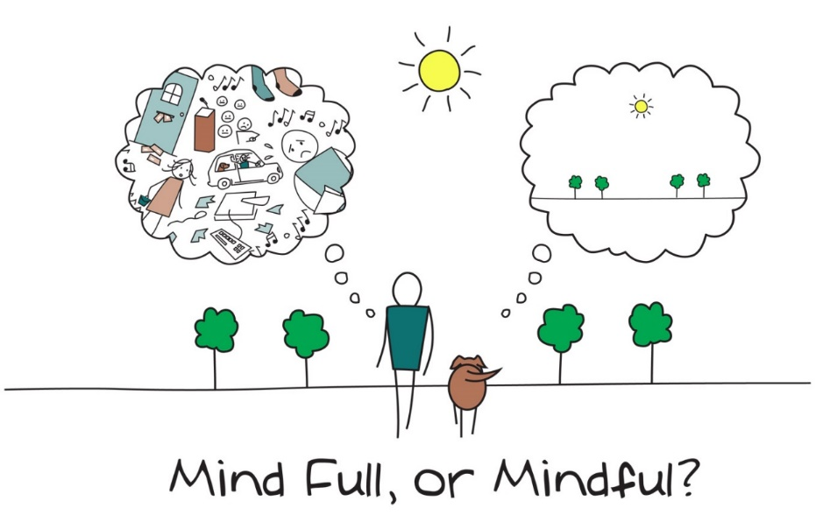
Mindfulness
“The goal of mindfulness is to maintain awareness moment by moment, disengaging oneself from strong attachment to beliefs, thoughts, or emotions, thereby developing a greater sense of emotional balance and well-being.” (Ludwig & Kabat-Zinn 2008)
Mindfulness training for physicians is associated with:
  Reduced psychological distress
  Increased empathy
  Decreased burnout

Slide 21
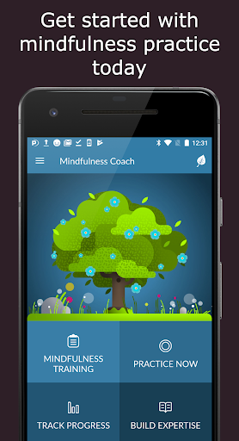
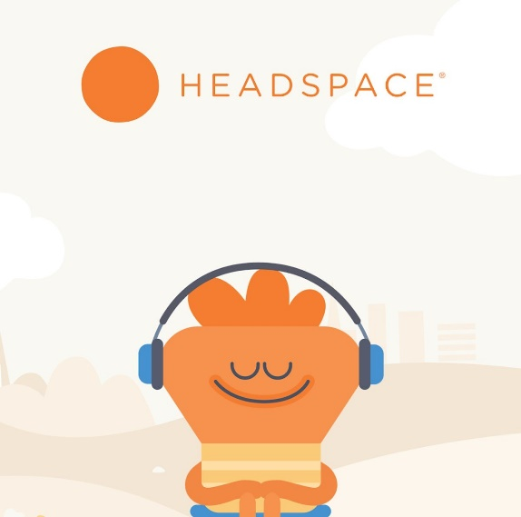
Mindfulness
But what if you can’t take an institution-sponsored 8 week Mindfulness course?
Numerous free apps that guide mindfulness practice
Headspace
Normally by subscription but free through 2020 w/an NPI
For-profit app
Highly customizable and tracks progress
Mindfulness Coach
Free
Developed by the VA
Progress through multiple levels of practice
https://help.headspace.com/hc/en-us/articles/360045161413-Headspace-for-Healthcare-Professionals
https://mobile.va.gov/app/mindfulness-coach

Slide 22

Role of Physician Leaders
Supporting Physician and Staff Emotional Well Being
  EAP program
Encouraging Social Connection
https://www.peerrxmed.com/
Implementing the use of Telemedicine when possible to increase ease and access for patient and provider
https://www.ama-assn.org/delivering-care/public-health/caring-our-caregivers-during-covid-19

Slide 23
Take Care of Your Staff
Adjust staffing procedures and scheduling where possible
Offer access to psychosocial support
Monitor and review staff member well-being
Create an environment of open communication
Allowing flexible hours, when possible
  Consider how and when meetings are scheduled
Model Flexible policies
  What time are emails sent and responded to?
  How are the needs of parents responded to?

Slide 24

Balancing Work and Home

Slide 25

Juggling
Some balls are plastic, and some are glass
Some will bounce, some will break
  Know which are which

Slide 26
Balancing work and parenting
Recognize that this is hard!
Take care of yourself as best you can
Stick to a routine
  Set times to focus on family
  Schedule breaks
Be open with your employer and colleagues – find solutions that work
Be clear about work time and space
  Boundaries & interruptions

Slide 27
Balancing work and parenting
Get creative with your schedule
Try to focus on work while you are working
  Time block, swap with a partner or another caregiver if that is an option
  Ensure kids are cared for or safely occupied
www.triplep-parenting.com

Slide 28
Age Specific Strategies
Routine!
Baby Wearing
Stations or Rotations
Taking advantage of developmental phases, ie. Parallel play
  Working/playing side by side
Help older kids set goals & maintain a routine

Slide 29

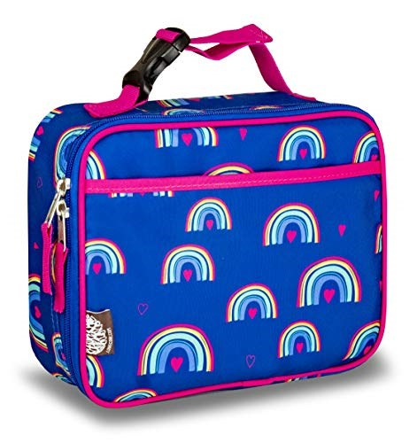
Balancing work and parenting
Visual Cues
Allowing choices

Slide 30
References
Argarwal, S. D., Pabo, E., Rozenblum, R., & Sherritt, K. M. (2020). Professional dissonance and burnout in primary care: a qualitative study. JAMA Internal Medicine.
Albott, C. S., Wozniak, J. R., McGlinch, B. P., Wall, M. H., Gold, B. S., & Vinogradov, S. (2020). Battle Buddies: Rapid Deployment of a Psychological Resilience Intervention for Health Care Workers During the Coronavirus Disease 2019 Pandemic. Anesthesia and Analgesia.
Dean, W., & Simon Talbot, A. D. (2019). Reframing Clinician Distress: Moral Injury Not Burnout. Federal Practitioner, 36(9), 400.
Freudenberger, H. J. (1975). The staff burn-out syndrome in alternative institutions. Psychotherapy: Theory, Research & Practice, 12(1), 73.
Goodman, M. J., & Schorling, J. B. (2012). A mindfulness course decreases burnout and improves well-being among healthcare providers. The International Journal of Psychiatry in Medicine, 43(2), 119-128.
Houtrow, A. (2020). Addressing Burnout: Symptom Management Versus Treating the Cause. The Journal of Pediatrics.
Krasner, M. S., Epstein, R. M., Beckman, H., Suchman, A. L., Chapman, B., Mooney, C. J., & Quill, T. E. (2009). Association of an educational program in mindful communication with burnout, empathy, and attitudes among primary care physicians. Jama, 302(12), 1284-1293.
Lee, S.J., Ward, K.P., & Chang, O.D. (2020, September). Research brief: Parents' perceptions of the shift to home-based education during the Covid-19 pandemic. Ann Arbor, MI: University of Michigan Parenting in Context Research Lab. Retrieved from: https://bit.ly/2Ra5Q2R

Slide 31
Quill, T. E. (2009). Association of an educational program in mindful communication with burnout, empathy, and attitudes among primary care physicians. Jama, 302(12), 1284-1293.
Ludwig, D. S., & Kabat-Zinn, J. (2008). Mindfulness in medicine. JAMA, 300(11), 1350-1352.
Maslach, C. (1993). Burnout: A multidimensional perspective. In W. B. Schaufeli, C. Maslach, & T. Marek (Eds.), Series in applied psychology: Social issues and questions. Professional burnout: Recent developments in theory and research (p. 19–32). Taylor & Francis.
Maslach, C., & Schaufeli, W. B. (1993). Historical and conceptual development of burnout. Professional burnout: Recent developments in theory and research, 12, 1-16.
Panagioti, M., Geraghty, K., Johnson, J., Zhou, A., Panagopoulou, E., Chew-Graham, C., ... & Esmail, A. (2018). Association between physician burnout and patient safety, professionalism, and patient satisfaction: a systematic review and meta-analysis. JAMA internal medicine, 178(10), 1317-1331.
Panagioti, M., Panagopoulou, E., Bower, P., Lewith, G., Kontopantelis, E., Chew-Graham, C., ... & Esmail, A. (2017). Controlled interventions to reduce burnout in physicians: a systematic review and meta-analysis. JAMA internal medicine, 177(2), 195-205.
Patel, R. S., Bachu, R., Adikey, A., Malik, M., & Shah, M. (2018). Factors related to physician burnout and its consequences: a review. Behavioral Sciences, 8(11), 98.
Sockalingam, S., Arena, A., Serhal, E., Mohri, L., Alloo, J., & Crawford, A. (2018). Building provincial mental health capacity in primary care: an evaluation of a project ECHO mental health program. Academic Psychiatry, 42(4), 451-457.
Shanafelt, T. D., Hasan, O., Dyrbye, L. N., Sinsky, C., Satele, D., Sloan, J., & West, C. P. (2015, December). Changes in burnout and satisfaction with work-life balance in physicians and the general US working population between 2011 and 2014. In Mayo Clinic Proceedings (Vol. 90, No. 12, pp. 1600-1613).
Sonnentag, S., Kuttler, I., & Fritz, C. (2010). Job stressors, emotional exhaustion, and need for recovery: A multi-source study on the benefits of psychological detachment. Journal of vocational Behavior, 76(3), 355-365.
Sonnentag, S. (2012). Psychological detachment from work during leisure time: The benefits of mentally disengaging from work. Current Directions in Psychological Science, 21(2), 114-118.

Slide 32
Resources
Maryland BHIPP COVID 19 Resources
  https://mdbhipp.org/covid-19-resources.html
Maryland Department of Health, Behavioral Health Administration resource listing: https://app.smartsheet.com/b/publish?EQBCT=a47b214c02f145caabe091beb1ff816a
Maryland Department of Humand Services COVID 19 Resources
  https://dhs.maryland.gov/coronavirus-covid-19-resources/parent-resources-covid/

