Slide 1
Involuntary Care:
What you might need to know
Dinah Miller, M.D.
Co-author, Committed: The Battle Over Involuntary Psychiatric Care
Assistant Professor, The Johns Hopkins School of Medicine
Twitter handle: @ShrinkRapDinah

Slide 2
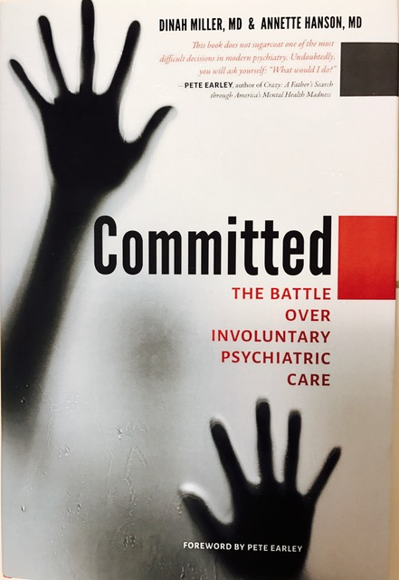
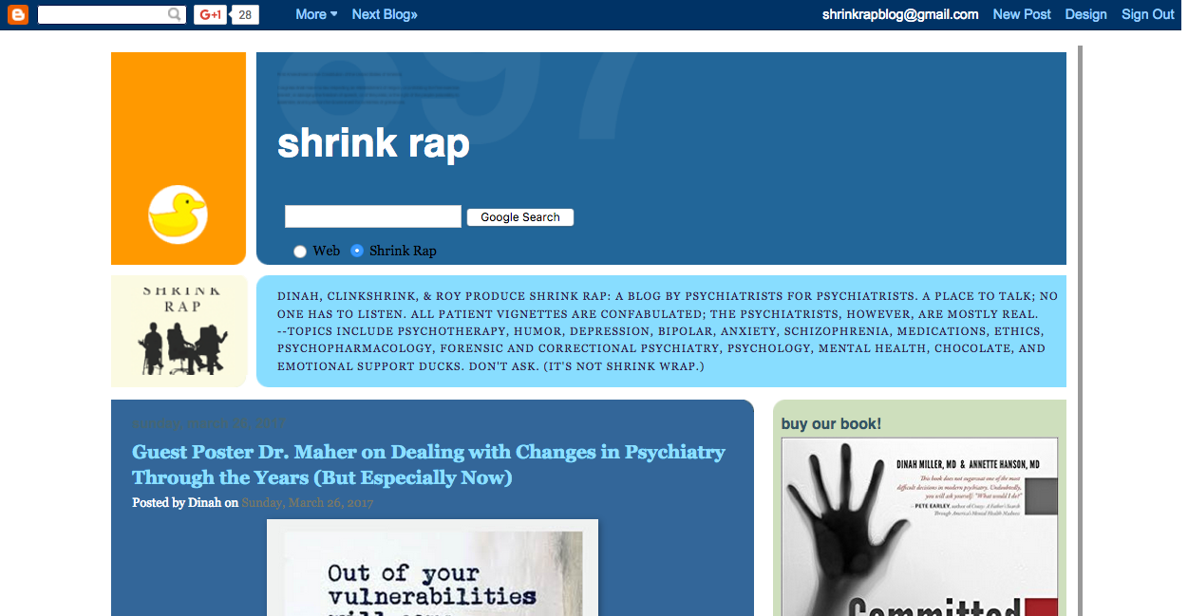
From Shrink Rap to Committed

Slide 3
What is the Battle about?
Standards for Involuntary commitment to hospitals
Outpatient Civil Commitment (AOT, MOT, CTO’s, OCC)
A patient’s right to refuse treatment/medications
A patient’s right to refuse release of their psychiatric information to caretakers (HIPAA)

Slide 4
THE BATTLEFIELD
In Favor………… Against
Involuntary Care

Slide 5
The Treatment Advocacy Center
>We need more state hospital beds
>Mandated care for those “in need of treatment”
>Proponent of outpatient commitment laws
>Anosognosia justifies involuntary treatment

Slide 6
National Alliance on Mental Illness
>A grassroots organization started by parents
>Support, education, advocacy
>Now with 180,000 paying members and includes patients and those representing the interests of those with less severe illnesses

Slide 7
The American Psychiatric Association
~38,000 psychiatrists
~“Dangerousness” as the standard for involuntary care
~In December, 2015 came out with a carefully worded stance in favor of outpatient civil commitment

Slide 8
The Bazelon Center for Mental Health Law
“The Bazelon Center envisions an America where people who have mental illnesses or developmental disabilities exercise their own life choices and have access to the resources that enable them to participate fully in their communities.”
Notes:
1978 Mental Health Law Project, changed in 1993 to Bazelon. Wyatt vs Stickney – right of psychiatric patients to get treatment

Slide 9
The Recovery Movement
The Recovery concept speaks to maintaining consumers’ autonomy and having them take a proactive role in their treatment
>It is a backlash to psychiatry as paternalistic field where where people with certain diagnoses were given dismal prognoses
>The Recovery Movement was started by consumers and includes an emphasis on peer supports
Notes:
It includes and emphasis on peer supports.
It is a backlash to psychiatry as paternalistic field where where people with certain diagnoses were given dismal prognoses.
Words that provoke, consumer, client, patient, survivor, involuntary versus force, medications versus psychiatric drugs

Slide 10
MindFreedom, International
>Started by David Oaks in the 1970’s first as the Mental Patients Liberation Front
>In 1986 Became MindFreedom, International (MFI)
>Psychiatric survivors who assert they have been injured by the treatment they have received and want to protect others from the same fate

Slide 11
The Citizens Commission on Human Rights (CCHR)
Started by Dr. Thomas Szasz, author of The Myth of Mental Illness, 1961 and the Church of Scientology in 1969
Notes:
~The Church of Scientology meets
Dr. Thomas Szasz—The Myth of Mental illness 1961
Joined with Church of scientology in 1969 to form the Citizens Commission on Human Rights

Slide 12
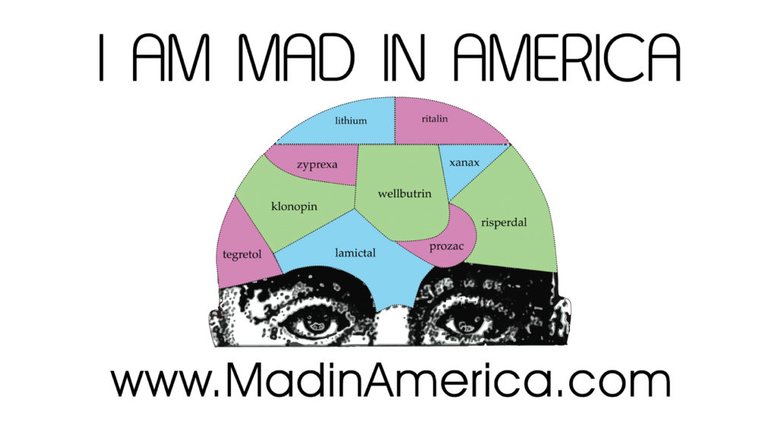
Notes:
Robert Whitaker, a journalist who wrote Mad in America and Anatomy of an Illness, and asserts that psychiatric medications cause psychiatric illness
Note there are groups in favor of involuntary care started by parents and psychiatrists, there are groups against involuntary treatment started by consumers, lawyers and advocates, there are no organized groups in favor of involuntary care that have been started by patients

Slide 13
THE BATTLEFIELD
TAC
CCHR/
MindFreedom
NAMI
The Recovery Movement
Mad in America
APA
The Bazelon Center

Slide 14
We live in a world where opinions are sharply polarized
We value autonomy in medical decision making
And when there is controversy about the validity of a treatment, then there is even more controversy about forcing it on people

Slide 15
My observations over time
People are involuntarily hospitalized because:
they are acutely psychotic
or
they are acutely suicidal
(or both)
Symptoms decrease during the course of a hospitalization

Slide 16
We, as psychiatrists, might expect patients/clients/consumers to be grateful for the help they have received during times of distress and desperation
Psychiatry has traditionally stayed away from the idea that treatment can be traumatizing for some people

Slide 17
If you start off with the idea that forced care is a good thing, that it helps people get well at times when they may be too sick to recognize that they are ill, and that treatment enables them to stay housed, working, connected to their loved ones, and out of jail and institutions, then you want it to be easier for people to get care, even if they don’t want it.

Slide 18
But if you start off with the idea that forced care is potentially traumatizing, in a way that leaves some patients with years of distress, which may dissuade them from seeking care later, then you alter your threshold for committing people to involuntary treatment.

Slide 19
But the issue is complicated. We have…
The patient/client/consumer
who may be suffering and unable to see they are sick
who may have very valid reasons for not wanting to take the medications psychiatrists have to offer
who ideally should have the right to refuse treatment

Slide 20
The family
who watch a loved one suffer, deteriorate, and miss opportunities
who don’t want to see loved ones homeless or incarcerated
who may be at risk of violent behavior

Slide 21
The Mental Health Professionals
Who want to do what is best for the patient
Who want to follow both legal and ethical mandates
Who want to be paid for their work
Who don’t want to be sued for a tragic outcome

Slide 22
Society:
Who may be at risk of violent behavior-- a risk that has been exaggerated by the media
The Taxpayer:
Who foots the bill for disability payments, lost productivity, uncompensated medical treatment, and institutionalization

Slide 23
The insurers
Who want to pay for as little care as possible and who serve as the gatekeepers to most care

Slide 24
Let’s make some assumptions
Let’s start with the assumption that psychiatric care may be traumatizing, and fears of involuntary or unkind treatment may discourage people from getting help.
Let’s also agree that it is never in someone’s best interest to seriously injure himself or anyone else, and that there are circumstances where there may simply be no other option but to commit someone to the hospital for care, and to use physical force to keep everyone safe

Slide 25
From the perspective of the treatment team, involuntary care puts us in the awkward position of being the adversaries to the people we are serving

Slide 26
Welcome to slide #27!
Have you noticed that there have been no charts, no graphs, no statistics?
Let me tell you what we don’t know

Slide 28
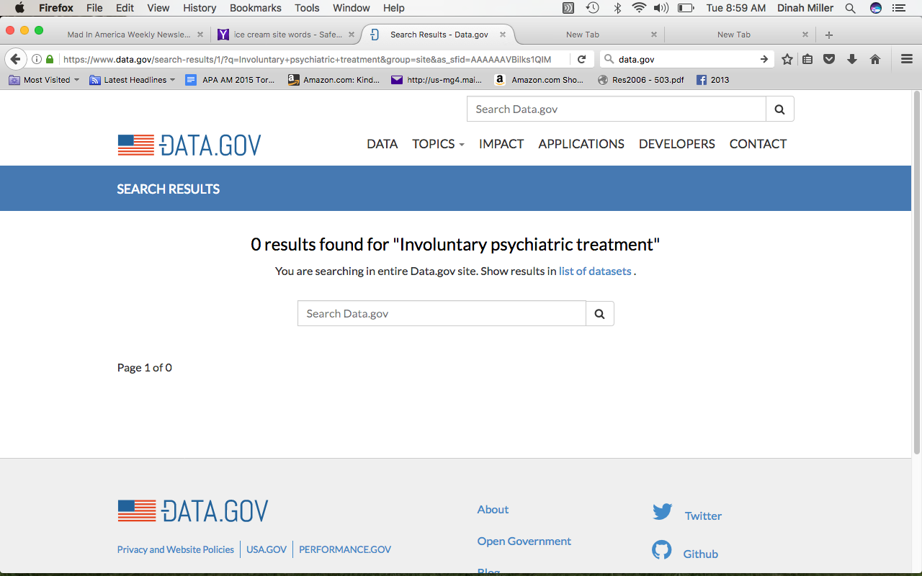
Notes:
Do our treatments help people? Or do they hurt them?
We wrote our book based on the assumption that psychiatric treatments help at least some of the people some of the time, and perhaps many of the people, much of the time.

Slide 29
Involuntary Treatment for Suicide Prevention
~It’s thought that 90% of completed suicides occur in people with psychiatric disorders (diagnosed or undiagnosed)
~Suicide is often an impulsive act and most (2/3) gun deaths are suicides, not homicides
~We don’t know if involuntary treatment prevents suicide, but it’s awfully hard to let an acutely suicidal person leave the Emergency Department

Slide 30
Psychiatric care is about alleviating suffering and helping people to live full and productive lives.
Involuntary treatment needs to take the individual patient’s best interests (both now and over time) into account.

Slide 31
So what’s a mental health professional to do?
>Careful assessment with as many sources as possibly and consideration of alternatives
>Try to engage the patient in voluntary care
>If that doesn’t work, try harder
>Explain the consequences of not agreeing to voluntary treatment Coercion may be better than legal commitment
Warning: while these suggestions are well-intentioned, they may not work
Notes:
If the patient can not be persuaded, consider alternatives that honor their wishes: does this patient absolutely need to be in the hospital? Is there no choice other than forced medication/seclusion/restraint?

Slide 32
If there is no other option, treatment should be forced:
A traumatized person is better than a dead person
We need to be nice to involuntary patients: our hope is that they will benefit from remaining in our care. No one wants to have an antagonistic relationship with someone they are trying to help.

Slide 33
Once the patient is in the hospital
Obviously, minimize the use of physical force
(but there is a downside)
Small acts of kindness are often greatly appreciated
Ask people at the end of their stay for feedback
Notes:
Our hospitals need better staffing; seclusion, restraint, and sedation are not substitutes for close observation.
Strip searches/ seclusion and restraint
Listen, but don’t argue with the patient or insist that this had to be done (even if it’s true)

Slide 34
From the perspective of a Peer Recovery Expert--
What do you do when you are very worried about someone you are working with?
~If anyone is at imminent danger of physical harm,
Call 911

Slide 35
If the danger is not immediate:
~Share your concerns with other members of the Treatment Team, including the person’s psychiatrist/therapist
~Speak with family members if you have permission
NEVER WORRY ALONE

Slide 36
What Options Are Available if Someone Refuses to Seek Treatment?
~Emergency Petitions
~Extreme Risk Protective Orders

Slide 37
How can we prevent involuntary care, or
at least make it less traumatizing?
Make voluntary care more accessible
earlier in the course of an illness
Police training to minimize injuries, death, and embarrassment, and to increase cooperation.
We need better medications with fewer side effects.
*Decrease Stigma!
Notes:
I want to point out to you that it’s very hard to decrease stigma when legislators are talking about how we need to increase forced care to prevent mass murders.

Slide 38
A final thought: it’s a little crazy that we invest so much in the discussion and legislation of involuntary treatment when there so many people who want treatment but are unable to access voluntary care.
Notes:
Thank you for inviting me today!

