Slide 1
Supporting Older Adults
Kim Burton
Mental Health Association of Maryland
December 7, 2018

Slide 2
The "Young Old" 65-74 10,000 new retirees will be added to the Social Security and Medicare rolls each day.
The "Old"74-84 During the next decade, increased life expectancy will strengthen the wave of aging Boomers
The "Oldest-Old" 85+ The fastest-growing segment of the total population is the oldest old—those 80 and over. Their growth rate is twice that of those 65 and over and almost 4-times that for the total population. This group will more than triple from 5.7 million in 2010 to over 19 million by 2050. (transgenerational.org)

Slide 3
Estimated Prevalence of Major Psychiatric Disorders by Age Group
Jeste, Alexopoulus, Bartels, et al., 1999

Slide 4
Issues
Risk Factors
Vulnerabilities

Slide 5
Age Related Vulnerabilities
Common experiences in later life raise the risk that someone will develop a behavioral health disorder or… worsen existing problems
Physical
Functional
Social
Mental
Emotional

Slide 6
Change Can Become Risks
Health Mobility Residence
Loss of loved ones Insurance concerns
Memory Financial circumstances
Changes to self esteem Family dynamics
Dependence on others Social network Marital status Role in community
Senses Physical appearance
Leisure time Employment Metabolism

Slide 7
Later Life Risk Factors
Illness – diabetes, heart disease, cancer, stroke
Serious disability, Conditions that are painful
Sensory loss
Sleep problems
Cognitive impairment
Polypharmacy
Compounded / significant loss and stress
Fewer resiliency / adaptation / coping skills

Slide 8
Under Identified and Under Treated
More than 80% with need DO NOT get help:
Don’t know of elevated risk, don’t know symptoms, don’t know how to get help
Symptoms mimic chronic health conditions
Screening and assessment is not routine
Diagnostic criteria inappropriate
Physician discomfort , lack of geriatricians
Fear of myths and lack of support

Slide 9
Trauma
Individual trauma results from an event, series of events or set of circumstances that is experienced by an individual as overwhelming or life-changing and that has profound effects on the individual’s psychological development or well-being.
Community trauma is experienced by a group, can be multi-generational and may be normalized.
(U.S. Substance Abuse and Mental Health Services Administration)

Slide 10
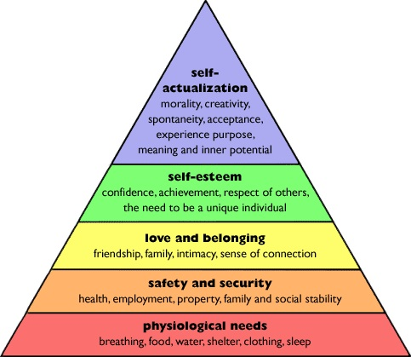

Slide 11
Recovery Dimensions (SAMHSA)
Health – overcoming or managing disease or conditions, making informed & healthy decisions in support of well-being
Home – a stable & safe place to live
Purpose – meaningful activities & the independence &resources to participate
Community - relationships and social networks for support, friendship, love & hope

Slide 12
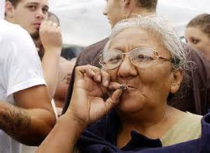
National Survey on Drug Use and Health projects the number of adults age 50+ years with a substance use disorder to double from 2.8 million in 2002-2006 to 5.7 million in 2020

Slide 13
More than 25% of older adults use prescription psychoactive medications that have abuse potential

Slide 14
Impact of Problem on Older Adults
Negative psychoactive medication effects include low motivation, memory problems difficulty with ADLs and social withdrawal
Benzodiazepines associated with mental health problems, cognitive decline, confusion, falls, hip fractures
Opioid / narcotic analgesics associated with excessive sedation, respiratory depression, vision impairment, poor attention and coordination, falls

Slide 15
Non-medical use of prescription drugs is estimated to increase 100% among older adults between 2001 and 2020
Misuse occurs by patient and by practitioner
121% increase in ED visits involving Rx drug misuse (2004-2008)

Slide 16
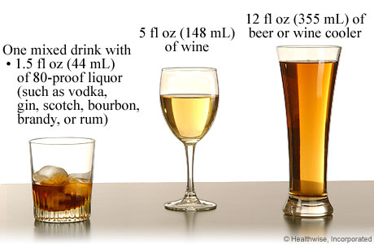
NIAA recommends no more than
one drink per day after age 65

Slide 17
Levels of Use
Low Risk: no problems setting limits
At-Risk: 7-10 drinks/week or drinks in risky situations, if patterns continue problems are likely to result
Problem Use: already resulting in medical, psychological or social problems – needs assessment
Dependence: loss of control, preoccupation with alcohol, continued use despite problems, difference in tolerance, withdrawal

Slide 18
“Men and women aged 60 and older who drink more than 7 drinks per week have greater impairments in instrumental activities of daily living (IADLs) ….. More than 3 drinks per occasion is associated with IADL impairment among older adults.”
Older Americans Behavioral Health Technical Assistance Center
Issue Brief 2: Alcohol Misuse and Abuse Prevention

Slide 19
Factors Associated with Risk
Females (psychoactive medication misuse / abuse)
Male (alcohol misuse / abuse)
Social isolation
Personal / family history of substance abuse
Mental health / sleep / pain disorder
Compounding stressors / losses
Unstructured time

Slide 20
Impact of Problem on Older Adults
Drinking alcohol can worsen:
Diabetes
High blood pressure
Congestive heart failure
Liver problems
Osteoporosis
Memory problems
Mood disorders

Slide 21
Guidelines for older adults:
Avoid alcohol if taking central nervous system depressants, psychiatric medications, analgesics, anticoagulants, antidiabetic drugs, or cardiovascular drugs. Always check with pharmacist.
Avoid alcohol consumption immediately before going to bed in order to avoid sleep disturbances.
Avoid alcohol if driving.

Slide 22
Guidelines for older adults cont.
Avoid alcohol if there is mild cognitive impairment / dementia
Avoid alcohol if there is a history of falls or unsteady walking

Slide 23
Problematic Outcomes
Reduced activity, functional impairments
Disturbed relationships
Diminished quality of life
Exacerbated health problems
Premature institutionalization or death (suicide)

Slide 24
Untreated or inadequately treated pain, anticipatory anxiety of the progression of illness, fear of dependence on others and fear of burdening one’s family are the major contributing factors in the suicidality of older adults that have a physical illness. (Szanto et al., 2002)

Slide 25
Early Identification of a Problem
Warning Signs:
Withdrawal from people and activities
Change in attitudes and behaviors (negative thinking, excessive, worry, loss of motivation, short temper, agitation, problems with memory / judgment / thinking)
Mood swings
Complaints of pain
Changes in appetite and sleep patterns

Slide 26
Signs & Symptoms
Bumps, bruises, falls that are unexplained or suspicious
Slurred speech, impaired balance
Memory loss, black outs, vague recollections
Depressed mood, anxiety, hostility
Behavioral changes
Empty bottles, multiple medications
Isolation
Denial

Slide 27
Signs & Symptoms
Medical problems – complaints of gastrointestinal disturbances, fatigue, insomnia, malnutrition, hypertension, unstable diabetes
Ignores warning labels on prescription drugs – does not take as directed
Neglect of personal appearance and dramatic weight fluctuations

Slide 28
Solutions
Innovative screening, prevention, intervention and treatment methods for alcohol and drug misuse among older adults are available and effective.
SAMHSA

Slide 29
Solutions: Screen and Assess
SBIRT
Alcohol Use Disorders Identification Test (AUDIT) – developed by WHO as a brief screen for excessive drinking
Short Michigan Alcoholism Screening Test – Geriatric Version (SMAST-G)
ASSIST drug use questionnaire adapted to target psychoactive meds

Slide 30
Screening
All adults over 60 should be screened as part of regular physical exam
Rescreen when there are major life changes / transitions or compounding stressors
Rescreen if the following symptoms present:
Sleep related problems
Cognitive difficulties
Seizures, malnutrition, muscle wasting

Slide 31
Screening
Rescreen if:
Persistent irritability or altered mood
Unexplained complaints of chronic pain
Incontinence, urinary retention
Poor hygiene and self neglect
Complaints of blurred vision or dry mouth
Unexplained nausea and vomiting
Tremors, poor motor coordination, shuffling gait
Frequent falls or unexplained bruising

Slide 32
Solution: Sensitive Approach
Use sensitive language
Describe impact of substances on health and functional status
State likely health and function gains to result from addressing problematic use
Invite older adults to identify goals, assess health habits and contribute to solutions
Remain non-confrontational, supportive and hopeful

Slide 33
Treatment and Recovery
Medical oversight potentially necessary
Multidisciplinary approach should include support team (family / caregivers)
Culturally appropriate, age specific and non-confrontational group treatment that aims to build / rebuild self esteem and support system
Address and mitigate physical and psychosocial challenges
Work on coping and resiliency skills
Build on strengths

Slide 34
Hope
“Hope, the belief that these challenges and conditions can be overcome, is the foundation of recovery. A person’s recovery is built on his or her strengths, talents, coping abilities, resources and inherent values. It is holistic, addresses the whole person and their community and is supported by peers, friends and family members.” (SAMHSA)

Slide 36
National Council on Aging, Center for Healthy Aging, “Older Americans Behavioral Health Issue Brief Series” www.ncoa.gov
US Department of Health and Human Services
Centers for Disease Control and Prevention
Substance Abuse and Mental Health Services Administration
National Survey on Drug Use and Health (2007, 2009)
CSAP – Pathways Courses
National Coalition on Mental Health and Aging http://www.ncmha.org/resources.php

