Slide 1
Sleep for the Family
Danielle R Glick, MD
PGY-7, Sleep Medicine
University of Maryland School of Medicine

Slide 2
Learning objectives
Describe the effects of sleep on the family as a unit
Discuss sleep needs across ages
Define healthy sleep habits for the family

Slide 3
Good Sleep is a family affair
50% of parents lose 30 minutes of sleep nightly
Parental sleep quality suffers from poor sleep in children, resulting in increased:
Daytime sleepiness
Depression
Parenting Stress
Family stress can both:
Be caused by poor sleep
Affect children’s sleep
BBC
National Sleep Foundation
Meltzer and Montgomery-Downs. Pediatr Clin North Am. 2011.

Slide 4
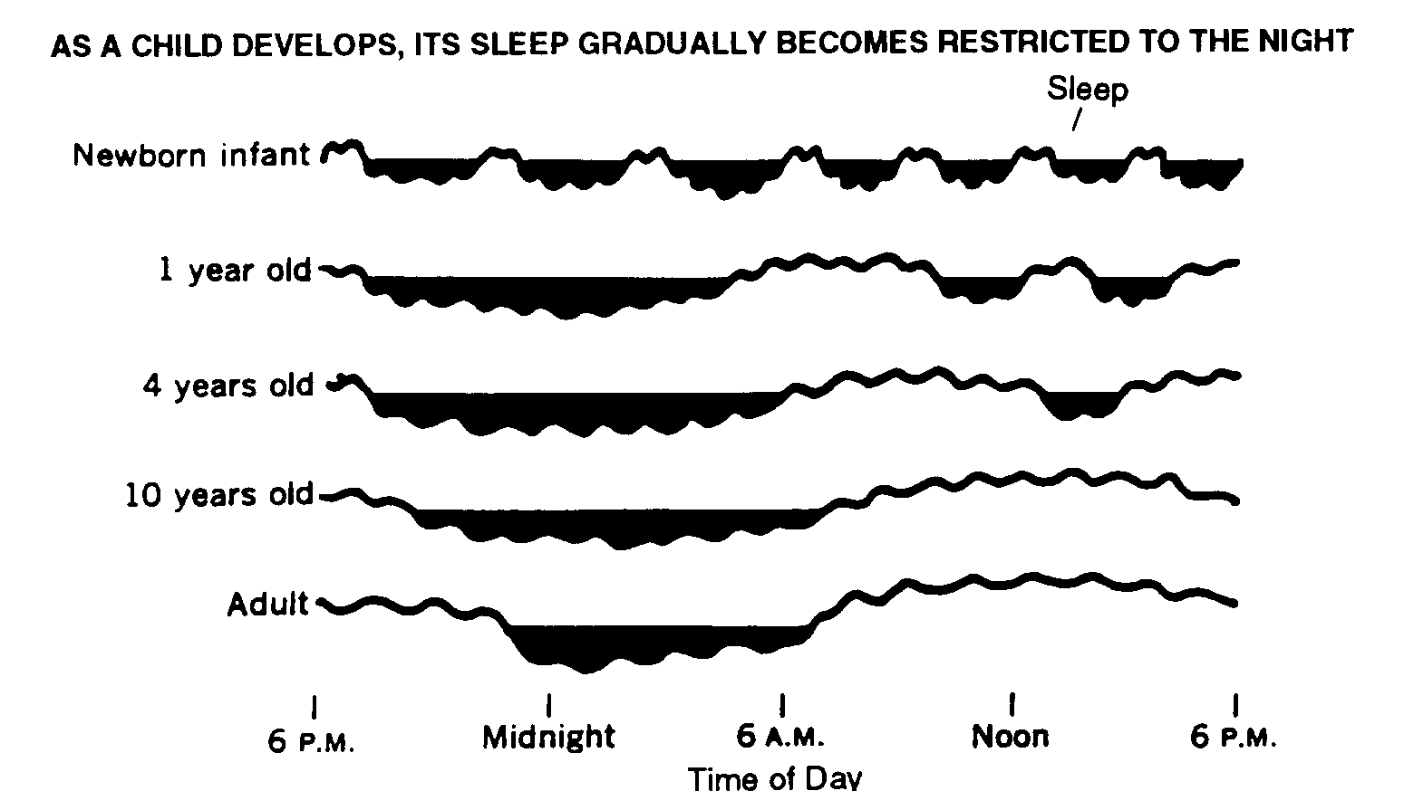
Sleep development

Slide 5
How much sleep do we all need?
Age | Recommended, h | May be appropriate, h | Not recommended, h
Newborns – 0-3 months | 14 – 17 | 11-13 or 18-19 | < 11 or > 19
Infants – 4-11 months | 12 – 15 | 10-11 or 16-18 | < 10 or > 18
Toddlers – 1-2 years | 11 – 14 | 9-10 or 15-16 | < 9 or > 16
Preschoolers - 3-5 years | 10 – 13 | 8-9 or 14 | < 8 or >14
School-aged – 6-13 years | 9 – 11 | 7-8 or 12 | < 7 or > 12
Teenagers – 14-17 years | 8 – 10 | 7 or 11 | < 7 or >11
Young adults – 18-25 years | 7 – 9 | 6 or 10-11 | < 6 or > 11
Adults – 26-64 years | 7 – 9 | 6 or 10 | < 6 or > 10
Older adults – 65+ years | 7 – 8 | 5-6 or 9 | < 5 or > 9
National Sleep Foundation. Sleep Health, 2015;1:40-43.
Notes:
May be surprising just how much sleep younger children need – this is one of the most common problems I see in the pediatric clinics; parents are not aware of how much sleep their children need and no one in the house is getting enough!

Slide 6
Setting a routine: young children
Regular sleep cycles develop by 6 months
Quiet routine, consistent time
Quiet, safe sleep environment
Promote falling asleep in bed
Avoid responding to crying or calling out
Do not sleep or lay down with your child
Healthychildren.org, American academy of pediatrics 2007
Notes:
- Put baby/toddler into bed when drowsy but still awake so that they adapt to falling asleep in bed, not elsewhere

Slide 7
Setting a routine: School-aged and teenagers
Routine remains key:
Clean, neat sleeping area
Quiet bedtime activities
Decreasing parental involvement
Maintain bed and rise times
Electronics:
Out of bedroom
Minimize nighttime use
Daytime routines matter too!
Sleep foundation
Notes:
-Even on weekends, aim for consistency (within an hour or so)
- Exercise, eat well, avoid caffeine

Slide 8
Consistency improves sleep for the whole family
Consistent bed and rise times
Bedtime routines:
Relaxation techniques
Stress journal
Protect sleep time
Remove screens
Cool, dark, quiet bedroom environment
Avoid heavy meals, alcohol, exercise before bed
headspace

Slide 9
Sleep supports the family
Sleep begets sleep
Poor sleep increases family stress and vice versa
Routines at each age/stage creates lifelong healthy sleep
Talk to your patients (and your family!) about their sleep
If sleep disruption persists, consider Sleep Medicine
Meltzer and Montgomery-Downs. Pediatr Clin North Am. 2011.
Notes:
- By getting a good nights’ sleep, daytime functioning improves which can improve the overall health of the family unit

Slide 10
Cme accreditation and designation
This activity has been planned and implemented in accordance with the Essential Areas and policies of the Accreditation Council for Continuing Medical Education (ACCME) through the joint providership of MedChi, The Maryland State Medical Society and the Behavioral Health Administration of the Maryland Department of Health. MedChi is accredited by the ACCME to provide continuing medical education for physicians. CMEs will be available at no cost, as will Participant Certificates, which for other disciplines may qualify for CEUs or other continuing education credit, although these are not approved for CEUs by the Maryland Board of Social Work Examiners. Participants should check with their certifying organizations to see how these would apply.
MedChi designates this webinar educational activity for a maximum of 1 AMA PRA Category 1 Credits™. Physicians should claim only the credit commensurate with the extent of their participation in the activity, as should other disciplines who claim credit for Participant Certificates. For CME/Participant Certificate questions please contact Sherrie Noonan at sherrie.noonan@maryland.gov.
Webinars jointly sponsored by the Behavioral Health Administration and MedChi

Slide 11
Cme disclosures
Presenters and Planners: Aliya Jones, MD and Steve Whitefield, MD have reported no relevant financial relationships to disclose. Emerson Wickwire, PhD, Danielle Glick, MD, and Howard Haft, MD have reported no relevant financial relationships to disclose.
MedChi CME Reviewers: The reviewers from the MedChi Committee On Scientific Activities (COSA) for this activity have reported no relevant financial relationships to disclose.
Webinars jointly sponsored by the Behavioral Health Administration and MedChi

Slide 12
resources
www.healthychildren.org
www.sleepfoundation.org
https://bha.health.maryland.gov/Pages/bha-covid-19.aspx

