Slide 1
Health Enterprise Zone
Dorchester-Caroline county health department

Slide 2
Overview
Introduction of the local evaluation team
Trackers (partners)
Process
M&D
Data collection process (Cyfluent, Inc.)
Goals
Limitations

Slide 3
Local Evaluation Team
Mrs. Lynn Lang- Program Assistant-HEZ
  Assessment Coordinator, UMES SOP
Dr. Amakoe Ajavon – Program Analyst-HEZ
  Pharmacist, Rite Aid, Berlin, MD
Dr. Jayesh Parmar – Lead-HEZ
  Assistant Professor at UMES SOP
Larry Walsh- President Cyfluent, Inc.

Slide 4
Trackers
  MHW – Maryland Healthy Weighs
  DSBWC – Dorchester School Based Wellness Center (Somatic and Behavioral)
  PRSS – Peer Recovery Support Specialist
    Dri Dock and Chesapeake Voyagers Inc.
  CCHD SBW – Caroline County School Based Wellness Behavioral Health
  SWP – Shore Wellness Partner
  ABC Chow – Associated Black Charity Community Health Outreach Workers
  ESMCT – Eastern Shore Mobile Crisis Team
  CWH – Chesapeake Women’s Health
  CCHS- Choptank Community Health Systems- Care Coordination
  SUPPORT PARTNERS-
    ESAHEC-Eastern Shore Area Health Education- Training of CHOWs
    Med-Chi- Recruitment
  Somatic and Behavioral health

Slide 5
Process
Consolidated
  Unduplicated/ Unique individuals
Code
  Active: face-to-face
  Passive: Phone/email
M&D

Slide 6
 | July - September 2014 | October - December 2014 | January - March 2015 | April – June 2015
Total Clinical Services Provided
Total # of unduplicated patients seen in reporting period | 443 | 493 | 751 | 512
Total # of patient visits in reporting period | 1606 + 1096 Passive | 1474 + 1160 Passive | 2474+ 1000 Passive | 2,302+ 1594 Passive
Behavioral Health Services
# of behavioral health dispatches diverted from hospitalization or incarceration | 21 | 45 | 62 | 110
M&D

Slide 7
Data Collection Process

Slide 8
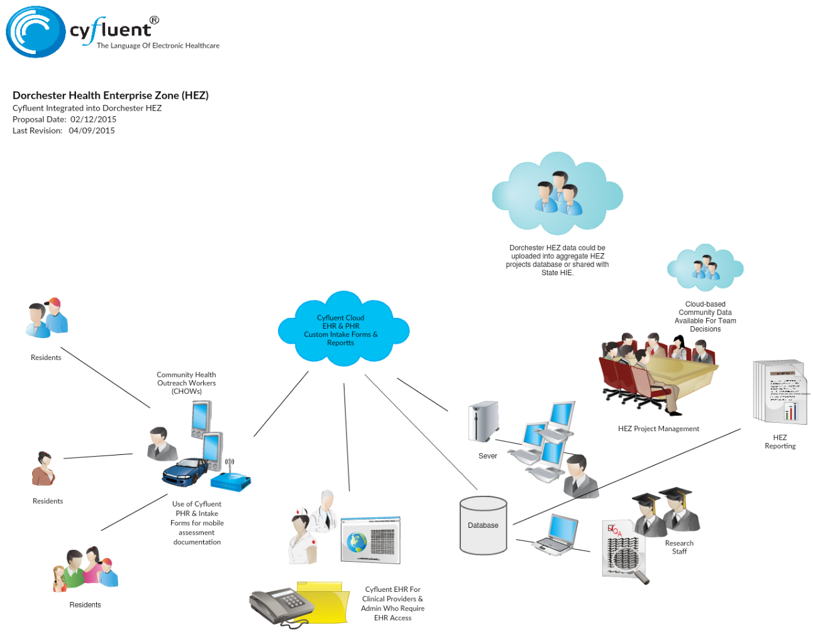
Documented Clinical encounters
Chow Tasks
Out reach efforts may not be uploaded

Slide 9
Phone calls/Emails/Mails
Face-to-Face encounters
Transportation
Education
Non-Clinical encounters

Slide 10
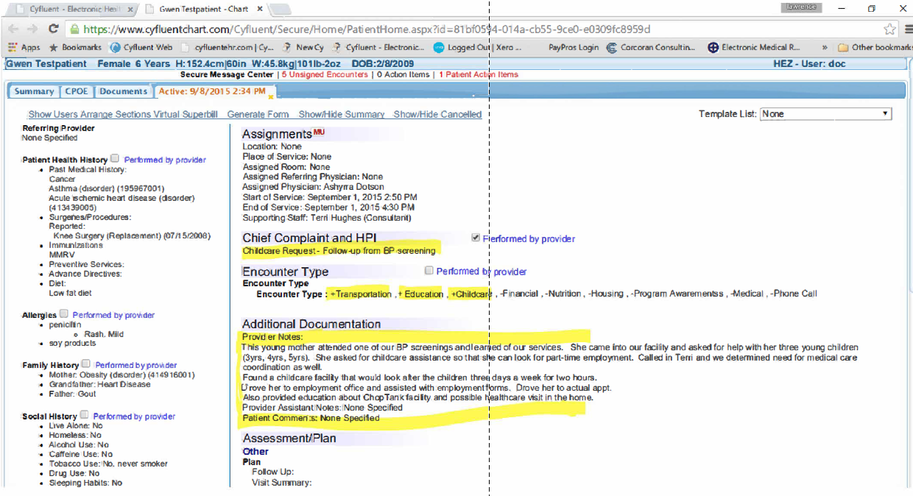

Slide 11
Goals
  Are the participants taking advantage of HEZ??
    Total # of enrolled individuals
  Rise in diversions
    Total # of diversions (hospital + incarcerations)
  Number of trained specialists (capacity)
    Total # of specialists
  Rise in the total visits
    Total # of visits
  Return on investment (ROI)

Slide 12
Limitations
Un-standardized operational definitions
  E.g. Enrollment Vs Encounter/visits
Differences in trackers reporting’s
  Template modifications on the provided services
Challenge to identify a participant(s) getting services from two or more partners
  E.g. John Smith visits ABC and Dri dock
How to determine the return of investments? How do we measure it?

Slide 13

Questions

