Slide 1
Best Practices in Provider
Self- Analysis for Transformation to an E1st Agency - Part I
Genni Sasnett
Subject Matter Expert
Office of Disability Employment Policy
Maryland Webinar
April 21, 2016

Slide 2


Introductions
COO of SJCS, headquartered in Washington, DC
Started work in SE in 1987
Collaborated with team to conceptualize, plan and implement transformation
Agency become 100% community based across multiple states and in different environments – urban, suburban and rural
More than one transformation experience at SJCS
Led to consultancy, assisting agencies with transformation across the states

Slide 3
Drivers of Change
94-142 (Public Education for All Handicapped Children, later IDEA)
Deinstitutionalization – Medicaid Waivers
Supported Employment
ADA
Olmstead
Customized Employment
HCBS settings rule
DOJ actions
WIOA
Notes:
ADA – 25th year anniversary of the law -The ADA prohibits discrimination on the basis of disability in employment, State and local government, public accommodations, commercial facilities, transportation, and telecommunications. It also applies to the United States Congress.
To be protected by the ADA, one must have a disability or have a relationship or association with an individual with a disability. An individual with a disability is defined by the ADA as a person who has a physical or mental impairment that substantially limits one or more major life activities, a person who has a history or record of such an impairment, or a person who is perceived by others as having such an impairment. The ADA does not specifically name all of the impairments that are covered.
ADA Title I: Employment Title I requires employers with 15 or more employees to provide qualified individuals with disabilities an equal opportunity to benefit from the full range of employment-related opportunities available to others. For example, it prohibits discrimination in recruitment, hiring, promotions, training, pay, social activities, and other privileges of employment. It restricts questions that can be asked about an applicant's disability before a job offer is made, and it requires that employers make reasonable accommodation to the known physical or mental limitations of otherwise qualified individuals with disabilities, unless it results in undue hardship. Religious entities with 15 or more employees are covered under title I.
Olmstead The Supreme Court’s 1999 decision in Olmstead v. L.C.(Lois Curtis) affirms Title II of the ADA and prohibits unnecessary segregation of people with disabilities and requires that people with disabilities receive services in the “most integrated setting” appropriate to their needs. The Olmstead case has driven the movement of people with disabilities out of institutions and into community-based living situations. The emphasis is now shifting to include the expectation that employment and day services also be delivered in the most integrated setting where a person’s needs can be met. 1 http://www.whitehouse.gov/the-press-office/2012/06/22/anniversary-olmstead-obama-adminis
In July of 2011, the US Department of Justice issued a Statement and technical assistance guide detailing public entities (e.g. states; counties; school districts) obligations with regard to the integration mandate in Title II of the Americans with Disabilities Act and the Olmstead decision.2 In this Statement, the US Department of Justice explained the applicability of the integration mandate to publicly funded employment and day services, saying: “Segregated settings include, but are not limited to…congregate settings populated exclusively or primarily with individuals with disabilities [and] settings that provide for daytime activities primarily with other individuals with disabilities.”
HCBS settings rule The setting is integrated in and supports full access of individuals receiving Medicaid HCBS to the greater community, including opportunities to seek employment and work in competitive integrated settings, engage in community life, control personal resources, and receive services in the community, to the same degree of access as individuals not receiving Medicaid HCBS. The setting is selected by the individual from among setting options including nondisability specific settings … The settings options are identified and documented in the person-centered plan and are based on the individual’s needs, preferences,
DOJ actions
RI DOJ found that Rhode Island did not comply with the Americans with Disabilities Act (ADA) and the Olmstead ruling requirements that services be provided in the most integrated setting appropriate to the needs of people with disabilities. Specifically, Rhode Island failed to provide opportunities and supports to individuals in sheltered workshops and facility-based day programs to receive services in integrated settings and to work in integrated, community employment.
The US DOJ’s findings included7:
• Rhode Island’s sheltered workshops and facility-based day programs are segregated settings. They function like most institutional settings, for reasons including isolation from non-disabled peers, the nature of the settings, and lengthy placements.
• Few individuals in Rhode Island with I/DD can access services that would enable them to work or participate in activities in the community. Most are served in sheltered workshops and facility-based day programs. This constitutes an over-reliance on segregated settings, and a violation of civil rights.
• Many people in Rhode Island’s sheltered workshops and facility-based day programs could be served in integrated work and day settings. DOJ’s expert found “that very few, if any, of the individuals that she observed in sheltered workshops and day programs could not work in competitive employment.”
• The state lacks the capacity to provide services in community settings for all people who are interested in them. Service recipients are not receiving information about their options, and there is a lack of resources, including job coaches, job developers, behavioral supports, and transportation. Individuals with the most severe disabilities have been screened out of supported employment and directed to day services, even if they want to work.
• Students with I/DD transitioning out of school are not being presented with community-based alternatives, and are receiving very limited transition services—this puts them at risk of placement in segregated settings.
OR -Oregon state attorneys petitioned to have the case dismissed, saying the integration mandate does not apply to employment services. In May 2012, the Federal court hearing the case ruled against the state of Oregon, asserting that the Olmstead integration mandate applies to employment, as well as housing. In March 2013, the US Department of Justice joined as a plaintiff in the lawsuit. The DOJ conducted its own investigation and concluded that Oregon has unnecessarily segregated people with intellectual and developmental disabilities in “sheltered workshops.”5
RSA In 2001, RSA issued a regulation clarifying that successful employment outcomes are those in the integrated labor market, including supported and self-employment, and consistent with the individual’s strengths, resources, priorities, concerns, abilities, capabilities, interests and informed choice [34CFR361.5(b)1]. Within this regulation, RSA stated that placements in sheltered workshops or other segregated settings would no longer be counted as a successful placement by state V.R. agencies

Slide 4

Employment First-How It Fits In
Current surge towards community integration and community integrated employment not likely to turn back
Economic opportunity and work parity are fundamental to achieving full citizenship
Employment is the gateway to community acceptance and value
Framing community employment in this manner makes the Employment First effort more understandable to the average person (a job like yours)
Government and provider agencies can coalesce around this concept and use it to encourage change, inspire staff and advance their work

Slide 5
Implications for Civil Rights
Work has an equalizing effect on different segments of society
Familiarity breeds acceptance
Observation of productivity changes perceptions of people
Economic parity is empowering
Laws/rules often precede practice
Cultural change occurs over time

Slide 6

But Most Important
It’s the right thing to do!!!!!

Slide 7
Implications for Service Provision
Competitive integrated work, and Customized Employment particularly, as a priority.
Meaningful community engagement as an imperative.
Change in the way we operate is inevitable.

Slide 8
My Experience with Agency Transformation
Worked at a very typical and traditional program providing the following services:
  Early intervention
  School
  Sheltered Workshop
  Day program
  Residential services

Slide 9
Introduction of Supported Employment - 1987
The opportunity
The impact
The beginning of the change to 100 % community based services
The process
The outcome

Slide 10
Community Integrated Employment and Other Community Based Services
100% in community – no facilities, administrative offices only
Established meeting places in the community
All travel within the day by public transportation (bus or subway) or van
Employment and other community activities identified according to interests of people served
Strong communication between staff and supervisors, with field based management support and crisis response procedures in place
Data collection and quality assurance strategies established

Slide 11

Sign me up!
So how do I get started!

Slide 12
Convening a Transformation Team
No leader can make transformation occur alone.
Teamwork is required to make change.
Building a culture of teamwork will help engage stakeholders in the process, provide an opportunity for them to have input, feel invested, and to share the responsibility for planning and implementing change.

Slide 13

Important Things to Consider When Forming and Using a Transformation Team
Team Composition
Delineating Responsibility
Communicating with Internal and External Stakeholders
Supporting the Team

Slide 14
Key Areas of Focus in the Change Process
People supported – the people with disabilities who are receiving support are the most effected by transformation and should be included and actively involved in all aspects of the process
Values, vision and mission – working with stakeholders to determine who you are as an agency, where you are going and how you will get there
Outreach – reaching out to stakeholders in a planned and consistent manner to inform, educate and receive feedback about the changes within the agency.

Slide 15
Key Areas of Focus 2
Communication and culture – providing information, making sure everyone knows the direction the agency is pursuing and why, being honest and building trust, not always having the answers but building a culture of optimism, determination, inclusiveness and teamwork.
Planning - engaging stakeholders in the process of setting the course for the future based on the agency’s values, vision and mission
Partnering – developing partnerships with staff, families, board members, community employers, funders and other stakeholders to accomplish transformation goals. Everyone has something they can contribute, whether leads for jobs or training in the community, private fundraising opportunities or other community resource options.

Slide 16
Key Areas of Focus3
Celebrating success - keeping morale high by recognizing and rewarding accomplishments, and keeping a focus on where your agency is going rather than what you’re leaving behind.
Branding and marketing – guiding the development of branding for the agency that will better reflect its new identity. Marketing the new brand.
Mentoring new leaders – building leadership from within the organization, providing them with them opportunities to lead throughout the change process, and mentoring them as they grow. They are the future of the agency and the ones who will carry the transformation forward
Finance – “No margin, no mission!

Slide 17

Max De Pree
“In the end, it is important to remember that we cannot become what we need to be by remaining what we are.”

Slide 18

Agency Self-Analysis
Why it is important ?
Who should be involved ?
What should happen to the results?

Slide 19
Conducting an Initial Gap Analysis
Focus on
First, focus on learning about best practice
Compare
Compare your agency’s performance against best practice
Identify
Identify the gap
Begin
Begin a more in-depth agency self analysis

Slide 20
Agency Self-Analysis Strategies
Organizational Self Assessment - Be prepared to review the following:
  Budgets/financial reports
  External survey results
  Marketing materials
  Organizational charts
  Strategic or business plans
  Services and Funding
  Facilities and others assets/liabilities
  Workforce

Slide 21
Components of ODEP’s Criteria for Performance Excellence in Provider Transformation
Leadership
Strategic Planning
Customer Focus
Workforce Focus
Operations Focus
Measurement, Analysis and Knowledge Management
Results

Slide 22

Leadership
Outreach
Mission
Communication
Marketing

Slide 23
Outreach
Awareness
Receptivity
Change should start with education and information sharing
Never surprise your stakeholders –provide education in advance of presenting new directions
Hearing something one time is not enough
Preceded by awareness
Better education provides better acceptance
Gives you a guide to where need to do additional work

Slide 24
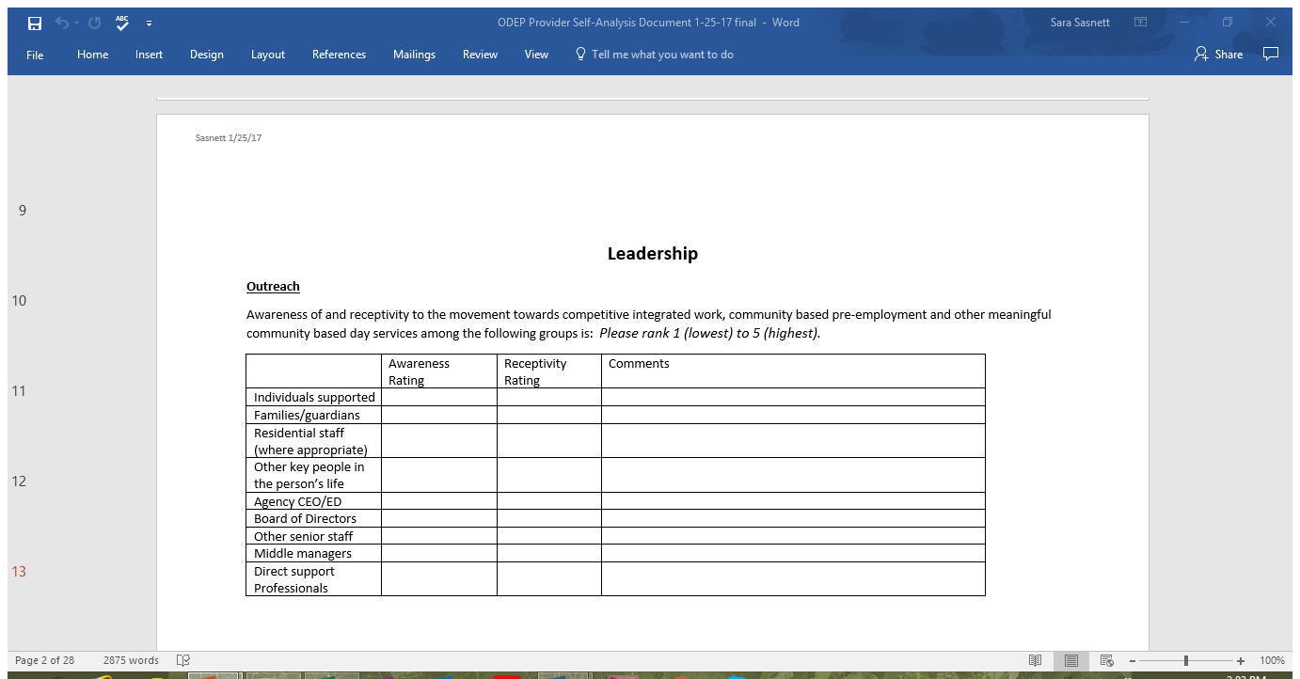

Slide 25
Outreach2
Important to have a plan to ensure that you are reaching all audiences.
Requires multiple modes of delivery.
Requires repetition to be absorbed.
Don’t wait until you know everything – you will never know everything.

Slide 26
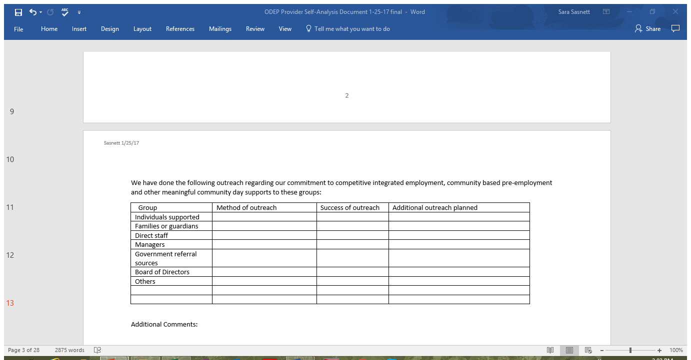

Slide 27
Mission
Values – the is “why” of what your agency is doing – what you believe in
Vision – is the “what” – what the services and supports of the agency will accomplish or become
Mission – is the “how” – what our strategies will be focused on to address the why and make the what reality.

Slide 28
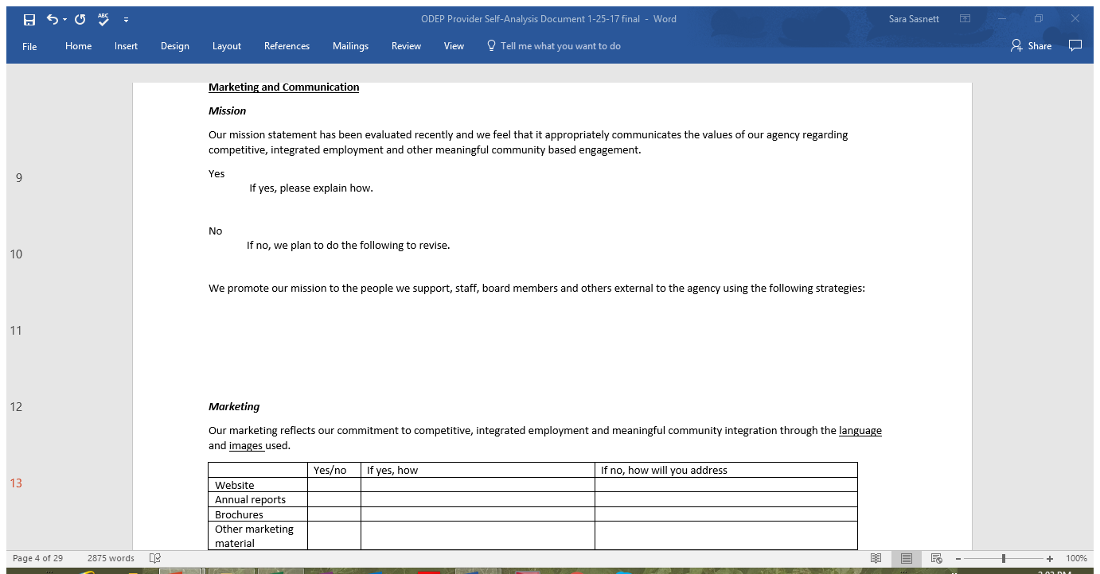
Mission

Slide 29
Marketing
How thoughtful are we in developing our marketing strategies? What is the message?
Do we use multiple modes?
Are we thoughtful about the language and images used?
Do we prepare our staff and board members to present the agency in the terms we prefer.

Slide 30
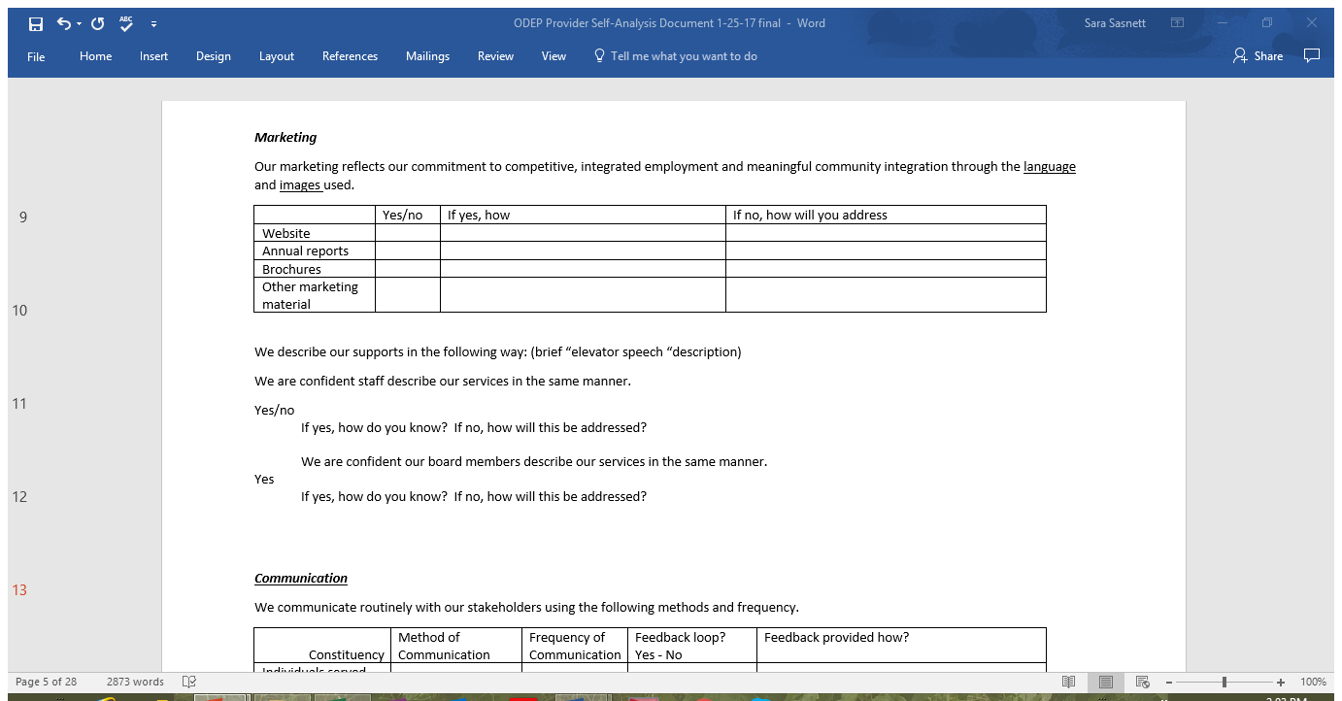

Slide 31


Slide 32
Communication
In the absence of information, people may spread misinformation to fill the void.
Communication has to be a two-way street. Stakeholders need to have their communication acknowledged.
All of your stakeholders communicate on your agency’s behalf. They need guidance to present a consistent image of your agency, particularly as you change.

Slide 33
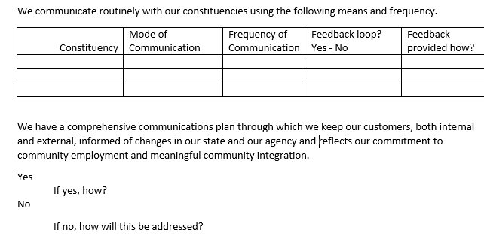

Slide 34
Strategic Planning
Transformative change requires careful planning by a team or teams.
Strategic or business plans should include benchmarks and targeted goals for increased competitive integrated employment.
Sharing goals and progress with stakeholders helps keep them up-to-date and invested in the process.

Slide 35
We have a current strategic plan, business or any other type of agency plan that addresses movement towards greater competitive, integrated employment, community integrated pre-employment training and meaningful community integrated day supports.
Yes It was developed in what year? Who was involved in the development? How?
Are there specific outcomes and benchmarks with timelines about increased numbers of people working in the community? If yes, please state what those outcomes and benchmarks are.
Does the plan include consideration of decentralization of services and resource re-allocation as the agency moves more into community integrated services?
Does the plan include strategies for diversification of funding streams? If so, how?

Slide 36
Customer Focus
Referral and In-take
What do we tell our potential new customers about our services?
Do we share our commitment to competitive integrated employment and other community based services?
Individual Planning
Does your agency engage in Person Centered Planning?
Is competitive integrated employment always addressed in planning meetings?

Slide 37
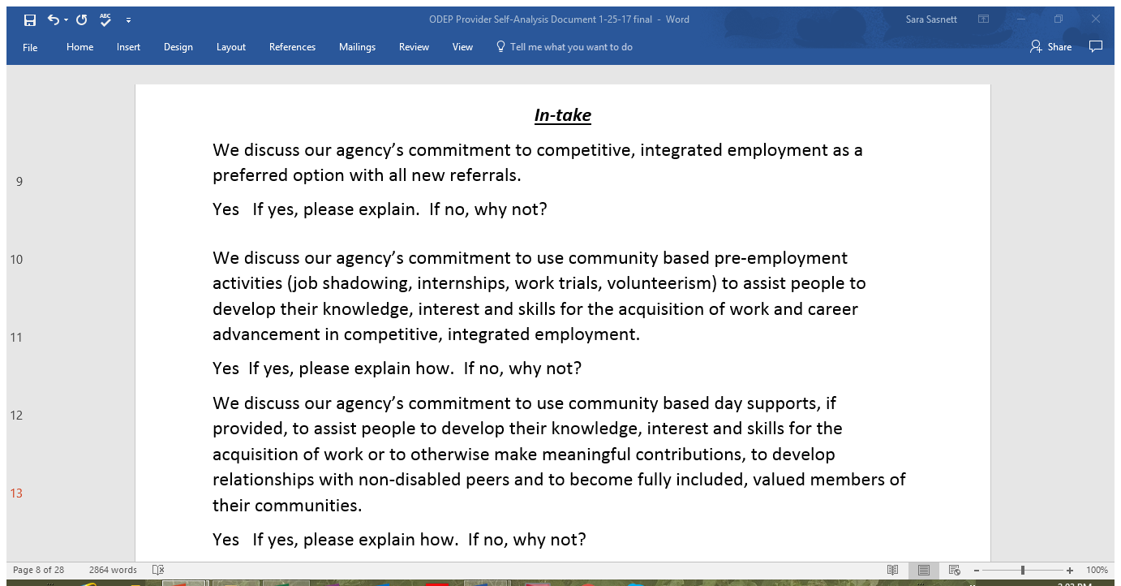

Slide 38
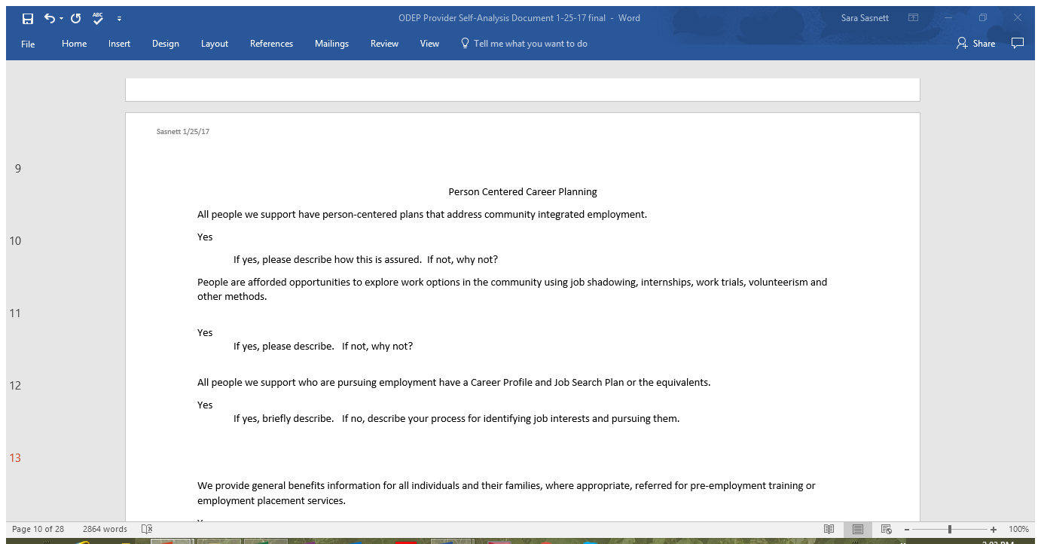

Slide 39
Benefits
Fear of loss of benefits is one of the greatest barriers to work for people with disabilities.
Do we place enough emphasis on general benefits counseling at the agency level?
Do we ensure that referrals are made to certified counselors when employment is imminent?

Slide 40
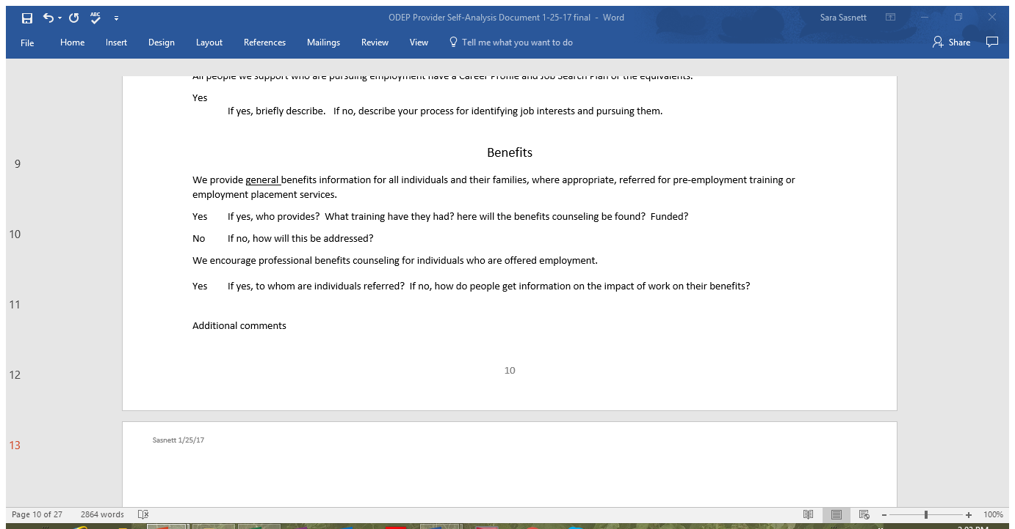

Slide 41
Summary
Self-reflection is key in transformation. Using a self-analysis tool can help.
You have to know who you are and how you are positioned before you can begin to make change – once you know who you are, then you can begin to become who you want to be.
Transformation is not just tacking new services on – it is real and significant change in most aspects of the agency. You have to identify what areas need to be addressed, plan for change, prioritize the tasks at hand, get help where you need it and don’t give up – you will make it!

Slide 42
Homework
Select
Select a preliminary group of individuals to be on your transformation team. Remember you can always modify the composition as needed.
Determine
Determine what information you need to complete the first ½ of the assessment.
Complete
Complete the first ½ of the assessment, answering all questions and follow-up. questions
Share
Come to the next session prepared to share some of your in-sights.

Slide 43


Slide 44
Genni Sasnett
National EFSLMP Subject Matter Expert
sasnettsara@outlook.com
202 812 4504

