Slide 1
Mid-Eastern Shore Maryland Regional Meeting University Of Maryland Shore Medical Pavilion at Easton
Elizabeth Vaidya, Primary Care Office (PCO) Director
January 10, 2020 10:30 AM - 2:30 PM
Notes:
Good morning everyone. Welcome and thank you for participating in our first Regional Meeting. My name is Elizabeth Vaidya and I am director of the Maryland Primary Care Office. I have a few announcements before we start. This meeting is scheduled to last until 2:30 pm. We have lunch scheduled a 12:30. At that time, the Community Health Worker program will speak to you about what they do. Bathrooms are located at ? This PP will be posted on our website within a week.

Slide 2
PCO Grant Requirements
Background & Purpose
Notes:
This presentation is to introduce everyone to the concept of Regional Meetings and what is to be expected. We will first discuss the Background and Purpose for why these meetings are occurring.

Slide 3
Regional Meetings
Background & Purpose
The purpose for holding Annual Regional Meetings is to aide the PCO in meeting federal requirements for:
Statewide Primary Care Needs Assessment,
New requirements in the coordination of shortage designation,
Determining Workforce needs, and
To provide technical assistance to communities to support efforts to expand or improve upon access to healthcare.
Notes:
The overall purpose in having annual Regional Meetings is to improve upon access to healthcare in your community. Specifically, these meetings will help to meet federal guidelines pertaining to Statewide Primary Care Needs Assessment, coordination of shortage designation, workforce needs, and to provide technical assistance to communities. Most importantly, it is my hope that these meetings will enable the PCO to make policy decisions in alignment with community needs and not within the walls of our offices. Hence the reason for the face-to-face meeting.

Slide 4
Regional Meetings
Background & Purpose
1st Year 4/1/19-3/31/20
Auto HPSA Update & Provider Verification
2nd Year 4/1/20-3/31/21
Geographic and Population HPSA Update
3rd Year 4/1/21-3/31/22
PCO Needs Assessment
4th Year 4/1/22-3/31/23
SRSA Plan
5th Year 4/1/23-3/31/24
Implement SRSA Plan
PCO Cooperative Grant
HRSA awarded the Primary Care Office (PCO) a 5-year grant that began April 1, 2019. Regional meetings are to occur each year to meet federal requirements.
Notes:
The Primary Care Office (PCO) was awarded a 5-year grant by the Health Resources and Services Administration (HRSA) to improve access to healthcare. As you can see, the first year began in April of last year, which means we are almost finished. In the PCO’s grant, we proposed the concept of Regional Meetings to meet specific federal requirements of the grant. Also demonstrated in the diagram, the end of the grant period will conclude in March of 2024.

Slide 5
Notes:
On your screen is a map of how the PCO divided the state into regions. These regions are associated in how geographically counties border each other and how the PCO looks at the areas for shortage designation.
Mid-Eastern Shore MD is in brown in the middle right on the map. It includes Kent, Queen Anne’s, Talbot, Caroline and Dorchester counties. It seemed very reasonable to group these jurisdictions together as a region due to similar demographics and existing collaborations. However, each county still has unique components that differ from each other as you will fine in each regional grouping.

Slide 6
Provider Data
HPSA Update
Notes:
Next up, are Logistics.

Slide 7
PCO Shortage Designation - Types
HPSA Update
Health Professional Shortage Areas (HPSAs)
Medically Underserved Areas/ Medically Underserved Populations (MUA/MUPs)
Other Facility Area Centers (OFACs)
Geographic Boundaries
Special Populations (homeless, Medicaid, etc.)
Auto HPSAs
Assigned a score (0-26) for federal workforce programs
Primary Care
Mental Health
Dental
Geographic Boundaries
Special Populations (homeless, Medicaid, etc.)
Primary Care
Correctional Institutions
Public or Non-Profit Private Facilities
State or County Mental Hospitals
Assigned a score (0-26) for federal workforce programs
Primary Care
Mental Health
Dental

Slide 8
Shortage Designation: Types of Providers
HPSA Update
Primary Care Providers
General Practice
General Internal Medicine
Family Practice
Pediatrics
Obstetrics and Gynecology
Mental Health Providers
Psychiatrist
Clinical Psychologist
Clinical Social Worker
Psychiatric Nurse Specialist
Marriage/Family Therapist
Licensed Clinical Professional Counselor
Dentists (DDS or DMD)
General Dentistry
Pediatric Dentistry
Notes:
Federally required provider types for each discipline

Slide 9
Benefits of HPSA Designation
HPSA Update
Component for Eligibility for certain HRSA Grants like:
Rural Health Center applications
Area Health Education Centers
CMS Physician Bonus Payments
Workforce Programs
National Health Service Corps’ Loan Repayment and Scholarship Programs
Nurse Corps and Scholarship Programs
MHEC’s Janet L Hoffman Loan Assistance Repayment Program
Maryland Dent Loan Assistance Program
Maryland state loan repayment program
Preceptor Tax Credit Program
J-1 Visa Waiver & National Interest Waiver Programs
Appalachian Regional Commission
Department of Health and Human Services (HHS)

Slide 10
Provider Verification
HPSA Update
Category | Caroline | Dorchester | Kent | Queen Anne’s | Talbot
Primary Care Physicians | 4 | 12 | 13 | 32 | 41
Dentists | 12 | 6 | 0 | 0 | 1
Psychiatrists | 2 | 11 | 2 | 4 | 7
Mental Health Mid-levels | 15 | 51 | 21 | 33 | 84
Source: HRSA’s Shortage Designation Management System (SDMS), 1/9/20

Slide 11
Caroline County Current HPSAs
HPSA Update
Geographic HPSAs due for update June 2020
None
Medicaid (Me) & Facility HPSAs due for update Summer 2020
Me-Caroline County, 1249599297 (Primary Care), Score 14
Me-Caroline County, 6244377071 (Dental Health), Score 17
Me-Caroline County, 7247593853 (Mental Health), Score 15
HRSA’s HPSA Find, https://data.hrsa.gov/tools/shortage-area/hpsa-find, 1/9/20

Slide 12
Dorchester County Current HPSAs
HPSA Update
Geographic HPSAs due for update June 2020
None
Medicaid (Me) & Facility HPSAs due for update Summer 2020
Me - Dorchester County, 1247385157 (Primary Care), Score 13
Me - Dorchester County, 6244438849 (Dental Health), Score 17
Me - Dorchester County, 7245325710 (Mental Health), Score 18
HRSA’s HPSA Find, https://data.hrsa.gov/tools/shortage-area/hpsa-find, 1/9/20

Slide 13
Kent County Current HPSAs
HPSA Update
Geographic HPSAs due for update June 2020
Kent County, 6247220531 (Dental Health), Score 11
Lower Kent County, 7246741787 (Mental Health), 11
Medicaid (Me) & Facility HPSAs due for update Summer 2020
Me-Upper Queen Anne and Kent Counties, 1247030213 (Primary Care), Score 7
HRSA’s HPSA Find, https://data.hrsa.gov/tools/shortage-area/hpsa-find, 1/9/20

Slide 14
Queen Anne’s County Current HPSAs
HPSA Update
Geographic HPSAs due for update June 2020
Queen Anne's County, 6246268524 (Dental Health), Score 15
Medicaid (Me) & Facility HPSAs due for update Summer 2020
Me-Upper Queen Anne and Kent Counties, 1247030213, Score 7
HRSA’s HPSA Find, https://data.hrsa.gov/tools/shortage-area/hpsa-find, 1/9/20

Slide 15
Talbot County Current HPSAs
HPSA Update
Geographic HPSAs due for update June 2020
Talbot County, 6244962197 (Dental Health), Score 14
Medicaid (Me) & Facility HPSAs due for update Summer 2020
None
HRSA’s HPSA Find, https://data.hrsa.gov/tools/shortage-area/hpsa-find, 1/9/20

Slide 16
Dental HPSAs and FQHCs
HPSA Update
Map of Mid-Eastern Shore Maryland Area
Source:
HRSA’s Map Tool, https://data.hrsa.gov/maps/map-tool/, 1/9/20

Slide 17
Primary Care HPSAs & FQHCs
HPSA Update
Map of Mid-Eastern Shore Maryland Area
Source:
HRSA’s Map Tool, https://data.hrsa.gov/maps/map-tool/, 1/9/20

Slide 18
Mental Health HPSAs & FQHCs
HPSA Update
Map of Mid-Eastern Shore Maryland Area

Slide 19
Questions
Time to Hear Your Thoughts
This Photo by Unknown Author is licensed under CC BY-SA
Notes:
It is now time for me to be quiet and to listen to you. Does anyone have any questions or comments?

Slide 20
Response Sheet - #1
HPSA Update
YOUR NAME
CONTACT INFO
Caroline | Dorchester | Kent | Queen Anne’s | Talbot | #1 Activities for Provider Vetting/Clean-up:
 |  |  |  |  | Would like to assist with vetting the list of primary care providers
 |  |  |  |  | Would like to assist with vetting the list of dental providers
 |  |  |  |  | Would like to assist with the vetting the list of psychiatrists
 |  |  |  |  | Would like to assist with the vetting of mid-level behavioral providers (Licensed clinical social workers (LCSW), psychologists, counselors, psychiatric nurse specialists only)
 |  |  |  |  | Want to be notified of Shortage designation updates for this area
 |  |  |  |  | Other:
 |  |  |  |  | Not able to assist

Slide 21
Collection of Data
Provider Survey

Slide 22
Why is a Provider Survey Needed?
Provider Survey
BOP’s License Renewal Survey
PCO Survey
Other State Program Questions
Provider Data
Availability
Types of Providers
Population Needs
Shortage Designations
Recruitment & Retainment of Providers
Notes:
Effective Dec 2018, the Maryland BOP ended agreements throughout the state to provide physician data. The Maryland PCO was one of the programs that had an agreement with BOP to incorporate our provider survey into the questions asked to providers in their license renewal survey. Since the survey is no longer available, the PCO no longer has a data source to update provider data for shortage designations.

Slide 23
Provider Data Needed & Sources
Data Needed:
Provider Name
Provider Type
Number of hours rendering service
Site location(s)
Accept Medicaid, Medicare, Federal Sliding Fee Scale (SFS)
Medicaid Claims
Waiting time for an appt for established and first time patients
Accepts new patients
Provider’s % of Patients with Medicaid and SFS
Maryland Board of Physicians Provides:
Everything except waiting time for patients and % of Medicaid and SFS patients
Maryland Medicaid Provides:
Primary Care and Mental Health Medicaid Claims
Number of residents eligible for Maryland Medicaid per county.
Notes:
Effective Dec 2018, the Maryland BOP ended agreements throughout the state to provide physician data. The Maryland PCO was one of the programs that had an agreement with BOP to incorporate our provider survey into the questions asked to providers in their license renewal survey. Since the survey is no longer available, the PCO no longer has a data source to update provider data for shortage designations.

Slide 24
Lack of Provider Data Concerns
Provider Survey
Fewer Shortage Designations will be made without a valid provider source.
Valid Dentist data is not available.
Not able to do low income population or insufficient capacity designations.
Only limited physician data is accessible to determine state defined needs.

Slide 25
Disclosure and Informed Consent Statement
Provider Survey
Outlines the purpose and procedure of the survey, as well as potential risks and benefits
After reading the provided information, the participant must select the option to either “agree” or “not agree” to participate in the survey

Slide 26
Survey Overview
Provider Survey
The survey is broken down into the following sections:
Contact Information
Services Provided
Patients
Payer Breakdown
Protocols and Partnerships
Areas of Need
Provider Information

Slide 27
Contact Information
Provider Survey
Notes:
Information in case we need to reach out to sites to follow up on responses

Slide 28
Services provided
Provider Survey
Notes:
Types of services provided→ primarily looking at primary care, mental health and dental used for shortage designations
broke down primary care
Focus on behavioral health with the Screening, Brief Intervention, Referral to treatment question

Slide 29
Patients*
Provider Survey
Notes:
Total number of patients
Average wait times for current and new patients

Slide 30
Payer Breakdown
Provider Survey
Notes:
Information useful for shortage designations. Currently we only do Medicaid, but we would be able to do low income with information on SFS
BENEFIT TO LOW INCOME DESIGNATIONS?

Slide 31
Protocols and Partnerships
Provider Survey
Notes:
Established protocols are helpful to understand for the Primary Care Model→ targeting diabetes and hypertension as two of the measures
Want to know which partnerships are being made and what outreach is occurring throughout the community

Slide 32
Areas of Need
Provider Survey
Notes:
Want to understand need in the community, not just for primary care. This will help not only shortage designations, but also workforce and loan repayment programs

Slide 33
Provider Information
Provider Survey
Notes:
Most likely the most important information for the HPSA update. This will give us the most accurate depiction of FTEs at and around your site, which impacts not only the need but also the NSC
Continue to “Add Provider” until the table accurately reflects all providers currently practicing at the site.
Necessary for PCO to have the most up-to-date information on providers

Slide 34
Questions
Time to Hear Your Thoughts
This Photo by Unknown Author is licensed under CC BY-SA
Notes:
It is now time for me to be quiet and to listen to you. Does anyone have any questions or comments?

Slide 35
Response Sheet - #2
Please select an activity you can assist with. Check all that apply:
#1 Provider Vetting/Clean-up
Provider Survey
YOUR NAME
CONTACT INFO
Caroline | Dorchester | Kent | Queen Anne’s | Talbot | #2 Activities for Provider Survey:
 |  |  |  |  | Interested in joining a sub-committee to work on this project
 |  |  |  |  | Interested in administering a survey to primary care providers
 |  |  |  |  | Interested in administering a survey to dental providers
 |  |  |  |  | Interested in administering a survey to psychiatrists
 |  |  |  |  | Interested in administering a survey to mid-level behavioral providers (Licensed clinical social workers (LCSW), psychologists, counselors, psychiatric nurse specialists only)
 |  |  |  |  | Other:
 |  |  |  |  | Not able to assist

Slide 36
30 Minute Break
Lunch

Slide 37
Community Grouping
Statewide Rational Service Area (SRSA) Plan

Slide 38
Rational Service Area (RSA)
Statewide Rational Service Area (SRSA) Plan
Whole county, or an area whose population has similar socio-economic characteristics, or an area that has physical access barriers which result in the population being isolated from nearby resources, or an established neighborhood within a metropolitan area which displays a strong self-identity.
A RSA is the area in which the PCO recommends to HRSA for shortage designations
HPSAs
MUA/MUPs

Slide 39
HRSA Requirement
Statewide Rational Service Area (SRSA) Plan
HRSA has required each PCO to establish Rational Service Area Plans covering their entire state/territory by year 4 (2023) of their grant period.
Each PCO has submitted a work plan that outlines how this will be accomplished -- which includes specific annual benchmarks which can be measured to evaluate progress.

Slide 40
Benchmark – Year 1 (4/1/19 - 3/31/20)
Statewide Rational Service Area (SRSA) Plan

Slide 41
Benchmark – Year 2 (4/1/20 - 3/31/21)
Statewide Rational Service Area (SRSA) Plan

Slide 42
Benchmark – Year 3 (4/1/21 - 3/31/22)
Statewide Rational Service Area (SRSA) Plan

Slide 43
Benchmark – Year 4 (4/1/22 - 3/31/23)
Statewide Rational Service Area (SRSA) Plan

Slide 44
Caroline County Neighborhoods
Source: PCO, Neighborhood Files, 2012

Slide 45
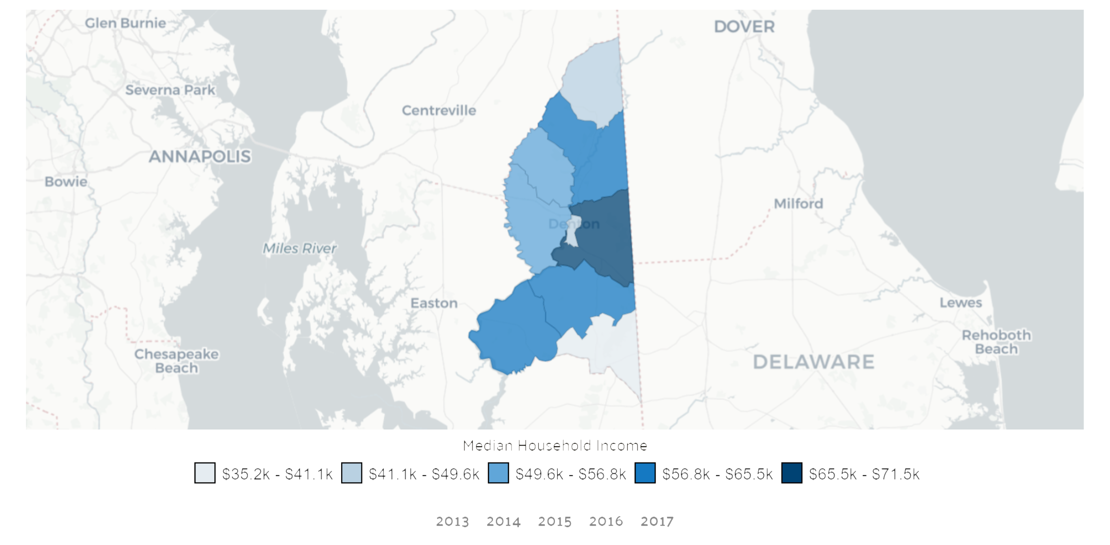
Caroline County by Median Household Income
Source: https://datausa.io/profile/geo/caroline-county-md, 1/9/20

Slide 46
Dorchester County Neighborhoods
Source: PCO, Neighborhood Files, 2012

Slide 47
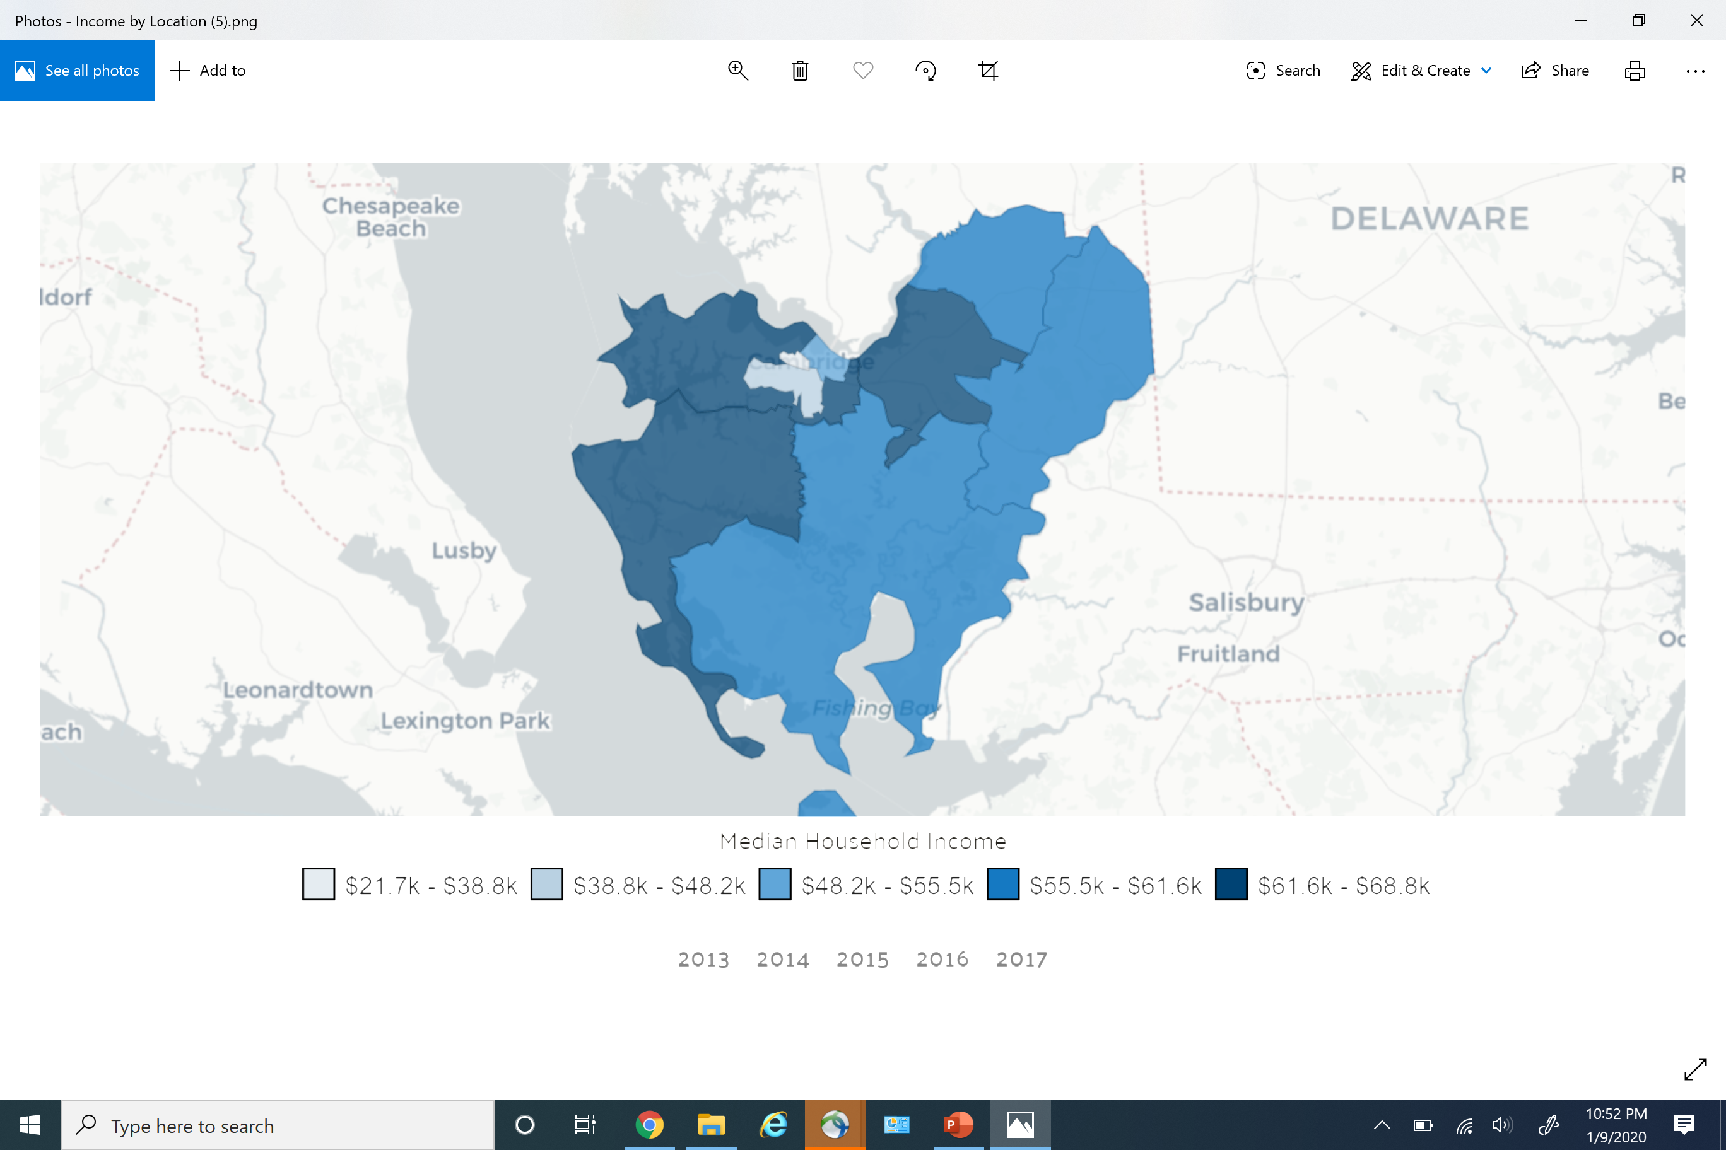
Dorchester County by Median Household Income
Source: https://datausa.io/profile/geo/caroline-county-md, 1/9/20

Slide 48
Kent County Neighborhoods
Source: https://maryland.hometownlocator.com/maps/countymap,cfips,029,c,kent.cfm, 1/9/20

Slide 49
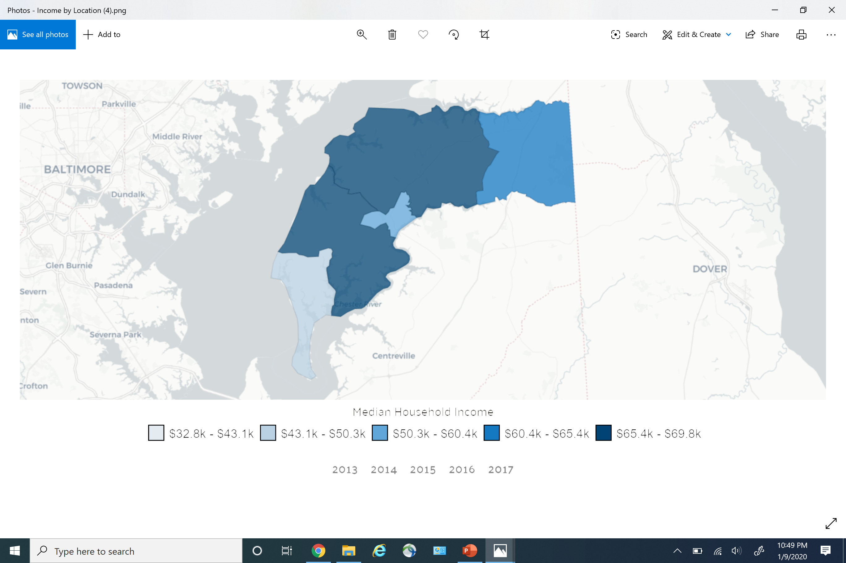
Kent County Neighborhoods
Source: https://datausa.io/profile/geo/caroline-county-md, 1/9/20

Slide 50
Queen Anne’s County Neighborhoods
Source: PCO, Neighborhood Files, 2012

Slide 51
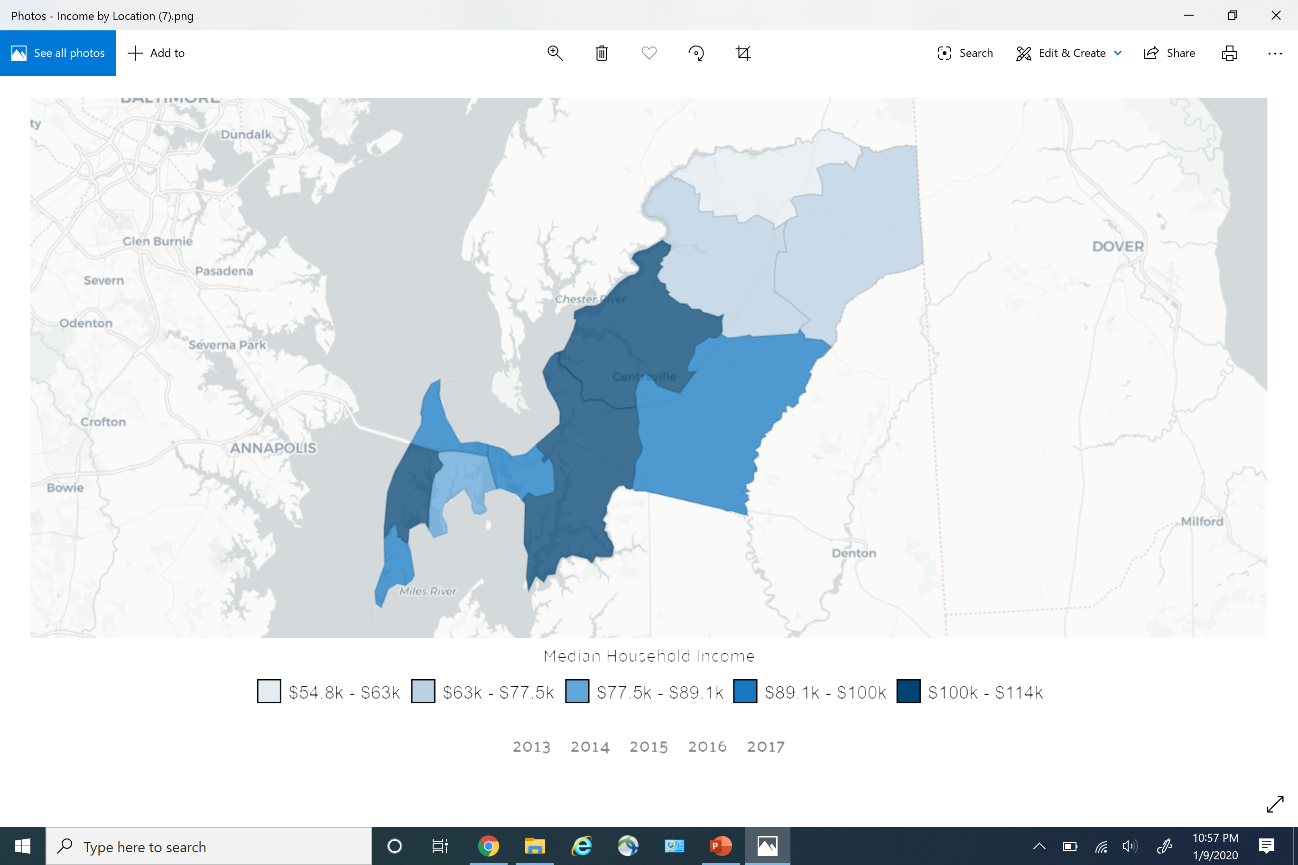
Queen Anne’s County by Median Household Income
Source: https://datausa.io/profile/geo/caroline-county-md, 1/9/20

Slide 52
Talbot County Neighborhoods
Source: PCO, Neighborhood Files, 2012

Slide 53
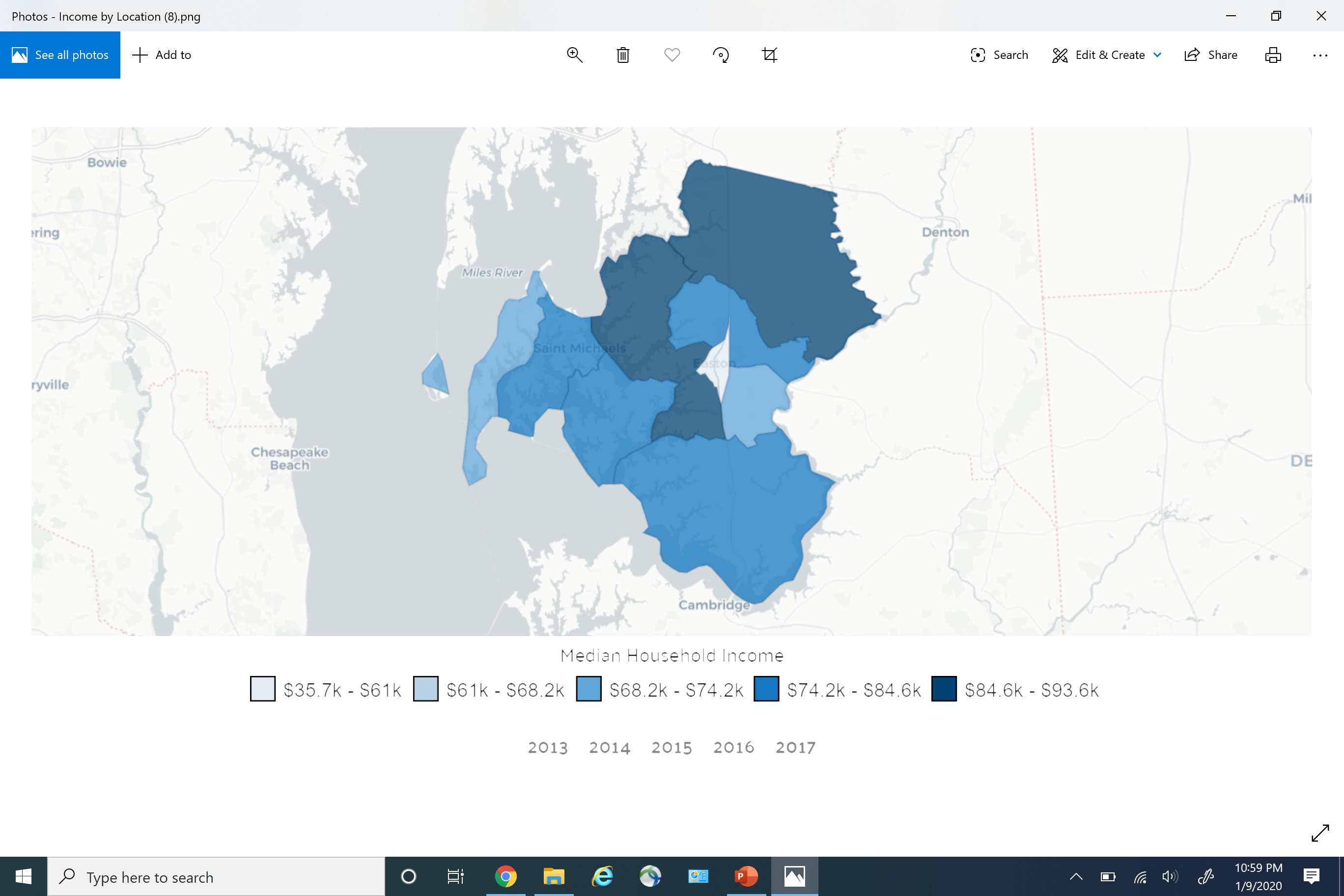
Talbot County by Median Household Income
Source: https://datausa.io/profile/geo/caroline-county-md, 1/9/20

Slide 54
Response Sheet - #3
Please select an activity you can assist with. Check all that apply:
#1 Provider Vetting/Clean-up
Statewide Rational Service Area (SRSA) Plan
YOUR NAME
CONTACT INFO
Caroline | Dorchester | Kent | Queen Anne’s | Talbot | #3 Activities for SRSA Plan:
 |  |  |  |  | Interested in joining a sub-committee to work on this project
 |  |  |  |  | Would like to provide data to the PCO
 |  |  |  |  | Would like to provide feedback to the PCO regarding grouping
 |  |  |  |  | Other:
 |  |  |  |  | Not able to assist

Slide 55
Questions
Time to Hear Your Thoughts
This Photo by Unknown Author is licensed under CC BY-SA
Notes:
It is now time for me to be quiet and to listen to you. Does anyone have any questions or comments?

Slide 56
Template Review
PCO Needs Assessment

Slide 57
Goal & Purpose
PCO Needs Assessment
The goal of the PCO Needs Assessment is to identify areas for priority to promote access to care, especially for the underserved, while executing the goals funded by HRSA through the PCO’s grant.
The Needs Assessment identifies priority areas needing state and federal resources to improve health. Maryland will target resources to the priority areas via enhanced technical assistance, workforce programs and other state and federal resources as available through partnerships and collaboration.

Slide 58
County Ranking
PCO Needs Assessment
County assessment is based on the integration of two health data tracking methods; the federal Agency for Healthcare Research and Quality (AHRQ) Prevention Quality Indicators (PQIs) and the State Health Improvement Process (SHIP).

Slide 59
Prevention Quality Indicators (PQIs)
PCO Needs Assessment
In 2015, 14 indicators were identified as causes of potentially preventable hospitalizations in Maryland. These conditions accounted for about 60% of all preventable hospitalizations. Improved access to healthcare will help reduce the number of preventable hospitalizations and reduce associated costs.

Slide 60
Listing of PQIs
PCO Needs Assessment
Diabetes with Short-term Complications 2014 | Angina without Procedure 2014
Diabetes with Long-term Complications 2014 | Uncontrolled Diabetes without Complications 2014
Chronic Obstructive Pulmonary Disease (COPD) or Asthma in Older Adults 2014 | Asthma in Younger Adults 2014
Hypertension 2014 | Lower Extremity Amputations among Admissions for Diabetes 2014
Heart Failure 2014 | AHRQ Overall Prevention Quality Indicator (PQI) Composite 2014
Dehydration 2014 | AHRQ Acute Prevention Quality Indicator (PQI) Composite 2014
Bacterial Pneumonia 2014 | AHRQ Chronic Prevention Quality Indicator (PQI) Composite 2014
Urinary Tract Infection 2014

Slide 61
State Health Improvement Process (SHIP)
PCO Needs Assessment
SHIP provides a framework for continual progress toward a healthier Maryland. The SHIP includes 38 measures grouped by five focus areas that represent clinical and non-clinical determinants for health. The five focus areas are: Healthy Beginnings, Healthy Living, Healthy Communities, Access to Health Care, and Quality Preventive Care. Each measure has a data source and a target which can be assessed at the county level.

Slide 62
Listing of SHIP Measurements
PCO Needs Assessment
Infant Death Rate 2010, 2011, 2012, 2013 | Life Expectancy 2008-2010, 2009-2011, 2010-2012, 2011-2013
Babies with Low Birth Rate 2010, 2011, 2012, 2013 | Increase Physical Activity 2011, 2012, 2013
Sudden Unexpected Infant Death Rate (SUIDs) 2005-2009, 2006-2010, 2007-2012, 2009-2013 | Child Maltreatment Rate 2011, 2012, 2013
Teen Birth Rate 2010, 2011, 2012, 2013 | Suicide Rate 2007-2009, 2008-2010, 2009-2011, 2010-2012, 2011-2013
Early Prenatal Care 2010, 2011, 2012, 2013 | Domestic Violence 2010, 2011, 2012, 2013
Students Entering Kindergarten Ready to Learn 2010, 2011, 2012, 2013 | Children with Elevated Blood Lead Levels 2009, 2010, 2011, 2012, 2013
High School Graduation Rate 2009-2010, 2010-2011, 2011-2012, 2012-2013, 2013-2014 | Fall-Related Death Rate 2007-2009, 2008-2010, 2009-2011, 2010-2012, 2011-2013
Children Receiving Blood Lead Screening 2010, 2011, 2012, 2013 | Pedestrian Injury Rate on Public Roads 2009, 2010, 2011, 2012, 2013, 2014
Adults who are a Healthy Weight 2011, 2012, 2013 | Affordable Housing 2009, 2010, 2011, 2012, 2013, 2014
Children and Adolescents who are Obese 2010, 2013 | Adolescents who Received a Wellness Checkup in the Last Year 2010, 2011, 2012, 2013
Adults who Currently Smoke 2011, 2012, 2013 | Children Receiving Dental Care in the Last Year
Adolescents who Currently Use Tobacco Products 2010, 2013 | Persons with a Usual Primary Care Provider 2011, 2012, 2013
HIV Incidence Rate 2009, 2010, 2011, 2012, 2013 | Uninsured ED Visits 2009, 2010, 2011, 2012, 2013, 2014
Chlamydia Infection Rate 2009, 2010, 2011, 2012, 2013, 2014

Slide 63
Findings
PCO Needs Assessment
The 2016 PCO Needs Assessment identified the jurisdictions in Maryland that have the greatest need in regards to the PQI and SHIP 54 measures.
Worst Quartile Ranking | Best Quartile Ranking
Baltimore City | Carroll County
Allegany County | Frederick County
Dorchester County | Harford County
Kent County | Howard County
Washington County | Montgomery County
Wicomico County | Queen Anne’s County

Slide 64
Quartile Ranking by County Statewide
PCO Needs Assessment
Jurisdictions | Indicator Score
Montgomery | 293 | Top Quartile (Best)
Howard | 339
Queen Anne's | 366
Carroll | 403
Frederick | 405
Harford | 469
Calvert | 527 | Second Quartile
Garrett | 532
Anne Arundel | 554
Worcester | 596
Talbot | 598
Cecil | 633
Prince George's | 640 | Third Quartile
Saint Mary's | 647
Caroline | 651
Charles | 689
Somerset | 690
Baltimore County | 699
Kent | 716 | Bottom Quartile (Worst)
Washington | 724
Allegany | 767
Wicomico | 811
Dorchester | 864
Baltimore City | 1,011

Slide 65
Other Data Included
PCO Needs Assessment
Shortage Designation Listing
FQHC Listing
Workforce Program Awards by Discipline and Jurisdiction
Provider to Population Ratios for primary care, mental health, and dental.
Medicaid Provider to Medicaid Population Ratios for primary care, mental health, and dental.
Map Indicating Safety-Net Sites (FQHCs, LHD sites, and hospitals) per County

Slide 66
New Ideas
PCO Needs Assessment
FQHC Assessment
Types of services provided
Breakdown of population served
Economic Impact of Workforce Programs
Economic Impact for Shortage Designations
Developing a State Methodology for Determining Health Care Access

Slide 67
Questions
Time to Hear Your Thoughts
This Photo by Unknown Author is licensed under CC BY-SA
Notes:
It is now time for me to be quiet and to listen to you. Does anyone have any questions or comments?

Slide 68
Response Sheet - #4
Please select an activity you can assist with. Check all that apply:
#1 Provider Vetting/Clean-up
PCO Needs Assessment
YOUR NAME
CONTACT INFO
Caroline | Dorchester | Kent | Queen Anne’s | Talbot | #4 Needs Assessment:
 |  |  |  |  | Connect a monetary value to provider/services
 |  |  |  |  | List out providers by need and specialty per county, and correlate it with poverty, chronic disease, and ethnicity to show need
 |  |  |  |  | List out workforce program providers: site name, address, specialty
 |  |  |  |  | Other:
 |  |  |  |  | Not able to assist

Slide 69
Next Steps
Wrap Up
Summarize Meeting
Develop Format to Distribute & Share Data
Sub Workgroups
Quarterly Meetings
Annual Regional Meeting
Notes:
The PCO will send out an evaluation form to you regarding this meeting.

Slide 70
Thank You!
PCO Contact Information
Elizabeth Vaidya, PCO Director
(410) 767-5695 office
Elizabeth.vaidya@maryland.gov
Notes:
I will like to thank everyone for their participation here in-person or on the webinar. Have a great day.

