Slide 1
Maryland Regional Meetings’
Introduction Webinar
Elizabeth Vaidya, Primary Care Office (PCO) Director
October 10, 2019 1-2 PM
Notes:
Good afternoon everyone. We will begin very shortly at 1:05.
Welcome and thank you for calling in to join us in today’s presentation, Maryland Regional Meetings’ Introduction Webinar. My name is Elizabeth Vaidya and I am director of the Maryland Primary Care Office. A few housekeeping rules, please only mute your line if you can do so without background music. I do not believe this presentation will take up the full hour. I will be taking questions at the end of the presentation. Please feel free type in your questions if you think you may forget it by the end. Lastly, please note that this presentation is being recorded. Okay, I will begin and again thank you for your participation.

Slide 2
PCO Grant Requirements
Background & Purpose
Notes:
This presentation is to introduce everyone to the concept of Regional Meetings and what is to be expected. We will first discuss the Background and Purpose for why these meetings are occurring.

Slide 3
Regional Meetings
Background
1st Year 4/1/19-3/31/20
2nd Year 4/1/20-3/31/21
3rd Year 4/1/21-3/31/22
4th Year 4/1/22-3/31/23
5th Year 4/1/23-3/31/24
PCO Cooperative Grant
HRSA awarded the Primary Care Office (PCO) a 5-year grant that began April 1, 2019. Regional meetings are to occur each year to meet federal requirements.
Notes:
The Primary Care Office (PCO) was awarded a 5 year grant by the Health Resources and Services Administration (HRSA) to improve access to healthcare. As you can see, the first year began in April of this year, which means we are already halfway finished. In the PCO’s grant, we proposed the concept of Regional Meetings to meet specific federal requirements of the grant. Also demonstrated in the diagram, the end of the grant period will conclude in March of 2024.

Slide 4
Regional Meetings
Purpose
The purpose for holding Annual Regional Meetings is to aide the PCO in meeting federal requirements for:
Statewide Primary Care Needs Assessment,
New requirements in the coordination of shortage designation,
Workforce needs, and
To provide technical assistance to communities to support efforts to expand or improve upon access to healthcare.
Notes:
The overall purpose in having annual Regional Meetings is to improve upon access to healthcare in your community. Specifically, these meetings will help to meet federal guidelines pertaining to Statewide Primary Care Needs Assessment, coordination of shortage designation, workforce needs, and to provide technical assistance to communities.

Slide 5
Who & Where
Logistics
Notes:
Next up, are Logistics.

Slide 6
Logistics of Meetings
Description
Nov.-Dec. of 2019
LHOs, MACHC, FQHCs, SBHCs, AHECs, hospitals, providers, and others
Meetings
Meet in-person with each region in a central location for 1 to 2-day increments
Meet, discuss federal requirements, regional needs, set goals, and provide next steps annually.
Stakeholders
Notes:
As stated in the previous slide, these meetings are being held each year to meet federal requirements, but we will also discuss regional needs, set goals and provide next steps. Those invited to the meetings include local health departments, the primary care association for Maryland, federally qualified health centers, school based health centers, hospitals, providers, Area Health Education Centers, and any other entities that have input to improve upon access to healthcare in the state. Lastly, the meetings are tentatively scheduled to occur from November to December. Dependent on the size of the region, a two day meeting may be necessary, but we are hoping in most cases, one day will be sufficient. I stated the tentatively because I am hoping to schedule these meetings and set locations fairly quickly. I am also hoping the weather is on our side for traveling to various areas.

Slide 7
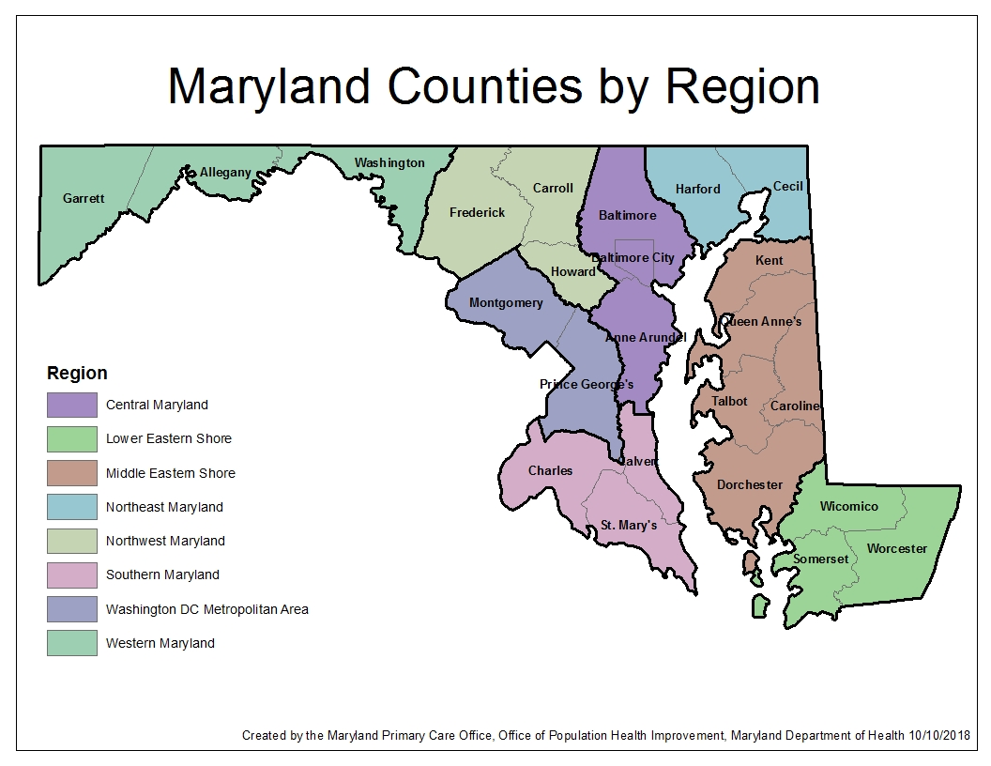
Notes:
On your screen is a map of how the PCO divided the state into regions. These regions are associated in how geographically counties border each other and how the PCO looks at the areas for shortage designation.
Central MD is in purple toward the right center of the map. It includes Balto City and the counties that border it, which are Baltimore County and Anne Arundel County. Currently, there are shortage designations that have a combination of these counties borders, which seem reasonable to then group as a region due to similar demographics. However, each county still have unique components from each other as you will fine in each regional grouping that will still be considered in proposing shortage designations.
The Lower Eastern Shore is in green is located at the bottom right of the map. It includes Wicomico, Worcester and Somerset. This grouping again shared shortage designation groupings and have been known to work together on common rural health needs in the past.
Center right in brown on the map is the Middle Eastern Shore which includes Kent, Queen Anne’s, Talbot, Caroline, and Dorchester counties. Again, this grouping is due to these counties being known to work together on common rural health needs.
Top right in blue is Northeast Maryland which includes Harford and Cecil counties. This grouping makes sense also due to the shared initiatives that occur between these jurisdictions.
Northwest Maryland is in light green and is center top left on the map. This grouping includes Frederick, Carroll and Howard counties. I know of some convesations regarding access with Frederick and Carroll, and Frederick and Howard, but not all three. However, it made sense to group these jurisdictions together due to similar demographics.
Right below Northwest is in blue is the Washington DC Metropolitan Area. These are counties that border Washington DC which include Montgomery and Prince George’s counties. These counties have had shared shortage designations in the past, and have certain areas that border that share similar demographics.
In pink in the bottom center on the map is Southern Maryland. This grouping includes Charles, Calvert and St. Mary’s counties. These counties have been known to work together on health concerns in the past and have more in common with each other than other jurisdictions bordering them.
Lastly, in the top left corner in green on the map is Western Maryland. This grouping includes Garrett, Allegany, and Washington counties. These counties are also known to work together and under the Appalachian geographic region as well.

Slide 8
Regional Meetings
Agenda
  Current shortage designations
  HRSA’s Required State Rational Service Area (SRSA)
  PCO Needs Assessment 2020
  Workforce Programs & Region’s Needs, and
  Technical assistance needs
  Community Health Worker Program Updates
  State Office of Rural Health Program Updates
  Prevention Behavioral Health Program Updates
Notes:
At the Regional Meetings, we will discuss the status of each jurisdiction’s current shortage designation. We will also discuss what is needed to improve access to healthcare in regards to shortage designation, workforce, workforce programs, and technical assistance. We will begin to discuss HRSA’s new requirement for a State Rational Service Area and what that means for your communities. The PCO is also required by HRSA to do another Needs Assessment, so we will be discussing what that will entail, any goals that you want to establish, and collect any input that you may have. We will also have representation from other programs under the Office of Population Health Improvement (OPHI) that will be providing information on Workforce Programs, Community Health Worker Program, State Office of Rural Health, and Prevention Behavioral Health Program.

Slide 9
What Can I Do?
Next Steps
Notes:
So, I know by now, many of you are asking how can I help the PCO? Well, let me pontificate exactly how you can help…

Slide 10
How can you Help?
Next Steps
Let the PCO know if you have free meeting space available for use.
Get the word out to healthcare and community leaders that need to be at these meetings.
Share any contacts with the PCO that you think should be on the invite distribution by sending an email to elizabeth.vaidya@Maryland.gov.
Help the PCO to know what is needed in your community to improve healthcare access by attending and participating in the Regional Meetings.

Slide 11
Meetings
Next steps
Tentative Regional Meeting Schedule:
  Western Maryland – Week of Nov 4th
  Northeast Maryland –Week of Nov 4th
  Lower Eastern Shore – Week of Nov 11th
  Middle Eastern Shore – Week of Nov 11th
  Southern Maryland – Week of Nov 18th
  Northwest Maryland – Week of Nov 18th
  Washington DC Metropolitan Area – Week of Dec 2nd
  Central Maryland – Week of Dec 2nd
Notes:
Dependent on how fast we can locate sites to host meeting and how kind the weather will be to us as we get deeper into the fall, the schedule listed here is tentative. Please call me or send me an email if you have available space for hosting the regional meetings in your area.

Slide 12

Questions
Time to Hear Your Thoughts
This Photo by Unknown Author is licensed under CC BY-SA
Notes:
It is now time for me to be quiet and to listen to you. Does anyone have any questions or comments?

Slide 13
Regional Meetings Information
Reminders
Please visit our website at https://pophealth.health.maryland.gov/Pages/Primary-Care.aspx to:
  Download this PowerPoint
  Updates and additional information regarding Regional Meetings
  Learn more about the PCO or other Office of Population Health Improvement (OPHI) Programs.
Notes:
For information regarding Regional Meetings, please go to the PCO’s website linked on this screen. It will have this PP, updates, and any additional information regarding these meetings. Also, if you would like to learn more about other OPHI programs, you can also navigate through this link as well.

Slide 14
New Federal Loan Repayment Programs for Providers
Reminders
The Substance Use Disorder (SUD) Workforce and the Rural Community Loan Repayment Programs (LRPs) were launched by the National Health Service Corps (NHSC) to combat the nation’s opioid crisis. Participants can receive up to $75,000 for the SUD Workforce LRP and $100,000 for the Rural Community LRP in tax-free awards aimed to help outpatient healthcare facilities to recruit and retain health professionals to expand access to substance use disorder treatment and prevent opioid overdose deaths.
In order to be eligible for these LRPs, your site must opt-in as a SUD treatment provider. Even if your Health Professional Shortage Area (HPSA) score has been too low to qualify for NHSC funding in the past, HPSA scores are not the biggest factor for these LRPs and eligible clinicians at opted-in sites may still qualify for a loan repayment award. Apply now to opt-in before the next LRP application cycle. Please click here for detailed instructions regarding how to opt-in.
Notes:
For those of you who are not on my distribution list, please note that there are two new loan repayment programs, the Substance Use Disorder workforce program and the rural community loan repayment programs by the NHSC. These programs were launched to combat the nation’s opioid crisis. Physicians, PAs, nurse practitioners, and others are eligible. There are links on this page that will give you detailed information regarding the program and how to opt in. It is important to opt in so you can participate in the program when it is open officially in the beginning of next year. Please note that these programs differ from other NHSC’s programs in that they do not prioritize eligibility based on the scores of your HPSA designations. As long as your site is located in a primary care or mental health HPSA, you are eligible. Again, there is a link on this screen detailing how to opt in.

Slide 15
New Federal Loan Repayment Programs for Providers
Reminders
Inpatient or residential facilities are not eligible for the SUD opt-in. Only outpatient facilities are eligible for NHSC programs. To be an NHSC-approved SUD site, facilities must have demonstrated that they meet the requirements set forth in the NHSC Site Agreement (PDF - 303 KB) and NHSC Site Reference Guide (PDF - 788 KB), including submission of SUD documentation (PDF - 257 KB). The following types of sites are eligible:
SAMHSA-certified opioid treatment programs (OTPs) Office-based opioid treatment facilities (OBOTs) Non-opioid substance use disorder treatment facilities (SUD treatment facilities) Federally Qualified Health Care Centers (FQHCs) Rural Health Clinics (RHCs) American Indian Health facilities FQHC Look-Alikes State or federal correctional facilities | Critical Access Hospitals Community health centers State or local health departments Community outpatient facilities Private practices School-based clinics Mobile units and free clinics
Notes:
This screen is a reference for the types of sites eligible to opt in for the SUD Workforce and Rural loan repayment programs. If you are inpatient or residential treatment facility, you are not eligible for any of NHSC’s programs. Is there any questions?

Slide 16
Thank You!
PCO Contact Information
Elizabeth Vaidya, PCO Director
  (410) 767-5695 office
  Elizabeth.vaidya@maryland.gov
Notes:
I will like to thank everyone for their participation in the webinar. Have a great day.

