Slide 1
Maryland Loan Assistance Repayment Program for Physicians and Physician Assistants Workgroup
March 12, 2021

Slide 2
Agenda
MLARP Workgroup
Welcome/ Roll Call
Opening Business/ Remarks
Priority Presentations and Discussion
Next Steps
Open Discussion with Public Comment
Adjournment
Notes:
Sara

Slide 3
Welcome/ Roll Call
MLARP Workgroup
  Welcome!
  Roll Call: Workgroup Members
    Name
    Affiliation
  III. Sign In: Guests
  Please note your name (with affiliation, as
  relevant), in the chat box
Notes:
Workgroup members, please share video
Quorum?

Slide 4
Opening Business/ Remarks
Notes:
Cheryl

Slide 5
Opening Business/ Remarks
MLARP Workgroup
  Approval of January 8, 2021 Minutes
  Program Operational Updates
Notes:
Minutes
The minutes have been distributed attached to today’s agenda (shared via meeting invite). Are there any corrections?
If there are no (further) corrections . . . (pause) . . . the minutes are approved as distributed/corrected.

Slide 6
MLARP Operational Updates
Opening Business/ Remarks
  Total of 26 awards offered for Fiscal Year 2021
    13 renewal (2nd year service obligations)
    13 initial (1st year service obligations)
    II. Initial payment requests submitted for State
    processing / payment distribution to lenders
    III. Fiscal Year 2021 application cycle is currently open!
    March 1 – April 15
Notes:
Will discuss FY2021 participants in more detail in just a moment
2 initial awardees will not be participating as employment status changed and they are no longer eligible as unable to meet service obligation requirements.

Slide 7
Fiscal Year 2021 Awarded Applicants
MLARP Operational Updates
Specialties
Specialty | #
Family Medicine / GP | 9
Internal Medicine | 7
Pediatrics | 5
Psychiatry | 4
Specialist | 1
Total | 26
Notes:
Physician 15
Physician Assistant 11
Total 26

Slide 8
Fiscal Year 2021 Awarded Applicants
MLARP Operational Updates
Site Types
Site Type | #
Private practice (group or private) | 9
Hospital | 7
FQHC / community clinic | 5
State facility (i.e. hospital, LHD) | 3
Correctional facility | 2
Total | 26

Slide 9
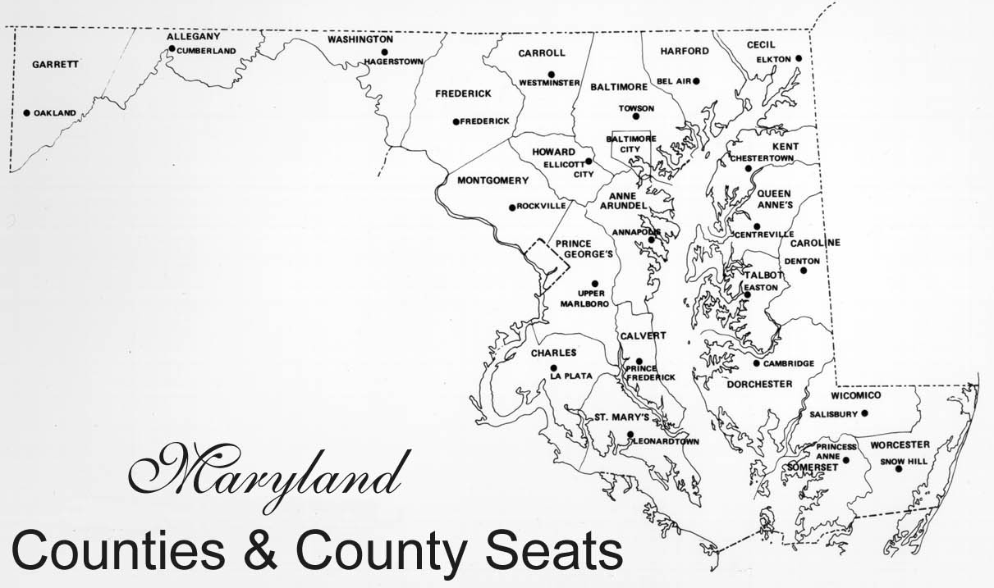
Fiscal Year 2021 Awarded Applicants
MLARP Operational Updates
Geographic Distribution of Practice Sites by Region
3
3
9
Rural/Non-rural Designation | #
State-designated rural | 15
Non-rural | 11
Total | 26
4
7

Slide 10
Priority Presentations
Notes:
Robert Sewell
Caryn Rizell
Elizabeth Vaidya
Speak for about 20 minutes to provide overview of program. Please use Q/A function, we will have a few minutes at the end of each for questions and a greater discussion period at the end.

Slide 11
Alaska’s SHARP Program
Alaska’s SHARP Program:
News from the Frontier
To
Maryland Loan Assistance Repayment Program for
Physicians and Physician Assistants Workgroup
March 12, 2021
By
Robert Sewell, Ph.D.
Section of Rural & Community Health Systems
Division of Public Health, Alaska DHSS

Slide 12

Access to Healthcare
Problem: Access to Healthcare
It’s about “Access to Healthcare; and it’s not about “loan repayment.”

Slide 13
SHARP: Purpose
The Purpose of SHARP:
Increase Access to Healthcare
by
Enhancing Alaska’s Healthcare Workforce

Slide 14
National Trends
Increasing general population
Increasing sub-populations
  Medicaid, Medicare, Other Fed Bens
Population is aging
  Chronicity, co-morbidity, poly-pharmacy
Clinician education loan debt

Slide 15

SHARP: Why
Adequate Healthcare Workforce
Quality & Efficiency Challenges
Recruitment Challenges
Retention Challenges
Turnover Challenges
Mal-distribution Challenges
Cost-Effectiveness
Workforce “shortage”
is only one of the issues

Slide 16
SHARP: Strategy
Alaska’s SHARP Program – Statewide
  Purpose: Increase Clinician Recruitment & Retention
  Practitioners: Medical, Dental or Behavioral Health
  Strategy: More practitioners => Increased healthcare
  Function: Incentive for clinicians to work in Alaska
  Benefit: Loan Repayment or Direct Incentive
  Oversight: Alaska’s SHARP Council, and AK DHSS

Slide 17
Program Structure
DHSS DPH SRCHS OHA
Staffing
  Program Director (full FTE)
  Fiscal Staff (FTE slivers)
  Data Analyst (contract)
SHARP Council (15v, 4 ex-o)
Site Representatives

Slide 18
Stakeholder Relationships
SHARP Council
Site Representatives
Interagency collaboration
Interdisciplinary collaboration

Slide 19
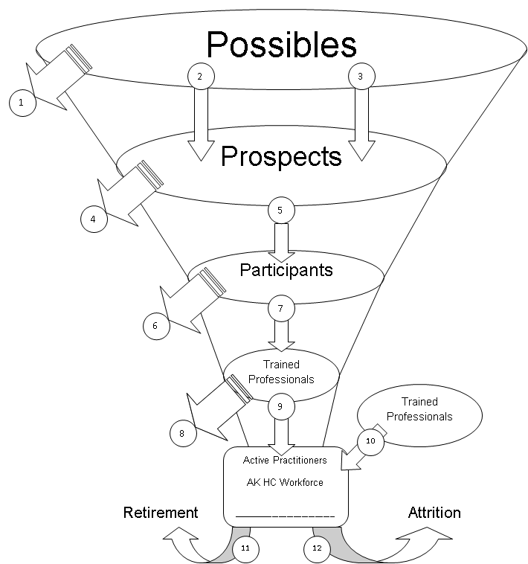
Alaska’s HC Workforce System
Healthcare workforce is an interagency and inter-disciplinary issue.
Possibilities for changing the “flow” exist at each level.

Slide 20
SHARP: History
Year
Milestone
2008
2009
2010
2012
2013
2015
2016
2018
2019
Dental Workforce: HRSA Grant
SHARP-1: 1st HRSA Grant
SHARP-1: 1st Contracts Issued
SHARP-2: Passes Unanimously
SHARP-2: 1st Contracts Issued
SHARP-1: 3rd HRSA Grant
SHARP-2: Last Contracts Issued
SHARP-1: 4th HRSA Grant
SHARP-3: Passes Unanimously

Slide 21
SHARP: Experience

Slide 22
Data Collection & Analysis
Quarterly Work Reports
Practice Sights (Prism)
Reports to:
  Federal HRSA
  AK MH Trust
  DHSS

Slide 23
SFY 2017-2020: Care Visits
Unduplicated visit count, within clinician .. (without pharmacists)

Slide 24
SFY’16-’20: Communities

Slide 25
SHARP: Budget
Total Contract Budget To-Date - Since Program Inception

Slide 26

SHARP-3: The Road Ahead
Many more occupations can participate
Available statewide … No HPSAs
Broadens healthcare employer eligibilities
Agency eligibility based on 30% or more of patients “underserved”
Status: Regs review
[See copy of Statute & Regs]

Slide 27
SHARP-3: Practitioner Tiers
Occupations – Examples - by Tier
Tier-Level | Behavioral | Dental | Medical
Tier-1 *** | Psychiatrist | Dentist | Physician, Pharmacist
Tier-2 *** | PA, NP, RN, LPC | RDH | PA, NP, Midwife, RN, PT
 | LCSW, LMDT, BCBA
Tier-3 | All other health occupations not listed as T1 or T2 | All other health occupations not listed as T1 or T2 | All other health occupations not listed as T1 or T2
*** must have full license, & do direct patient care

Slide 28
SHARP-3: Award Amounts
Annual Contract Values
Tier-Level | Regular Fill | Very Hard-to-Fill
Tier-1
Full-Time | $35,000 | $47,250
Half-Time | $17,500 | $23,625
Tier-2
Full-Time | $20,000 | $27,000
Half-Time | $10,000 | $13,500
Tier-3
Full-Time | $15,000 | $20,250
Half-Time | $7,500 | $10,125

Slide 29

For more information...
Robert Sewell, Ph.D.
Alaska’s SHARP Program
robert.sewell@alaska.gov
(907) 465-4065
SHARP website at:
http://dhss.alaska.gov/dph/healthplanning/pages/sharp/
Acknowledgements:
SHARP has received program support from the U.S. Health Resources and Services Administration (#H56CR25037), the Alaska Mental Health Trust Authority, the Mat-Su Health Foundation, & Alaska Division of Public Health.
Matthew Dudzic & Sara Seitz are thanked for organizing this presentation.

Slide 30
Office of Statewide Health Planning and Development (OSHPD)
California’s Physician Workforce Programs
Maryland Loan Assistant Repayment Program Workgroup
March 12, 2021

Slide 31
Contents
Organization Overview
Loan Repayment Programs
Scholarship Programs
Physician Residency Programs
Challenges

Slide 32
Healthcare Workforce Development Division
Conducts healthcare workforce research to identify areas of unmet need and understand the healthcare education pipeline.
Educates decision-makers about the healthcare workforce.
Provides financial incentives to encourage:
  Under-represented groups to pursue healthcare careers.
  Individuals and organizations to provide services in areas of unmet need
Financial incentives include loan repayment programs, scholarship programs, and grants to residency programs.

Slide 33
Loan Repayment Programs
Allied Healthcare Loan Repayment (AHLRP)​
Advanced Practice Healthcare Loan Repayment (APHLRP)​
Bachelor of Science in Nursing Loan Repayment (BSNLRP)​
California State Loan Repayment Program (SLRP)
County Medical Services (CMSP) Loan Repayment Program (LRP)
Licensed Mental Health Services Provider Education (LMHSPEP)​
Licensed Vocational Nurse Loan Repayment (LVNLRP)​
Steven M. Thompson Physician Corps Loan Repayment (STLRP)

Slide 34
California State Loan Repayment Program (SLRP)
Funding:
Health Resources and Service Administration grant: $1M
Song-Brown state funds: $333,000
Mental Health Workforce Investment state General Fund: $1M
Award Structure:
Eligible sponsoring organization/practice sites must match the award dollar for dollar, up to $50,000 maximum award
Can receive award until no further qualifying loans
Disciplines:
Primary Care: primary care physicians, physician assistants, nurse practitioners, pharmacists, and certified nurse midwives
Mental Health: psychiatric nurse specialists, licensed clinical social workers, licensed professional counselors, licensed marriage and family therapists, and health service psychologists
Dental: dentists and registered dental hygienists

Slide 35
County Medical Services Program Loan Repayment Program (CMSP LRP)
OSHPD is contracted by CMSP to administer the program to increase the number of providers in the 35 participating CMSP counties
Funding:
$2M grant from CMSP
Award Structure:
Award amount up to $50,000:
  Two-year full-time and two-year half-time initial service agreements
  One-year extension agreements
  Can receive award until no further qualifying loans
Disciplines:
Family Medicine, General Internal Medicine, General Psychiatrics, Obstetrics/Gynecology, Primary Care Nurse Practitioner, Primary Care Physician Assistant, and General Dentist.

Slide 36
Steven M. Thompson Physician Corps Loan Repayment Program (STLRP)
Increase the number of culturally and linguistically competent physicians practicing in medically underserved areas of California.
Funding:
$25 licensing fee from the Medical Board of California and Osteopathic Medical Board of California.
$1 million from the Managed Care Administrative Fines and Penalty Fund.
Other funding from private sources and state General Fund
Award Amount:
Up to $105,000 in exchange for three years of service:
  65 percent of funds must be given to primary care doctors.
  15 percent of funds must be directed to geriatric physicians.
  No more than 20 percent may be directed to other specialties.

Slide 37
Steven M. Thompson Physician Corps Loan Repayment Program: Disciplines
Disciplines:
Physicians (MD/DO) – Family Medicine, General Internal Medicine, General Pediatrics, Obstetrics/Gynecology, Gerontology, Psychiatry, Emergency Medicine, Surgery, and Oncology

Slide 38
Loan Repayment Awards Summary
Program | Number of Awards | Amount Awarded
CMSP Loan Repayment * | 51 | $1,720,463
SLRP | 118 | $1,838,200
STLRP * | 121 | $12,020,551
TOTALS | 290 | $15,579,214
*Last funding cycle, 2020 awards still in progress

Slide 39
Song-Brown Workforce Training Program
Health and Safety Code 128200-128241
Grants to health profession educational institutions to improve primary care provider access in medically underserved areas, using the following priorities:
  Clinical training in areas of unmet need
  Placement of graduates in areas of unmet need
  Recruitment of underrepresented racial and ethnic populations
  Disciplines: Family Medicine (FM), Primary Care (Internal Medicine, Obstetrics/Gynecology, Pediatrics), Family Nurse Practitioners/Physician Assistants (FNP/PA), and Registered Nurses
California Healthcare Workforce Policy Commission:
  15-member advisory board provides expertise on healthcare workforce issues
  Sets policy and recommends awards

Slide 40
Psychiatric Residency Expansion
  California Mental Health Services Act provides funding for workforce, education, and training programs
  Instituted a new Psychiatric Education Capacity Program:
    Expands the number of California psychiatric residency and public mental health nurse practitioner training programs.
    Awarded almost $12M to support three psychiatry residency programs, adding 36 new residency slots

Slide 41
Challenges
Overlapping loan repayment and scholarship programs
Insufficient funding to award all eligible applicants
Certain qualified SLRP practice sites lack non-federal matching funds to attract and retain medical providers
COVID-19 pandemic shutdown caused awardees to move out of state, change jobs, or reduce their hours.
  Extended awardee grant end dates to complete service obligations

Slide 42
MLARP Workgroup Meeting
Provider Data for Shortage Designations
Elizabeth Vaidya, Director of the Primary Care Office (PCO)
March 12, 2021 10:00 am - 12:00 PM

Slide 43
Primary Care Office (PCO)
Background & Purpose

Slide 44
Primary Care Office (PCO)
Background
  Mission – To improve access to dental, mental and primary care health services for all Maryland residents.
  Source – Federally funded grant from the Health Resources & Services Administration’s (HRSA’s) Bureau of Health Workforce and housed within MDH’s Office of Population Health Improvement (OPHI).
  Staff – Comprised of two members: Director and Health Policy Analyst

Slide 45
Principal Functions
Background
Shortage Designation
Workforce Development
Technical Assistance
Data Collection
Community Engagement
Shortage Designations
Workforce Development
Community Engagement
Data Collection
Technical Assistance:
  Data, Maps, Needs Assessment
Notes:
Although we have several functions, the key point here is that they all revolve around our primary function of analyzing areas of Maryland to be designated as a federally designated underserved area.

Slide 46
Shortage Designation
Data & Sources
Notes:
Next up, are Logistics.

Slide 47
PCO Shortage Designation – Types & Disciplines
Shortage Designation
Health Professional Shortage Areas (HPSAs)
Medically Underserved Areas/ Medically Underserved Populations (MUA/MUPs)
Other Facility Area Centers (OFACs)
Geographic Boundaries
Special Populations (homeless, Medicaid, etc.)
Auto HPSAs/FQHCs
Assigned a score (0-26) for priority funding by some workforce programs
Primary Care
Mental Health
Dental
Geographic Boundaries
Special Populations (homeless, Medicaid, etc.)
Primary Care
Correctional Institutions
Public or Non-Profit Private Facilities
State or County Mental Hospitals
Assigned a score (0-26) for priority funding by some workforce programs
Primary Care
Mental Health
Dental
Notes:
Shortage designations are based on federal regulations and guidance. They are based on the principal of not having enough providers to serve the population. There are different types and disciplines for shortage designations.

Slide 48
Benefits
Shortage Designation
Component for Eligibility for certain HRSA Grants like:
  Rural Health Center applications
  Area Health Education Centers
  Federally Qualified Health Centers or Look-Alikes
CMS Physician Bonus Payments
State and Federal Workforce Programs
  National Health Service Corps’ Loan Repayment and Scholarship Programs
  Nurse Corps Loan Repayment and Scholarship Programs
  MHEC’s Janet L Hoffman Loan Assistance Repayment Program
  Maryland Dent Loan Assistance Program
  Maryland state loan repayment program
  Preceptor Tax Credit Program
  J-1 Visa Waiver & National Interest Waiver Programs
    Appalachian Regional Commission
    Department of Health and Human Services (HHS)
Notes:
The benefits of shortage designations are more than what is listed here, but these are the most sought after.

Slide 49
Types of Providers Reviewed
  Shortage Designation
Primary Care Providers (MDs and DOs)
General Practice
General Internal Medicine
Family Practice
Pediatrics
Obstetrics and Gynecology
Mental Health Providers
Psychiatrist
Clinical Psychologist
Clinical Social Worker
Psychiatric Nurse Specialist
Marriage/Family Therapist
Licensed Clinical Professional Counselor
Dentists (DDS and DMD)
General Dentistry
Pediatric Dentistry
Notes:
Even though shortage designations benefit a plethora of providers from physicians, nurses, social workers, counselors, and many more! The only providers that the federal grant requires the PCO to review are listed here. We do not collect data on physician assistants, nurses, or specialists. The data for the providers in the dark grey boxes under mental health are only collected by communities or organizations when surveying for us. We can also collect data from Core Service Agencies. HRSA allows PCOs throughout the US to review mental health providers 3 different ways, by psychiatrist only, by mid level only, or by all three together. Maryland generally only uses psychiatrist data only.

Slide 50
Provider Data Cycle
Data & Sources
PERFECT WORLD SCENARIO
Data Sources
Shortage Designation Survey
Medicaid Claims
Access Barriers
Benefits
Shortage Designations
Recruitment & Retainment of Providers
License Board Websites
Alignment of State Funds to Needs of the State
Provider Availability to Residents
Types of Providers
Capacity
Open Panels
Community Surveys
Internet Search
Insurance
I
III
II
Notes:
In a “perfect world” all our data sources listed under Section 1 would provide enough data to analyze all Access barriers listed under Section 2. With all barriers identified, the PCO could provide all the necessary benefits under Section 3 needed to recruit and retain providers through out the state. However, this is not a “perfect world”, our sources are limited and does not provide all of the details. The PCO had an MOU with the BOP license board to incorporate the shortage designation survey into its license renewal. Although not a perfect solution because it did not include all provider types needed like dentists or mental health mid-levels, it was a fantastic solution that most states still do not have. However, after hearing about it, some states have mimicked. Effective Dec 2018, the Maryland BOP ended agreements throughout the state to provide physician data. Since the survey is no longer available, the PCO no longer has a data source to update detailed provider data for shortage designations. We do receive Medicaid claims data for primary care, dental and mental health. Great data, but only useful for high poverty areas of Maryland. Some smaller rural counties at times will survey through the LHD or hospitals that volunteer staff that have other duties to perform. This leaves the PCO to perform Internet searches to try to find data on providers for validation. Since there are thousands of providers, every provider cannot be checked by a staff of two. This also does not cover specialists or other types of provider inquiries that our office is also asked about. If we had better data sources, Maryland would be able to determine all of its barriers better to provide needed resources in communities to improve access to healthcare.

Slide 51
Poll of 37 States – Provider Validation
Data & Sources
86.5%
Utilizes a provider survey
64.8%
Survey in physician license renewal process
27%
Utilizes Medicaid data
40.5%
Utilizes license board data
Notes:
There is a PCO office in every state and territory of the US. Since Congress has mandated that each PCO office update provider data within the federal database annually, validation is an important subject to most PCOs. I sent out a poll to all PCOs and also pulled data from the State Health Workforce Data Collection Inventory’s website. I was able to gather how 32 states collected provider data. Almost 87% of participating states utilize a provider survey to collect data. 65% of provider surveys are incorporated in the retrospective state’s license renewal process. Some states questions are directly in the questions of the license renewal application like Maryland prior to 2018. While others are electronically embedded as a different document to complete. Some surveys are mandatory while others are not. 41% of states utilizes license board data from websites or reports. As Maryland does now. Only 27% of states are able to utilize Medicaid data from their state programs. Maryland is very lucky to be a part of this group that is able to receive Medicaid data.

Slide 52
Provider Data – Validated
Data & Sources
 | Elements | Sources | Disciplines
1 | First & Last Name | BOP, SDMS, Medicaid, Dental Examiners | PC, MH, D
2 | Specialty | BOP, Dental Examiners | PC, MH, D
3 | License Number | BOP, SDMS, Medicaid, Dental Examiners | PC, MH, D
4 | Practice Site Name | BOP | PC, MH
5 | Public Site Address | BOP, Dental Examiners | PC, MH, D
6 | Primary Practice Address | BOP | PC, MH
7 | Physician Status | BOP, Dental Examiners | PC, MH, D
8 | Practice Jurisdiction | BOP, SDMS, Medicaid | PC, MH, D
9 | Is a provider in a NHSC or Loan repayment program? | Workforce Programs | PC, MH, D
10 | Is a provider on J1-Visa or H-1B Visa? | Workforce Programs | PC, MH
11 | Does a provider accept Medicaid patients? | BOP, Medicaid | PC, MH, D
12 | Does a provider accept Federal SFS? | NHSC | PC, MH, D
13 | % of Patients Seen with Federal SFS | NHSC | PC, MH, D
14 | % of Patients Seen with Medicaid | Medicaid, Workforce Programs | PC, MH, D
15 | Eligible Medicaid Population | Medicaid | PC, MH, D
Notes:
The next few slides will go over the required data necessary to analyze Maryland communities' access to providers per our grant requirements. These 15 elements listed can be validated through the BOP’s website, SDMS database, Medicaid claims, Dental Examiner’s website and/or via workforce programs. However, this is only for MDs/DOs for the provider types that we went over in the previous slide. The PCO does not have consistent access to data for mid-level providers. These data elements are our most verifiable and come from our most consistent sources.

Slide 53
Provider Data – Inferred
Data & Sources
 | Elements | Sources | Disciplines
1 | Is a provider a Fed Employee? | Address/Site Name | PC, MH, D
2 | Does a provider provide direct care? | BOP, Medicaid, Address/Site Name | PC, MH, D
3 | Is provider in practice? | BOP, Medicaid, Dental Examiners, Community | PC, MH, D
4 | Is provider solely in administration, research or teaching? | Address/Site Name, Community | PC, MH, D
5 | Does provider work exclusively in inpatient or emergency room care? | Address/Site Name & Specialty | PC, MH, D
6 | Practice Setting (Outpatient VS Inpatient) | Address/Site Name & Specialty | PC, MH, D
Notes:
All six of these data elements were previously validated by the agreement that ended with the BOP. Now these data must be inferred. For example…. If we come across the name of a military base or veteran’s hospital we can look up the address and log into the database that the employees there are federal and do not see the general public in Maryland. However, this is only when we can connect the dots. This is the same for all six elements, the connection must be inferred and is not a direct link to the data.

Slide 54
Provider Data – Not Validated
Data & Sources
 | Elements | Sources | Disciplines
1 | Practice Hours per Week | NONE | PC, MH, D
2 | Does a provider accept New Patients? | NONE | PC, MH, D
3 | Waiting Time for Appointment - days (Current Patients) | NONE | PC, MH, D
4 | Waiting Time for Appointment - days (New Patients) | NONE | PC, MH, D
5 | Date of Birth (for dentist only) | NONE | D
6 | Number of Dental Assistant (for dentist only) | NONE | D
Notes:
These six data elements cannot be validated at all. The only way to validate these data elements is if the community surveys. Communities rarely survey. The first two elements were previously validated by the agreement with BOP; practice hours and acceptance of new patients. At this time, we assume that providers are working 40 hours a week. The other elements we are not able to answer.

Slide 55
Dental, Primary Care & Mental Health Provider Concerns
Provider Data Concerns
Not able to source FTE, federal physicians, inpatient only, teaching/administration only, and insufficient capacity data.
Only physician data is received, need mid-level data for:
  Clinical Psychologist
  Clinical Social Worker
  Psychiatric Nurse Specialist
  Marriage and Family Therapist
  State needs may include assessing all providers among all disciplines
Rely on communities with limited resources to do surveying.

Slide 56
Results & Next Steps
Provider Data Concerns
Results:
  Fewer Shortage Designations are made without valid provider sources.
  Not able to do insufficient capacity designations.
Next Steps:
  A survey should be included with all license renewals that is separate, but required to complete.
  Establish a central data collection unit for the state
  Establish State defined parameters for population to provider ratios to determine where state resources should go.

Slide 57

Questions
Time to Hear From You
This Photo by Unknown Author is licensed under CC BY-SA
Notes:
It is now time for me to be quiet and to listen to you. Does anyone have any questions or comments?

Slide 58
Thank You!
PCO Contact Information
Elizabeth Vaidya, Director
Primary Care Office
  (410) 767-5695 office
  (443) 977-0417 cell
  Elizabeth.vaidya@maryland.gov

Slide 59
Discussion
Notes:
Cheryl

Slide 60
Discussion
MLARP Workgroup Meeting
Starter Topics
What stakeholder/partner support is necessary?
Methods to determine partner interest/willingness?
Subgroup structures to focus on:
  Diversifying revenue sources;
  Building robust workforce data;
  Recommending pre-residency/graduation incentives

Slide 61
Next Steps
Notes:
Sara

Slide 62
Next Steps
MLARP Workgroup
I. Action steps for members
II. Next Meeting
  Goals
  May 14, 2021; 10:00 a.m.
III. Notes
  Please continue to upload relevant resources and data to the workgroup’s dedicated Google Drive
  Additional comments/needs: Email sara.seitz@maryland.gov
Notes:
Sara

Slide 63
Open Discussion
Notes:
Sara

Slide 64
Questions: sara.seitz@Maryland.gov
Adjournment
Notes:
Sara
Motion to adjourn

