Slide 1
All Hazards Hazard Agnostic Problem Solving Across All Phases of Emergency Management
Chas Eby
2 October 2018

Slide 2
Takeaways
Same role across consequence management: identify problems; coordinate; info & resource support to stakeholders, esp. the *local* level
Plans, programs, activities specific to you
Winter’s coming...NOAA 2018-19 outlook

Slide 3
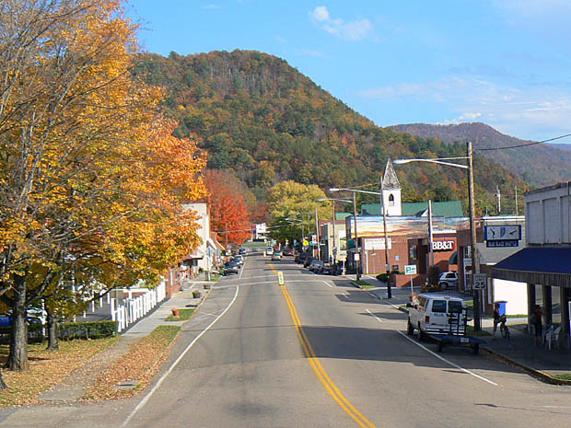
The Story of Two Maryland Towns
Goofusburg
Gallantville

Slide 4
The Story of Two Maryland Towns
Goofusburg
Gallantville
Population: 54,362
100-year flood plain
Avg. 8 weather incidents/ year
4 volunteer fire departments
700 LE officers
EMAP certified
State of the art EOC
WebEOC 8.2
Population: 55,104
100-year flood plain
Avg. 8 weather incidents/ year
4 volunteer fire departments
695 LE officers
EMAP certified
State of the art EOC
WebEOC 8.2

Slide 5
The Story of Two Maryland Towns
Goofusburg
Gallantville
Population: 54,362
75 Year Flood Plain
8 major weather events a year
4 fire houses
700 police
EMAP certified
State of the art EOC
WebEOC 8.2
Population: 55,104
75 Year Flood Plain
8 major weather events a year
4 fire houses
695 police
EMAP certified
State of the art EOC
WebEOC 8.2
Poor public health
No land use zoning
Low building code enforcement
Ancient storm drain systems
Food deserts
Strong public health programs
Regulates land use
Building codes strictly enforced
New storm drain systems
Accessible and affordable food

Slide 6
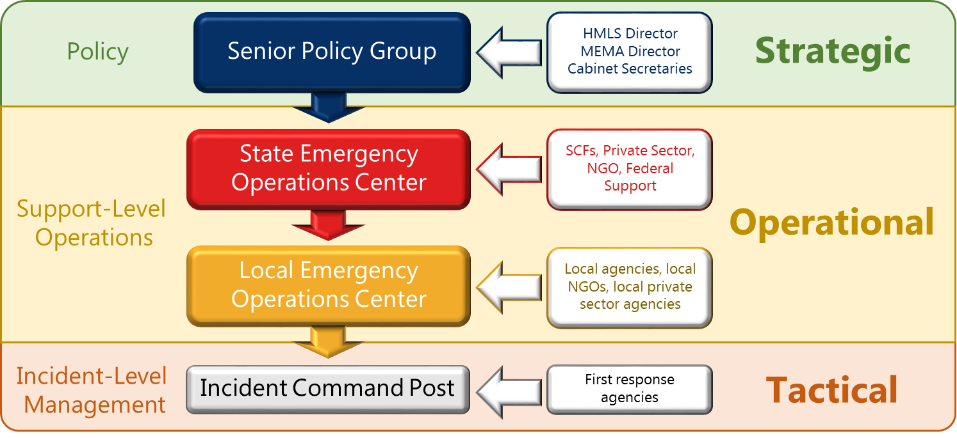
Levels

Slide 7
Planning
Consequence Management Operations Plan - 2017
Prevention Chapter – 2017
Response Chapter – 2017
Recovery Chapter – 2017
State Coordinating Function Plans – 2018
Annexes
Annex 1 - Fleet Week 2018
Annex 2 - Gubernatorial Inauguration 2019
Annex A - Fixed Nuclear Facilities - 2017
Annex B - Cyber Disruption - 2016
Annex C - Highly Pathogenic Avian Influenza - 2015
Annex D – Emergency Repatriation – 2018
Attachments
Attachment a – Disaster Assistance Appendix - 2018
Attachment b – State Evacuation Appendix - 2018
Attachment c – Tropical Cyclone Appendix - 2018
Attachment d – Winter Weather Appendix - 2018
Attachment e – Ocean City Relocation Plan - 2018
Attachment f – CBRNE Appendix - 2019
Attachment g – CCTA Appendix - 2019
Attachment h – Debris Management Appendix 2018
Guides
Guide I - Maryland Plan Development Process - 2016
Guide II - Maryland Special Event Guide - 2018
Guide III - Advance Team & Duty Officer - 2017

Slide 8
Planning
Disaster Assistance Appendix
Consequence Management Operations Plan - 2017
Prevention Chapter – 2017
Response Chapter – 2017
Recovery Chapter – 2017
State Coordinating Function Plans – 2018
Annexes
Annex 1 - Fleet Week 2018
Annex 2 - Gubernatorial Inauguration 2019
Annex A - Fixed Nuclear Facilities - 2017
Annex B - Cyber Disruption - 2016
Annex C - Highly Pathogenic Avian Influenza - 2015
Annex D – Emergency Repatriation – 2018
Attachments
Attachment a – Disaster Assistance Appendix - 2018
Attachment b – State Evacuation Appendix - 2018
Attachment c – Tropical Cyclone Appendix - 2018
Attachment d – Winter Weather Appendix - 2018
Attachment e – Ocean City Relocation Plan - 2018
Attachment f – CBRNE Appendix - 2019
Attachment g – CCTA Appendix - 2019
Attachment h – Debris Management Appendix 2018
Guides
Guide I - Maryland Plan Development Process - 2016
Guide II - Maryland Special Event Guide - 2018
Guide III - Advance Team & Duty Officer - 2017

Slide 9
Planning
Consequence Management Operations Plan - 2017
Prevention Chapter – 2017
Response Chapter – 2017
Recovery Chapter – 2017
State Coordinating Function Plans – 2018
Annexes
Annex 1 - Fleet Week 2018
Annex 2 - Gubernatorial Inauguration 2019
Annex A - Fixed Nuclear Facilities - 2017
Annex B - Cyber Disruption - 2016
Annex C - Highly Pathogenic Avian Influenza - 2015
Annex D – Emergency Repatriation – 2018
Winter Weather Appendix
Attachments
Attachment a – Disaster Assistance Appendix - 2018
Attachment b – State Evacuation Appendix - 2018
Attachment c – Tropical Cyclone Appendix - 2018
Attachment d – Winter Weather Appendix - 2018
Attachment e – Ocean City Relocation Plan - 2018
Attachment f – CBRNE Appendix - 2019
Attachment g – CCTA Appendix - 2019
Attachment h – Debris Management Appendix 2018
Guides
Guide I - Maryland Plan Development Process - 2016
Guide II - Maryland Special Event Guide - 2018
Guide III - Advance Team & Duty Officer - 2017

Slide 10
Planning
Consequence Management Operations Plan - 2017
Prevention Chapter – 2017
Response Chapter – 2017
Recovery Chapter – 2017
State Coordinating Function Plans – 2018
Annexes
Annex 1 - Fleet Week 2018
Annex 2 - Gubernatorial Inauguration 2019
Annex A - Fixed Nuclear Facilities - 2017
Annex B - Cyber Disruption - 2016
Annex C - Highly Pathogenic Avian Influenza - 2015
Annex D – Emergency Repatriation – 2018
Attachments
Attachment a – Disaster Assistance Appendix - 2018
Attachment b – State Evacuation Appendix - 2018
Attachment c – Tropical Cyclone Appendix - 2018
Attachment d – Winter Weather Appendix - 2018
Attachment e – Ocean City Relocation Plan - 2018
Attachment f – CBRNE Appendix - 2019
Attachment g – CCTA Appendix - 2019
Attachment h – Debris Management Appendix 2018
Guides
Guide I - Maryland Plan Development Process - 2016
Guide II - Maryland Special Event Guide - 2018
Guide III - Advance Team & Duty Officer - 2017
Maryland Plan Development Process

Slide 11
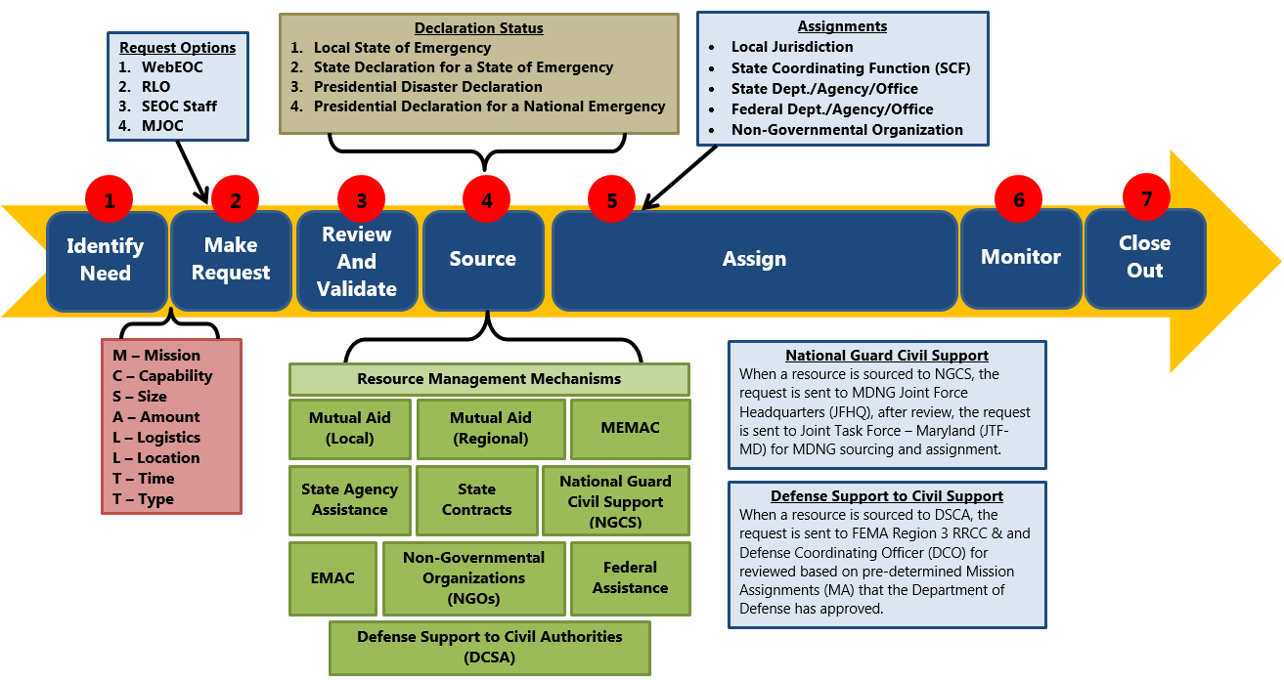
Resource Coordination

Slide 12
Incident Management Team
Forthcoming information…

Slide 13
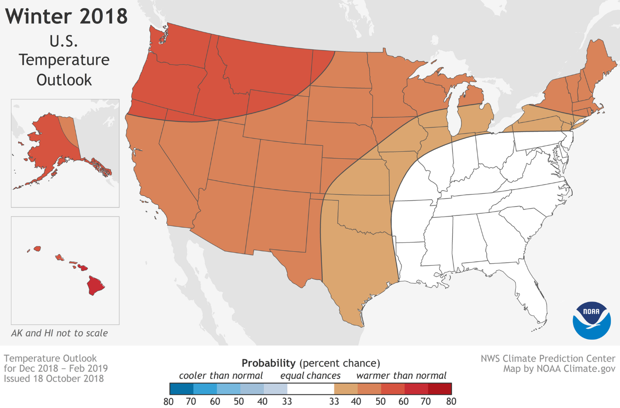
Notes:
A mild winter could be in store for much of the United States this winter according to NOAA’s Climate Prediction Center. In the U.S. Winter Outlook for December through February, above-average temperatures are most likely across the northern and western U.S., Alaska and Hawaii. Additionally, El Nino has a 70 to 75 percent chance of developing.
The Southeast, Tennessee Valley, Ohio Valley and Mid-Atlantic all have equal chances for below-, near- or above-average temperatures.

Slide 14
Notes:
Wetter-than-average conditions are favored across the southern tier of the U.S., and up into the Mid-Atlantic. Northern Florida and southern Georgia have the greatest odds for above-average precipitation this winter.

