Slide 1
MARYLAND DEPARTMENT OF HEALTH
FORENSIC CHALLENGES IN DETERMINING CAUSE OF DEATH
David R. Fowler MB. ChB. M.Med. Path.(Forens) FCAP FAAFS FNAME
Chief Medical Examiner, State of Maryland
July 2018

Slide 2
Fentanyl 2013

Slide 3
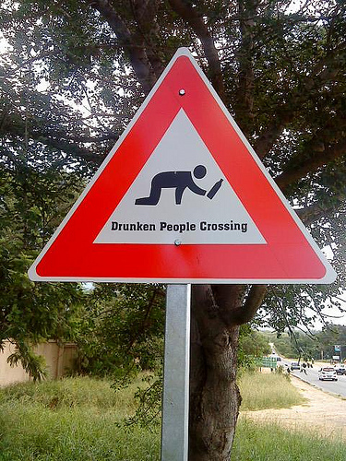
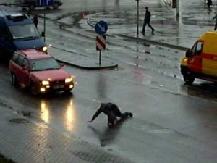
Problem or Symptom?

Slide 4
Fatal overdoses in Carroll up 76 percent over first half of 2018
Jon KelveyContact ReporterCarroll County Times
Carroll County saw a 76 percent increase in fatal drug and alcohol overdoses in the first six months of 2018 over the first half of 2017.
That’s according to new statistics from the Carroll County’s Sheriff’s Office, which recorded 44 overdose deaths from January through June this year. There were 25 such fatalities recorded in the first six months of 2017, and 48 in all of 2017, according to Sheriff’s Office statistics.

Slide 5
Challenge?
Appeals Court Overturns Overdose Manslaughter Conviction; ‘State Failed To Establish A Casual Connection’
BERLIN — It remains possible and likely probable that prosecutors will continue to try and convict drug dealers when their customers die, but in at least one local case, a state appeals court has made it more difficult.
In what has become an increasingly utilized weapon in the battle over the growing heroin epidemic, prosecutors have been successful in gaining manslaughter convictions for drug dealers whose customers fatally overdose. There have been a handful of such cases already in Worcester County where heroin dealers have been found guilty of manslaughter when he or she supplied the drugs that ultimately caused the fatal overdose of another individual.

Slide 6
Cases Reported to OCME 2007- 2017

Slide 7
Autopsy Cases 2007 to 2016 (2017 pro-rated based on first quarter)

Slide 8
Heroin and Fentanyl 2016

Slide 9
OCME Policy
Over 55 with no suspicion
Heart disease
Release directly to Funeral Home
No autopsy
No Toxicology
How many are we missing
How many are not reported to OCME
Repeat for 50 states!

Slide 10
Heroin and Fentanyl 2016

Slide 11
Fentanyl 2016

Slide 12
MMWR Weekly / January 6, 2017 / 65(52);1497 QuickStats: Rates of Drug Overdose Deaths Involving Heroin,* by Selected Age Groups — United States, 2006–2015 Holly Hedegaard, MD, Margaret Warner, PhD; Arialdi M. Miniño, MPH

Slide 13
Heroin and Fentanyl 2016

Slide 14
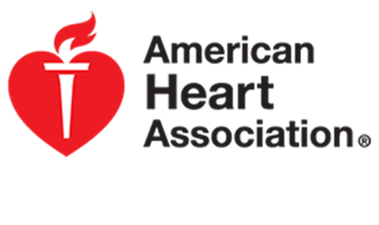
Lies, Damn Lies and Statistics
“Latest statistics show heart failure on the rise; cardiovascular diseases remain leading killer”
How many are missed drug deaths

Slide 15
Rise in heart disease deaths sends experts down new paths Aneri Pattani | @aneripattani Published 8:56 AM ET Thu, 22 Dec 2016 | Updated 10:31 AM ET Thu, 22 Dec 2016
“The number of Americans dying of heart disease increased last year for the first time in more than a decade, delivering a wake-up call to the medical and scientific communities. After nearly 40 years of victories in the battle against heart disease — from the development of medications to control blood pressure and cholesterol to the public campaign against smoking — heart health experts are now facing a stark truth: Progress has stalled.”

Slide 16
Take Home Message
If it makes no sense, it makes no sense!
Always Question Assumptions!

Slide 17
Lies, Damn Lies and Statistics
2017 provisional data suggests 62,000 deaths

Slide 18
Toxicology Issues: The New Peak
Rapid development of analogs
Lack of laboratory capacity in U.S.
Lack of control substances to validate assay method and calibrate equipment
DEA precluded from assisting
Time lag to develop new methods
Cost of new assays ($30K)

Slide 19
Post Mortem Toxicology
Interpretation of results
Rapidity of death
Levels of detection
List of substances on assay
Redistribution
Stability of the substance
Metabolism
Protein binding
Storage of specimen
Time and quality

Slide 20
Questions?

