Slide 1
Active Assailant Events
Local Best Practices
Greg Ford MA, BSN, RN
PHEP-St. Mary’s County

Slide 2
ESF-8’s Role in an Active Shooter Event
Primary role: Mass Casualty/Mass Fatality Management
Coordination with EMS providers
Victim Identity/Information
Coordination with local morticians/funeral homes
Identification of health hazards resulting from incident
Secondary role: support for reunification/sheltering ops
SMC-DSS is primary on reunification, coordination with SMCPS

Slide 3
The Plan: EOC Activation
Upon notice of activation from Emergency Services:
One SMCHD representative (myself or HO) to EOC for representation
One representative from each ESF to coordinate field operations
EM is conduit for internal information related to incident
PIO/JIC conduit for external information
Upon decision whether MCI or support role (for LHD)
Multiple representatives from SMCHD programs (LBHA, Community Outreach) respond to Forrest Technical Center for Reunification operations
Assist DSS, SMCPS, Walden, etc. for reunification of families, behavioral health, and sheltering (if needed)

Slide 4
The Reality
Great Mills High School-March 21, 2018
On the morning of March 21, 2018, approximately 7:55am, a student carrying a loaded handgun opened fire in a hallway at GMHS. The single shot struck one victim in the head then striking another in a lower extremity. The school resource officer engaged the shooter, firing one shot while the gunman simultaneously fired a self-inflicted shot at himself. The school was immediately placed on lock-down

Slide 5
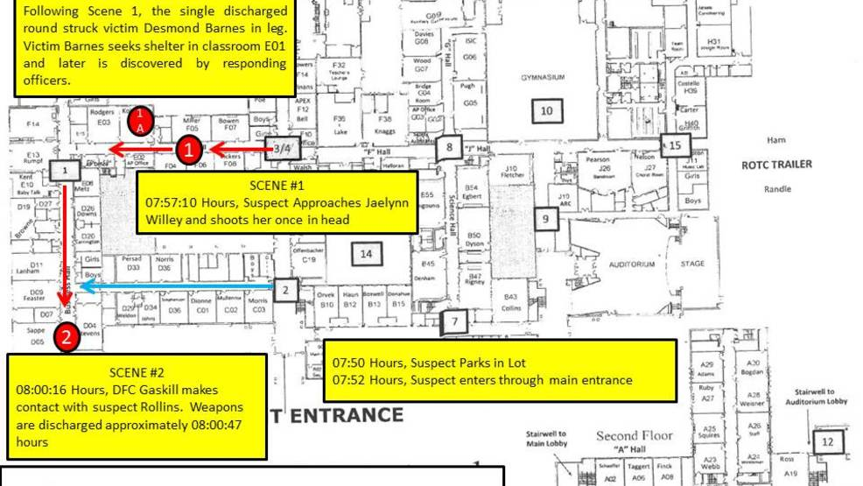

Slide 6
The Reality: EOC
No formal activation or notifications received, even at SMCPS
My notification was relay from my wife, which she got from Facebook
Myself, Director of PHPR, and HO all self-dispatched to EOC
External calls/directions were being made at will
“Chaos” at the EOC, many ESF’s unrepresented
Conflicting reports of # of fatalities
No Joint Information Center/PIO coordination

Slide 7
The Reality: Tech Center Reunification
Extreme difficulty getting to Tech Center due to traffic
Hundreds of parents responding along with 20 buses of evacuees from GMHS
Tech Center located en route to GMHS, closed to traffic
No check-in/credentialing, SMCPS running reunification process
Buses with GMHS students being dropped off at Tech Center, students placed in various gymnasiums/cafeterias, parents convening at Leonardtown HS
Walden took command of behavioral health for witnesses

Slide 8
The Reality: Reunification cont’d
Myself and Dir. Of LBHA set-up command at Tech Center
All DSS responded to Tech Center
Cell towers maxed out-vary little signal to connect externally
Local law enforcement, FBI, and FBI Victim Assistance convened in lobby of Tech Center
Red Cross responded with food, water
Approximately 1,700 students reunited with parent(s) in roughly 7 hours

Slide 9
Recovery
EOC and SMCHD Operations Command stayed on full-activation for several operational periods
Behavioral health became first priority for community
Set-up remote locations with counseling services in libraries, public buildings, etc.
Control of false information proved difficult

Slide 10
Recovery cont’d
Extended as Jaelynn Willey was taken off life support a few days later
Jaelynn Willey was 2nd oldest of nine children
Active family at GMHS and member of swim team
Students returned later in the week to retrieve their belongings following investigation; all schools closed remainder of week
Provided behavioral health services through Spring Break that followed
Large presence of LBHA first school day back following Spring Break

Slide 11
The Good
Inbound assistance from all over state
No ‘turf wars’ amongst responding agencies
Outpouring of support from community
Great cooperation at Tech Center to process as many families as possible

Slide 12
Lessons Learned
Emergency Operations Center
No formal activation sequence
Too many cooks in the kitchen
No Joint Information Center
Lack of or too much agency representation
DSS, Medstar, DPU missing from EOC
No community AAR yet-7 months later
Forrest Tech Center Reunification
No accountability/credentialing/check-in
No formal command structure-SMCPS running the show
Witnesses being interviewed multiple times-
Re-traumatized and possibly PTSD down the road

Slide 13
Take Aways
Practice, practice, practice!
2016-Emergency Services and SMCPS hold active shooter exercise at GMHS-health department not invited
Oct. 2018-Emergency Services and SMCPS hold another active shooter at middle school-health department not invited (I invited myself)
Each agency needs to attend/train for ICS-DSS, LBHA had no training in ICS
ESF #8-phone charger analogy: always overlooked until you get caught needing it

