Slide 1
The State of Community Reception Centers (CRC): Past, Present and Future activities in New York State
Michael Primeau, Director
Office of Health Emergency Preparedness (OHEP) New York State Department of Health (NYSDOH)

Slide 2
The Past

Slide 3
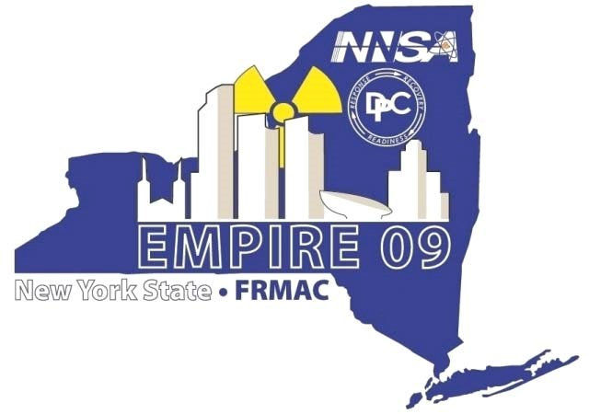
CRC Full Scale Exercise 2009
“Dirty Bomb” – Radiological Dispersal Device (RDD) scenario basis
Multi-agency
  Federal – State – Local
  Health, emergency management, environmental, military, etc.
Notes:
Pulled from Empire 09 AAR (p. 25)
Objective 6: Demonstrate the ability to conduct population monitoring to include bioassays.
This objective was met during the exercise. Population Monitoring was successfully demonstrated at the Community Reception Center (CRC) for one day during the exercise with seamless participation of Federal, State, and local personnel. Activities included development of policies and procedures for establishment and operation of a CRC, “just-in-time” training for CRC personnel, and victim tracking. In all, the community reception center processed 210 victims, decontaminated 20, and collected 41 urine bioassay samples for processing. New York State proactively requested Federal assistance for establishing additional CRCs to conduct population monitoring in response to an exercise inject that other local areas were requesting population monitoring support.

Slide 4
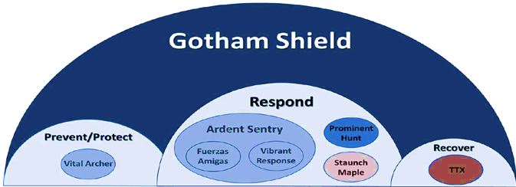
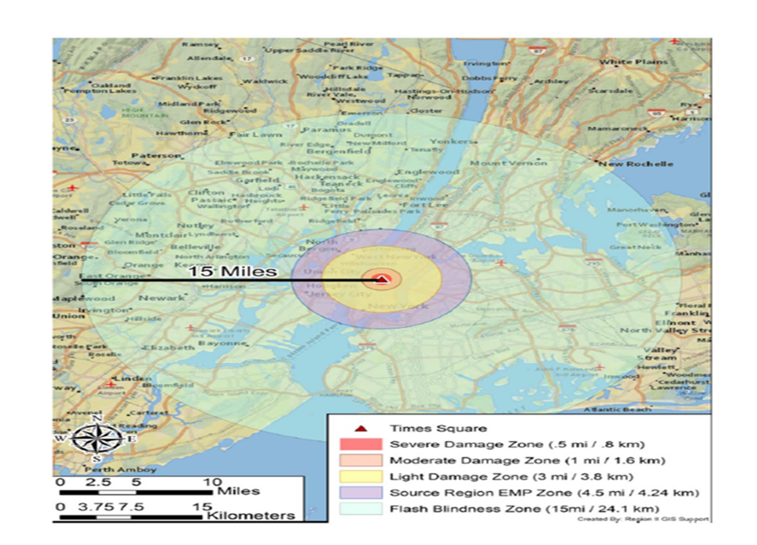
Improvised Nuclear Device Exercise (2017)
Like Empire 09 in partner scope and participation
NYS test of ESFs with federal integration

Slide 5
The Present

Slide 6
Local & State Radiological Activities 2016-2018
14 related multi-agency State and Local exercises, focuses include:
  CRCs and Personnel Monitoring Centers (PMCs)
  Potassium Iodide (KI) Distribution
  Volunteer Reception Centers
  Sheltering Consideration
  Family Assistance Centers
Training initiative of Electronic Data Collection System for CRCs: Countermeasure Data Management System
(CDMs)
Notes:
13 exercises among 6 counties, most were Nuclear Facility (Schoharie outlier).
Almost half (18 of 57) LHDs participated in CDMS for CRC training activities.

Slide 7
NYSDOH Countermeasure Data Management System (CDMS) recognized as “Success Story” by NACCHO
System includes: Web-based Pre-registration, real-time reporting, flexibility to local screening considerations

Slide 8
The Future

Slide 9
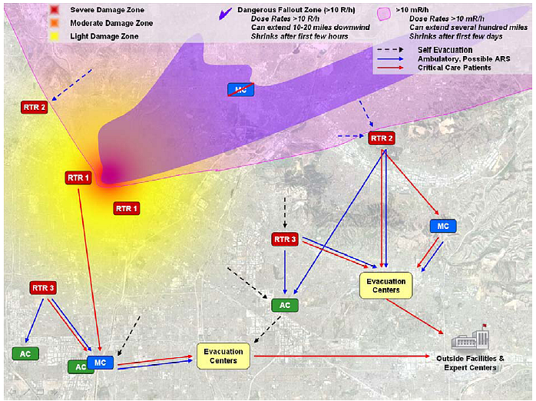
CRC Planning
RTR – Radiation Triage, Treatment and Transport System
CRCs as one of many local operations supported by state and federal agencies evolving through a radiological incident
Source: Planning Guidance for Response to a Nuclear Detonation, Second edition, 6/2010
Notes:
RTR concept was looked at as part of Gotham Shield
Operational impacts going from RTRS with PMCs and CRCs and shelters going on at the same time, along with EMS and medical surge

Slide 10
Down to the Details
Operational planning from concepts to protocols (Staff schedules, Job Aids, etc.)
Planning and Training similarities to other Public Health Response Operations (Points of Dispensing (PODs))
Multi-discipline planning workgroup → Multi-agency planning workgroup
Orange County, NY CRC Exercise 2017 – providing Just-in-Time training for CDMS
Notes:
Drilling down planning documents to better provide examples for operations

Slide 11
? QUESTIONS ?
THANK YOU!
michael.primeau@health.ny.gov

