Slide 1
Planning and Responding to All Hazards: Infectious Diseases 2018 Statewide Fall Preparedness Conference
MARYLAND DEPARTMENT OF HEALTH
Ruth Thompson, Deputy Director
Infectious Disease Epidemiology and Outbreak Response Bureau
October 31, 2018

Slide 2
MISSION AND VISION
Prevention and Health Promotion Administration
MISSION
The mission of the Prevention and Health Promotion Administration is to protect, promote and improve
the health and well-being of all Marylanders and their families through provision of public health
leadership and through community-based public health efforts in partnership with local health
departments, providers, community based organizations, and public and private sector agencies, giving
special attention to at-risk and vulnerable populations.
VISION
The Prevention and Health Promotion Administration envisions a future in which all Marylanders and
their families enjoy optimal health and well-being.

Slide 3
Infectious Disease Outbreaks
Definition varies – may be a single case or a cluster of epidemiologically linked or related cases connected by person, place or time
Are reportable under Code of Maryland Regulations (COMAR) 10.06.01
Might present an infectious disease emergency

Slide 4
Infectious Disease Outbreaks
Might be caused by an infectious disease that is novel or new to a geographic area, an existing infectious disease with a marked increase in cases or geographic spread, or by a biological agent deliberately used to cause illness or death
Infectious Disease Epidemiology and Outbreak Response Bureau (IDEORB), with local health departments, investigates more than 350 outbreaks per year

Slide 5
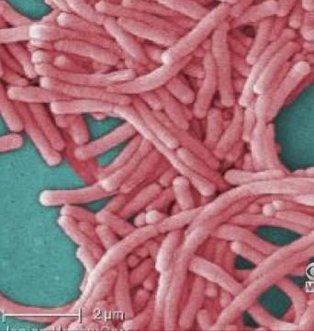
North Baltimore Apartments Affected by Legionnaires’ Disease

Slide 6
Maryland reflects on lessons learned from swine influenza outbreaks at county fairs

Slide 7
Maryland confirms papayas contaminated with Salmonella

Slide 8
Maryland Infectious Disease Response Plan
Developed in 2016 by representatives from local health departments, the Office of Preparedness and Response and the Infectious Disease Epidemiology and Outbreak Response Bureau
Builds on outbreak activities that local health departments in coordination with MDH do everyday
Designed to provide a framework for the coordination of local, state, and federal partners to prevent, control, and or stop the spread of infectious disease
Is scalable and applicable to any infectious disease outbreak or emergency
Includes disease-specific annexes

Slide 9
Plan Assumptions
Outbreaks and public health emergencies might occur with little or no warning
Detection could involve a variety of partners and data sources
Increased international travel might result in the introduction of a novel infectious agent
Control measures might include pharmaceutical and non-pharmaceutical responses
Characteristics of the pathogen and the disease might vary and change over time
Response will follow NIMS/ICS principles

Slide 10
Plan Assumptions
Response will involve local, state, and federal partners
Roles and responsibilities for preparedness and response need to be defined and relationships developed ahead of time

Slide 11
Summary
Maryland currently has an all hazards plan for response to infectious diseases
It is currently being reviewed and will be revised as needed
It will be available once the revisions are complete

