Slide 1
Office of Preparedness and Response (OP&R)
New Employee Orientation
MARYLAND DEPARTMENT OF HEALTH

Slide 2
Presentation Overview
Office of Preparedness and Response
Introduction to OP&R
Why be Prepared?
Steps to Preparedness
Be Informed
Make a Plan
Build a Kit
Get Involved
Conclusion/Learn More
2
Notes:
This is a overview of what we will cover today.
First, we will talk a little about our office and what we do
Next we will go over different types of emergencies and give you reasons why everyone should be prepared.
Then comes the most important part of the presentation in which we will discuss the Steps to Preparedness.
Lastly, we will talk about some preparedness resources where you can look for more information on how to be prepared for any emergency.

Slide 3
Introduction to OP&R
Office of Preparedness and Response
The Office of Preparedness and Response (OP&R) manages two preparedness programs (Public Health Emergency Preparedness and the Hospital Preparedness Programs), collaborating with the following groups:
Local Health Departments
Hospitals
Healthcare Coalitions
Federally Qualified Health Centers
Maryland Emergency Management Agency
Maryland Institute for Emergency Medical Services Systems
Other local and state partners
Federal partners
Notes:
OP&R manages two programs (Public Health Emergency Preparedness and the Hospital Preparedness Programs)
The purpose of these programs is to prepare for and respond to significant public health emergencies
We organize and prepare for public health and medical emergencies through statewide partnerships with public, private and government agencies, such as:
Local Health Departments
Hospitals
Healthcare Coalitions
Maryland Emergency Management Agency and other state partners, such as MIEMSS (state EMS agency), Department of Human Services, Maryland Insurance Administration, and other
Federal partners, such as the Centers for Disease Control and Prevention and the US Department of Health and Human Services Office of the Assistant Secretary for Preparedness and Response (ASPR)

Slide 4
Introduction to OP&R
Office of Preparedness and Response
OP&R coordinates the state’s public health and medical response during an emergency, including:
​​​​Infectious disease outbreaks and pandemics
Natural disasters
Acts of terrorism (use of chemical, biological, radiological, nuclear, and explosive weapons)
MDH employees may be asked to support response to emergencies
Notes:
OP&R is the office at the Maryland Department of Health (MDH) that is responsible for coordinating the public health and medical response during an emergency that occurs in Maryland.
All OP&R staff are trained in the National Incident Management System (NIMS) and Incident Command System (ICS), the standardized approach for managing emergencies, to better integrate and work with other responders
The aim of all these efforts is to increase the capability of the state to coordinate an effective emergency response to ensure the health and safety of Maryland residents.
Examples:
We were and are actively involved in planning, preparing for and responding to the Ebola outbreak of 2014-2015, the Zika virus outbreak, the Opioid crisis, and many winter storms and other emergencies involving severe weather.
MDH employees may be asked to support response to emergencies
Examples include H1N1 response (set up in L-3); the Ebola response/call center (set up in L-2)
Recommended general training includes FEMA IS-100 and IS-700 to learn more about the National Incident Management System (NIMS) and Incident Command System (ICS)

Slide 5
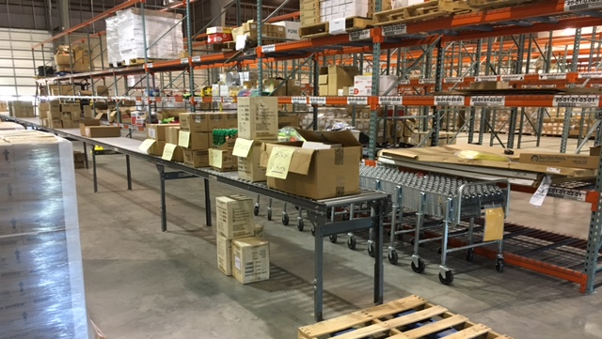
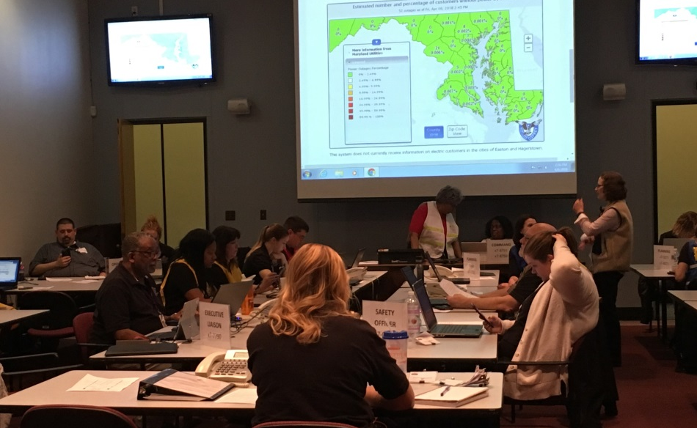
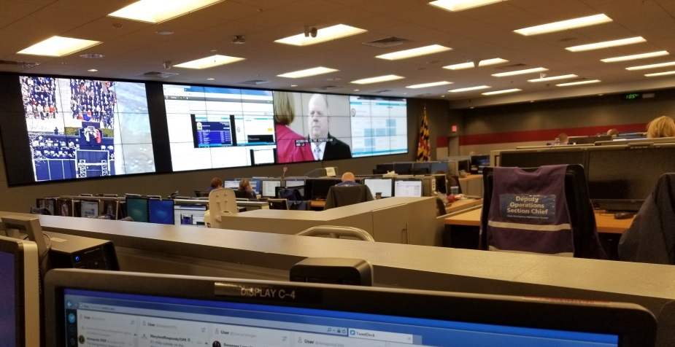
MDH Emergency Response
Office of Preparedness and Response
Notes:
Top left: 2016 Presidential Inauguration at the Alternate Departmental Operations Center
Top right: Warehouse for receipt, staging, and storing of public health and medical supplies for the emergency
Bottom left: MEMA State Emergency Operations Center – Maryland Gubernatorial Inauguration
Bottom right: L-3 set up as the MDH Department Operations Center

Slide 6
COVID-19 Response
Office of Preparedness and Response
Assist with providing guidance to support policy decisions
MDH Call Center
Logistical Support

Slide 7
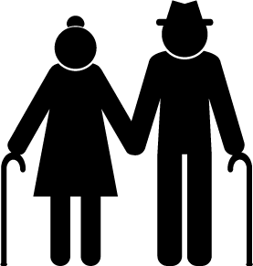
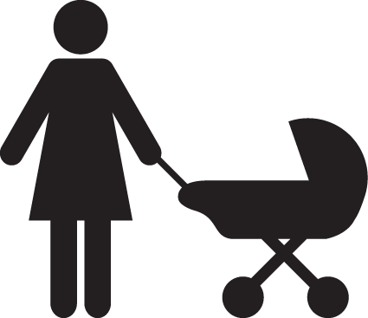
Why Be Prepared?
Office of Preparedness and Response
Emergency resources in your community may be limited
Reduce fear and anxiety
Help you and those around you
7
Notes:
Why be prepared if you are not responding to the emergency?
Families and individuals can better cope with disasters by preparing in advance for emergencies. There are many reasons to start planning and preparing for emergencies today but here are just a few reasons that we thought of.
Emergency resources in your community might be limited. There might not be enough shelter space and necessities for all the people affected by an emergency. Depending on the emergency, medical supplies, hospital beds and medical staff shortages may occur.
When an emergency happens, some of the first things you might panic about are:
How can I contact my family to make sure they are safe?
Where is a safe place to go and how do I get there?
What will I eat and drink?
What if I run out of my medications or medical supplies?
Thinking about and preparing for these questions before-hand can save some in the moment fear and anxiety. By preparing ahead of time you can insert a bit of personal control into an uncontrollable situation.
Most importantly, being prepared helps you and those around you including family, friends and neighbors stay safe. You will also lead by example and your preparations may encourage others in your family and community to be prepared as well.
The best protection = knowing and planning what you should do before a disaster strikes.

Slide 8
Steps to Preparedness
Office of Preparedness and Response
Preparedness!
Get Involved
Build a Kit
Make a Plan
Be Informed
8
Notes:
Here are some ways you can be prepared:
Be Informed
Know what to do before, during, and after an emergency – both at work and at home.
Sign up for emergency alerts through your city or county government and Nixle for State Center alerts
Maryland Prepares app from MEMA allows users to get real time alerts for emergencies, weather and traffic on their Smartphone.
Make a Plan
Have a plan for home and a plan for work
For home:
Create a family communication plan, including out-of-town emergency contacts
Find safe spots in your home if you need to shelter in place
Know where your neighborhood meeting place is for your family if you need to meet outside your home
Know your local emergency evacuation routes
For work:
Know what paths to take and where your office meets if the building is evacuated
Know where Automatic Electronic Defibrillators (AEDs) are within your building
Listen or watch for messaging via intercom system or television monitors
Build a Kit
Should include emergency essentials, such as 3 days worth of food/water/medications, flashlight, cell phone/charger, battery powered radios, first aid kit, cash, and important documents
Additional supplies may include personal hygiene items, pet food/water, baby food/supplies, and a can opener
Be sure to check your kit twice a year and replace items that have been used or expire
Get Involved
There are two great programs you can join to become more involved in emergency preparedness and response within MDH and your community (next slide)

Slide 9
Maryland Responds
Office of Preparedness and Response
OP&R and local health departments coordinate the community-based volunteer program
Supports public health initiatives and response capabilities in Maryland
Assists MDH and local health departments with disaster and emergency response and recovery
Volunteers include physicians, nurses, and other health professionals, as well as non-clinician community members
Notes:
There are a couple of ways to get more involved! The first is through volunteering with Maryland Responds.
OP&R and local health departments coordinate Maryland Responds, the community-based volunteer program
This program supports public health initiatives and response capabilities in Maryland
Assists MDH and local health departments with disaster and emergency response and recovery
OP&R coordinates recruitment, training, activation, and retention of physicians, nurses and other health professionals, as well as community members who volunteer during on-going public health needs and emergencies – you don’t have to be a health professional to join Maryland Responds!

Slide 10
Maryland Responds
Office of Preparedness and Response
Requirements:
18+ years old
Volunteer Orientation Training
Able and willing to assist in an emergency
Participate in annual exercises and drills
Support ongoing public health projects
Notes:
Requirements:
18+ years old
Volunteer Orientation Training (this includes online trainings about the National Incident Management System (NIMS) and Incident Command System (ICS) – IS100 and IS700)
Able and willing to assist in an emergency
Participate in annual exercises and drills
Support ongoing public health projects

Slide 11
Emergency Management Team
Office of Preparedness and Response
MDH employees interested in participating in emergency management and coordination activities
Quarterly meetings
Seasonal or topical emergency discussion
Tabletop exercises
Activities may take place at MDH or at MEMA’s State Emergency Operations Center
Notes:
MDH employees interested in participating in emergency management and coordination activities
Monthly meetings
Seasonal or topical emergency discussion
Tabletop exercises
Activities may take place at MEMA’s State Emergency Operations Center (SEOC)
If you would like more information, please come see me after the presentation.

Slide 12
Conclusion
Office of Preparedness and Response
MDH is responsible for coordinating the state’s public health and medical response for emergencies in Maryland
All MDH employees can take steps to be prepared, both at work and at home
Consider volunteering to become a member of Maryland Responds Medical Reserve Corps or the MDH Emergency Management Team
Notes:
MDH is responsible for coordinating the state’s public health and medical response for emergencies in Maryland
OP&R oversees the day-to-day coordination
But anyone from any part of MDH may be asked to assist during an emergency
All MDH employees can take steps to be prepared, both at work and at home
Consider volunteering to become a member of Maryland Responds Medical Reserve Corps or the MDH Emergency Management Team

Slide 13
Learn More
Office of Preparedness and Response
Office of Preparedness and Response
300 W. Preston Street, Suite 202 Baltimore, Maryland 21201 (410) 767-0823
preparedness.health.maryland.gov
Maryland Responds Medical Reserve Corps
mdresponds.health.maryland.gov

Slide 14
Questions?

