Slide 1
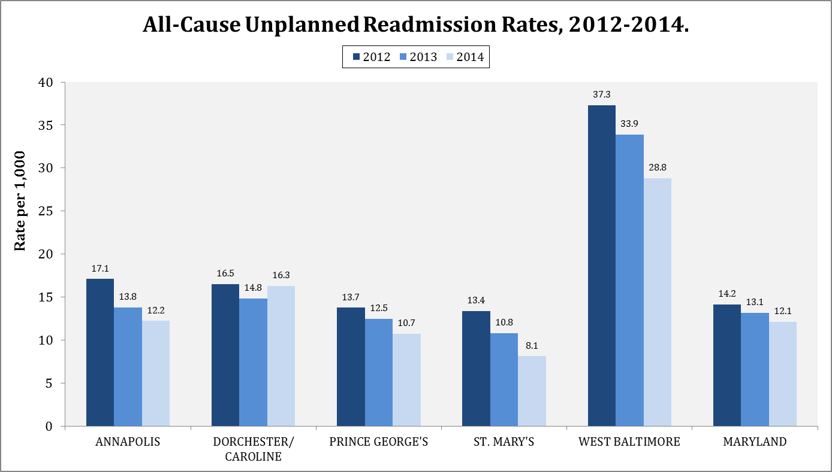

Slide 2
HEZ All-Cause, Unplanned Readmission Rates
In general, all-cause, unplanned readmission rates (per 1,000 population) have decreased for each Health Enterprise Zone (HEZ) from 2012 to 2014 with the following decrease by zone:
(Maryland: 14.8%)
Annapolis: 28.7%
Dorchester/Caroline: 0.01%
Prince George’s: 21.9%
St. Mary’s: 39.6%
West Baltimore: 22.8%
From 2012 to 2014, all HEZ’s, with the exception of Dorchester/Caroline, had a rate that decreased even more than the Maryland statewide rate.
Additionally, Annapolis, Prince George’s, and St. Mary’s have all-cause, unplanned readmission rates below Maryland’s statewide rate.

Slide 3
HEZ All-Cause, Unplanned Readmission Rates
Although the Dorchester/Caroline all-cause, unplanned readmission rate increased from 2013 to 2014 [14.8 (n = 531) to 16.3 (n = 577)], the 2014 rate was still lower than the 2012 rate [16.5 (n = 595].
These readmissions include the following number of unique patients:
2012 = 407
2013 = 350
2014 = 377
The 2013 to 2014 slight increase in the Dorchester Caroline HEZ rate could not be attributed to an increase in asthma, COPD, diabetes, hypertension, mental health, or addictions-related conditions.
There were only a few more asthma and hypertension readmissions, not enough to explain the rate increase.

Slide 4
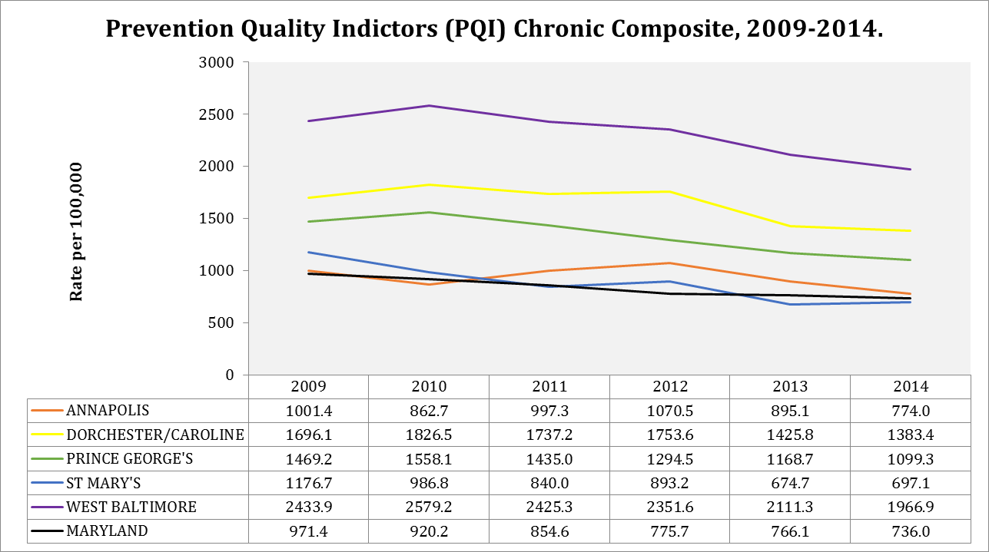

Slide 5
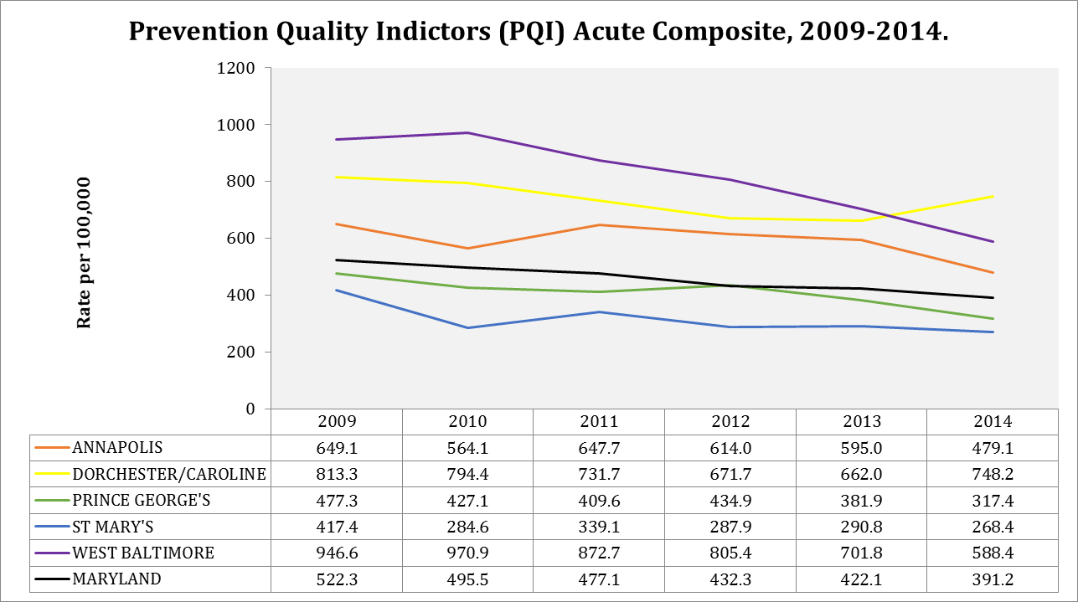

Slide 6
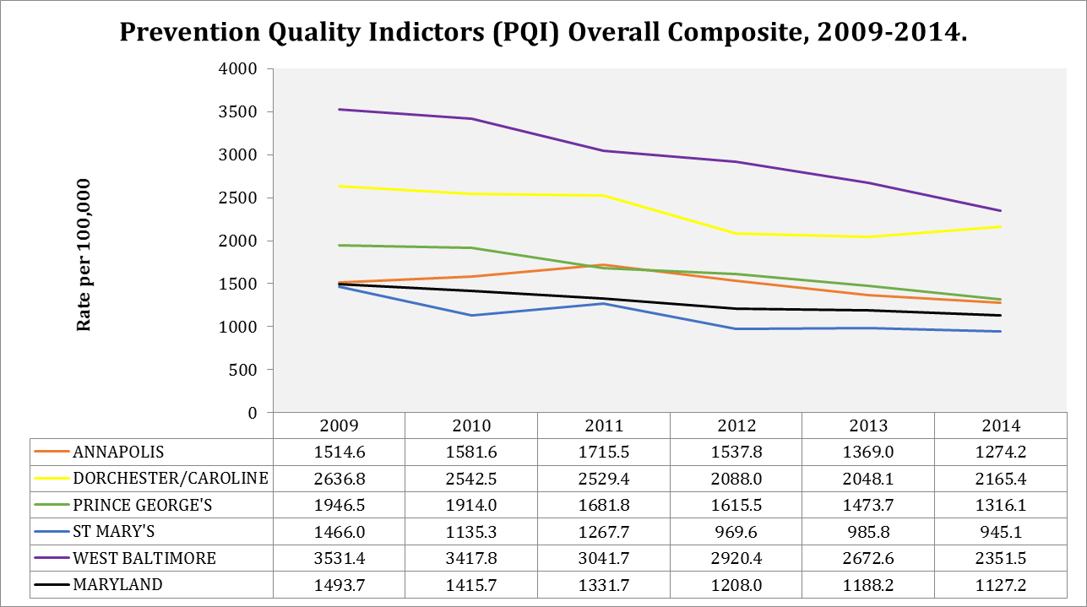

Slide 7
HEZ PQI Rates
All HEZ Chronic PQI rates have been on a downward trend from 2009 to 2014 (slight increase in the St. Mary’s rate from 2013 to 2014).
Only St. Mary’s HEZ had a Chronic PQI rate below the Maryland rate (2014).
The Chronic PQI rate for Annapolis rate is not much higher than the Maryland.
If the downward trend continues, the rate may drop below the State.
All HEZ Acute PQI rates have been on a downward trend from 2009 to 2014, with the exception of the Dorchester/Caroline rate having a significant increase from 2013 to 2014.
This suggests that the driver of the increase in Dorchester/Caroline readmission rate from 2013 to 2014 are acute, rather than chronic, conditions.

