Slide 1
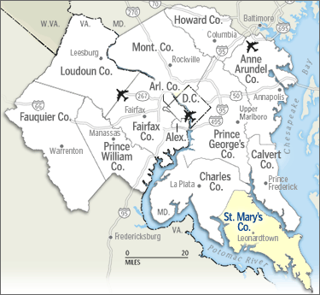
Hospital-Community Partnerships
MedStar St. Mary’s Hospital
St. Mary’s County Health Department
Walden Sierra, Inc.

Slide 2
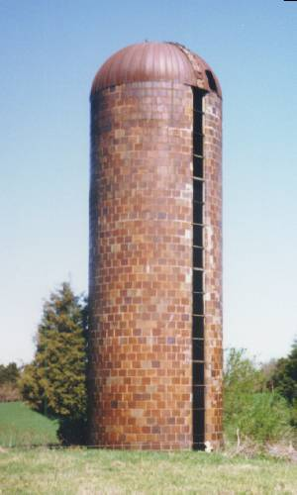
Why Partner?
The old ways don’t work anymore

Slide 3
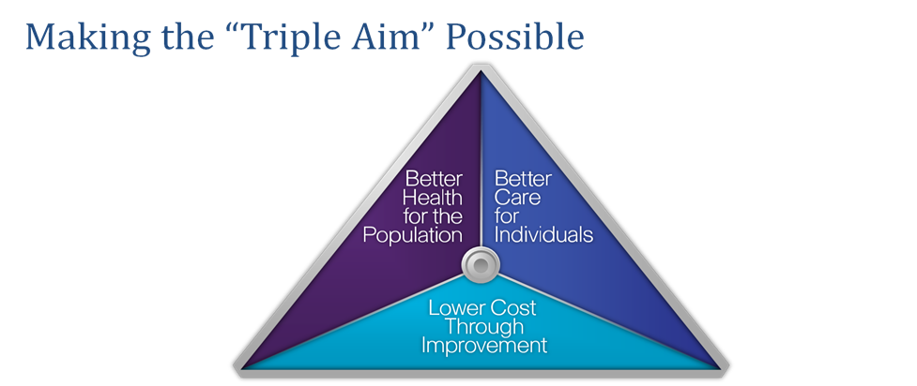
In the New World Order
Population Health initiatives require innovation, integration and collaboration on a whole new level to achieve the Triple Aim in our community

Slide 4
How We Set Priorities
Needs Assessments
2015 in process
LHIC Action teams
Community Conversations
Right thing to do

Slide 5
Listen to Your Community

Slide 6
Common Goals
Action Teams
Needs Assessment
Healthy Eating, Active Living, and Overweight/Obesity
Tobacco Use and Exposure to Secondhand Smoke
Behavioral Health (including Mental Health and Substance Abuse)
Access to Healthcare Services
Obesity – Adult and Child
Substance Abuse – Alcohol and Tobacca
Access to Care – Disperities and Provider Shortage

Slide 7
Elements of a Successful Partnership
Buy in by all partners–common goals
MOUs or other guiding documents
Evaluation plan in advance
Realistic expectations – achievable goals
Funding ---- $$ is important
Communication
Be true to your mission
Agree to do what you are good at
Do what no one can do alone

Slide 8
Examples from St. Mary’s County
Domestic Violence
Behavioral Health Integration
Million Hearts

Slide 9
Hospital Based Domestic Violence Program
Need identified by Domestic Violence Coordinating Council
Grant funding supported by partners for start-up (3 different funders and significant in kind)
Referrals to partners for appropriate follow-up
Ongoing meetings to achieve rapid cycle improvement

Slide 10
Behavioral Health Integration
Started as a small pilot between Walden and MSMH Get Connected to Health program
Expanded to full time with Health Enterprise Zone Grant
Long term vision is true integration in Community Health Center and private practice.

Slide 11
Million Hearts
Health Department led
Primary care providers, case management and pharmacist working together to stabilize hard to control hypertensives.
Pharmacists (hospital) provide consultation to providers.
Case manager (hospital) provides additional support to prevent high utilization.

Slide 12
Questions?
Lori_Werrell@smhwecare.com
Kerri_Frank@smhwecare.com
Angela.cochran@maryland.gov
Betsy@walden.com

