Slide 1
Maryland Overdose Response Program Training of Trainers
Mark Lockwood and Elizabeth Murphy
Prevention and Health Promotion Administration, Center for Harm Reduction Services
-and-
Miera Corey
Maryland Harm Reduction Training Institute
October 5, 2020

Slide 2
Overview
Part I: Introduction
Introduction
ORP training curriculum
Required reporting
-------------------Break for questions------------------
Tailoring the training
Wrap-up and additional questions

Slide 3
Purpose of this training
Part I: Introduction
This training provides:
Information about the Overdose Response Program
Information about the overdose death crisis in Maryland
A curriculum for Overdose Response Program trainings that meets the statute requirements
Suggestions for risk reduction messaging
Guidance on reporting and dispensing requirements
Suggestions for tailoring trainings to meet your audience
Intended audience: Overdose Response Programs
Notes:
While there is no trainer certification for overdose response training, this training provides individuals with all the information needed to effectively deliver their own trainings. In this training, you will learn about laws governing ORPs, how to treat someone suffering from an overdose, and the required reporting for authorized ORPs.
This training equips staff of ORPs to provide naloxone trainings in the community, and to train others to be TRAINERS
This training will sufficiently train YOU to train others on naloxone use, and to train others to be trainers

Slide 4
Learning Objectives
Part I: Introduction
Participants will:
Identify 8 signs and symptoms of opioid overdose
List 5 key steps to respond to an opioid overdose
Identify 3 ways to prevent opioid overdoses
Learn how to conduct a brief training
Identify 3 ways to tailor overdose response trainings to different audiences

Slide 5
Housekeeping
Part I: Introduction
Logistics
Introductions

Slide 6
Part I
Introduction

Slide 7
MISSION AND VISION PREVENTION AND HEALTH PROMOTION ADMINISTRATION
Part I: Introduction
MISSION
The mission of the Prevention and Health Promotion Administration is to protect, promote and improve the health and well-being of all Marylanders and their families through provision of public health leadership and through community-based public health efforts in partnership with local health departments, providers, community based organizations, and public and private sector agencies, giving special attention to at-risk and vulnerable populations.
VISION
The Prevention and Health Promotion Administration envisions a future in which all Marylanders and their families enjoy optimal health and well-being.

Slide 8
Part I: Introduction
VISION AND STRATEGIC GOAL CENTER FOR HARM REDUCTION SERVICES
STRATEGIC GOAL
The Center’s strategic goal is to reduce substance-related morbidity and mortality by optimizing services for people who use drugs.
VISION
CHRS envisions a Maryland where:
Health care and social service systems meet the needs of people who use drugs in a comprehensive, community-based manner;
People who use drugs have equitable access to high-quality care; and
Services provided to people who use drugs are free from stigma and discrimination

Slide 9
Harm Reduction Approach
Part I: Introduction
Goal: minimize the negative effects of drug use for people who use drugs, their families, and their communities
Harm reduction approaches:
Are rooted in a commitment to public health & human rights
Combat stigma
Recognize the realities of trauma, racism, poverty, class, and sex-based discrimination as contributing factors
Empower people who use drugs to keep themselves as safe as possible
Meet people where they are
Aim to attain any positive change
https://harmreduction.org/about-us/principles-of-harm-reduction/

Slide 10
Part I: Introduction
Center for Harm Reduction Services
Overdose Response Program

Slide 11
Overdose Response Program
Part I: Introduction
Established by statute in 2014 and revised by the HOPE Act in 2017; regulations revised most recently in 2019
Provides a mechanism for naloxone to be dispensed outside of a health care setting
Allows entities to become authorized as ORP training entities, partner with a prescriber, and have the prescriber issue a standing order prescription whereby any employee or volunteer of the organization can dispense naloxone to trainees, without the prescriber being present

Slide 12
Center for Harm Reduction Services Role
Part I: Introduction
Processes new applications and authorizes ORPs
Manages and monitors ORP reporting required by statute
Provides technical assistance
Purchases naloxone for eligible ORPs to distribute
Ensures naloxone is reaching people most at risk for overdose
Fills gaps by providing naloxone training and dispensing naloxone in the community

Slide 13
Benefits of ORP Authorization
Part I: Introduction
Allows you to dispense naloxone outside of the patient-provider relationship
Employees or volunteers can dispense naloxone on behalf of a prescriber
Naloxone can be dispensed to an individual who does not have a prescription (the ORP’s standing order acts as a prescription for all trainees)
If your organization is not-for-profit, allows you to receive naloxone from MDH free of charge
If you currently send patients to a pharmacy to get naloxone, eliminates a step that many patients don’t follow through on and allows you to put the medication directly into the patient’s hands
Connects you with other ORPs through monthly collaborative calls and a listserv

Slide 14
Requirements for authorized ORPs
Part I: Introduction
Monthly reporting of number of people trained and doses of naloxone dispensed, including aggregate demographic information when available
Reauthorization every two years
Resubmit application documents with updated information
Notify MDH of changes to ORP points of contact
Conduct trainings that cover the required topics

Slide 15
Part I: Introduction
Requirements for authorized ORPs
Required training content
Training provided by authorized Overdose Response Program must include, at minimum, information on the following topics:
Education on recognizing the signs & symptoms of opioid overdose
Training on responding to an opioid overdose
The proper use and administration of naloxone
Proper rescue breathing technique
The importance of contacting emergency medical services
The care of an individual after administering naloxone
Any other topic required by the Department
Notes:
There is no MDH mandated PowerPoint presentation for the training, however; the content of your presentation must contain the aforementioned topics to be in compliance.

Slide 16
Part I: Introduction
Background information
Overdose death crisis in Maryland

Slide 17
Current Statistics
Part I: Introduction
Know what is happening in your geographic area.
Stay informed on the latest statistics.
Statewide Ethnographic Assessment of Drug Use and Services (SEADS)
Maryland Vital Statistics Administration overdose death reports
OOCC reports:
2019 annual report
2020 Q2 report

Slide 18
Unintentional Drug and Alcohol-Related Intoxication Deaths in Maryland
The data in this presentation is from the latest Unintentional Drug and Alcohol-Related Intoxication Deaths Quarterly Report (2020,Q2) from the Opioid Operational Command Center
During the 2nd Quarter of 2020, Maryland saw increases in fatalities related to almost every substance. Fentanyl continues to present the most serious challenges as it plays an increasing role in the majority of opioid-related deaths AND all intoxication-related deaths in the state.
Equally concerning is the recent spike in alcohol-related deaths. There were 287 alcohol-related deaths in 2020, an increase of 34.7%.
Drastic increases in alcohol & non-opioid substances are evidence of general increases in substance use due to despair caused by COVID-19. The effects are broad and far-reaching.
Notes:
MC comment: Not sure if we should keep the stats regarding alcohol but I do like that it mentions COVID-19

Slide 19
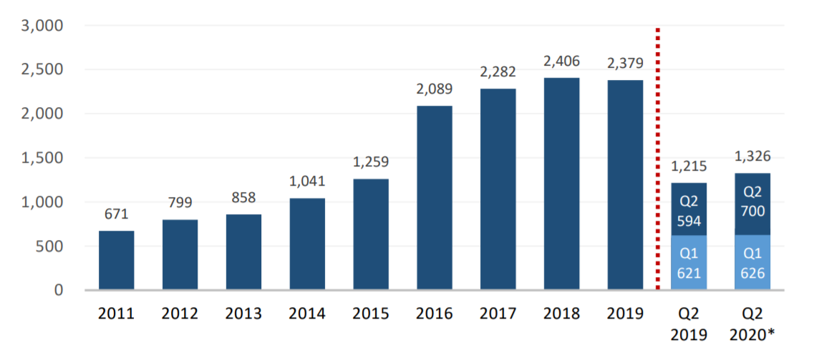
Total Number of Unintentional Intoxication Deaths Occurring in Maryland from 2011 through Q2 of 2020

Slide 20
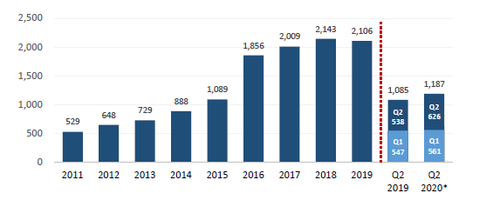
Total Number of Opioid-Related Fatalities in Maryland from 2011 through Q2 of 2020

Slide 21
Intoxication Deaths by Opioid Type in Maryland (2019 vs. 2020-through second quarter)

Slide 22
Intoxication Deaths by Substance (2019 vs. 2020 through second quarter)

Slide 23
Deaths Involving Substances Mixed with Opioids (2019 vs. 2020 through second quarter)

Slide 24
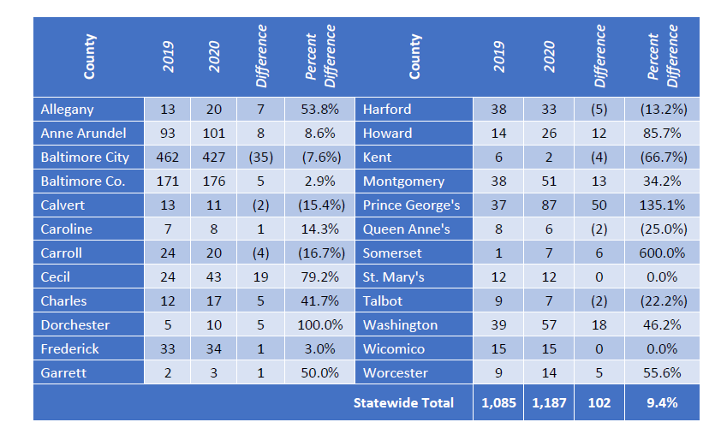
Opioid-Related Intoxication Deaths by County (2019-2020 through second quarter)

Slide 25
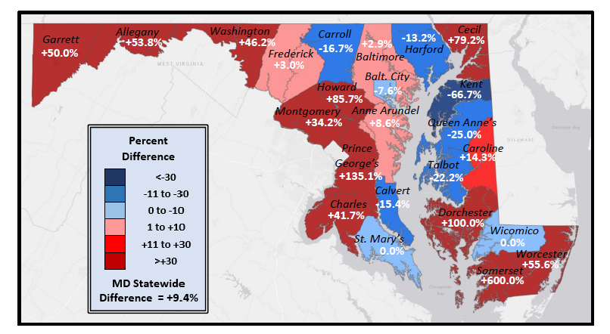
Opioid –Related Intoxication Deaths by County (2019-2020 through second quarter)

Slide 26
Total number of drug and alcohol intoxication deaths occurring in Maryland by Age Group, 2007-2018

Slide 27
Naloxone Administrations (Positive Result)

Slide 28
Non-Fatal Opioid-Related ED Visits

Slide 29
More on Fentanyl
Part I: Introduction
Fentanyl continues to be involved in the vast majority of opioid-related fatalities. There were 1,100 fentanyl-related deaths during the first 6 months of 2020.This is an 11.9% increase compared to the first half of 2019.
Fentanyl has been involved in 92.7% of all opioid-related fatalities in the first 6 months of 2020 versus only 8% in 2013.
Fentanyl may be sold with heroin. People may or may not realize that there is fentanyl mixed with their heroin or other drugs.

Slide 30
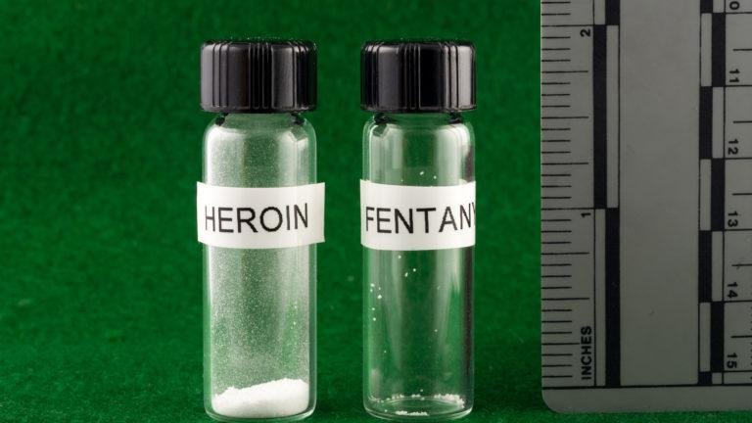

Slide 31
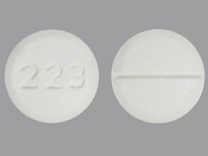
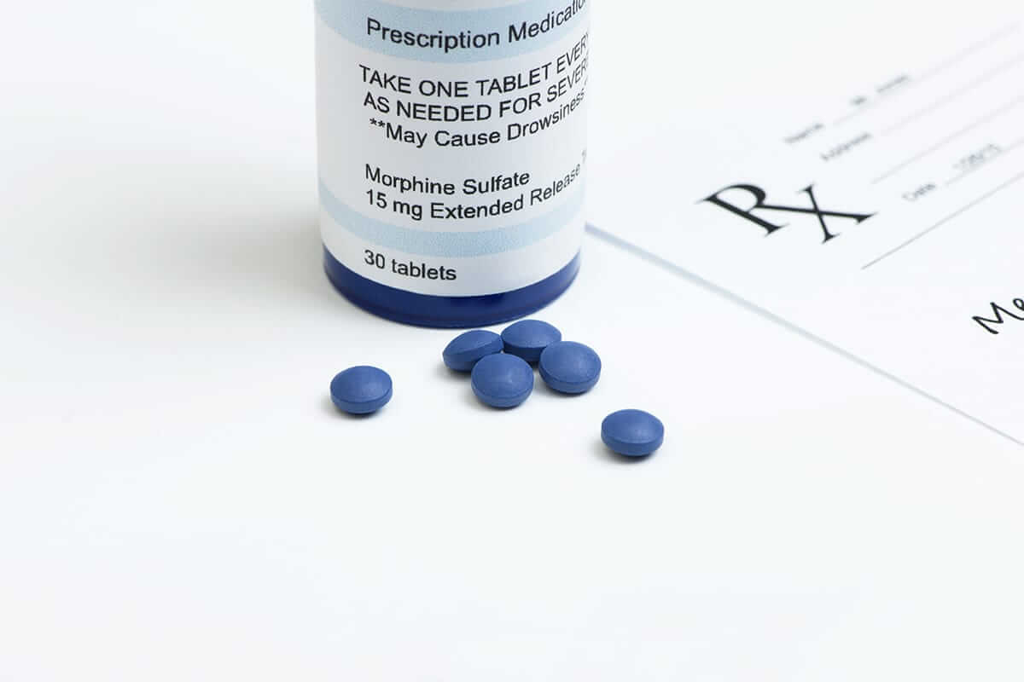
Examples of Prescription Opioids
ORP Training Curriculum: Section A
Generic Name | Brand Name
Oxycodone | Oxycontin, Percocet, Roxicodone
Oxymorphone | Opana
Hydrocodone | Vicodin, Lorcet, Zohydro, Zortab
Hydromorphone | Dilaudid
Morphine | Arymo ER, Kadian, MorphaBond ER, MS Contin
Meperidene | Demerol
Codeine | Tylenol 3 & 4
Buprenorphine | Suboxone, Subutex, Zubsolv
Methadone | Dolophine, Methadose
Fentanyl | Duragesic

Slide 32
Examples of Illicit Opioids
ORP Training Curriculum: Section A
Heroin
Non-pharmaceutical fentanyl
Illicitly produced, synthetic drug
Pill form packaged to look like prescription medications
Powder form looks similar to heroin
Fentanyl + heroin can be a deadly combination.
Fentanyl may be hundreds of times more potent than heroin.

Slide 33
Part II
ORP Training Curriculum

Slide 34
ORP Training Curriculum Overview
Part II: ORP Training Curriculum
Recognizing an Opioid Overdose
What is an opioid? (optional)
Signs and symptoms
Responding to an Opioid Overdose
Using naloxone
Rescue breathing
Contacting EMS
Care of individual after naloxone administration
Tips for Preventing Opioid Overdose (optional)
Resources (optional)

Slide 35
ORP Training Curriculum: Section A
RECOGNIZING AN OPIOID OVERDOSE

Slide 36
What is an Opioid Overdose?
ORP Training Curriculum: Section A
Opioid overdose happens when a toxic amount of an opioid—alone or mixed with other opioid(s), drugs and/or substances— overwhelms the body’s ability to handle it.
Many opioid-related overdoses result from mixing prescription painkillers or heroin with benzodiazepines (benzos), cocaine and/or alcohol.

Slide 37
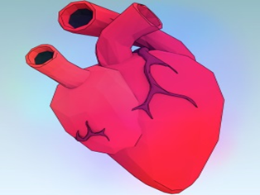
What Leads to Overdose Death?
ORP Training Curriculum: Section A
Respiratory failure
🡻
Lack of oxygen in the blood
🡻
Vital organs like heart and brain start to fail
🡻
Unconsciousness, coma, death

Slide 38
Signs & Symptoms of Opioid Overdose
ORP Training Curriculum: Section A
Slow, shallow, or no breathing
Unresponsive
Unconscious
Loud snoring or gurgling noises
Limp body
Lips/fingertips turn blue or gray
Skin pale/gray, clammy
Pulse slow or erratic

Slide 39
ORP Training Curriculum: Section B
RESPONDING TO AN OPIOID OVERDOSE

Slide 40
What is Naloxone?
ORP Training Curriculum: Section B
Naloxone is a medicine that reverses opioid overdose by restoring breathing.
Wears off in 30 minutes to 2 hours
Safe for children and pregnant women
Delivery: intramuscular, intranasal or intravenous
Intramuscular: in the muscle
Intranasal: in the nose
Intravenous: in the vein
No potential for misuse
No effect on someone who hasn’t taken opioids
Side effects are minimal and rare
Naloxone is only effective in reversing overdoses involving opioids

Slide 41
Simulation of an Overdose
ORP Training Curriculum: Section B

Slide 42
Naloxone Reversing an Overdose
ORP Training Curriculum: Section B

Slide 43
Responding to an Opioid Overdose
ORP Training Curriculum: Section B
Rouse & stimulate
Call 911
Give naloxone
Rescue breathing
Care for the person

Slide 44
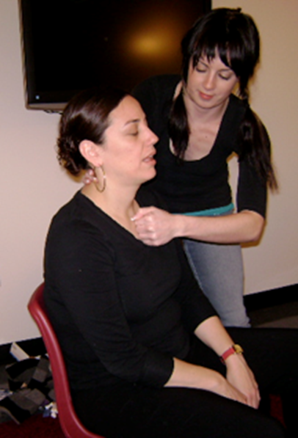
Step 1: Rouse & Stimulate
ORP Training Curriculum: Section B
Noise – Shake person’s shoulders and yell:
“[Name!] Are you all right? Wake up!”
Pain – If no answer, do a sternum rub:
Make a fist & rub your knuckles firmly up and down the breastbone

Slide 45
Step 2: Call 911
ORP Training Curriculum: Section B
Get emergency medical help for someone experiencing an overdose!
Why?
Naloxone is only temporary.
Person may:
have complications or other health problems
need more naloxone
May be a non-opioid overdose.

Slide 46
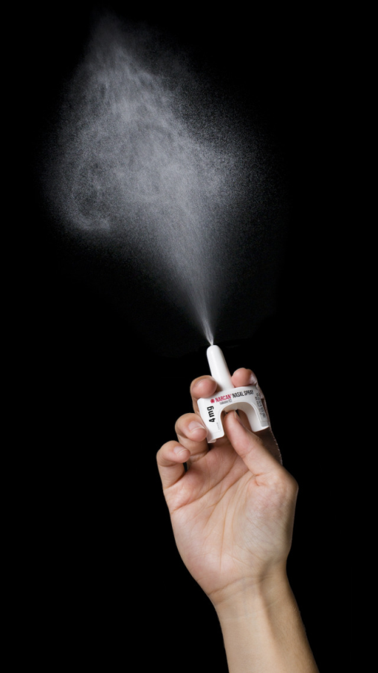
Step 3: Give Naloxone
ORP Training Curriculum: Section B

Slide 47
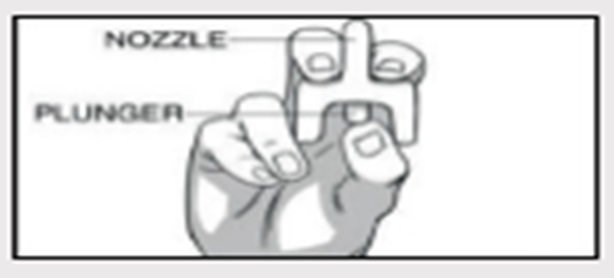
Instructions: NARCAN© Nasal Spray
ORP Training Curriculum: Section B
Remove NARCAN nasal spray from box. Peel back tab with circle to open.
Hold NARCAN nasal spray with your thumb on the bottom of the plunger and your first & middle fingers on either side of the nozzle.

Slide 48
Instructions: NARCAN© Nasal Spray
ORP Training Curriculum: Section B
Tilt head back & support person under neck. Gently insert tip of nozzle into nostril, until your fingers on either side of the nozzle are against the bottom of the nose.
Press plunger firmly to administer.

Slide 49
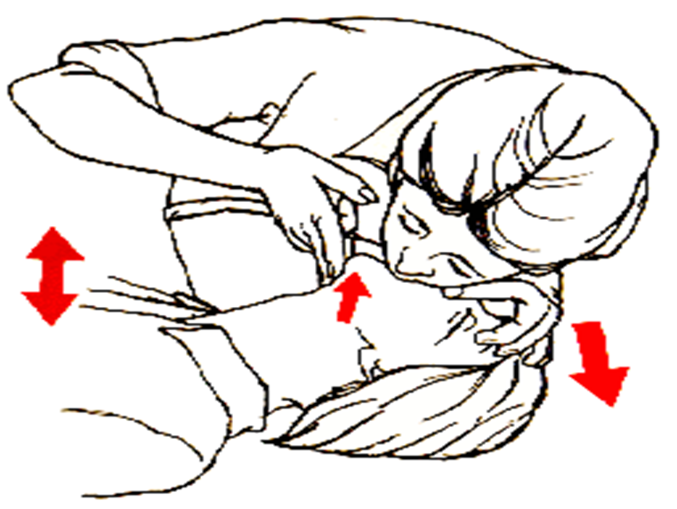
Step 4: Rescue Breathing Instructions
ORP Training Curriculum: Section B
Lay the person face-up on a flat surface.
Lift the chin and tilt the head to open the airway.
Check to see if anything is in the mouth, blocking the airway. If so, remove it.
Notes:
Rescue breathing is: the quickest way to get oxygen into the body; one of the most important things you can do to prevent someone dying from an opiod overdose.

Slide 50
Step 4 (continued): Rescue Breathing Instructions
ORP Training Curriculum: Section B
Pinch the nose shut.
Make a complete seal over the person’s mouth with your mouth. Blow two regular breaths, then give one breath every five seconds.
If chest does not rise, re-tilt the head and give another rescue breath.

Slide 51
Step 5: Care for the Person
ORP Training Curriculum: Section B
Stay with the person until medical help arrives.
If person cannot sit up, put him/her in recovery position.
Keep person calm.
Encourage person not to take more opioids.
If overdose happens again, give another dose of naloxone.

Slide 52
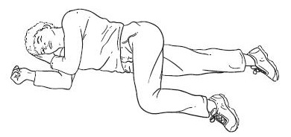
Recovery Position
ORP Training Curriculum: Section B
If you have to leave the person (even briefly) put them into the recovery position.
This keeps the airway clear and prevents choking or aspiration if vomiting occurs.

Slide 53
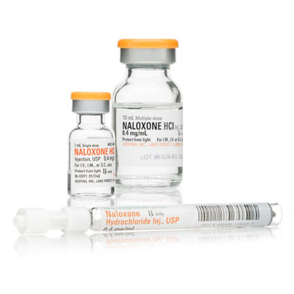
Instructions: Injectable Naloxone
ORP Training Curriculum: Section B
Pop off the flip-top from naloxone vial.
Insert needle into vial & draw up 1 cc of naloxone into syringe.
Use alcohol wipe to clean injection site: shoulder, thigh, or buttocks.
Inject needle straight into muscle (through clothes, if necessary), then push in plunger.
Do not inject naloxone into the person’s heart, chest, or back.
Notes:
We should mention that some entities use intramuscular Narcan. But not many.

Slide 54
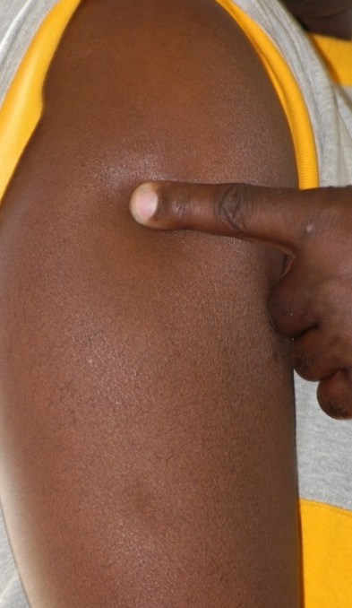
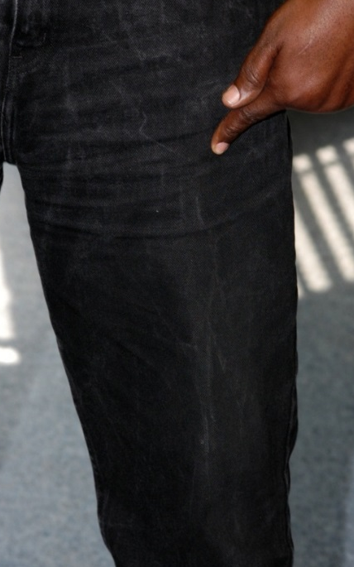
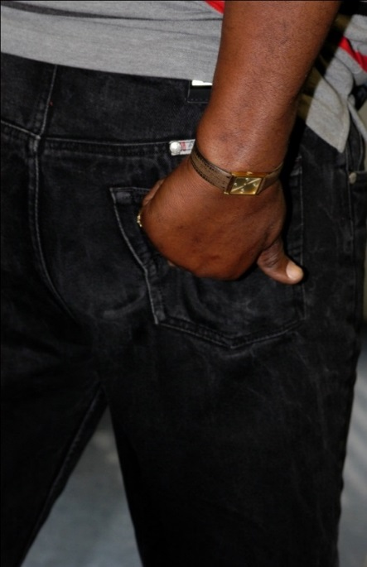
Instructions: Injectable Naloxone
ORP Training Curriculum: Section B
Where to inject naloxone:
Shoulder Thigh Buttocks
(upper, outer quadrant)

Slide 55
If You Administer Naloxone…
ORP Training Curriculum: Section B
Call the Poison Center: 1-800-222-1222
Or report directly any naloxone administrations to the Naloxone Use Report (bit.ly/naloxoneusereport)
ORPs can share this link publicly and may want to include this link in the naloxone kit

Slide 56
ORP Training Curriculum: Section C
TIPS FOR PREVENTING OPIOID OVERDOSE

Slide 57
Harm Reduction = Opioid Overdose Prevention
ORP Training Curriculum: Section C
Risk Factor | Strategies to Manage/Reduce Risk
Quantity | “Start low and go slow”: use a smaller amount than usual and inject slowly to see how it affects you
Quality/Potency | Use the same supplier/a trusted supplier Ask dealer about quality, talk to friends and compare pills, powders, products Notice differences in color, taste, consistency, drug effect Use fentanyl test strips if you have them available
Using Alone | Don’t use alone Let someone know where you are, leave a door open or unlocked If using with others, take turns and have naloxone
First use | Injection is highest overdose risk route– snorting still carries risk but may make it easier to control intake
Recent abstinence | “Test shot” (use a small amount at first to test the strength and its effect)
Mixing drugs | Try not to mix opioids with alcohol and/or benzos Use one drug at a time, or use less of each drug
Age | Tools and technologies that help with medication schedules Help from a family member or friend
Physical health | Recognize medical history and physical health problems, such as previous overdose, asthma, or other respiratory illness.
Notes:
Risk factors might include:
A period of abstinence/lowered tolerance (release from jail, rehab/treatment)
Mixing opioids with other drugs, especially other opioids, benzos, alcohol
Using alone
Drug quality (fentanyl and unpredictable drug supply fit here)
Route of administration
Medical history and physical health problems, such as previous overdose and asthma or other respiratory illnesses
Harm reduction tips
Tester shots – use a small amount at first to test the quality/strength of a drug and notice how it affects you before doing more
Start “low” (lower dosage) and go “slow” (injecting more slowly than usual)
Use one drug at a time, or use less of each drug
Try to avoid mixing alcohol/benzos with opioids like heroin
If you are mixing substances, do the heroin (stronger drug) first to better gauge how high you are
Don’t use alone
Let someone know where you are, leave a door open or unlocked
If using with others, take turns, have naloxone
Try to use the same supplier/a trusted supplier
Talk to friends and compare powders, pills, products or brand names
Notice differences in color, taste, consistency, drug effect
Injection is highest risk route of admin – snorting still carries overdose risk but may make it easier to control intake
Don’t think it won’t happen to you!

Slide 58
ORP Training Curriculum: Section D
Resources and Information
Notes:
Additional information to share with trainees

Slide 59
Good Samaritan Law in Maryland
ORP Training Curriculum: Section D
Who does it protect?
This law protects these individuals from arrest and prosecution for certain crimes:
Individuals assisting in an emergency overdose situation
Individuals who are experiencing an overdose
The law does not protect people witnessing the medical emergency if they’re not helping
Good Samaritan Law Fact Sheet

Slide 60
Good Samaritan Law in Maryland
ORP Training Curriculum: Section D
What does it protect you from?
Protects from criminal arrest, charge or prosecution for the following misdemeanors,
§5-601: Possessing or Administering CDS
§5-619: Drug Paraphernalia
§5-620: Controlled Paraphernalia
§10-114: Underage Possession of Alcohol
§10-116: Obtaining Alcohol for Underage Consumption
§10-117: Furnishing for or allowing underage consumption of alcohol
Protects from violation of a condition of pretrial release, probation, or parole
These protections only apply if the evidence was obtained solely because of the act of seeking medical assistance.

Slide 61
How to Get Naloxone
ORP Training Curriculum: Section D
From a pharmacy:
You can request naloxone at participating pharmacies throughout Maryland under the statewide standing order. The pharmacy can bill your insurance, even when using the statewide standing order. You do not need a prescription; you do not need to prove you were trained. If you have difficulty accessing naloxone at a pharmacy, let MDH know by contacting mdh.naloxone@maryland.gov.
From an Overdose Response Program or Syringe Services Program:
Visit bit.ly/MDHaccessHR
Contact mdh.naloxone@maryland.gov

Slide 62
Local Resources
ORP Training Curriculum: Section D
It may be helpful to include information about local resources in your ORP training information, such as:
Local Syringe Services Program locations, hours, and contact information
Local social services information
Local resources for family and friends of people who use drugs
Information about how to get a refill if the person uses the naloxone

Slide 63
END OF ORP TRAINING CURRICULUM

Slide 64
Part III
REPORTING AND DISPENSING

Slide 65
ORP Training Report
Part III: Reporting and dispensing
Maryland law requires ORPs to report aggregate data monthly to MDH, if any trainings were conducted
The Center requires ORPs to report on the following for each training conducted:
Training date, jurisdiction, and setting
Number of individuals trained
Aggregate numbers of individuals trained in each demographic category, if available (sex, ethnicity, race, age)
Aggregate numbers of individuals trained in each “Reason for training category”
If dispensing naloxone, number of doses dispensed (initial and refill) of each formulation
If dispensing fentanyl test strips, number of test strips dispensed and number of people receiving test strips

Slide 66
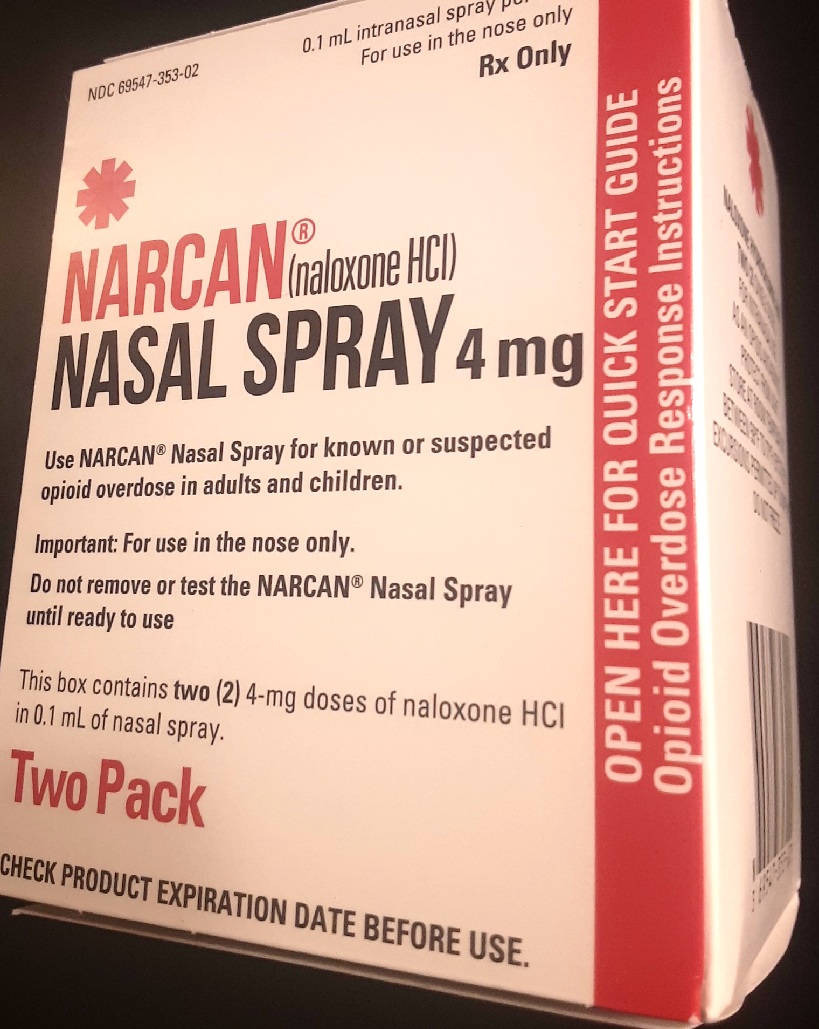
ORP Training Report
Part III: Reporting and dispensing
ORPS submit these monthly training reports through a webform
A reporting guidance document is available here
ORPs should submit one report for each group training conducted
One-on-one trainings may be batched and submitted as a single entry each month
Report naloxone doses dispensed
ONE NARCAN KIT/UNIT/BOX = TWO DOSES

Slide 67
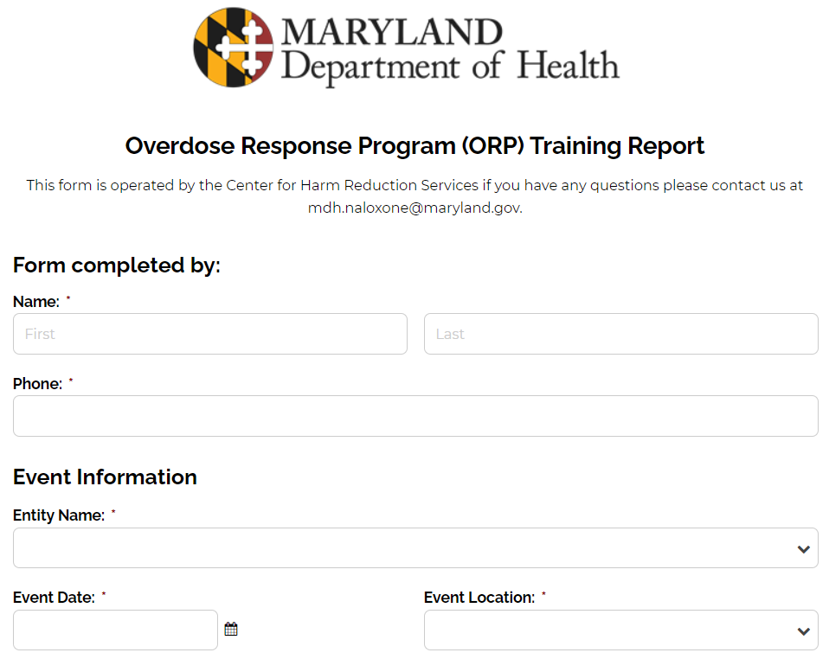
ORP Training Report
Part III: Reporting and dispensing

Slide 68
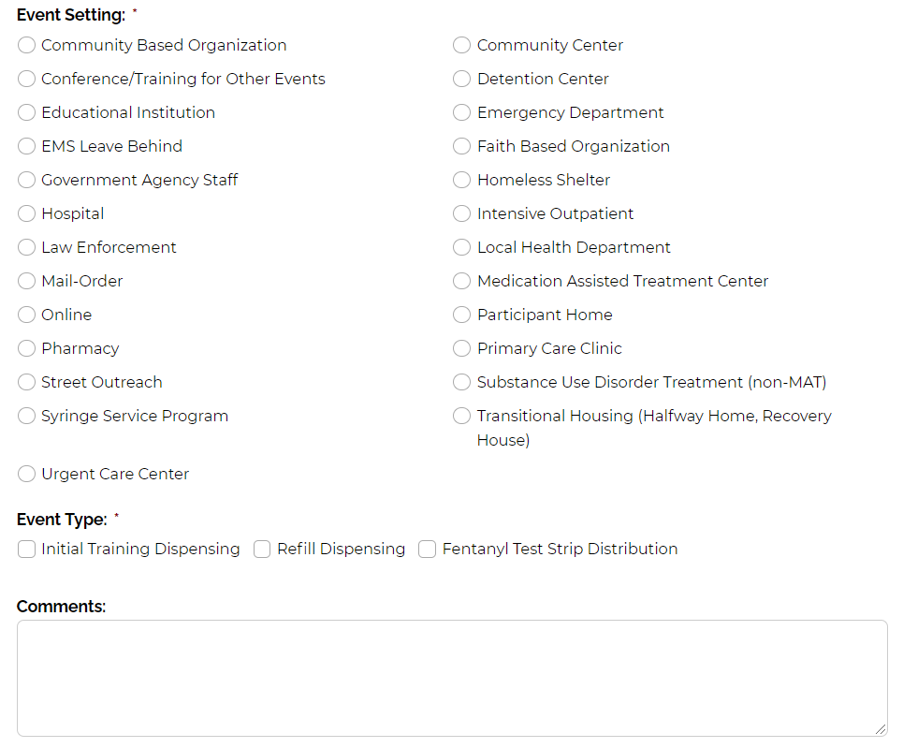
ORP Training Report
Part III: Reporting and dispensing
Selecting a response to this question will populate the remaining questions in the form—check all that apply

Slide 69
Trainee Registration Form
Part III: Reporting and dispensing
MDH has created a Trainee Registration Form to assist ORPs in collecting the information required for reporting.
ORPs can use this form to collect information from trainees, and then aggregate information from the form to submit through the MDH form.
Trainee registration forms are for ORP records only and should not be submitted to MDH. MDH does not collect any personal identifying information on trainees.

Slide 70
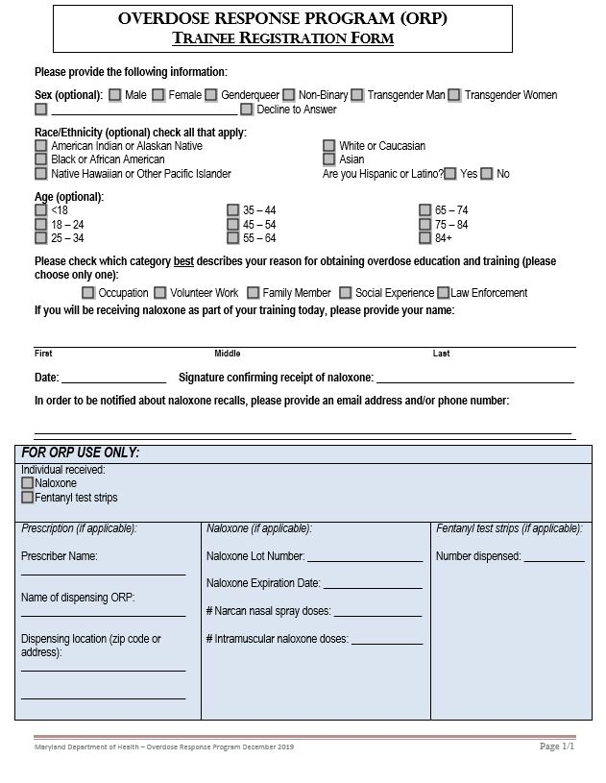
Part III: Reporting and dispensing
Trainee Registration Form
Applicant Information:
First and last names
Sex (optional)
Race/Ethnicity (optional)
Age (optional)
Reason for obtaining training
Date
ORP Information (This is only for entities that are dispensing naloxone):
Naloxone Lot # (on medication box)
Naloxone expiration date (on medication box )
# Doses and formulation – keep in mind that one box of Narcan has two doses.
If you train one person and give out one box of Narcan, write “2” in the space next to “# of Narcan nasal spray doses.”
Make an effort to collect demographic info and reason for training when possible!

Slide 71
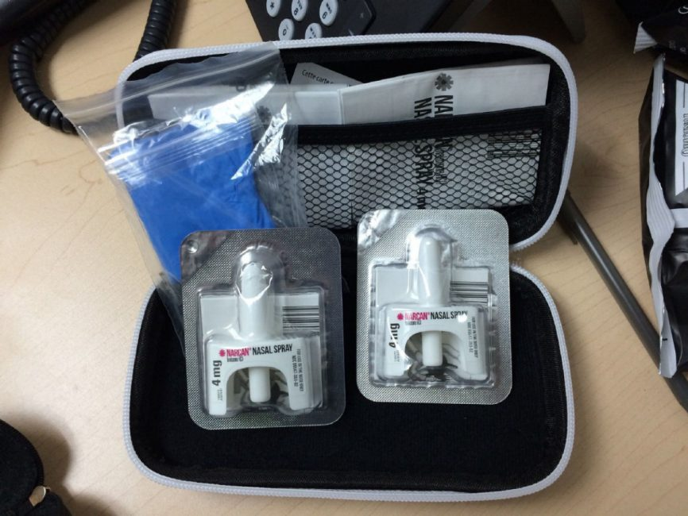
Dispensing Nasal Naloxone
Part III: Reporting and dispensing
Ensure kits include: 2 doses of nasal naloxone, rescue breathing masks, and educational inserts (i.e. informational flyers).
Note: What goes in your kits should be determined by the ORP staff and the prescriber; it should also be specified in your standing order and/or dispensing protocols.

Slide 72
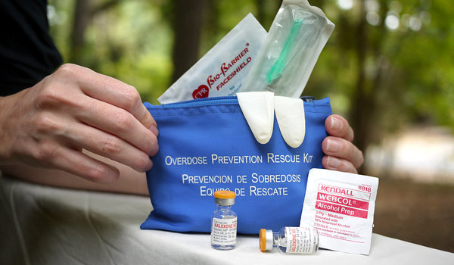
Distributing IM Naloxone Kits
Part III: Reporting and dispensing
If you are distributing 10ml vials of naloxone, include several syringes for one syringe per 1ml injection.
Any option is okay as long as the point is 1 inch long to reach the muscle.
Intra muscular syringes are larger gauges than insulin syringes.
If you are distributing 1ml vials of naloxone, include at least two vials in the kit with muscle syringes.
Ensure kits include: alcohol pads, rescue breathing masks, rubber gloves, and educational inserts (i.e. informational flyers).
Note: What goes in your kits should be determined by the ORP staff and the prescriber; it should also be specified in your standing order and/or dispensing protocols.
Notes:
IM syringes are typically 21-25 gauge while insulin syringes are usually 28-31 gauge. The larger the number, the finer the needle.

Slide 73
Labeling
Part III: Required Reporting
If dispensing Narcan in its original packaging, ORPs should label the kits/medication with the following:
Name and address of the dispensing ORP
Date dispensed or date standing order was issued
Name of the prescriber (licensed health care provider who issued the ORP’s standing order)
21 U.S.C. §353 (2018)
Md. Code Ann., Health-General §21-221

Slide 74
BREAK FOR QUESTIONS

Slide 75
Part IV
TAILORING THE TRAINING

Slide 76
Overview: Tailoring the Training
Part IV: Tailoring the Training
What content is required by law?
Training structure
Quick trainings (10 minutes)
Classroom-style training (1 hour)
Audience
General public
People who use drugs
Family & friends
Patients of opioid treatment programs
Others

Slide 77
What Content is Required by Law or Regulation?
Part IV: Tailoring the Training
Education and training must include, at minimum, information on the following topics:
Education on recognizing the signs & symptoms of opioid overdose
Training on responding to an opioid overdose
The proper use and administration of naloxone
Proper rescue breathing technique
The importance of contacting emergency medical services
The care of an individual after administering naloxone
Any other topic required by the Department
Notes:
There is no MDH mandated PowerPoint presentation for the training, however; the content of your presentation must contain the aforementioned topics to be in compliance.

Slide 78
Trauma-Informed Approach
Part IV: Tailoring the Training
A trauma-informed approach recognizes that the impact of trauma is widespread and strives to avoid re-traumatizing people.
Why might the material in this training be difficult for some participants?
As a trainer, how can you be sensitive to overdose-related trauma?

Slide 79
Tailoring to the Audience
Part IV: Tailoring the Training
When planning, consider your audience.
What do they likely know already?
What will likely be new to them?
What will their concerns likely be?
Make educated guesses but remember that you may be wrong!

Slide 80
All Audiences
Part IV: Tailoring the Training
Remember that the training may bring up painful memories or difficult emotions. Be sensitive to that and respectful of participants.
Model respectful language.
Prepare based on educated guesses, but don’t make assumptions about individuals.

Slide 81
Audience
Part IV: Tailoring the Training
Some examples of target audience for naloxone trainings:
People who use opioids
People who use substances other than opioids
Friends, family members, and associates of people who use drugs
People recently discharged from emergency medical care following an opioid overdose
People experiencing homelessness and housing instability
People transitioning from the correctional system back to communities
People recently released from supervision or treatment
People with a history of mental health disorders
People who use drugs over the age of 55
Non-Hispanic Black individuals and Latinx individuals who use substances (including alcohol)
People who use drugs in jurisdictions lacking access to medication assisted treatment and intensive outpatient facilities
Female PWUD and PWUD with children
People with employment instability
Pharmacists, nurses, law enforcement, clergy, etc.
Anyone at risk of experiencing an overdose or in a position to assist in the event of an overdose.
Notes:
Due to fentanyl adulterating the majority of the drug supply, all people who come into even casual contact with substance users ideally should be trained to use naloxone. Administering naloxone is as simple as administering an nasal spray or Epi-pen injection.
(Note: intoxication deaths were 2.8 times higher among men than women; however services specifically for female PWUD and PWUD with children are lacking)
This list of audiences specifically noted by the Statewide Ethnographic Assessment of Drug use and Services (SEADS) by Johns Hopkins

Slide 82
Settings
Part IV: Tailoring the Training
Where and when to do naloxone trainings? Anywhere!
Treatment settings
Recovery groups/centers
Jails
Parole and probation (both staff and clients)
Community centers (could have drop-in hours)
Why is it important to be able to do outreach-style trainings in 10 minutes?
People don’t have a lot of time
Can only retain so much info
Some people already have previous knowledge

Slide 83
Systems that touch People Who Use Drugs
Part IV: Tailoring the Training
Medicaid (state program, MCOs)
FQHCS and Hospitals
Housing and Economic Development Programs
Drug User Health
Criminal Justice System
Infectious Disease Programs
Bureau of Substance Abuse and Mental Health
Others?
Notes:
Trainer Instructions: Use the following when explaining the various systems that interact or in some way impact the health of PWUDs. This slide can be used to help explain the complexity of addiction and the lived experiences of PWUDs.
Right, so LOTS of our interconnected systems touch people who use drugs---
Yet we often lack a common understanding/language/framework to address people who use drugs –
What we want ideally, is a common starting point – a drug user health FRAMEWORK
Integrating a DUH framework can/should involve LOTS of stakeholders and services
And like I said, what we are going for here is a more unified framework – a shared understanding – of working with people who use drugs
So, we need to know a bit more about people who are using drugs
Ask: So, how do we get there?

Slide 84
Language
Part IV: Tailoring the Training
Research demonstrates that the language we use about drug use can affect our attitudes toward people who use drugs.
Our attitudes, in turn, impact our actions and our policies.
As a trainer, part of your role is to model how to use non-stigmatizing language.

Slide 85
Model Respectful Language
Part IV: Tailoring the Training
Avoid | Use this instead:
Substance abuser Addict Junkie | Person with a substance use disorder Person who uses drugs
Substance abuse | Substance use Using drugs not as prescribed Substance use disorder
“Clean” | Negative urinalysis Substance-free
“Dirty” | Positive urinalysis

Slide 86
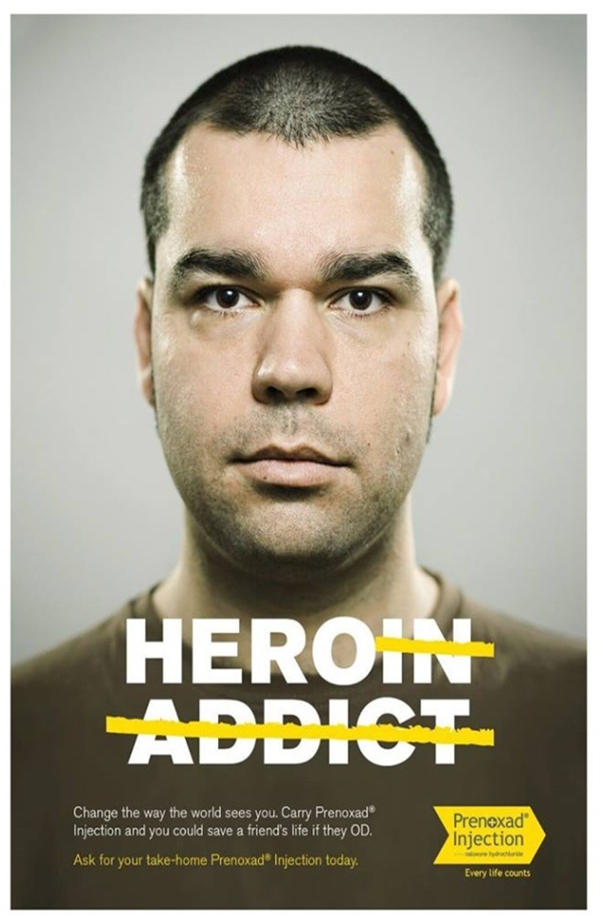
Part IV: Tailoring the Training
Change the conversation!

Slide 87
Talking to Clients about Overdose
Part IV: Tailoring the Training
Focus on safety and risk reduction
Sends message that your priority is the client’s survival, even during a relapse
Use words such as avoidable, preventable, survivable
Say you talk to everyone about overdose prevention
Acknowledge trauma of experiencing overdose
Can play a powerful role in therapeutic engagement
Emphasize client’s ability to contribute to their community
They are a potential life saver in an overdose situation
Can be responders, not just victims

Slide 88
Part V
WRAP-UP AND ADDITIONAL QUESTIONS

Slide 89
Additional Resources
Part V: Wrap up and Additional Questions
ORP regulations and statute
Request naloxone from MDH for your ORP (nonprofit and government agency ORPs only)
Next Naloxone mail order for Maryland residents
The Good Samaritan Law
Save a life poster
Naloxone Administration Brochure
Before it’s too late
Data & reports
How to administer naloxone video
Standing order for pharmacy naloxone dispensing
Center for Harm Reduction Services website

Slide 90
Part V: Wrap up and Additional Questions
Thank you!
Elizabeth Murphy, Overdose Response Community Engagement Manager elizabeth.murphy2@maryland.gov
410-218-2475
Mark Lockwood, Harm Reduction Programs Manager
mark.lockwood@maryland.gov
410-767-5061
Miera Corey, Maryland Institute Training Institute Coordinator
miera.corey@bhsbaltimore.org
410-637-1900
mdh.naloxone@maryland.gov
Center for Harm Reduction Services
Maryland Harm Reduction Training Institute

