Slide 1
Applied Visual Identity
MDH Office of Communications
Reflects August 2019 standards issued by GOV Comms

Slide 2
What is visual identity?
Visual identity includes the colors, type, graphics and imagery that represent a brand.

Slide 3
Best practices
Public-facing communications—especially those with strong visual components—are to be reviewed and approved by the Office of Communications prior to release.
The Office of Communications is the starting point for guidance, collaboration, review and approval in developing and distributing communicative material for a mass audience.
This does not include provider or constituent correspondence.

Slide 4
Best practices
For all creative projects and any communications-based procurement or production—both large-scale (e.g., campaigns) and small-scale (e.g., tri-fold brochures)—please engage the Office of Communications as early as possible in the process.
Contact the Office of Communications prior to engaging with vendors on communications-based projects; this includes signing a use agreement or issuing an RFP. Vendors must be provided MDH brand/visual identity guidelines prior to beginning production.
The Office of Communications should never see projects for the first time as a final product.

Slide 5
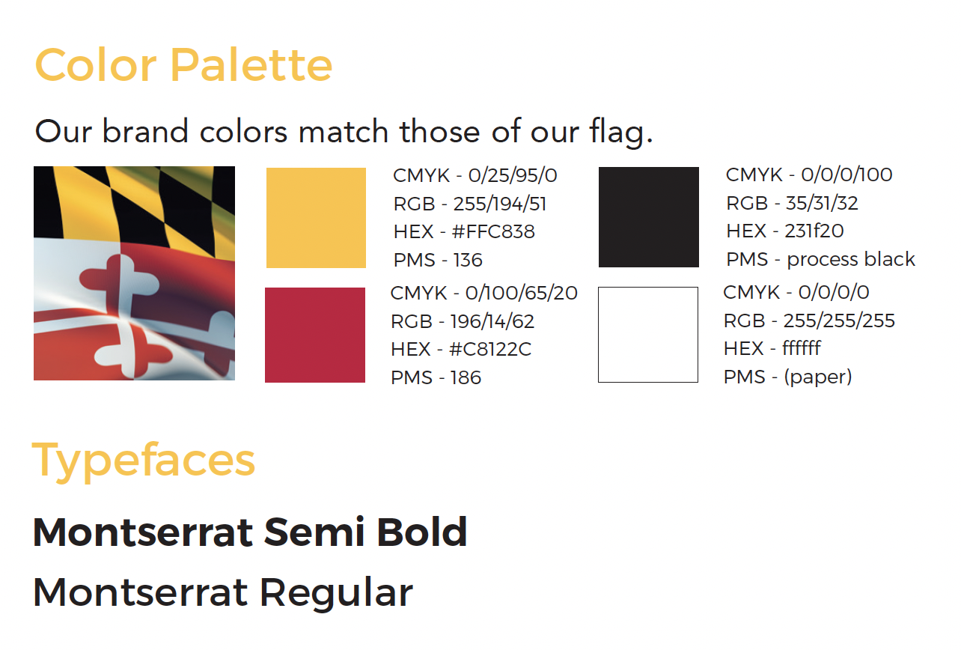
Type and color
Colors may not be modified.
Calibri is the acceptable alternative typeface if Montserrat is not available or accessible.

Slide 6
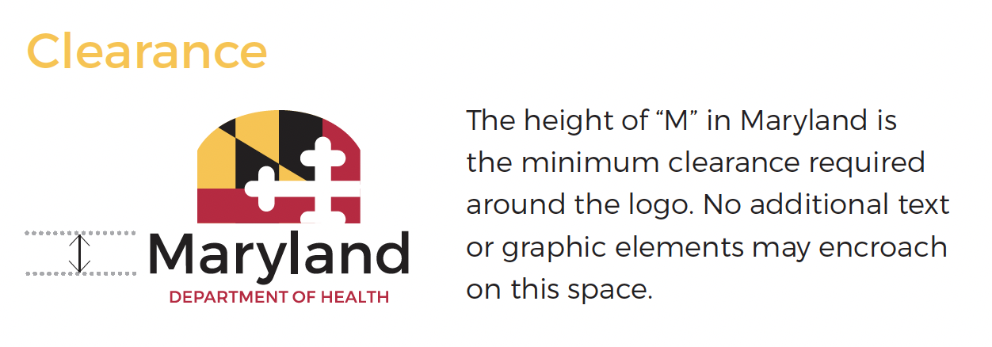
Primary MDH logo

Slide 7
Secondary MDH logo

Slide 8
MDH logo use guidelines
Do not outline the logo
Do not change the colors, typefaces or layout in the logo
Do not add new elements (e.g., words or graphics) to the logo
Do not distort or manipulate the logo; resize the logo using the software’s procedure for resizing
Do not use the logo as a pattern
Do not place the logo on a background/image that doesn’t provide maximum contrast for legibility; the best background is white or black
Do not place the logo over words or other graphics
Do not apply effects to the logo (e.g., drop shadow, outer glow)
Do not tint the logo; it should always appear at 100% opacity

Slide 9
MDH logo use guidelines
Email mdh.communications@maryland.gov to request logo files and to request review for logo use
Administrations, offices, programs, initiatives, etc. may not create their own logo
Only one logo represents the whole of MDH

Slide 10
Imagery best practices
Because imagery spans a very broad range of materials and subjects, there is no single style designated.
However, the tone and quality of all imagery should project quality and professionalism. Imagery should also support the message and content of the piece to which it is applied, in order to help tell the story.

Slide 11
Imagery best practices
Full color imagery is always preferred.
Use of clip art and cartoons is generally discouraged, unless it is audience-appropriate.
Please contact the Office of Communications to download stock images through Shutterstock.

Slide 12
Imagery best practices
When using imagery, follow legal requirements.
Copyrighted images (including those found via Internet search) should not be used.
Appropriate licensure/permission for using images is required.

Slide 13
Imagery best practices
Ensure logos and images are not distorted.

Slide 14
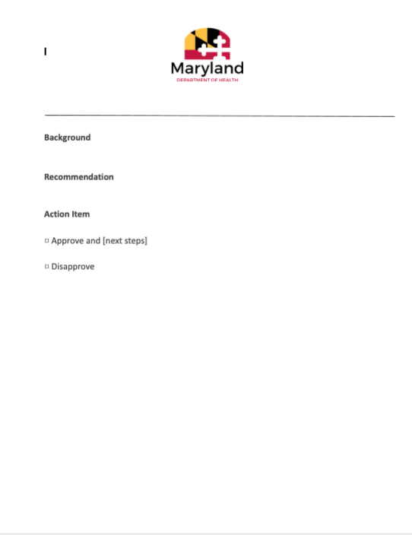
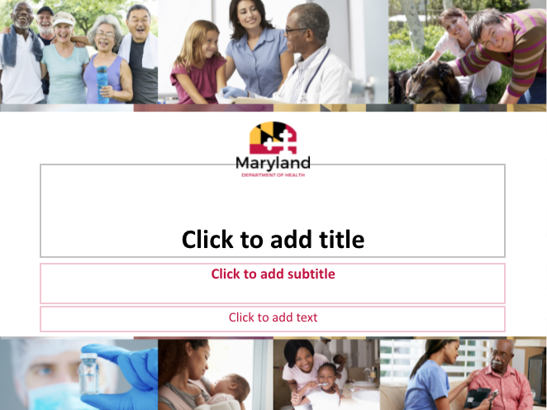
Templates
Email mdh.communications@maryland.gov to receive MDH templates for letterhead, PowerPoint, etc.

Slide 15
Email signature
Name
Title, Office/Program/Etc.
Maryland Department of Health
Office Address Line 1
Office Address Line 2
Email:
Phone:
*Please do not add other graphics to the email signature.

Slide 16
Contact
For questions, please contact the Office of Communications.
mdh.communications@maryland.gov

